Slide 1





Graph-Aligned Multi-Atlas fMRI Modeling for Depression Detection Using Pruned GCNs
Classifying Depressed vs. Non-Depressed Patients Using fMRI Data
Team Name: The Exception Handlers

Slide 2








Problem Statement
How can we accurately classify depressed patients versus healthy controls using resting-state fMRI data, given challenges like small sample size, high dimensionality, and variability in brain connectivity?"
Inconsistent Atlas Resolutions
Misaligned Brain Graphs
Poor Generalization
Structural differences between subjects cause alignment issues, resulting in inaccurate connectivity mapping.
Models trained on one dataset often fail to generalize to new datasets due to domain-specific characteristics.
Different atlases use varying resolution standards, making direct comparison and integration of brain graphs difficult.
Unified Pseudo Atlas for Multi-Atlas Brain Graph Integration
Page 2 of 10

Slide 3









Why This Problem Matters
Addressing these challenges is crucial for advancing depression analysis using fMRI data. The limitations impact multiple critical aspects of neuroimaging research and clinical applications.
Clinical Diagnosis Accuracy
System Robustness
Inconsistent atlas resolutions and misaligned brain graphs lead to incorrect connectivity measurements, reducing the accuracy of depression classification models in clinical settings.
Poor generalization across datasets means models fail when applied to new data sources, limiting the practical utility of fMRI-based diagnostic tools in diverse clinical environments.
Research Scalability
Research Consistency
Inconsistencies between studies hinder the ability to scale fMRI depression analysis to larger datasets and multi-center trials necessary for more robust scientific findings.
Lack of unified analysis frameworks leads to inconsistent results across studies, impeding progress in understanding the neural correlates of depression.
Unified Pseudo Atlas for Multi-Atlas Brain Graph Integration
Page 3 of 10

Slide 4

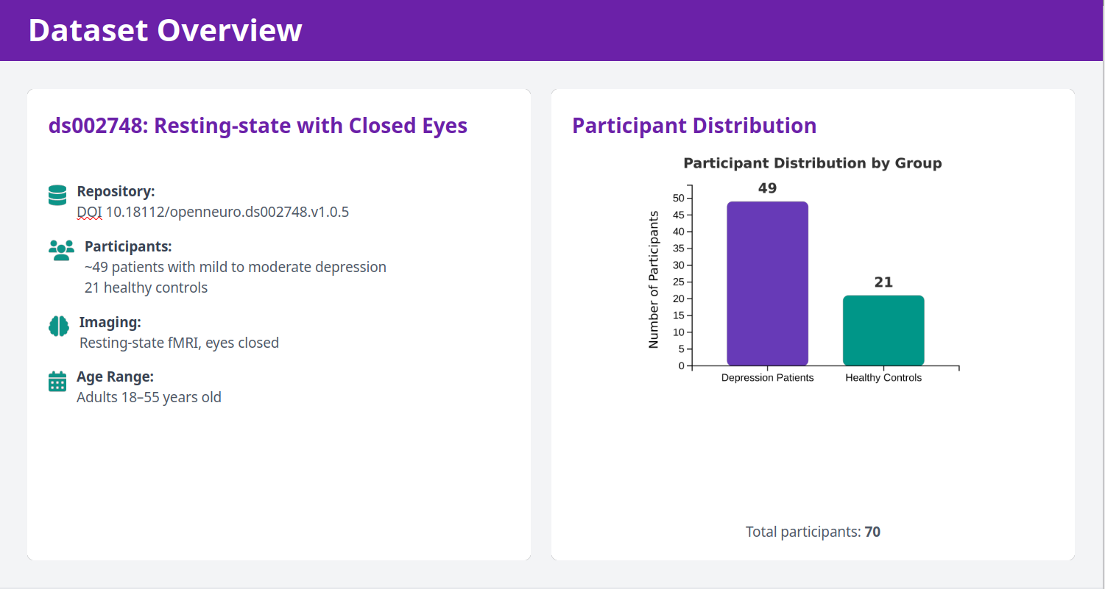

Slide 5










Existing Challenges in Multi-Atlas fMRI Classification
Graph Misalignment
Inconsistent ROI Mapping
Brain graphs from different atlases exhibit structural misalignments due to variations in registration techniques and subject-specific anatomical differences, leading to incorrect connectivity mapping.
Regions of interest (ROIs) are mapped differently across atlases, causing discrepancies in feature representation and making it difficult to compare or integrate results consistently.
Lack of Unified Structure
Poor Model Interpretability
There is no standardized framework for organizing and integrating multi-atlas brain graphs, resulting in fragmented approaches and inconsistent methodologies across research groups.
Existing models often function as "black boxes" with limited interpretability, hindering clinical acceptance and scientific understanding of the classification mechanisms.
Unified Pseudo Atlas for Multi-Atlas Brain Graph Integration
Page 4 of 10

Slide 6


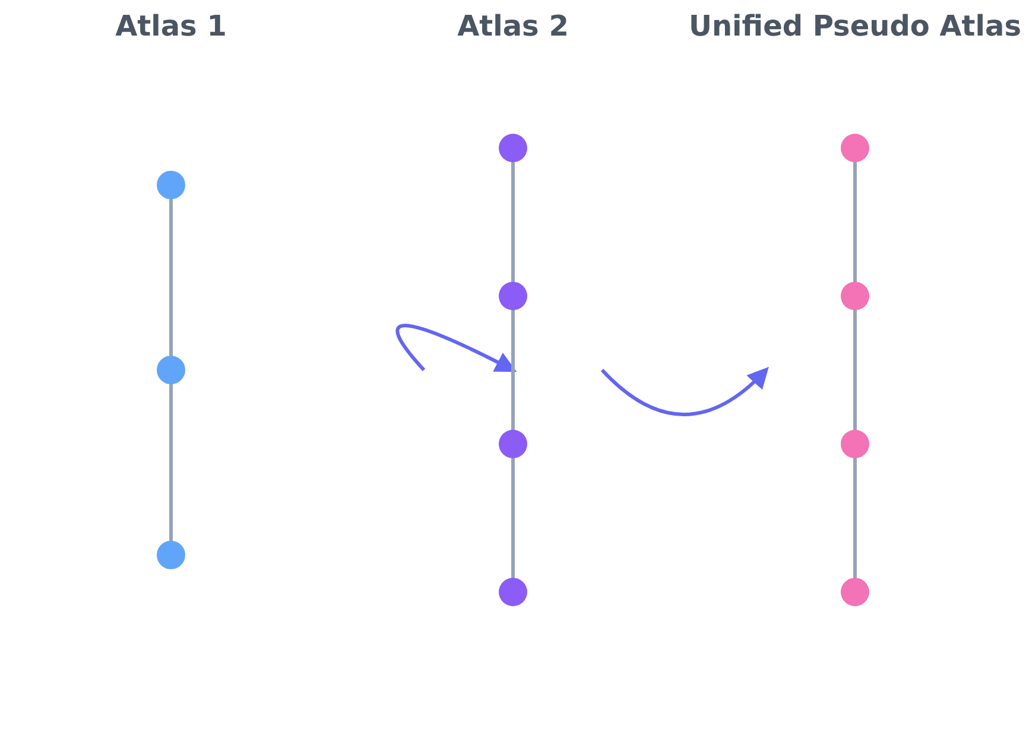




Our Solution - Unified Pseudo Atlas
Our approach uses the Hungarian algorithm to align multi-atlas brain graphs, creating a unified representation for depression analysis.
Multi-Atlas Integration
Combines multiple brain atlases into a cohesive framework
Cost Matrix Construction
Creates alignment cost matrices based on node similarities
Hungarian Alignment
Optimally aligns brain graphs using the Hungarian algorithm
Unified Representation
Generates unified matrices for classification
Unified Pseudo Atlas for Multi-Atlas Brain Graph Integration
Page 5 of 10

Slide 7

















Workflow Architecture
1
2
3
4
5
6
7
Preprocessing
ROI Extraction
Graph Generation
Cost Matrices
Hungarian Alignment
Unified Pseudo Atlas
GNN Training
Data normalization and noise reduction
Region of interest identification
Connectivity matrix creation
Similarity measurement calculation
Graph matching optimization
Graph neural network classification
Integrated brain graph creation
Workflow Benefits
Improved alignment accuracy
Enhanced classification performance
Better generalization across datasets
Unified Pseudo Atlas for Multi-Atlas Brain Graph Integration
Page 6 of 10

Slide 8




















System Architecture Overview
Frontend Interface
Processing Engine
GNN Models (GCN)
Data upload
Multi-atlas alignment
Graph neural networks
Parameter selection
Graph construction
Classification
Results visualization
Feature extraction
Pattern recognition
Dataset Management
Real-time updates
Quality control
Expansion capability
Unified Pseudo Atlas for Multi-Atlas Brain Graph Integration
Page 7 of 10

Slide 9













Key Features and Capabilities
Multi-atlas Integration
Hungarian Graph Matching
Pseudo Atlas Creation
Seamlessly combines multiple brain atlases with varying resolutions into a unified framework for consistent analysis.
Generates a unified pseudo atlas that serves as a common reference framework for all brain graphs.
Implements the Hungarian algorithm to optimally align and match brain graphs, overcoming structural differences.
Prune-GCN-based Classification
Enhanced Interpretability
Model Robustness
Demonstrates improved generalization across diverse datasets and subject populations.
Utilizes Pruned Graph Covolutional Networks for improved classification accuracy of depressed vs. non-depressed patients.
Provides clear insights into brain connectivity patterns and features that contribute to classification decisions.
Unified Pseudo Atlas for Multi-Atlas Brain Graph Integration
Page 8 of 10

Slide 10






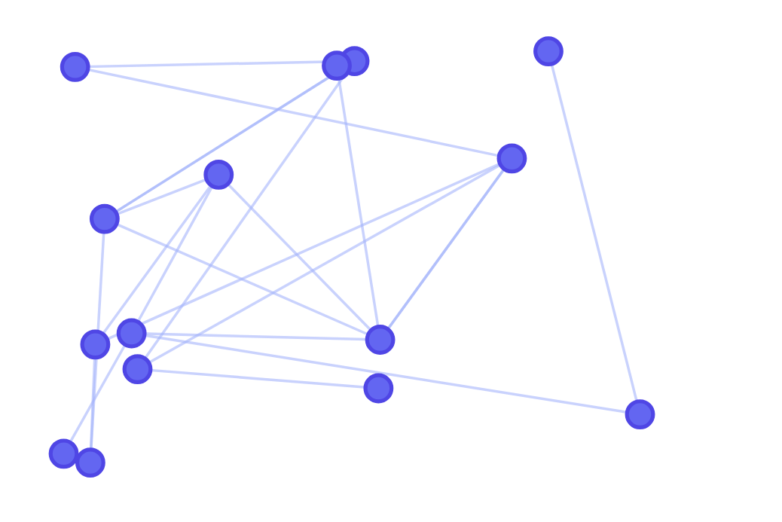
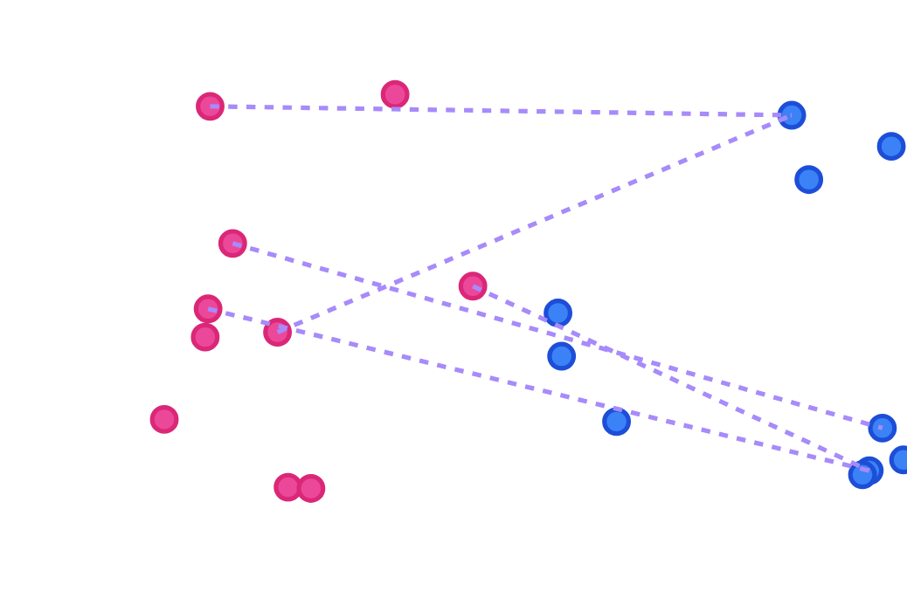
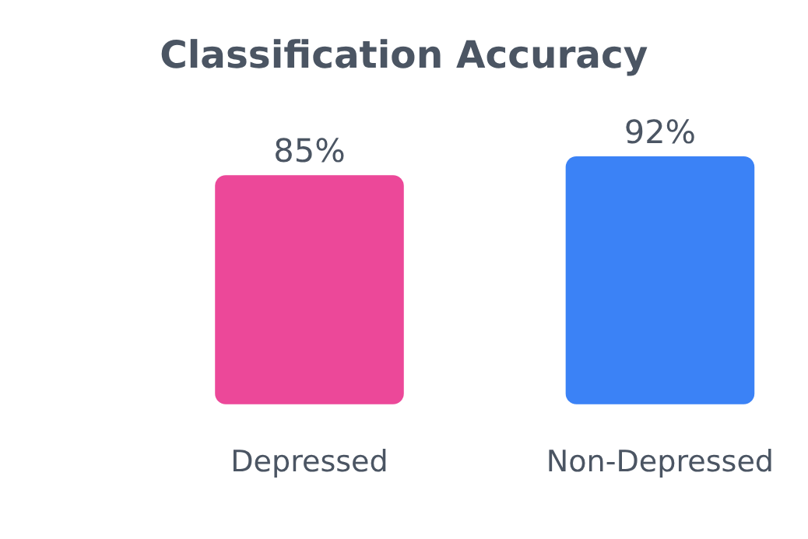
Demo Preview
Connectivity Graph
Atlas Alignment
Classification Results
Visualization of brain connectivity using unified pseudo atlas
Demonstration of Hungarian algorithm for graph matching
Sample depression classification with GNN model
Nodes represent ROIs, links represent connectivity
Iterative alignment to consensus atlas
High accuracy with interpretability
Unified Pseudo Atlas for Multi-Atlas Brain Graph Integration
Page 9 of 10

Slide 11






Expected Results and Impact
Higher Classification Accuracy
Enhanced Model Robustness
Unified pseudo atlas alignment will improve classification accuracy by providing consistent brain graph representations across datasets, leading to more reliable depression detection.
The approach will create models less susceptible to variations in imaging protocols and scanner types, improving reliability across different clinical settings.
Improved Clinical Interpretability
Cross-dataset Stability
The unified framework will provide clearer insights into depression-related brain network changes, enabling clinicians to better understand and explain diagnostic decisions.
Researchers will benefit from consistent results across different datasets and institutions, promoting collaboration and accelerating scientific discovery.
The Unified Pseudo Atlas approach bridges critical gaps in multi-atlas fMRI graph integration, with profound implications for clinical diagnosis and research consistency.
Unified Pseudo Atlas for Multi-Atlas Brain Graph Integration
Page 10 of 10

