Slide 1
EV Charging Demand Prediction and Usage Pattern Analysis
My goal: predict how much an EV charging session will use before it starts, and spot the high-demand ones.
Gowni Harshith Reddy
github.com/GowniHarshithReddy/ev-charging-demand-prediction
Notes:
I worked on EV charging sessions. I did two tasks: predict the Demand value, and classify a session as High or Normal demand. Then I put everything in a Streamlit dashboard.

Slide 2
My data and how I cleaned it
About 72,000 charging sessions from 30 Sep 2021 to 30 Sep 2022, with 14 types of location.
There were no missing values, but Duration had problems. 735 rows had a Duration of 0 or less. Some were real sessions with a wrong Duration, and some were sessions under a minute that look like failed plug-ins.
I kept the very large Demand values (up to 97) because high-demand sessions are what I want to predict.
Step | Result
Raw sessions | 72,856
Duplicates removed | 13
Real, wrong Duration | 167 (removed)
Failed short sessions | 568 (removed)
Final dataset | 72,108
2
Notes:
The data has about 72,000 sessions over one year. I removed 13 duplicates and 735 rows with invalid Duration. I kept the big Demand values because they are real sessions.

Slide 3
What I found in the data
The hour matters most: sessions that start between 8 PM and 2 AM are the biggest, daytime ones the smallest
The busiest time is 5 to 7 PM, so the busiest hours are not the biggest sessions
Day of the week and month made almost no difference
Accommodation and bus garage have very few sessions, so I trust camping more
3
Notes:
The hour of the day was the clearest pattern. Accommodation and bus garage have very few sessions, so I trust the camping result more.

Slide 4
Two things I had to be careful about
1. Data leakage
2. The guest ID
Duration is only known after the session ends, so I did not use it
History features only look at earlier sessions
I split by time: first 80% to train, last 20% to test
43.3%
of sessions come from UserID 0. LIME once showed a user with 25,934 earlier sessions, which cannot be one person, so I checked. It is a shared guest ID. I set its history to missing, added an IsGuest column and re-ran all the models.
4
Notes:
First, Duration is only known after a session ends, so I left it out. Second, I found that UserID 0 is a shared guest ID. I noticed it when LIME showed a user with 25,934 earlier sessions.

Slide 5
Regression: predicting Demand
XGBoost and LightGBM are almost tied
All models are better than guessing the average, and the error drops from 10.8 to about 8.4
R2 is only about 0.33 because I left Duration out on purpose
The models are close to each other, so the inputs limit accuracy more than the algorithm
Best: XGBoost, MAE 8.35 and RMSE 11.39. A model that always guesses the average has MAE 10.85 and R2 of 0.
5
Notes:
XGBoost and LightGBM are almost the same, so I do not say one is clearly better. R-squared is only about 0.33 because I left Duration out on purpose.

Slide 6
Classification: High vs Normal demand
Model | Accuracy | Recall | F1 | ROC-AUC
XGBoost | 0.714 | 0.783 | 0.728 | 0.792
LightGBM | 0.716 | 0.778 | 0.727 | 0.791
Random Forest | 0.712 | 0.770 | 0.722 | 0.790
Decision Tree | 0.702 | 0.791 | 0.721 | 0.779
Logistic Regression | 0.695 | 0.699 | 0.691 | 0.773
KNN | 0.698 | 0.732 | 0.702 | 0.771
About class imbalance
My classes are already 50 / 50, so I did not need resampling
To still try it, I made the training data imbalanced on purpose
Recall went from 0.17 to 0.61 with Random Oversampling
SMOTE gave 0.45 and ADASYN 0.44
High Demand = 14.36 or more (the median of the training data). Accuracy is about 71%, compared with 50% for guessing.
6
Notes:
High Demand means Demand of 14.36 or more, the median of the training data. Because it is the median the classes are balanced, so I only demonstrated SMOTE and ADASYN on a training set that I made imbalanced.

Slide 7
Why the models predict what they do
Feature importance and SHAP
LIME on one 11 PM session
The user's past average demand is the strongest input by far
Hour of the day is second
Charger type 1 pushes the prediction up
Camping and apartment push it up; hotel and market push it down
Day of the week and charger company hardly matter
The late hour and an above-average user history pushed it towards High
Charger type 0 and a hotel location pushed it towards Normal
This agrees with what SHAP showed
7
Notes:
Feature importance, SHAP and LIME all agree. These tools explain what the model uses, not what causes demand in real life.

Slide 8
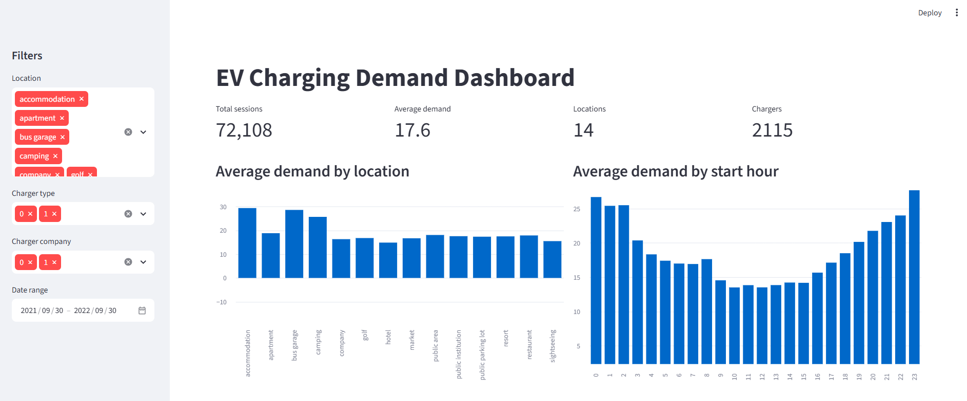
My Streamlit dashboard: filters and charts
Screenshot: filters, KPIs and charts
Filters on the left, KPIs and charts on the right. The hour chart shows the U shape I found in the data.
8
Notes:
Run it with: streamlit run app/dashboard.py. I can filter by location, charger type, company and date, and the KPIs and charts update. Replace the frame with the screenshot.

Slide 9
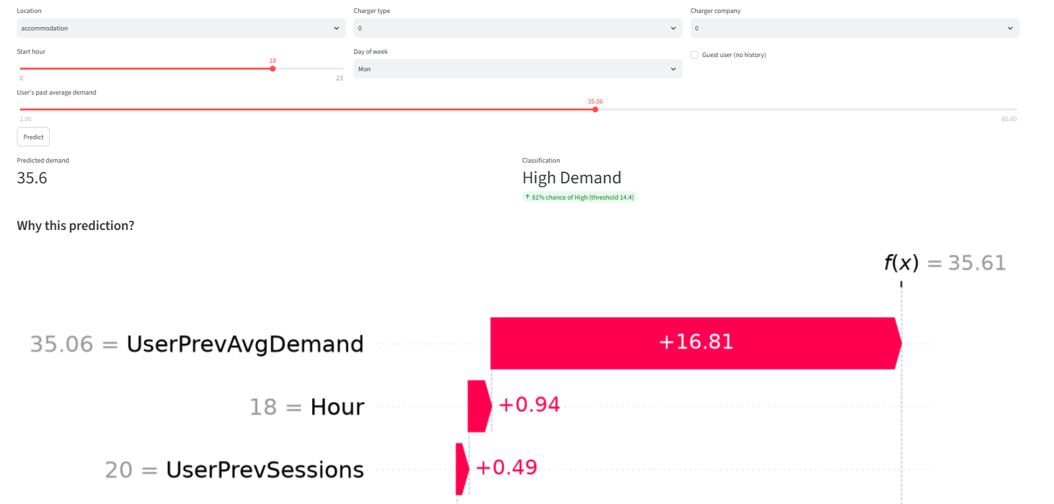
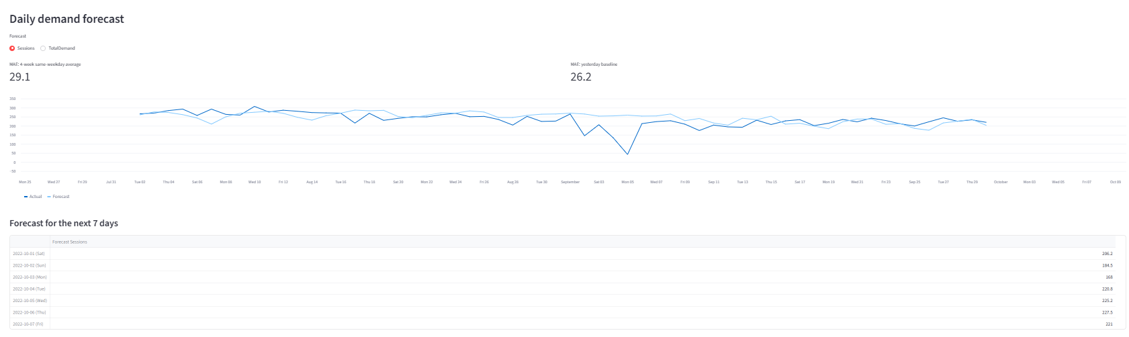
Dashboard: predictions and model results
Screenshot: model tables
Screenshot: prediction + SHAP
Left: predicted demand, High or Normal label and why. Right: regression and classification results for every model I tried.
9
Notes:
In the form I enter a session and get the predicted demand, a High or Normal label with a probability, and a SHAP chart that explains the prediction. The tables show all the models I compared.

Slide 10
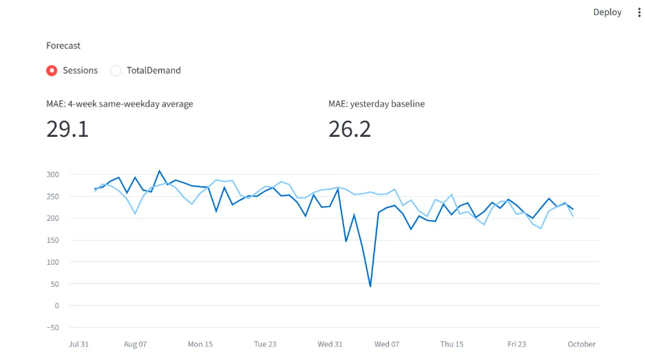
Forecasting daily sessions
Two simple methods on the last 60 days: the same-weekday average (MAE 29.1) and yesterday's value (MAE 26.2)
Neither is clearly better, which fits the weak weekday effect in the data
Both miss a sharp drop in early August that I could not explain
The dashboard also shows a 7-day forecast of about 170 to 230 sessions per day
Screenshot: forecast chart
10
Notes:
I compared two simple methods on the last 60 days. Neither is clearly better. Both miss the drop in early August, which I could not explain.

Slide 11
Limitations and what I would do next
Limitations
Next steps
I only use information known before a session starts, so predictions are rough
43% of sessions are guests with no history
Only one year of data, so no yearly seasonality
My forecast is simple, and I could not explain a drop in early August
Try ARIMA or Prophet for the forecast
Add weather and holiday data
Retrain the models automatically as new data arrives
11
Notes:
The R-squared is modest and guest sessions have no history. The early August drop in sessions is something I could not explain.

