Slide 1
BANKING PROJECT The data is related with direct marketing campaigns (phone calls) of a Portuguese banking institution. The classification goal is to predict if the client will subscribe a term deposit (variable y)
By
Gowri C
Candidate ID: 16299
Batch: LB_DSC_6th Sep_WKDY_EN_24

Slide 2
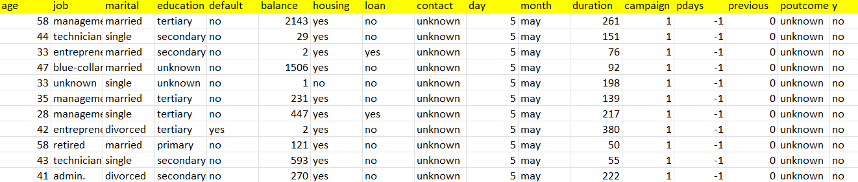
agenda
Abstract-Data from a marketing campaign run by Retail bank is examined. The campaign’s aim was to increase customers’ subscription rates to fixed-term deposit products, such as CDs. Using knowledge from the course, a number of machine learning algorithms are implemented to answer the question: How can banks successfully market these products in the most efficient way possible and with the highest possible rate of success?
Goal-The classification goal is to predict if the client will subscribe (yes/no) a term deposit(variable y).

Slide 3
Steps followed to build predictive model
Importing required libraries & the data
Separate the dataset into input (independent features) & output data (dependent feature)
Data Pre-processing (includes data cleaning, removing duplicate values, Outlier handling)
Dividing the data set into training and testing data
Handling Data Imbalance issue
Model building
Comparing different models based on evaluation metrics to select the most suitable model.
Extracting out important features defining the features having maximum impact on predicting the output.

Slide 4
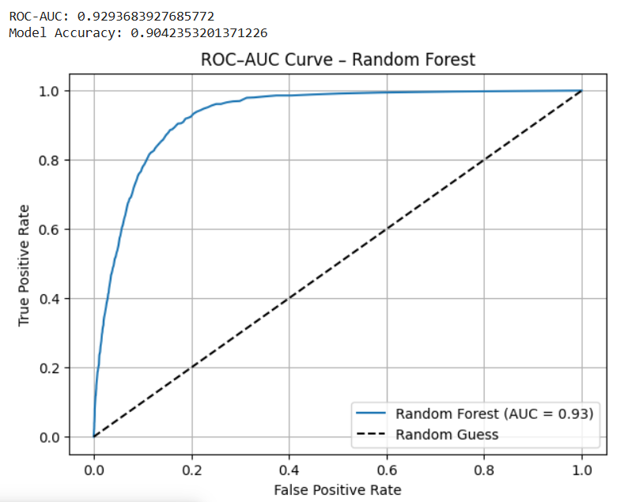
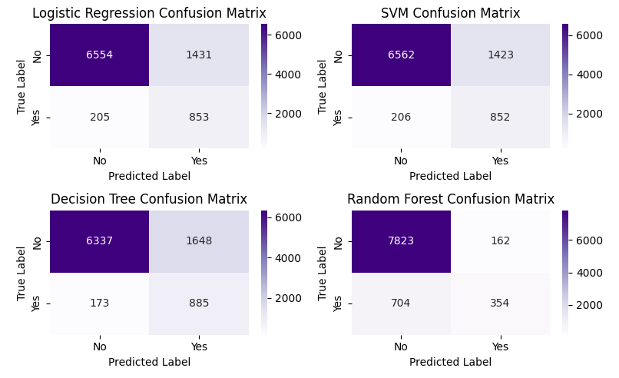
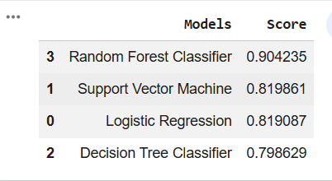
Model building

Slide 5
Thank you

