Slide 1

Employee Data Analysis using Excel
STUDENT NAME: Gowranji R
REGISTER NO: 122203977
DEPARTMENT: B.Com CS
COLLEGE : Shri Krishnaswamy College for Women
<number>
Notes:
<number>

Slide 2
EMPLOYABILITY GENDER ANALYSIS USING EXCEL
<number>

Slide 3




AGENDA
Problem Statement
Project Overview
End Users
Our Solution and Proposition
Dataset Description
Modelling Approach
Results and Discussion
Conclusion
3/21/2024 Annual Review
<number>

Slide 4

PROBLEM STATEMENT
Problem Statement:
"To evaluate the impact of gender on employability rates and job characteristics within a specific workforce or industry, we will conduct a gender-based employability analysis using Excel. The analysis aims to identify any significant disparities in employment outcomes between different genders, such as hiring rates, salary differences, job positions, and career progression."
Key Objectives:
Assess Hiring Rates: Compare the proportion of men and women hired over a specific period or for various job roles.
Analyse Salary Differences: Examine average salaries by gender to identify potential wage gaps.
Evaluate Job Positions: Analyse career advancement opportunities and promotion rates by gender.
Data Required:
Gender
Hiring dates
Job titles and roles
Salaries
<number>

Slide 5

PROJECT OVERVIEW
Excel involves several key Steps to evaluate and improve employee performance
1.Objective defining
2.Data collection
3.Data organisation
4.Data cleaning
5.Performance metrics
6.Analysis
7.Bench marking
8.Reporting
<number>

Slide 6

WHO ARE THE END USERS?
The end users of employee performance analysis typically include:
HR Managers:
Use the analysis to make decisions about promotions, raises, and training needs.
Department Managers:
Assess individual and team performance to improve productivity and address performance issues.
Executives:
Review overall performance metrics to align workforce performance with organizational goals and strategy.
Team Leaders/Supervisors:
Monitor team performance, provide feedback, and implement improvements.
Employees:
Receive feedback and performance reviews based on the analysis, which can guide their personal development.
<number>

Slide 7

OUR SOLUTION AND ITS VALUE PROPOSITION
Our solution
1.Data collection
2.Data analysis
3.Visualisation
Value Proposition
1. Cost-Effective Solution:
Excel is widely available and does not require additional software investments, making it a budget-friendly option for performance analysis.
2. Customizable and Flexible:
Tailor the analysis tools and reports to fit specific organizational needs and performance metrics. .
3. Ease of Use:
With a user-friendly interface and familiar functions, Excel makes it accessible for users with varying levels of technical expertise.
4. Data Integration:
Excel can integrate with other data sources and systems, allowing for a comprehensive view of employee performance when combined with other tools or databases.
<number>

Slide 8
Dataset Description
When analysing employability data using Excel, it's helpful to understand the types of data you might encounter. Here’s a typical description of such a dataset:
Demographic Information:
Age: Age of the individuals.
Gender: Gender of the individuals.
Location: Geographic location or region.
Educational Background:
Highest Degree: The highest level of education achieved (e.g., High School, Bachelor’s, Master’s, Ph.D.).
Field of Study: Major or field in which the degree was obtained.
Employment Status:
Current Employment Status
Job Title
Industry
Years of Experience
Previous Job Titles
Employee ID
Name
Department
Position
Performance Rating
Goals Achieved
Attendance Record
Sales Figures
Customer Feedback
Training Hours
Project Completion
Date of Review
John Doe
Sales
Sales Manager
4
10
5 absences
$100,000
8.5/10
20
12
2024-08-30
002
Jane Smith
HR
HR Specialist
5
15
2 absences
N/A
9.0/10
25
8
2024-08-30

Slide 9

THE "WOW" IN OUR SOLUTION
1 Data collection and preparation
2 Data organisation
3 Basic Analysis
4 Pivot Tables
<number>

Slide 10
MODELLING
1 Data collection
2.Data preparation
3.Data Cleaning
4.Data analysis
5.Interpretation
<number>

Slide 11
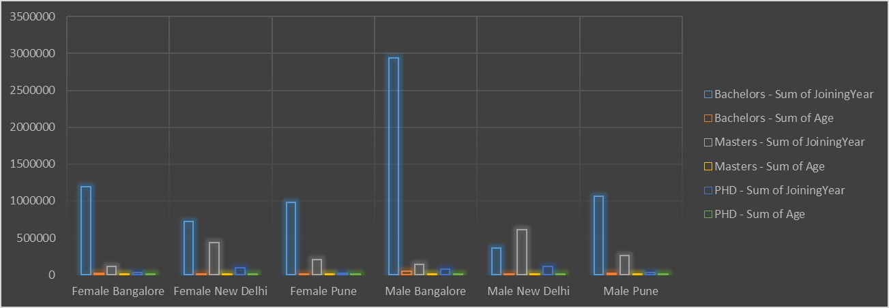
RESULTS

Slide 12
CONCLUSION
This is about how problem will
be created and for this how we will give various solutions for that .

