Slide 1

-“GIVE YOUR CLOTHES SECOND LIFE”
VASTRA SAMHITHA

Slide 2

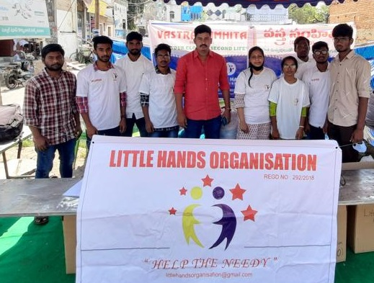
INITIATION of VASTRA SAMHITHA
Vastra samhitha project was inagurated by Dr.ABBAS on February 14TH 2021(Sunday)

Slide 3
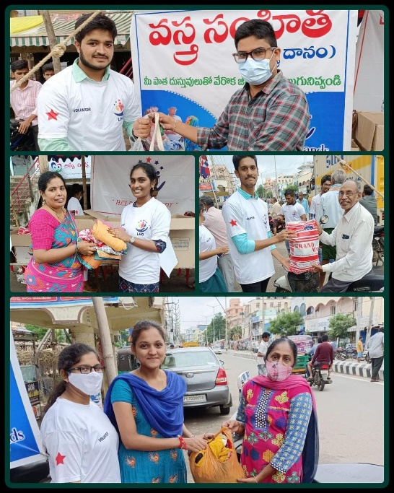
WHAT IS VASTRA SAMHITHA ?..
Vastra samhitha is all about conducting stalls for collecting old clothes in different areas ,recondition them and distribute to needy.

Slide 4
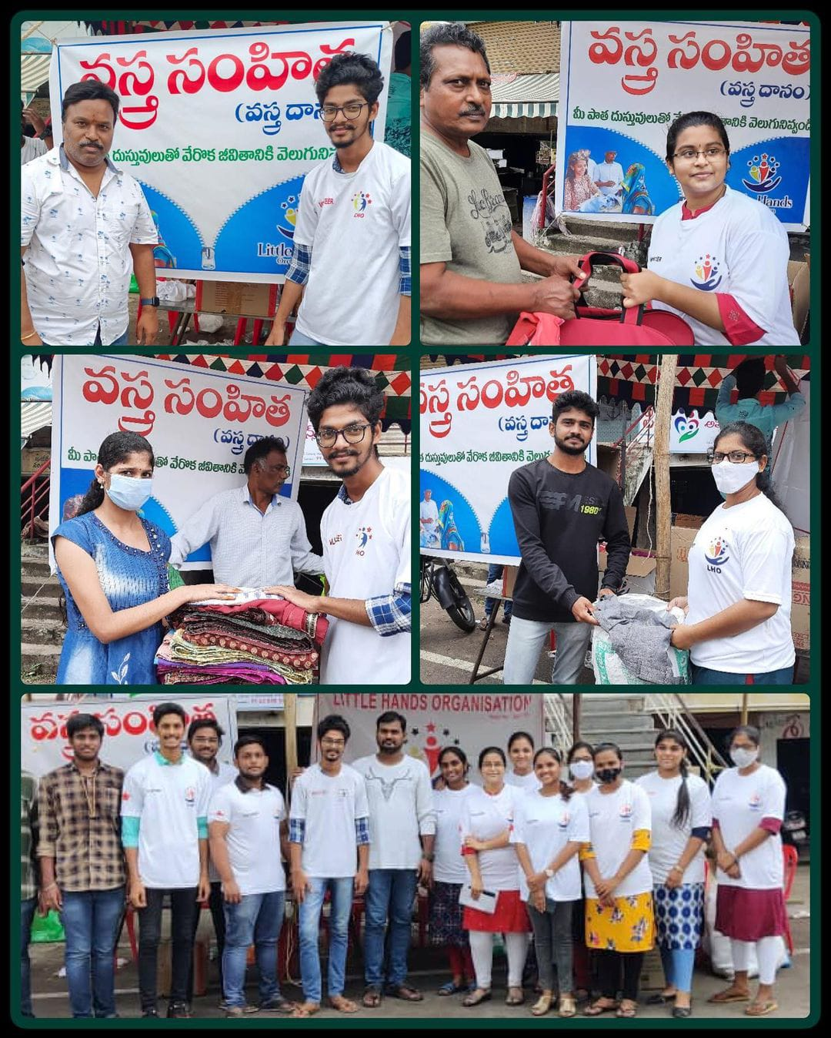
Clothes drive will be operated as follows :
There will be stalls organised at
designated areas and people can
drop off clothes there.

Slide 5
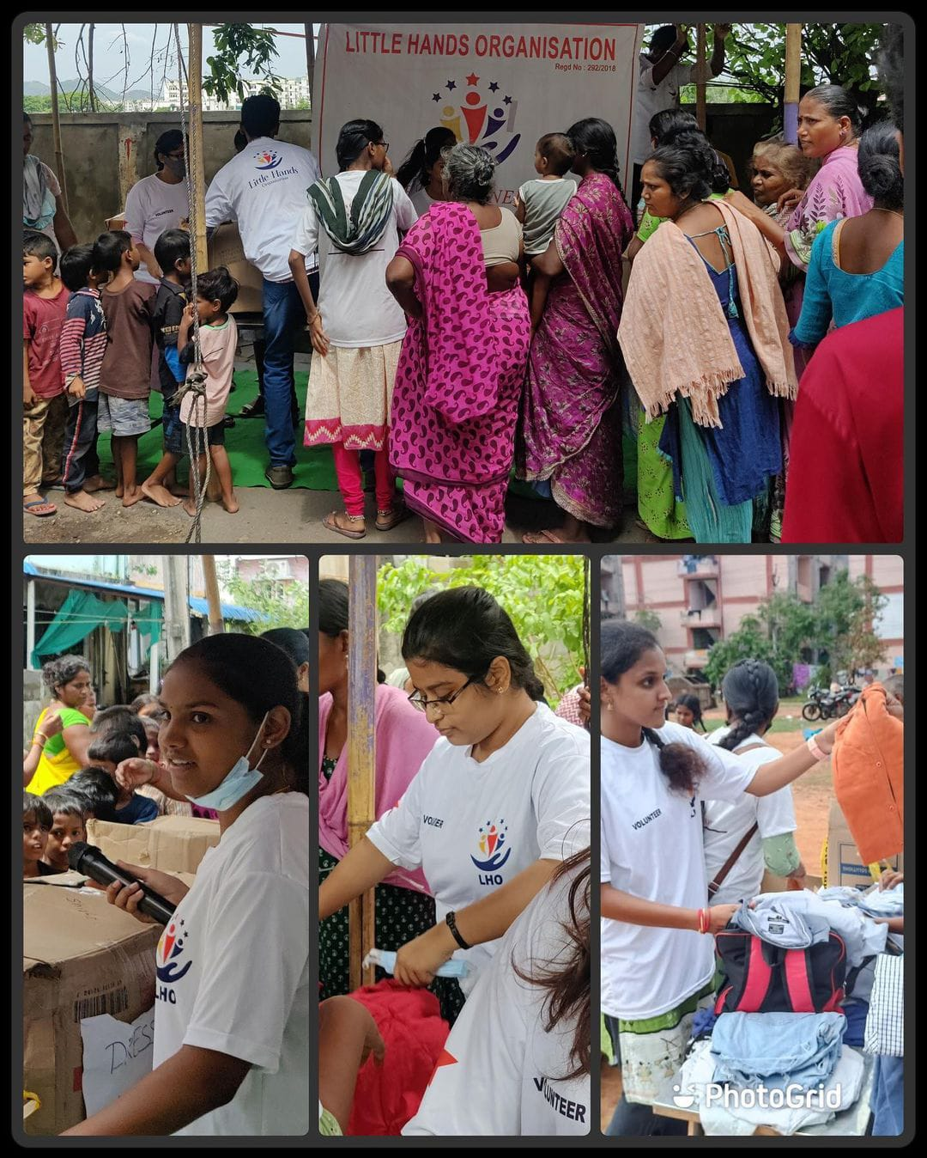
2 . The clothes collected are checked to ensure if they are in good condition to distribute

Slide 6
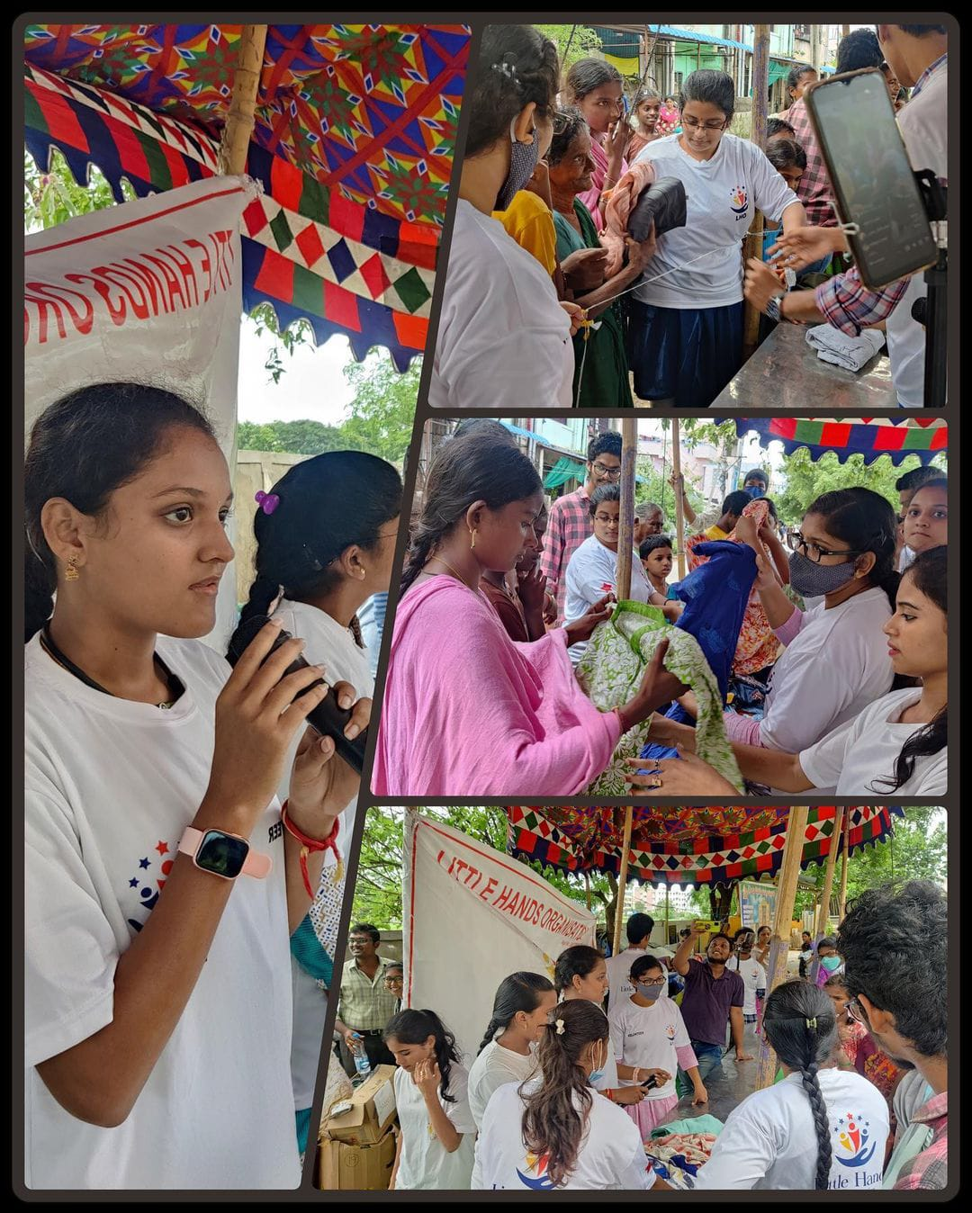
3 . All the collection and distribution process will take place on weekends.

Slide 7
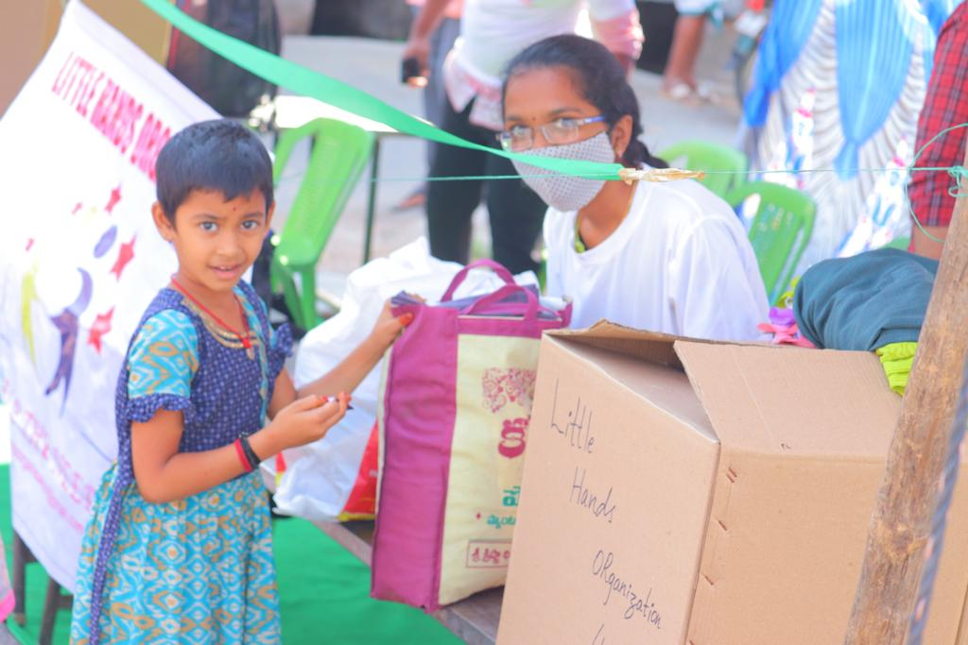
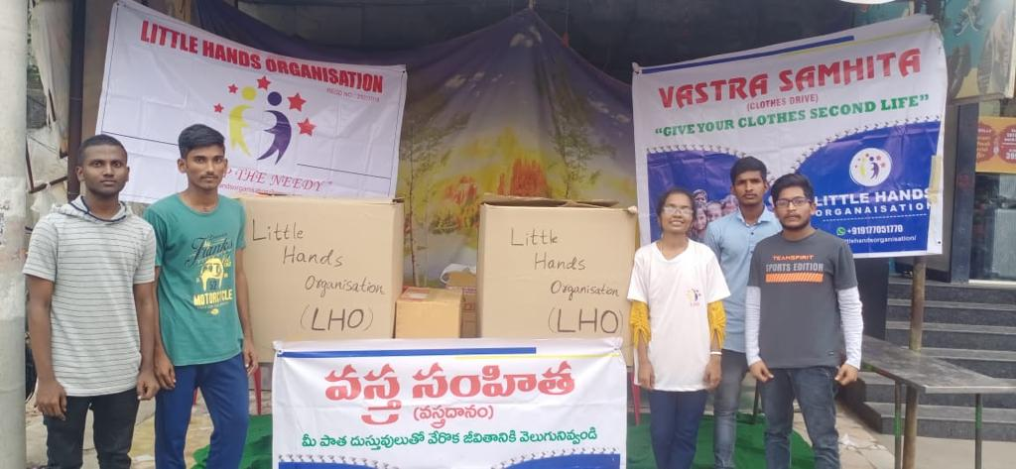
Give your clothes second life

Slide 8
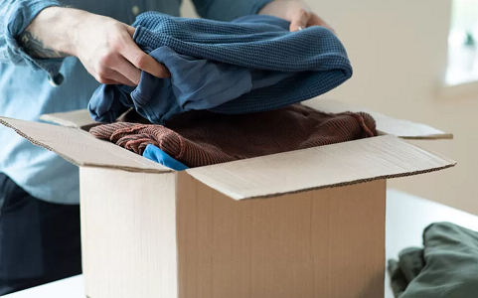
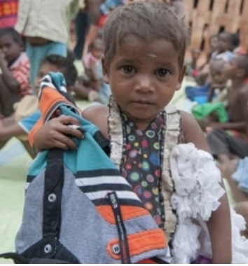
Purpose of vastra samhitha
Helps environment(eco friendly)
Keeps your home clutter free
Helps people in need
Builds generosity

Slide 9
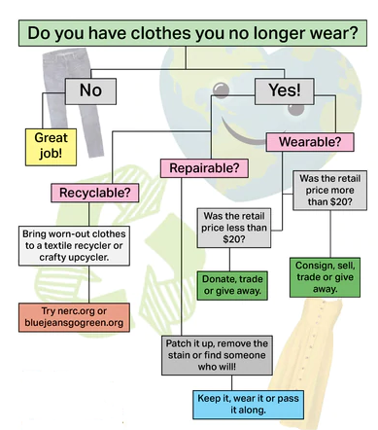

Slide 10
CONCLUSION YOUR “TRASH” IS SOMEONE ELSE’S “TREASURE”

Slide 11
THANK YOU

