Slide 1
Software Engineering
Module 1 -Extreme Programming
Dr.A.P.Janani, ASP/IT

Slide 2
Extreme Programming
Suitable for object oriented projects.
The methodology is based upon five underlying values:
  Communication
  Simplicity
  Feedback
  Courage and respect.
Communication:
  Culture of oral communication among stake holders.
  Communicating important concepts, continuous feedback, and the avoidance of voluminous documentation as a communication medium.

Slide 3
Extreme Programming
Simplicity:
To achieve simplicity, XP restricts developers to design only for immediate needs ,rather than consider future needs.
The intent is to create a simple design that can be easily implemented in code. If the design must be improved, it can be refactored at a later time.

Slide 4
Extreme Programming
Feedback:
Feedback is derived from three sources: Implemented software itself, the customer, and other software team members.
XP makes use of the unit test as its primary testing tactic.
As each class is developed, the team develops a unit test to exercise each operation according to its specified functionality.
As an increment is delivered to a customer, the user stories or use cases are used as a basis for acceptance tests.
software implements the output, function, and behavior of the use case is a form of feedback.
Finally, as new requirements are derived as part of iterative planning.
The team provides rapid feedback to customer regarding cost and schedule .
The development team obtains feedback from the customers at the end of each iteration and external release.
.

Slide 5
Extreme Programming
Courage and Respect
An agile XP team must have the discipline (courage) to design for today, recognizing that future requirements .
Demanding substantial rework of the design and implemented code.

Slide 6
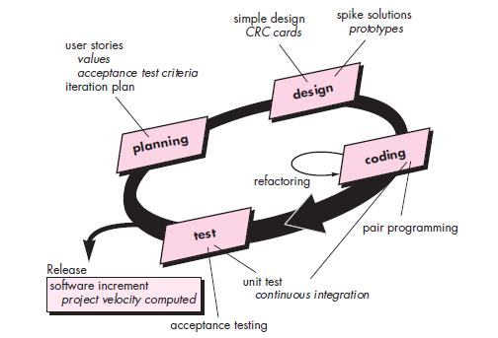
Extreme Programming

Slide 7
Planning…
• The planning activity begins with listening a requirements gathering activity that enables the technical members of the XP team to understand required output and major features and functionality.
• Creation of a set of “stories” (also called user stories) that describe required output, features, and functionality for software to be built.
• Each story is written by the customer and is placed on an index card.
• The customer assigns a value (i.e., a priority) to the story based on the overall business value of the feature or function.
• Members of the XP team then assess each story and assign a cost to it.
• The story is estimated to require more than three development weeks.
The customer is asked to split the story into smaller stories and the assignment of value and cost occurs again if lengthier.

Slide 8
Planning…
• New stories can be written at any time.
• Customers and developers work together to decide how to
group stories into the next release to be developed by the
XP team.
Once a basic commitment is made for a release, the XP team
orders the stories that will be developed in one of three
ways:
  All stories will be implemented immediately
  (within a few weeks).
  (2) The stories with highest value will be moved up in the schedule and implemented first.
  (3) The riskiest stories will be moved up in the schedule and implemented first.
After the first project release (also called a software increment) has been delivered, the XP team computes project velocity.

Slide 9
Planning…
Project velocity is the number of customer stories implemented during the first release.
Project velocity can then be used to
(1) Help estimate delivery dates and schedule for
subsequent releases.
(2) Determine whether an over commitment has been
made for all stories across the entire development
project. If an over commitment occurs, the content
of releases is modified or end delivery dates are
changed.
As development work proceeds, the customer can add stories, change the value of an existing story, split stories, or eliminate them.
The XP team then reconsiders all remaining releases and modifies its plans accordingly.

Slide 10
Design…
XP design rigorously follows the KIS (keep it simple) principle.
XP encourages the use of CRC cards as an effective mechanism for thinking about the software in an object-oriented context.
CRC (class-responsibility-collaborator) cards identify and organize the object-oriented classes that are relevant to the current software increment.
The CRC cards are the only design work product produced as part of the XP process.

Slide 11
Design…
If a difficult design problem is encountered as part of the design of a story, XP recommends the immediate creation of an operational prototype of that portion of the design, called a spike solution, the design prototype is implemented and evaluated.
XP encourages refactoring—a construction technique that is also a method for design optimization.
Refactoring is the process of changing a software system in such a way that it does not alter the external behavior of the code yet improves the internal structure.

Slide 12
Coding…
After stories are developed and preliminary design work is done, the team does not move to code, but rather develops a series of unit tests that will exercise each of the stories that is to be included in the current release.
Once the code is complete, it can be unit-tested immediately, thereby providing instantaneous feedback to the developers.
A key concept during the coding activity is pair programming. XP recommends that two people work together at one computer workstation to create code for a story.
One person might think about the coding details of a particular portion of the design while the other ensures that coding standards are being followed or that the code for the story will satisfy the unit test that has been developed to validate the code against the story.
As pair programmers complete their work, the code they develop is integrated with the work of others.

Slide 13
Testing…
Creation of unit tests before coding commences is a key element of the XP approach.
The unit tests that are created should be implemented using a framework that enables them to be automated.
This encourages a regression testing strategy, whenever code is modified
Integration and validation testing of the system can occur on a daily basis. This provides the XP team with a continual indication of progress.
XP acceptance tests, also called customer tests, are specified by the customer and focus on overall system features and functionality that are visible and reviewable by the customer.
Acceptance tests are derived from user stories that have been implemented as part of a software release.

Slide 14
References:
Roger S. Pressman, Bruce.R.Maxim, “Software Engineering – A Practitioner’s Approach”, Eighth Edition, McGraw-Hill International Edition, New Delhi, 2015
Ian Sommerville, “Software engineering”, Tenth Edition, Pearson Education Asia, 2015.

Slide 15
THANK YOU

