Slide 1
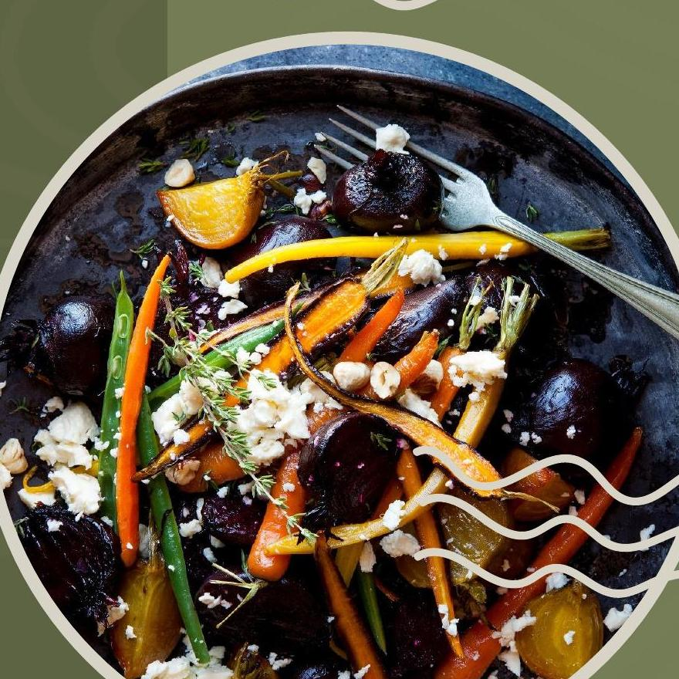
FOOD WASTE
REDISTRIBUTION
PLATFORM
GUIDE
MS. SREELEKSHMI K S
ASSISTANT PROFESSOR
DEPARTMENT OF COMPUTER APPLICATIONS
STUDENT
GOWRI RAJESH
ROLL NO: 32
S3 MCA

Slide 2
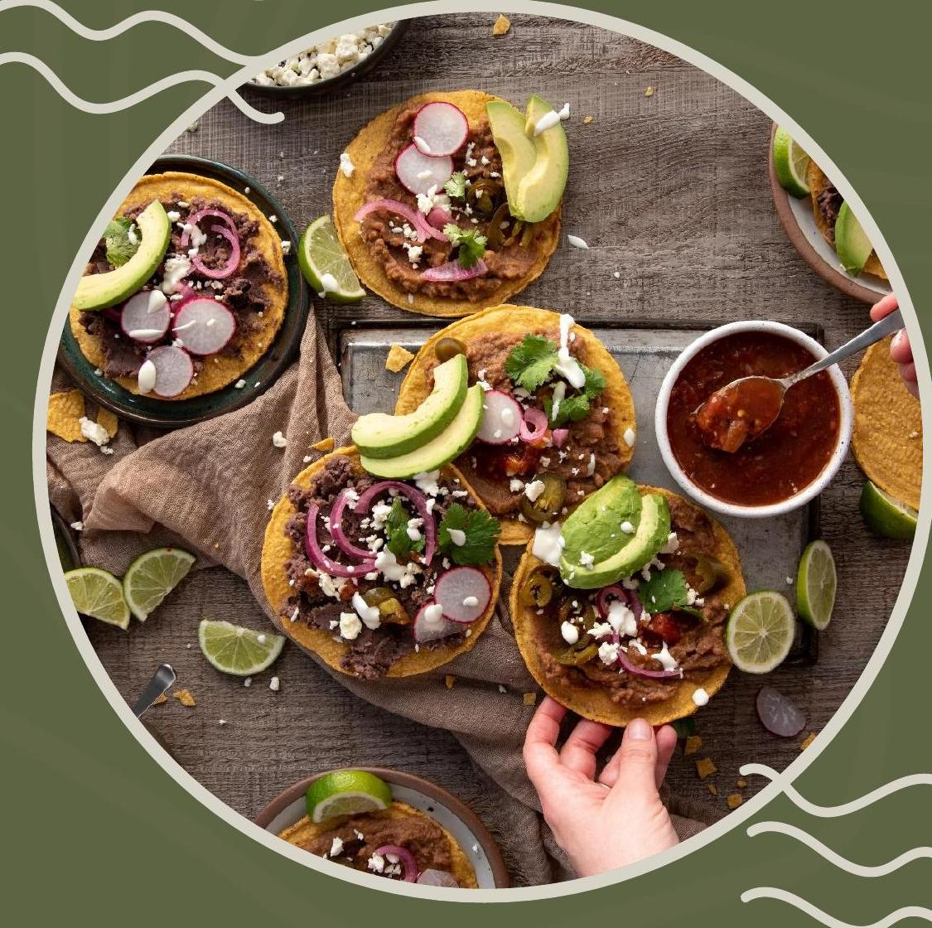
INTRODUCTION
Food waste is a major issue despite widespread hunger, with large quantities of edible food discarded daily
Lack of proper coordination and inefficient systems prevent surplus food from reaching those in need
A digital platform can connect donors, NGOs, and beneficiaries for real-time food redistribution
This solution reduces waste, supports community welfare, and promotes sustainable resource utilization

Slide 3
ABSTRACT
Connects food donors with NGOs and people in need.
Allows donors to share surplus food details easily.
Helps volunteers collect and deliver food efficiently.
Uses location tracking and notifications to reduce food waste and ensure timely distribution.

Slide 4
PROBLEM STATEMENT
Inefficient and uncoordinated redistribution leads to delays and food spoilage.
Lack of real-time tracking, location-based matching, and proper monitoring.
Need for a reliable digital solution to ensure timely and efficient food distribution.

Slide 5
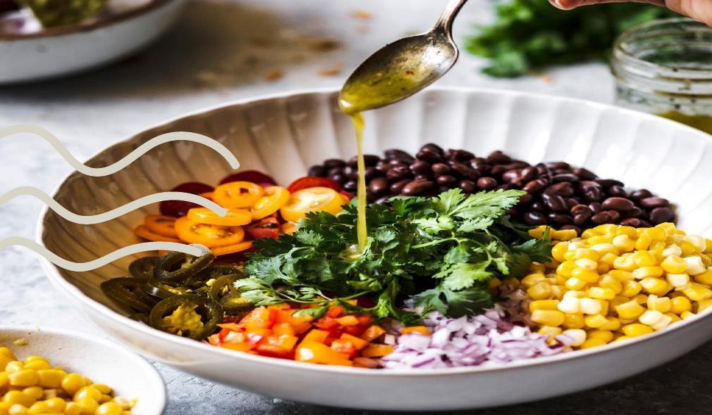
OBJECTIVES
Reduces food waste and supports needy people.
Connect donors and recipients.
Enable real-time food sharing.
Ensure timely and efficient distribution.
Provides location-based matching.

Slide 6
EXISTING SYSTEM
Food redistribution is mostly manual and handled by individuals without a centralized platform.
Lack of real-time information about available surplus food and nearby recipients.
Poor coordination leads to delays, mismanagement, and food spoilage.
Limited use of technology; communication is often through calls or messaging.
No proper tracking, monitoring, or analytics for transparency and efficiency.

Slide 7
PROPOSED SYSTEM
A web-based platform that connects food donors, NGOs, volunteers, and beneficiaries.
Donors can upload surplus food details (type, quantity, location, availability time) in real time.
Location-based matching helps identify nearest recipients and enables quick pickup.
Includes features like expiry tracking, notifications, and priority-based allocation.
Admin dashboard for monitoring, reporting, and improving transparency and efficiency.

Slide 8
SCOPE OF PROJECT
Provides a simple platform for managing food donations.
Enables real-time updates on food availability.
Supports coordination between donors, NGOs, and volunteers.
Maintains donation records and delivery status.
Offers an admin dashboard for monitoring and reporting.

Slide 9
LITERATURE REVIEW
Title & Year | Author(s) & Publication | Algorithm | Methodology | Metric | Key Finding
Surplus Food Donation: Effectiveness, Carbon Footprint & Rebound Effect (2022) | Niina Sundin et al. — Resources, Conservation & Recycling | Material Flow Analysis + LCA | Food donation analysis, carbon footprint calculation | Carbon footprint, recovery rate | Redistribution beat anaerobic digestion on environmental benefit.
Understanding Food Waste-Reducing Platforms: A Mini-Review (2023) | Fabio de Almeida Oroski et al. — Waste Management & Research | Systematic Literature Review | Digital food-sharing platform & stakeholder analysis | Platform effectiveness | Platforms connect donors & receivers but need trust and coordination.
Game Theoretic Framework for Surplus Food Distribution in Smart Cities (2021) | Surja Sanyal et al. | Game Theory | Smart donor–recipient matching, optimized allocation | Resource utilization | Improved fairness and efficiency of city-wide distribution.
Food Surplus Redistribution in the European Policy Context (2026) | Sustainable Futures (Elsevier) | Digital Platform + Socio-Technical System | Policy-based redistribution, digital coordination | Food redistributed, social impact | Large-scale redistribution with strong social/economic benefit.
Systematic Review of Data-Driven Approaches to Food Waste & Loss Management (2025) | Environmental Advances | Machine Learning + Digital Tech | AI prediction, mobile apps, blockchain | Prediction accuracy | AI/data-driven tools improve prediction and redistribution.
Digital Technologies and Food Waste: FoodCloud Platform (2026) | Michalis K. — SSRN | Digital Platform | Real-time donor–NGO matching, food tracking | Usability, efficiency | Digital platforms make donation faster, transparent, efficient.

Slide 10
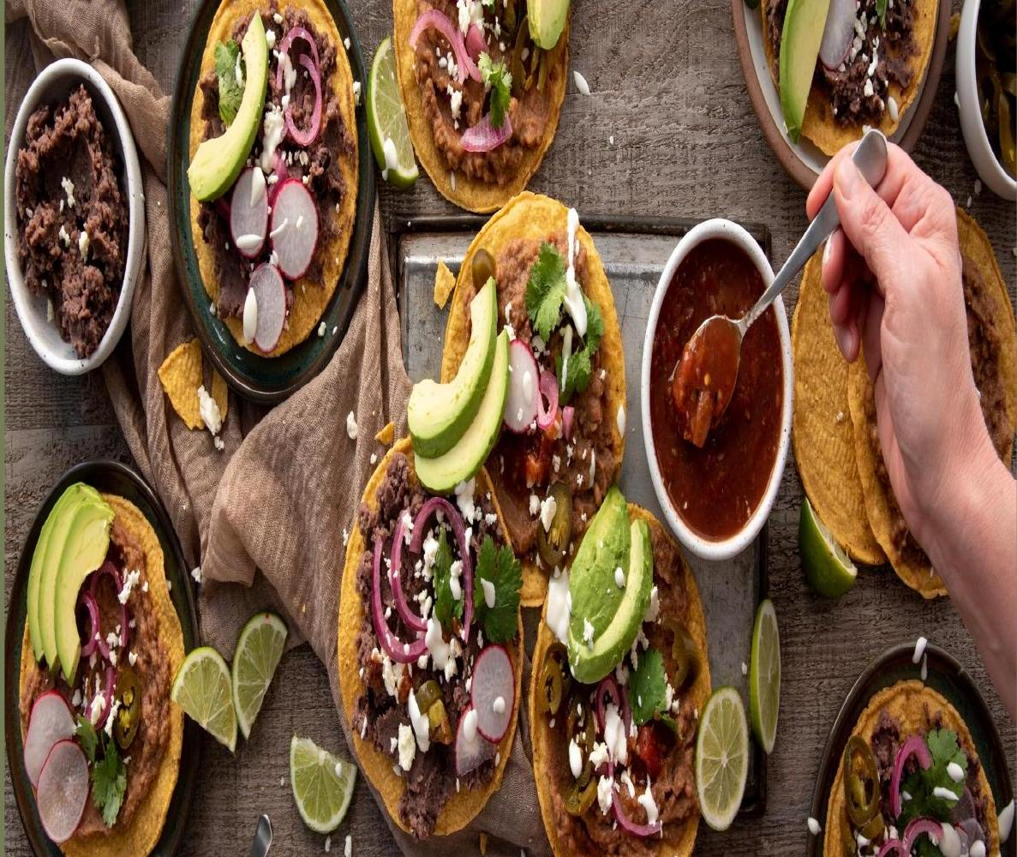
TECHNOLOGIES USED
Frontend: HTML, CSS, JavaScript
Backend: Python , Flask
Database: MySQL
APIs & Services: Google Maps API (for location-based matching), Notification APIs
IDE: VS Code
Version Control: Git and GitHub

Slide 11
FEASIBILITY STUDY
1
Technical Feasibility
Developed using HTML , CSS, JavaScript , Python and MySQL with location and notification APIs.
2
Economic Feasibility
Uses open-source technologies and low-cost APIs, making development affordable.
3
Operational Feasibility
Easy to use or donors, NGOs , volunteers , and admin.
4
Schedule Feasibility
Can be completed within the academic project timeline by developing modules step by step.
5
Social Feasibility
Helps reduce food waste , support needy people and promote sustain able resource utilization.

Slide 12
SOFTWARE AND HARDWARE REQUIREMENTS
Hardware Requirements
Processor: Intel Core i3 or above
RAM: Minimum 4 GB
Hard Disk: 500 GB
Operating System: Windows 10 or above
Internet connection
Software Requirements
Front End: HTML, CSS, JavaScript
Back End: Python, Flask
Database: MySQL
IDE: Visual Studio Code

Slide 13
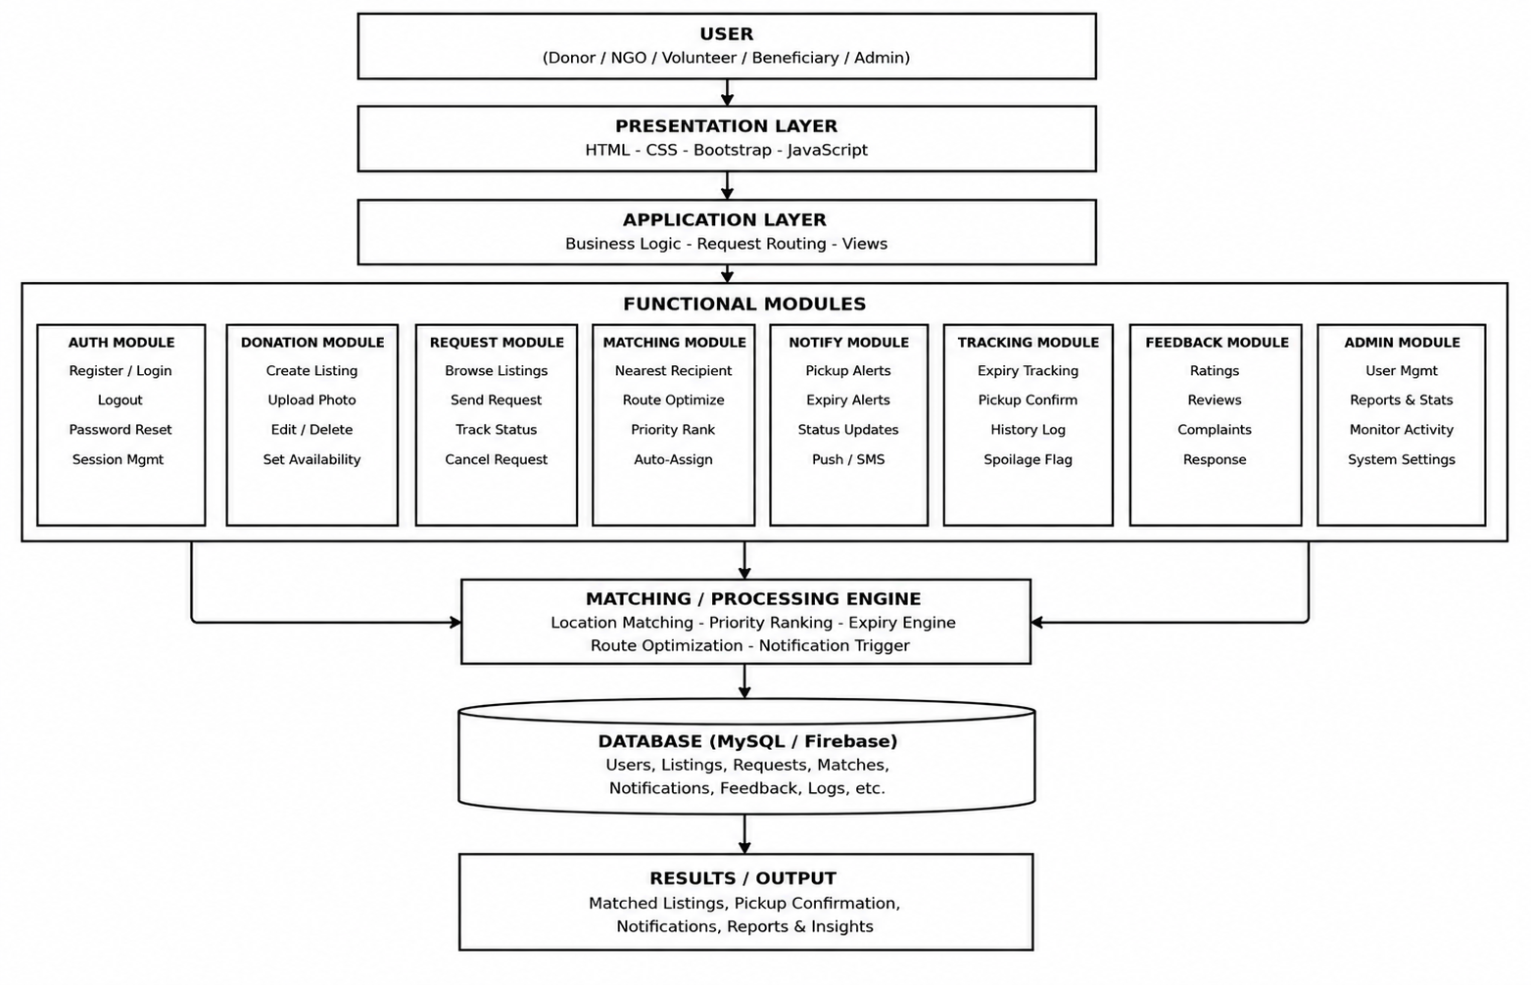
SYSTEM ARCHITECTURE

Slide 14
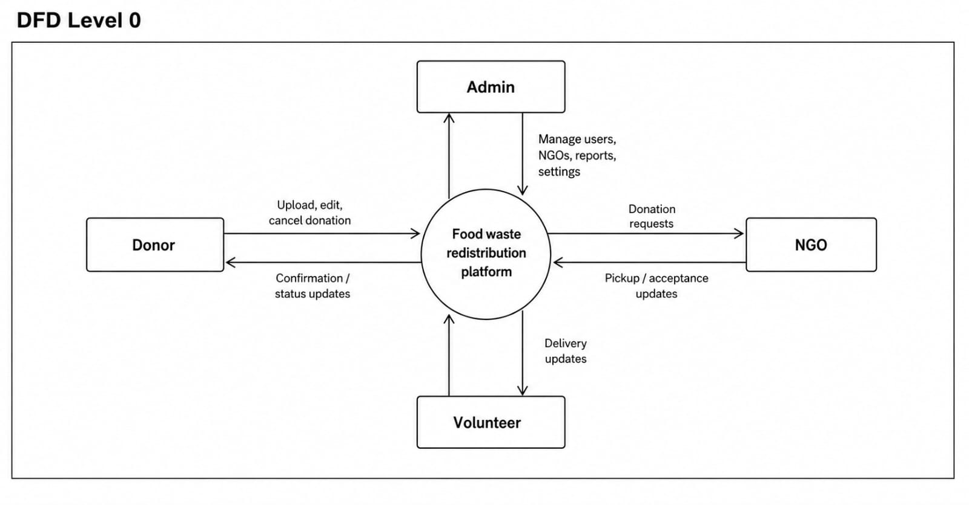
DFD — LEVEL 0

Slide 15
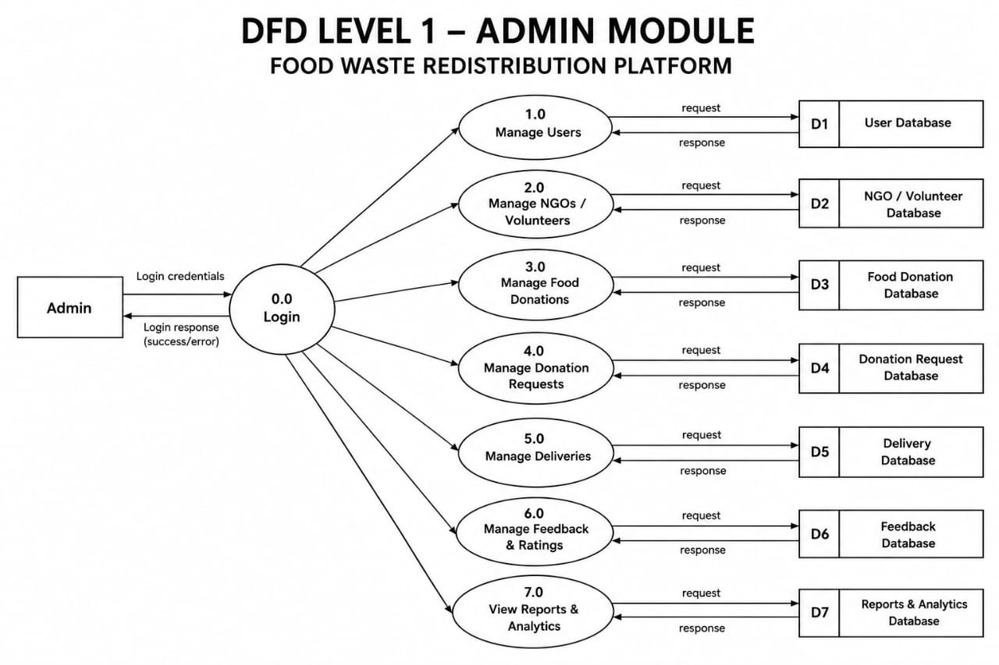
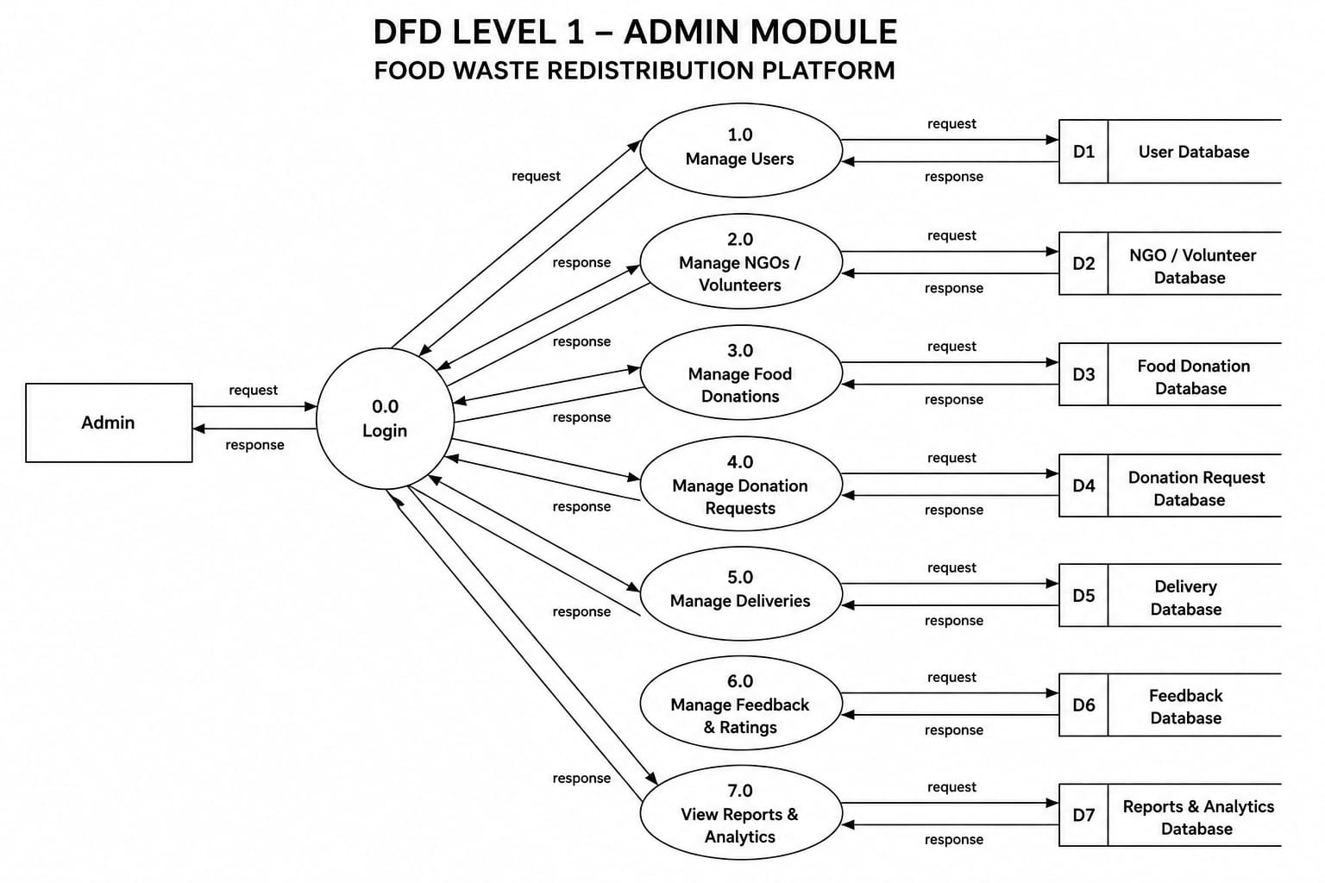

DFD — LEVEL 1

Slide 16
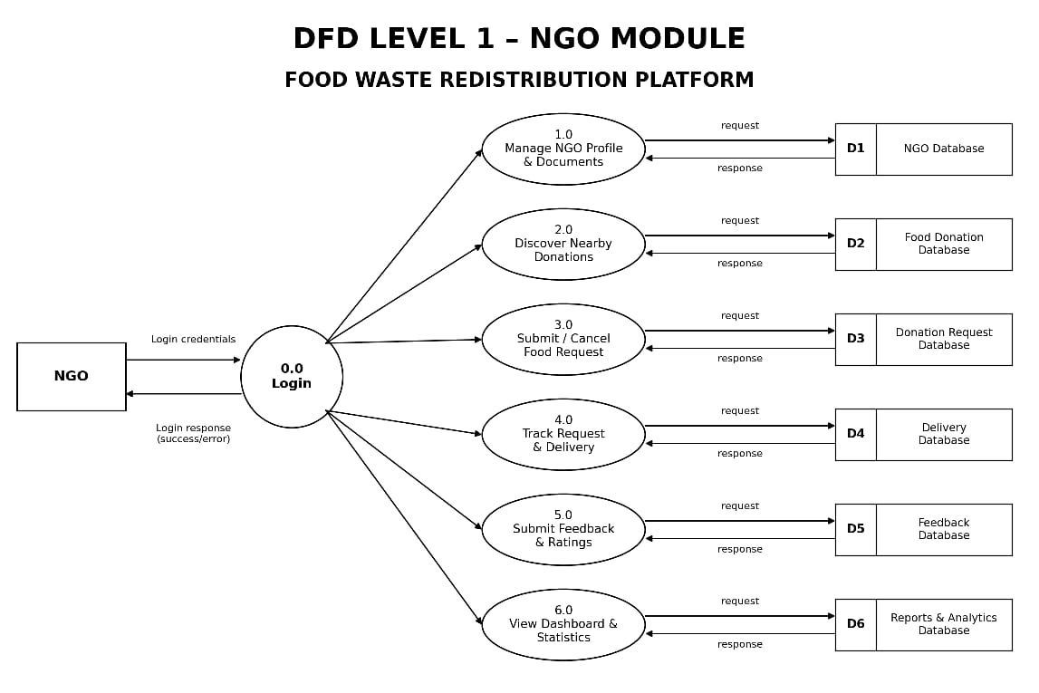
DFD — LEVEL 1

Slide 17
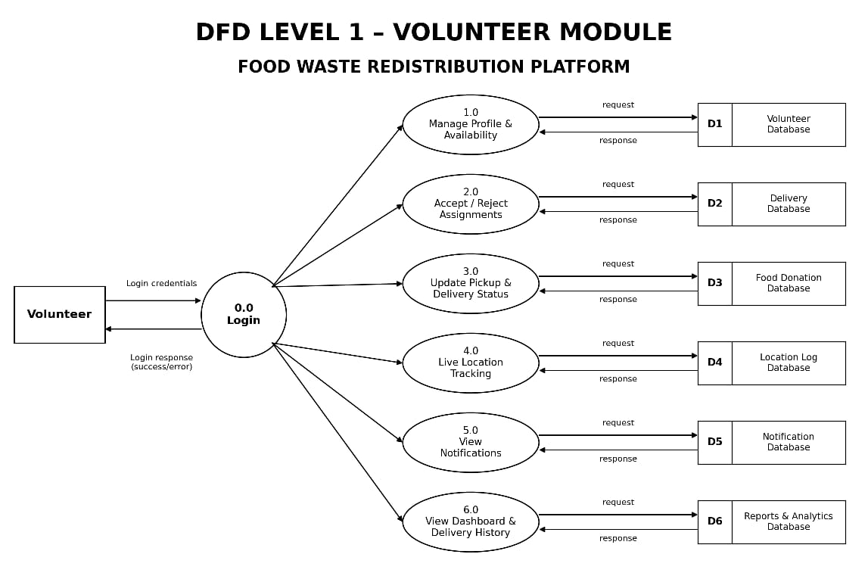
DFD — LEVEL 1

Slide 18
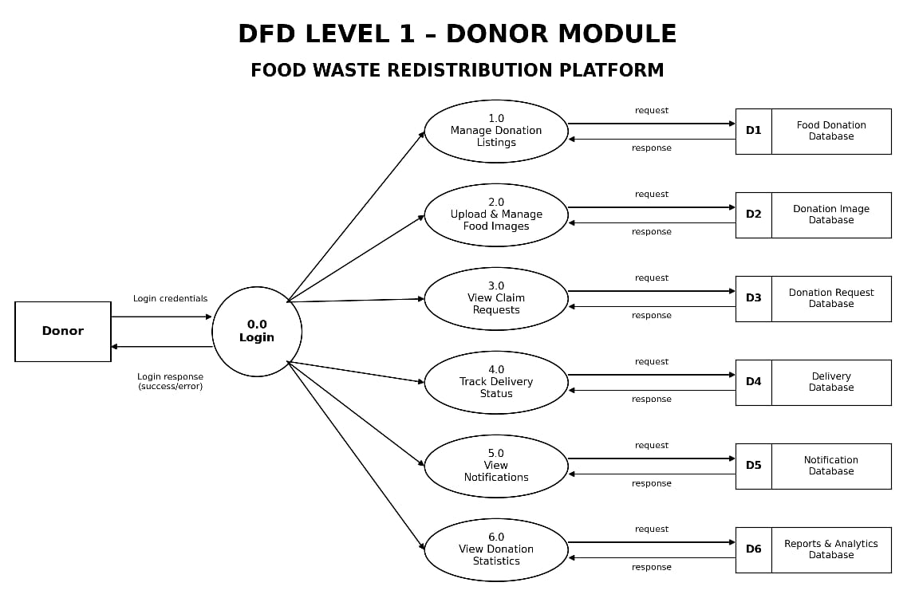
DFD — LEVEL 1

Slide 19
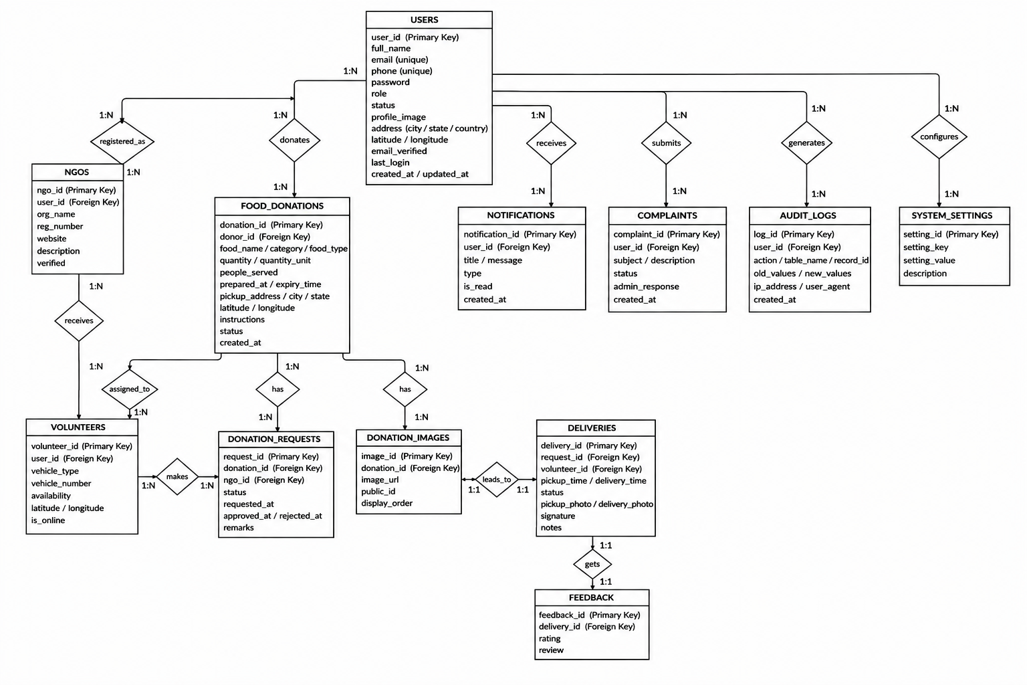
ER DIAGRAM

Slide 20
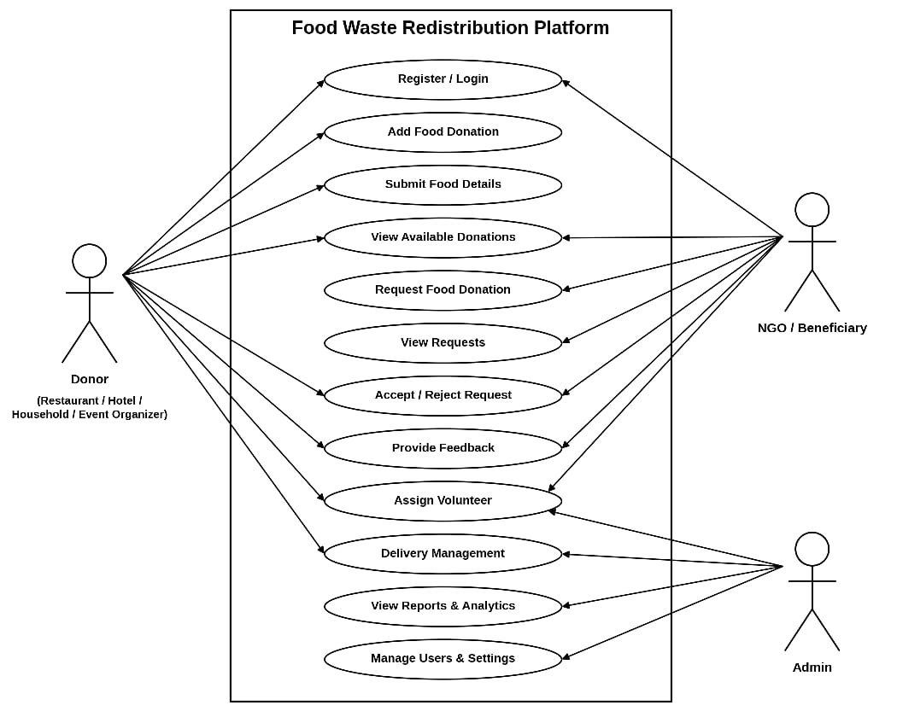
USE CASE DIAGRAM

Slide 21
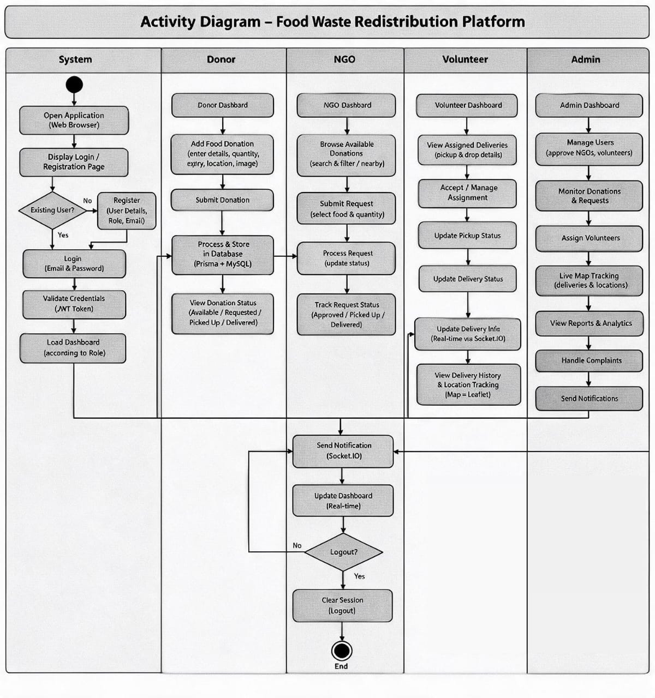
ACTIVITY DIAGRAM

Slide 22
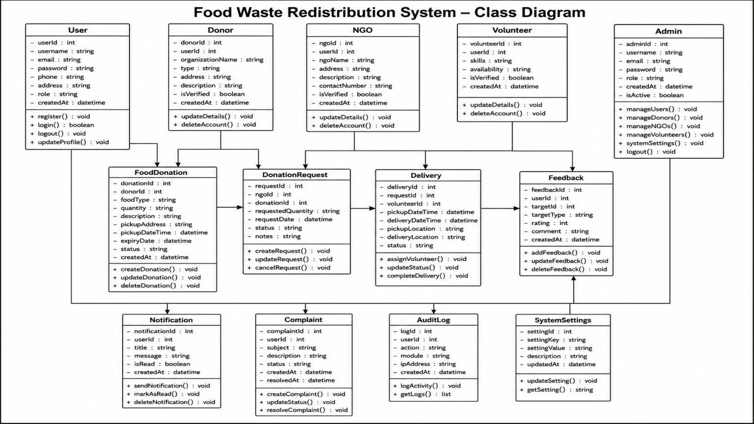
CLASS DIAGRAM

Slide 23
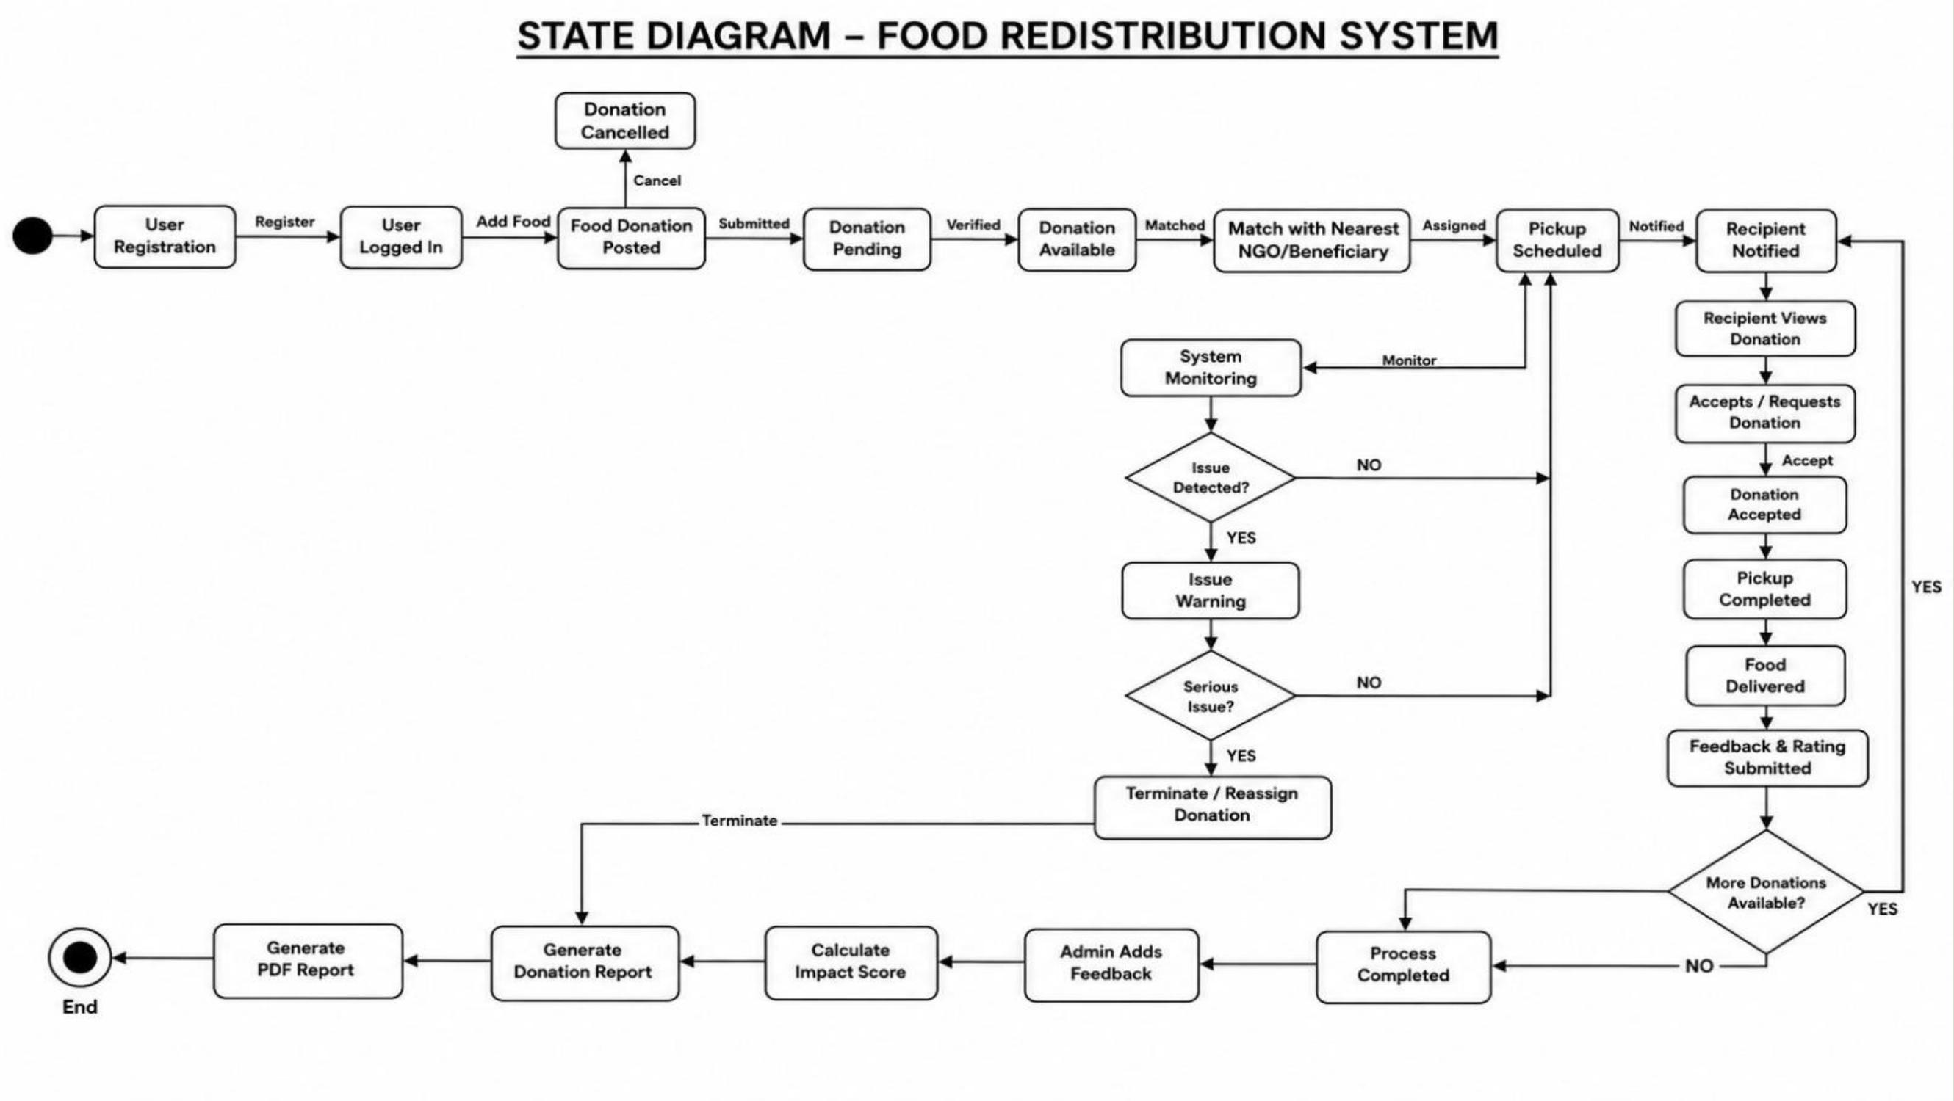
STATE DIAGRAM

Slide 24
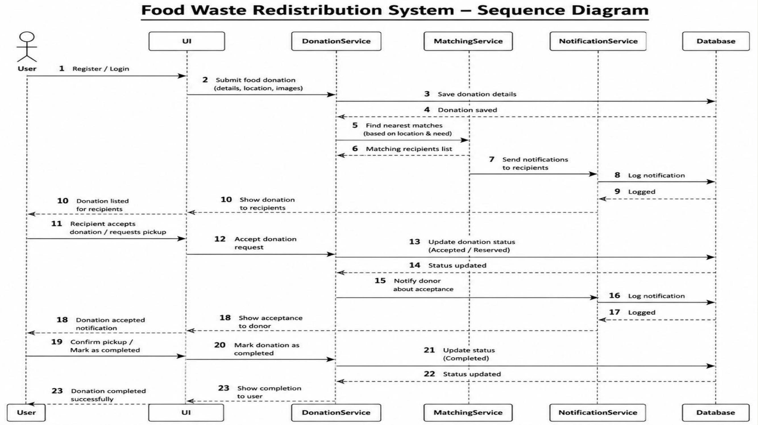
SEQUENCE DIAGRAM

Slide 25

MODULE DESCRIPTION
Admin Module: Manages users, monitors donations, and views reports.
Donor Module: Allows donors to upload surplus food details and track donations.
NGO Module: Enables NGOs to view available food and request donation.
Volunteer Module: Manages food pickup, delivery, and status updates.

Slide 26
ALGORITHM/METHODOLOGY
Location-Based Matching Algorithm – Finds nearby NGOs and connects them with food donors.
Priority-Based Allocation Algorithm – Prioritizes food distribution based on availability and expiry time.
Greedy Algorithm (if implemented) – Helps select the nearest suitable recipient for quick food delivery.

Slide 27
IMPLEMENTATION
Frontend: React.js for user interface and dashboards.
Backend: Node.js and Express.js for application logic and APIs.
Database: MySQL with Prisma ORM for data storage.
Key Features: User authentication, food donation, NGO requests, volunteer assignment, and delivery tracking.
Integrations: Leaflet maps and Socket.IO for location tracking and real-time updates.

Slide 28
RESULT/ANALYSIS
Successfully connects food donors, NGOs, and volunteers.
Simplifies food donation and request management.
Enables location-based volunteer assignment.
Supports food expiry monitoring and delivery tracking.
Improves coordination and helps reduce food wastage.

Slide 29
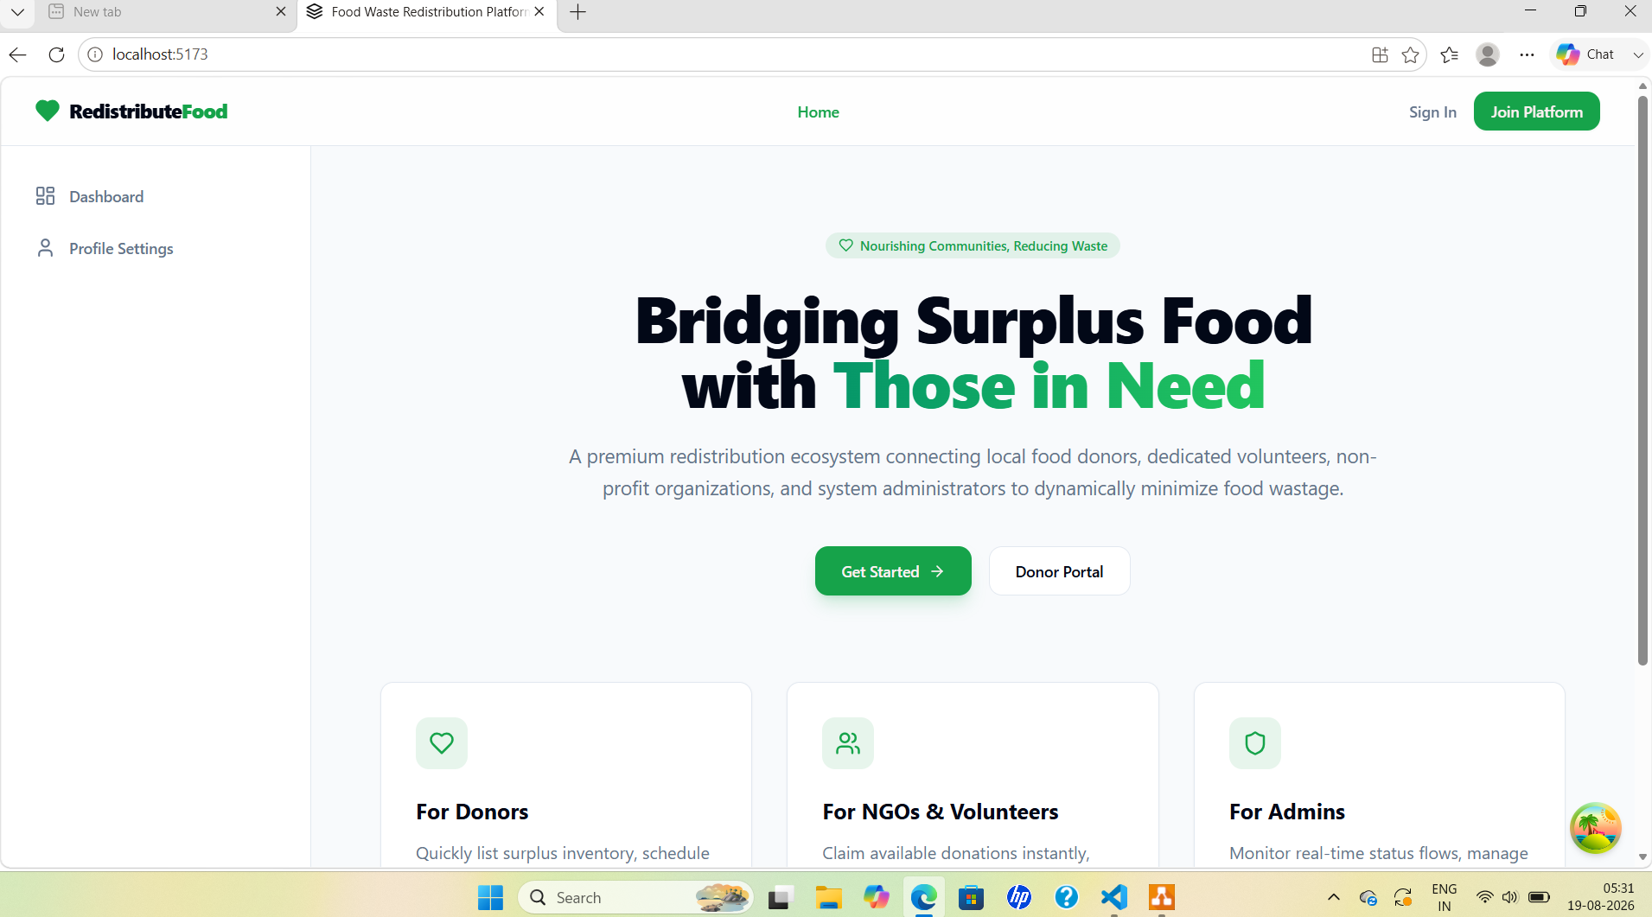

FUTURE SCOPE

Slide 30
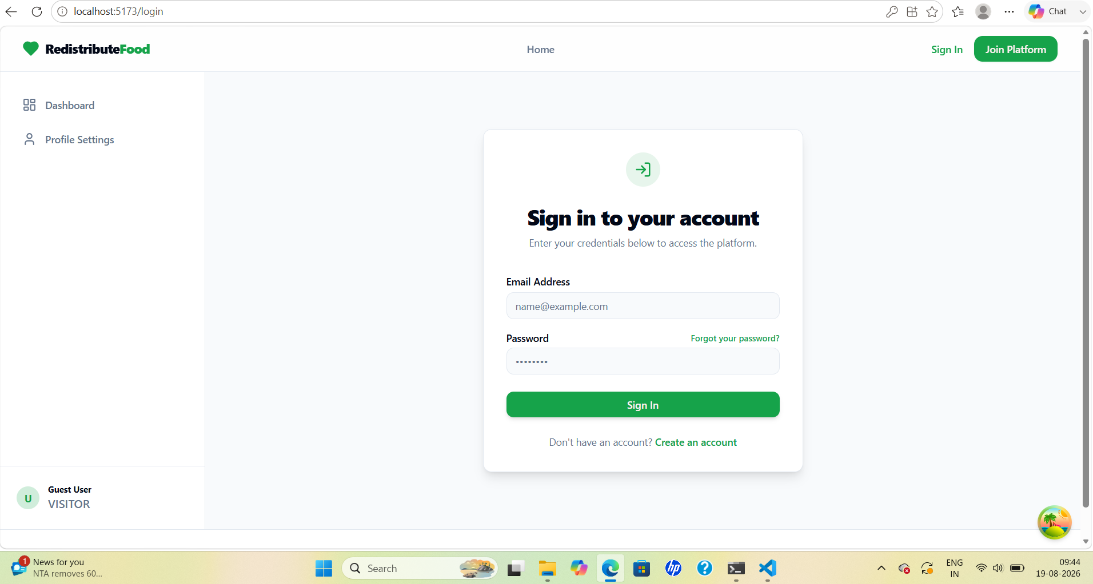
TOOLS AND TECHNOLOGIES
Frontend: HTML, CSS, JavaScript
Backend: Python
Database: MySQL
APIs & Services: Google Maps API (for location-based matching), Notification APIs
Tools: VS Code

Slide 31
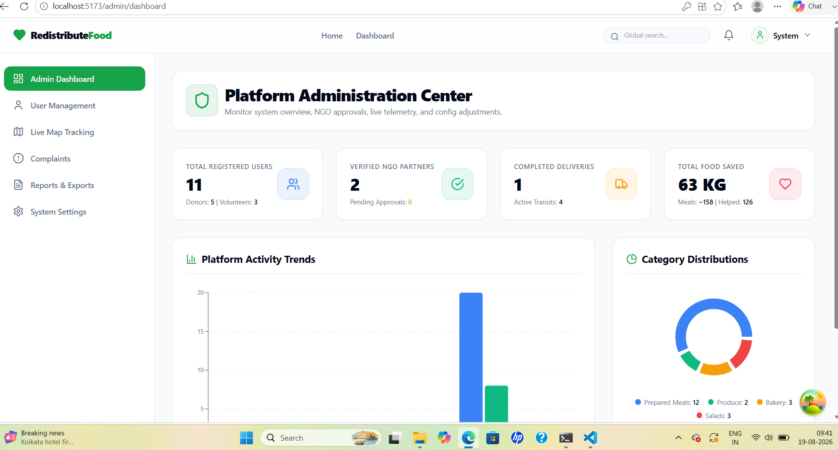
TOOLS AND TECHNOLOGIES
Frontend: HTML, CSS, JavaScript
Backend: Python
Database: MySQL
APIs & Services: Google Maps API (for location-based matching), Notification APIs
Tools: VS Code

Slide 32
COMPARISON WITH EXISTING SYSTEM
Feature | Existing System | Proposed System
Processing | Manual | Automated
Accuracy | More chances of errors | Improved accuracy
Time | Time-consuming | Faster process
Security | Limited access | Secure login
Accessibility | Limited communication | Easy online access
Reporting | Manual records | Digital reports

Slide 33
TESTING
Unit Testing: Tests individual modules.
Integration Testing: Checks the connection between modules.
System Testing: Verifies the complete application.
User Acceptance Testing: Ensures the system meets user requirements.
Test Case | Expected Result | Status
Valid Login | Login successful | Pass
Invalid Login | Error message displayed | Pass
Add Food Donation | Food details saved | Pass
NGO Request | Request submitted successfully | Pass
Update Delivery Status | Status updated successfully | Pass

Slide 34
ADVANTAGES
Reduces food waste and prevents unnecessary disposal.
Helps provide food to people in need.
Connects donors, NGOs, and volunteers efficiently.
Enables faster food collection and delivery.
Supports location-based matching and tracking.
Improves transparency through real-time updates.
Promotes community welfare and sustainability.

Slide 35
LIMITATION
Requires a stable internet connection.
Depends on timely food pickup and delivery.
Food quality may decrease if distribution is delayed.
Limited availability of volunteers may affect delivery.
Location accuracy depends on GPS and mapping services.
Requires regular monitoring and maintenance.

Slide 36
CONCLUSION
Reduces food waste and prevents unnecessary disposal.
Connects food donors, NGOs, and volunteers.
Enables timely food collection and distribution.
Improves coordination through location-based matching and real-time updates.
Promotes community welfare and environmental sustainability.

Slide 37
FUTURE SCOPE
Develop a mobile application for easier access.
Integrate AI to predict food surplus and demand.
Improve route optimization for faster delivery.
Expand the platform to more cities and communities.
Introduce advanced analytics to monitor food waste reduction.
Collaborate with more NGOs, restaurants, and volunteers.

Slide 38
REFERENCES
Sundin et al. (2022) – Surplus Food Donation: Effectiveness, Carbon Footprint and Rebound Effect.
Oroski & da Silva (2023) – Understanding Food Waste-Reducing Platforms: A Mini-Review.
Sanyal et al. (2021) – Game Theoretic Framework for Surplus Food Distribution.
Food Surplus Redistribution in the European Policy Context (2026)
Systematic Review of Data-Driven Approaches to Food Waste & Loss Management (2025).
Michalis K. (2026) – Digital Technologies and Food Waste: Food Cloud Platform.

Slide 39
THANK YOU

