Slide 1
Microproject: Insertion Sort on Linked Lists
Name: D. Gowri
Roll No: 23ITR048

Slide 2
Problem Description
Implement insertion sort for sorting linked lists.
Compare the time efficiency with the array-based insertion sort.
Analyze the performance and suitability of this approach.

Slide 3
Algorithm Design Technique
Technique Used: Decrease-and-Conquer
- Break the problem into smaller subproblems
- Solve a simpler version and insert the current element
- Repeatedly build the sorted list from the unsorted portion

Slide 4
Appropriate Data Structure
Chosen Data Structure: Singly Linked List
Reasons:
- Efficient insertion at arbitrary positions
- No shifting required as in arrays
- Pointer manipulation enables dynamic memory usage

Slide 5
Input Size
Input: Unsorted singly linked list of n elements
Example Sizes:
- Small: 5 elements
- Medium: 100 elements
- Large: 10,000+ elements

Slide 6
Efficiency Class
Worst Case Time Complexity: O(n²)
Best Case (already sorted): O(n)
Space Complexity: O(1) auxiliary (in-place)
Efficiency is similar to array version but more optimized for linked list insertion.

Slide 7
Sample Input/Output
Input:
5 -> 3 -> 8 -> 1 -> 2 -> None
Output:
1 -> 2 -> 3 -> 5 -> 8 -> None

Slide 8
Sample Code
// Helper for sorted insert
private Node sortedInsert(Node sorted, Node newNode) {
if (sorted == null || newNode.data <= sorted.data) {
newNode.next = sorted;
return newNode;
}
Node current = sorted;
while (current.next != null && current.next.data < newNode.data) {
current = current.next;
}
newNode.next = current.next;
current.next = newNode;
return sorted;
}
}
public class CompareInsertionSort {
// Array Insertion Sort
public static void arrayInsertionSort(int[] arr) {
for (int i = 1; i < arr.length; i++) {
int key = arr[i];
int j = i - 1;
while (j >= 0 && arr[j] > key) {
arr[j + 1] = arr[j];
j--;
}
arr[j + 1] = key;
}
}
import java.util.*;
class LinkedListSort {
static class Node {
int data;
Node next;
Node(int d) {
data = d;
next = null;
}
}
Node head;
// Insert at end
public void insert(int data) {
Node newNode = new Node(data);
if (head == null) head = newNode;
else {
Node temp = head;
while (temp.next != null) temp = temp.next;
temp.next = newNode;
}
}
// Print list
public void printList() {
Node temp = head;
while (temp != null) {
System.out.print(temp.data + " -> ");
temp = temp.next;
}
System.out.println("null");
}
// Insertion Sort for Linked List
public void insertionSort() {
Node sorted = null;
Node current = head;
while (current != null) {
Node next = current.next;
sorted = sortedInsert(sorted, current);
current = next;
}
head = sorted;
}

Slide 9
public static void main(String[] args) {
Random rand = new Random();
int n = 10000;
int[] array = new int[n];
LinkedListSort list = new LinkedListSort();
// Fill both structures with same data
for (int i = 0; i < n; i++) {
int val = rand.nextInt(100000);
array[i] = val;
list.insert(val);
}
// Time array sort
int[] arrayCopy = array.clone();
long startArray = System.nanoTime();
arrayInsertionSort(arrayCopy);
long endArray = System.nanoTime();
// Time linked list sort
long startList = System.nanoTime();
list.insertionSort();
long endList = System.nanoTime();
System.out.println("Time for Array Insertion Sort: " + (endArray - startArray) / 1_000_000.0 + " ms");
System.out.println("Time for Linked List Insertion Sort: " + (endList - startList) / 1_000_000.0 + " ms");
}
}

Slide 10
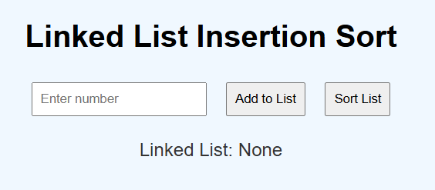
Output

Slide 11
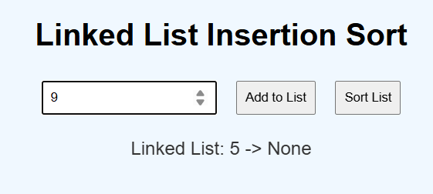
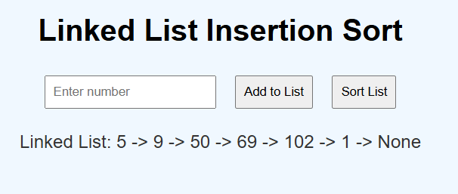
Input

Slide 12
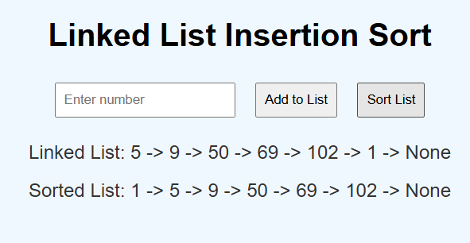
Final Output

Slide 13
Thank you

