Slide 1



SMARTPCB-XAI: A Dual-Head Deep Learning Framework for Explainable PCB Inspection, Deterministic Quality Auditing, and Digital Twin Synthesis
PROJECT MEMBERS
ABISHA REBEKKAL T – 23ITR001
GOWRI D – 23ITR048
PROJECT GUIDE
Ms. M. E. PRATHIKA
ASSISTANT PROFESSOR / DEPARTMENT OF IT
KONGU ENGINEERING COLLEGE

Slide 2
Objectives
• Develop an intelligent PCB inspection platform using YOLOv11-based computer vision.
• Detect PCB components and manufacturing defects from inspection images.
• Provide visual AI explanations for defect predictions using an XAI heatmap.
• Calculate a deterministic project-defined defect severity and PCB quality score.
• Generate possible-cause and repair recommendations using a rule-based knowledge base.
• Provide Digital Twin visualization, inspection analytics, and PDF/Excel reports.
• Integrate the AI service, backend, frontend, database, and feedback workflow into one Industry 4.0 platform.

Slide 3
Introduction
Manual PCB inspection is time-consuming, subjective and prone to human error.
Existing AI-based inspection methods mainly focus on detecting components or defects, with limited explanation and decision support.
SmartPCB-XAI is proposed as an intelligent PCB inspection platform combining:
  AI-based component and defect detection
  Explainable AI (XAI)
  Severity and PCB quality assessment
  Possible-cause and repair recommendations
  Real-time inspection dashboard and reporting
The system aims to support faster, consistent and explainable PCB quality inspection for Industry 4.0.

Slide 4
Literature Review
S.No | Title of the Paper | Algorithm / Methodology | Limitation / Research Gap
1 | FICS-PCB: A Multi-Modal Image Dataset for Automated PCB Visual Inspection (2020) | FICS-PCB dataset; multimodal PCB component inspection | Dataset diversity and domain variation remain challenges
2 | On-line PCB Defect Detector on a New PCB Defect Dataset (DeepPCB, 2019) | DeepPCB benchmark; six PCB defect categories | Detection-focused; no integrated XAI or repair guidance
3 | Few-Shot Adaptation of Foundation Vision Models for PCB Defect Inspection (2025) | Few-shot learning + foundation vision models | Requires adaptation for different PCB types
4 | PCB Defect Detection Algorithm Based on CDI-YOLO (2024) | YOLOv7-tiny + Coordinate Attention | Still depends on labelled training data
S.NO | TITLE OF THE PAPER | JOURNAL NAME,YEAR | ALGORITHM/ METHODOLOGY | LIMITATIONS
1. | Few-Shot Adaptation of Foundation Vision Models for PCB Defect Inspection | MDPI (2025) | Few-Shot Learning + Foundation Models | Needs adaptation for different PCB types
2. | PCB Defect Detection Algorithm Based on CDI-YOLO | Scientific Reports (2024) | YOLOv7-tiny + Coordinate Attention | Still requires labeled dataset
3. | Improved PCB Defect Detection Scheme (PD-YOLOv8) | Scientific Reports (2025) | YOLOv8 + ECANet Attention | Focus only on defect detection

Slide 5
Literature Review
S.No | Title of the Paper | Algorithm / Methodology | Limitation / Research Gap
5 | Improved PCB Defect Detection Scheme – PD-YOLOv8 (2025) | YOLOv8 + ECANet attention | Focuses mainly on defect detection
6 | Enhanced YOLOv11 Framework for PCB Defect Detection (2025) | Advanced YOLOv11-based framework | Higher model complexity
7 | YOLO-HDEW: Efficient PCB Defect Detection Model (2025) | YOLOv8 + enhanced detection architecture | Limited to defect detection
8 | A Lightweight PCB Defect Detection Algorithm Based on an Improved YOLOv11s (2026) | EfficientViT + PConv/EMA + Inner-Wise-IoU | Optimized for defect detection; does not provide the full inspection + XAI + analytics workflow
Research Gap: Existing studies largely isolate detection; SmartPCB-XAI integrates detection, explanation, severity, recommendations, analytics and reporting.

Slide 6
Summary of Literature Review
Area | Existing Research | Limitation Identified
PCB Datasets | FICS-PCB, DeepPCB | Dataset diversity and labelling challenges
YOLO-based Detection | YOLOv5, YOLOv7, YOLOv8, YOLOv11 | Mainly focuses on detection accuracy
Attention-based Models | Coordinate Attention, ECANet | Increased model complexity
Lightweight Detection | Improved YOLO variants | Accuracy/complexity trade-off
Foundation Models | Few-shot / foundation vision models | Requires adaptation to different PCB types
Explainable AI | Grad-CAM / Grad-CAM++ approaches | Explanation is often separate from complete inspection workflow

Slide 7
Problem Description
• Manual PCB inspection is slow, subjective and affected by operator fatigue.
• Industrial AOI systems can be costly and may generate false alarms.
• Many AI inspection models stop at defect/component localization.
• A detection result alone does not explain why the model made the decision.
• Severity, board-level quality and actionable repair guidance are often separated from detection.
Need for an Integrated Smart Inspection Platform
• Component + defect detection
• Explainable AI output
• Severity and quality scoring
• Possible-cause and repair recommendations
• Digital Twin + analytics
• Automated PDF / Excel reporting

Slide 8
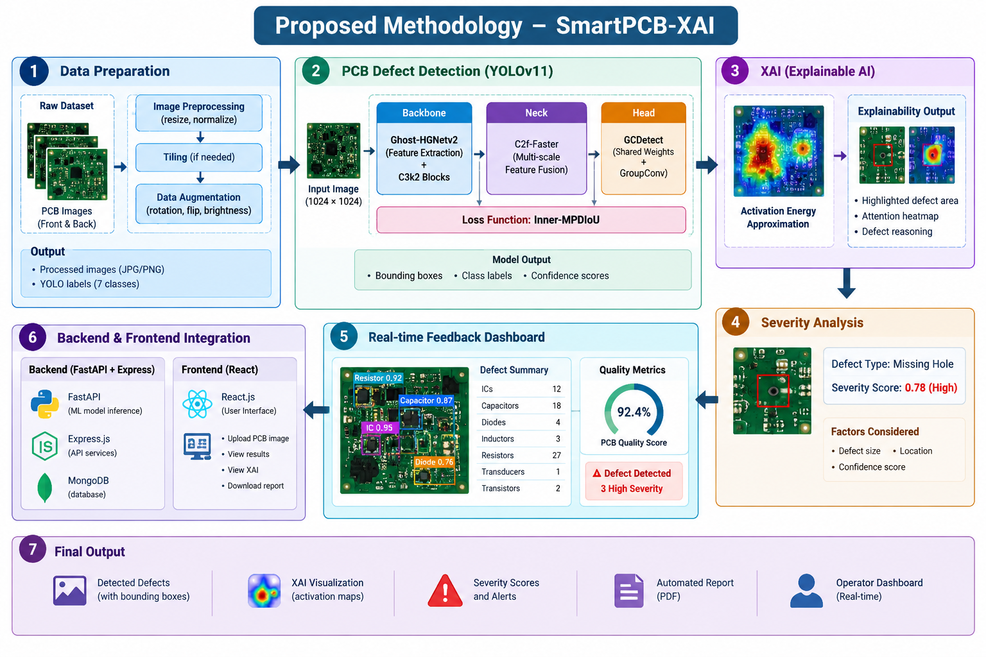

Slide 9
Software / Tools Used
AI / Computer Vision
Platform / Development
• Python 3 + PyTorch
• Ultralytics YOLOv11s
• OpenCV + Pillow + NumPy
• CLAHE preprocessing
• High-resolution tiled inference + NMS
• XAI: activation-energy heatmap approximation
• DeepPCB + FICS-PCB based datasets
• FastAPI – AI inference service
• Node.js + Express – backend
• MongoDB – inspection / feedback data
• React + TypeScript + Vite + TailwindCSS
• ReportLab – PDF reports
• OpenPyXL – Excel reports
• Git / Kaggle GPU workflow

Slide 10
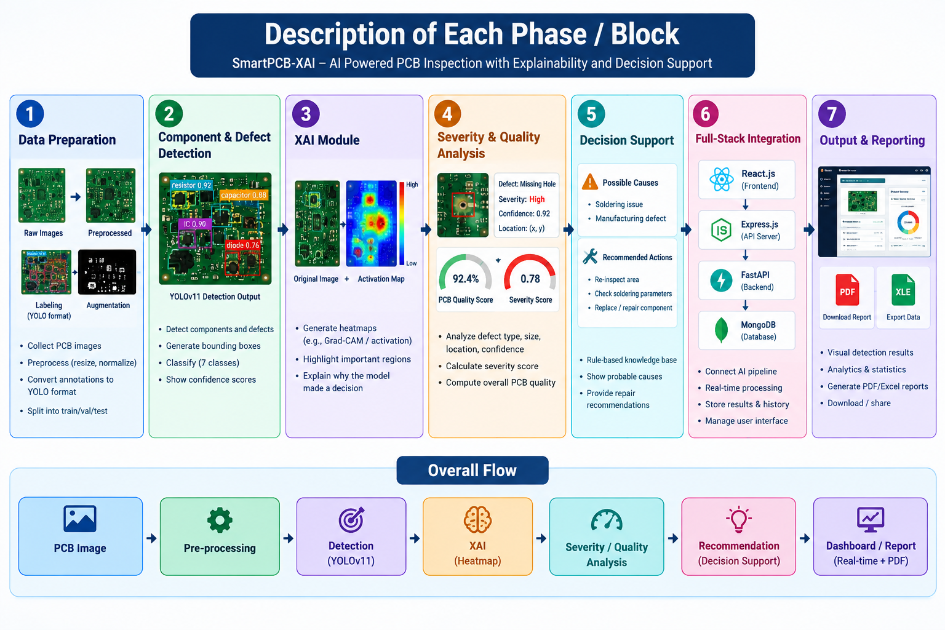
Description of Each Phase/Block

Slide 11
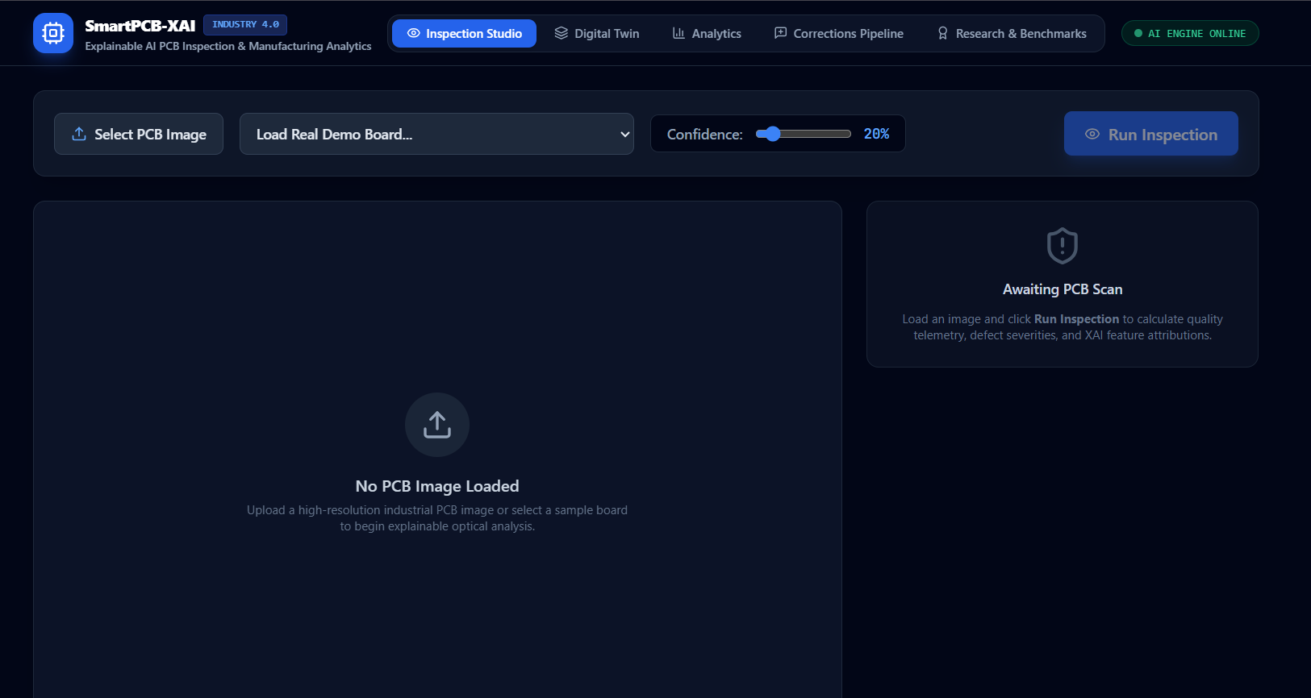
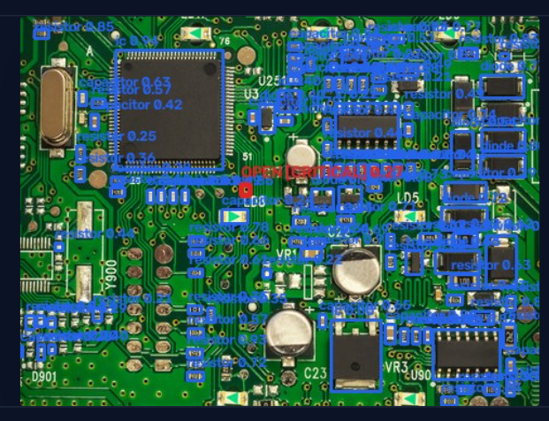
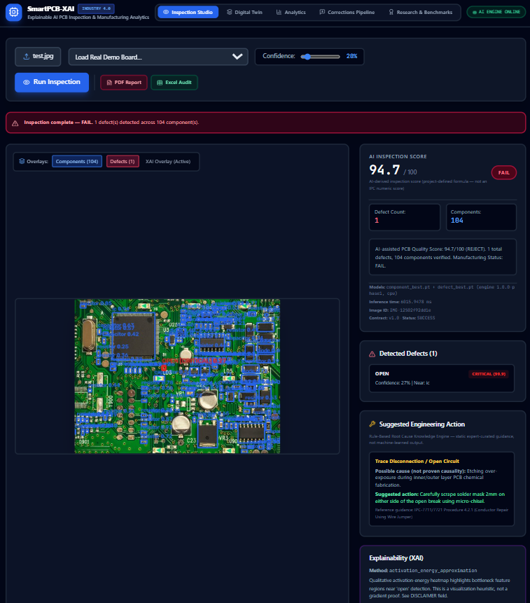
Screenshots

Slide 12
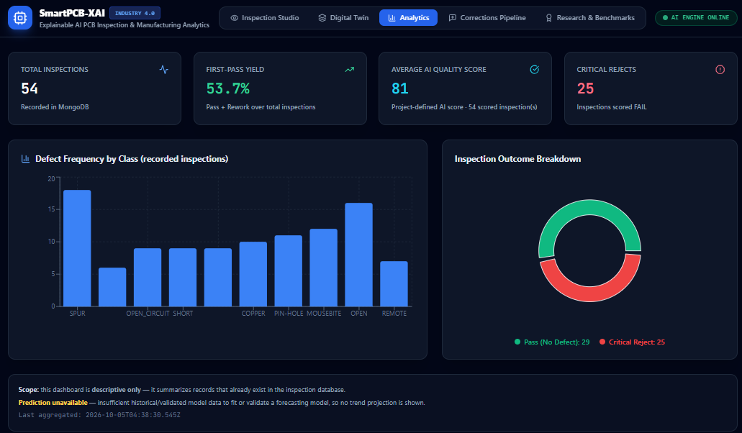
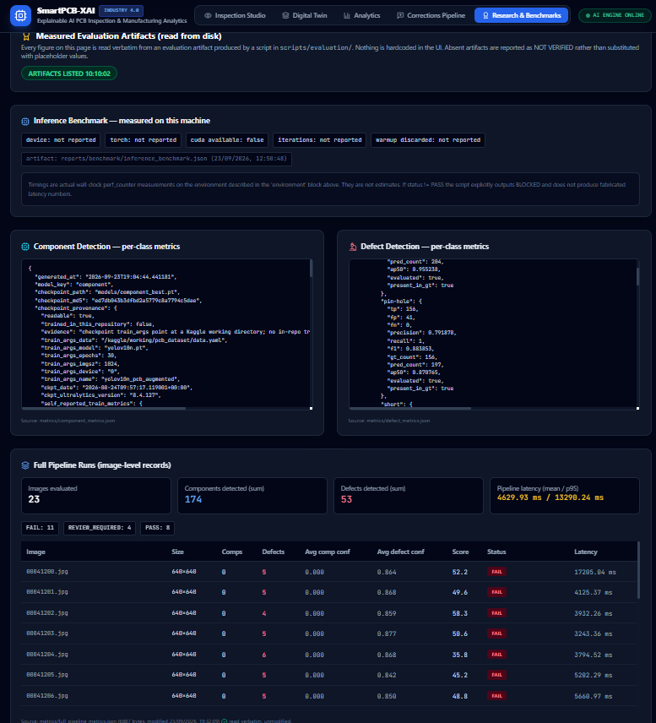
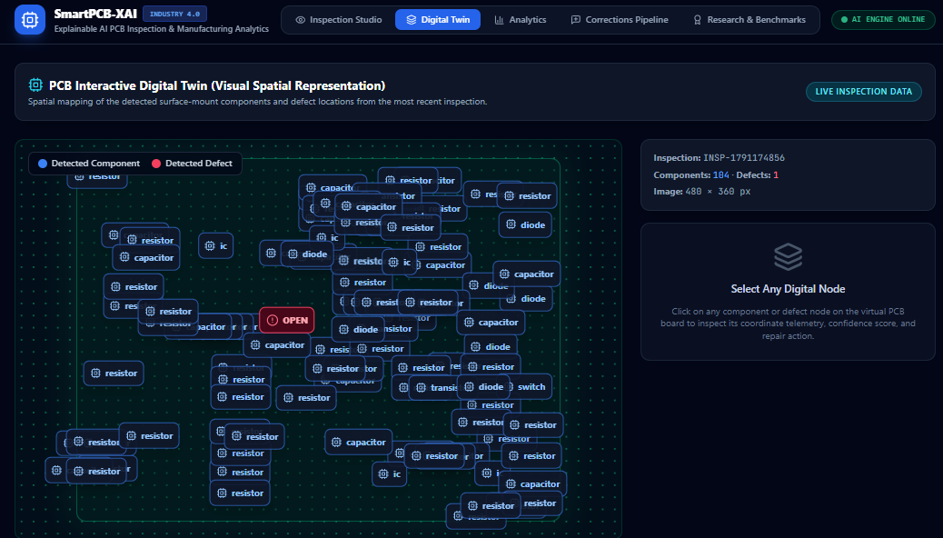

Slide 13
SUSTAINABLE DEVELOPMENT GOALS (SDGs)
SDG 9
INDUSTRY, INNOVATION
AND INFRASTRUCTURE
Smart manufacturing,
AI-based inspection and
Industry 4.0 integration.
SDG 12
RESPONSIBLE CONSUMPTION
AND PRODUCTION
Early defect detection
reduces rework, scrap and
avoidable production loss.
SDG 8
DECENT WORK AND
ECONOMIC GROWTH
AI assists engineers with
consistent inspection,
analytics and decision support.
Primary alignment: SDG 9 and SDG 12

Slide 14
References
• [1] B. Shakya et al., “FICS-PCB: A multi-modal image dataset for automated PCB visual inspection,” IEEE TVLSI, 2020.
• [2] S. Tang et al., “On-line PCB defect detector on a new PCB defect dataset,” arXiv:1902.06197, 2019.
• [3] R. R. Selvaraju et al., “Grad-CAM: Visual explanations from deep networks via gradient-based localization,” ICCV, 2017.
• [4] A. Chattopadhay et al., “Grad-CAM++: Generalized gradient-based visual explanations,” WACV, 2018.
• [5] Ultralytics, “YOLOv11: State-of-the-Art Real-Time Object Detection,” 2024.
• [6] IPC, “Acceptability of Electronic Assemblies (IPC-A-610G),” 2017.
• [7] F. Tao et al., “Digital twin in industry: State-of-the-art,” IEEE TII, 2019.
• [8] X. Ye et al., “A Lightweight PCB Defect Detection Algorithm Based on an Improved YOLOv11s,” IEEE Access, 2026, DOI: 10.1109/ACCESS.2026.3678967.

Slide 15
Thank you

