Slide 1


ResumeProjectChallenge 17 – Media Survival Analysis
Domain: Media/Broadcasting
Presented By:
Gowri Abbigeri

Slide 2
Bharat Herald
Bharat Herald is a 70-year-old regional newspaper facing declining print circulation.
Pandemic accelerated the shift toward digital news consumption.
Competitors have gained audience share with mobile-friendly formats.
Advertiser confidence has dropped in key cities and categories.
The company needs a data-driven digital transition plan to regain relevance and revenue.

Slide 3
Analysis & Insights Overview
Ad-hoc Analysis
Power BI Dashboard
Primary and Secondary Analysis
Recommendations

Slide 4

Business Request 1: Monthly Circulation Drop Check
Objective: Identify the top 3 months between 2019–2024 where any city experienced the sharpest decline in newspaper circulation. This helps spotlight operational or market shifts that may require strategic attention.
Results:
Varanasi appears twice, suggesting a recurring circulation challenge—possibly seasonal or market-driven.
Jaipur’s drop in early 2020 may correlate with broader disruptions (e.g., pandemic onset).

Slide 5
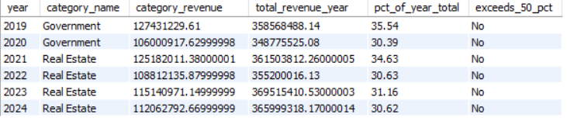
Business Request 2: Yearly Revenue Concentration by Category
Objective:
Identify ad categories that contributed more than 50% of the total yearly ad revenue between 2019 and 2024. This helps pinpoint dominant revenue drivers and assess dependency risks.
Results:
No category exceeded 50% in any year—indicating a diversified revenue mix.
Real Estate dominated from 2021 onward, consistently contributing over 30%.
Government was the top contributor in 2019–2020, but its share declined.
This suggests a shift in advertiser focus from public sector to private real estate investments post-2020.

Slide 6
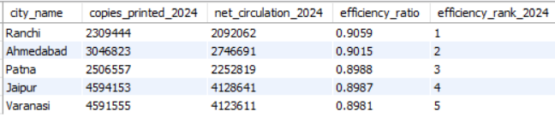
Business Request 3: 2024 Print Efficiency Leaderboard
Objective:
Rank cities by print efficiency in 2024, calculated as: Efficiency Ratio = Net Circulation / Copies Printed. This helps identify cities that maximize distribution with minimal waste.
Results:
Ranchi leads with the highest efficiency—over 90.5% of printed copies reached readers.
The top 5 cities all hover near the 90% mark, showing strong operational control.
Minimal variance between ranks 3 to 5 suggests consistent performance across regions.

Slide 7
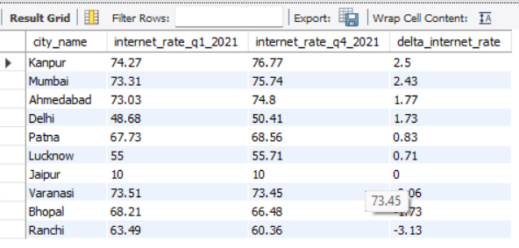
Business Request – 4 : Internet Readiness Growth (2021)
Objective:
We’re looking at how internet penetration evolved across ten Indian cities from Q1 to Q4 of 2021. The key metric is:
Δ Internet Rate = Q4 Rate − Q1 Rate
Results:
Kanpur recorded the highest improvement in internet penetration, with a +2.50 point increase from Q1 to Q4.
Delhi showed strong growth (+1.92), despite starting from a lower baseline—indicating rapid digital catch-up.
Jaipur remained flat (0.00), signaling stagnation or lack of new internet initiatives during the year.
Ranchi experienced the largest decline (−3.13), suggesting possible infrastructure or adoption challenges.

Slide 8
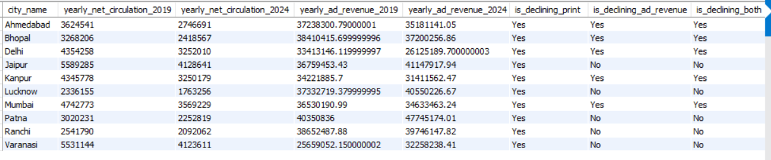
Business Request – 5: Consistent Multi-Year Decline (2019→2024)
Objective:
Cities where both newspaper net circulation and ad revenue have shown a strictly decreasing trend every year from 2019 to 2024.
Results:
Ahmedabad, Bhopal, Delhi, Mumbai, Patna, Ranchi. These cities meet the strict criteria for multi-year decline in both print circulation and ad revenue
Jaipur, Kanpur, Lucknow, Varanasi
These cities do not meet the criteria for consistent multi-year decline in both metrics.

Slide 9
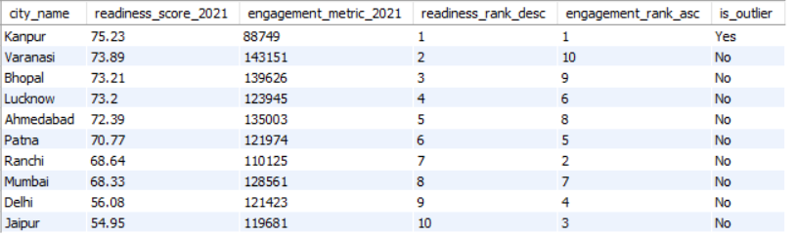
Business Request – 6 : 2021 Readiness vs Pilot Engagement Outlier
Objective:
City that ranks highest in digital readiness but falls into the bottom 3 for digital pilot engagement in 2021.
Results:
Kanpur is the city with the highest digital readiness score in 2021 but underperformed in pilot engagement, making it a flagged outlier.
Varanasi is the 2nd highest readiness, 2nd lowest engagement.

Slide 10
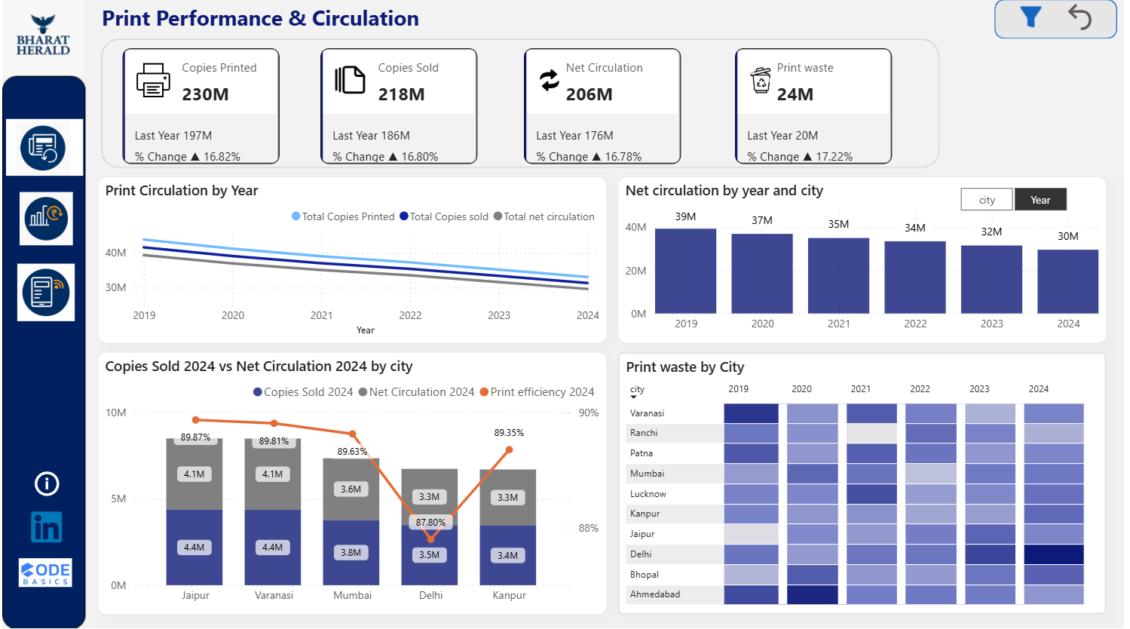

Slide 11
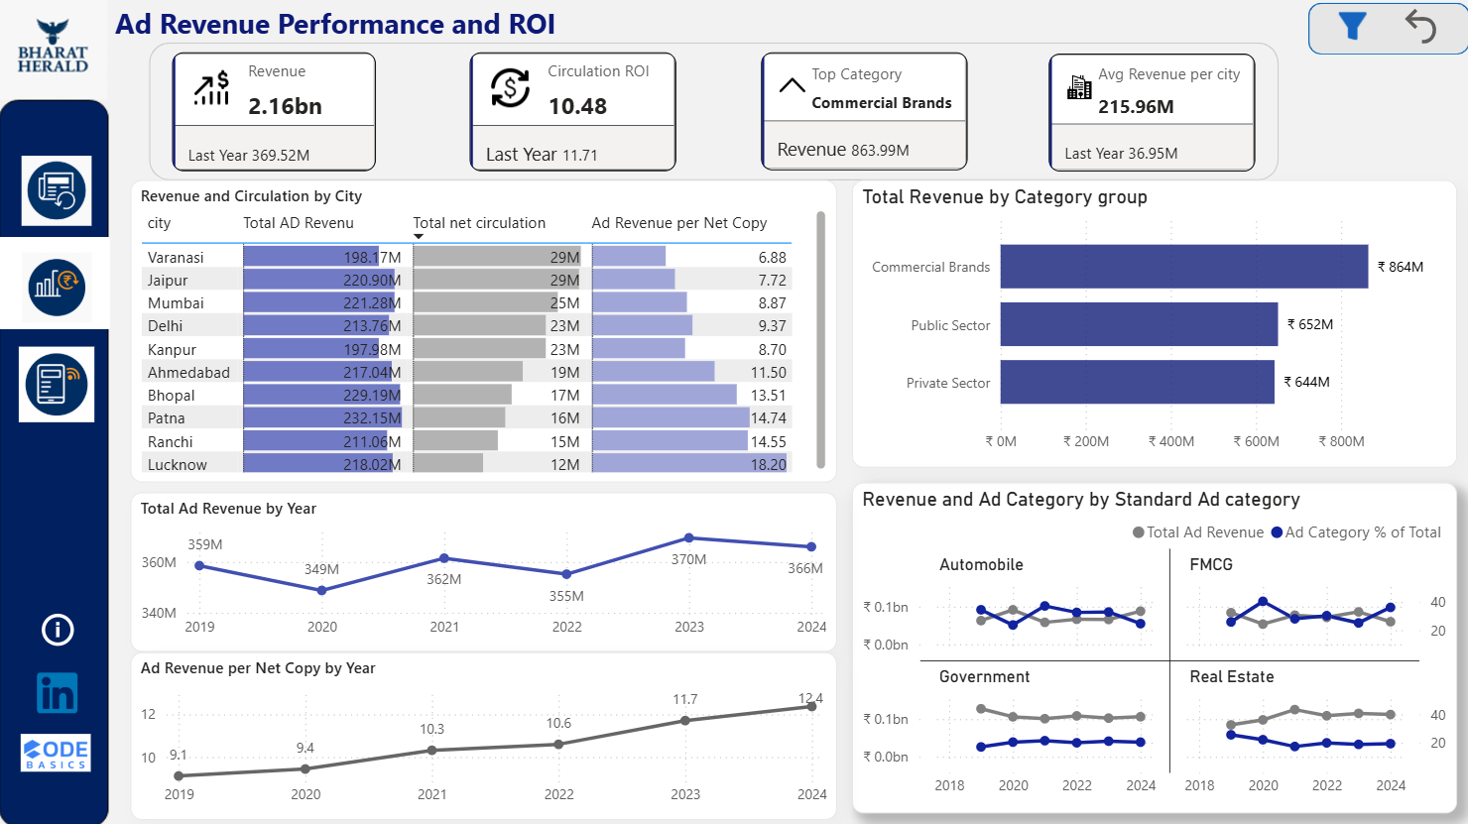

Slide 12
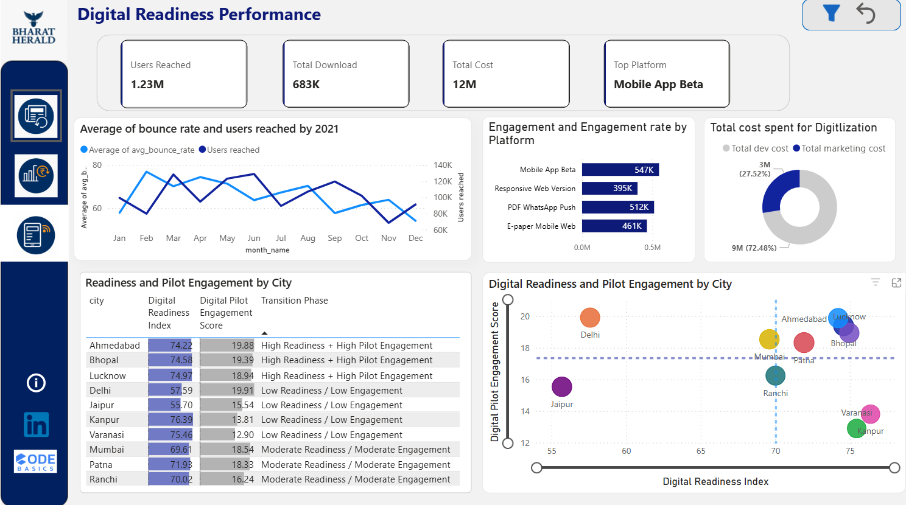

Slide 13
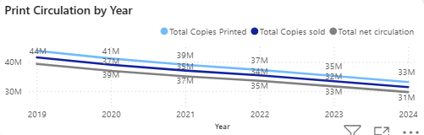
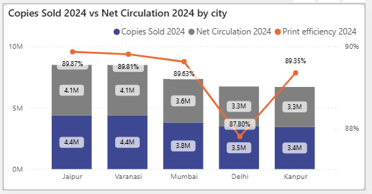
Print Circulation Trends
Printed, sold, and circulated copies all declined year-over-year.
Reflects growing preference for digital media.
Printed copies fell from 44M to 33M; sold from 41M to 31M.
Net circulation stabilizes at 31M in 2024.
To Performing Cities in 2024
This chart shows the Top 5 cities in print circulation for 2024.
Jaipur shows best print efficiency at 89.87% indicating strong circulation and leads with 4.4M copies sold.
Delhi Lags: Lowest efficiency at 87.80%, with a smaller gap between sold and circulated.
Consistent Ratios: Most cities maintain ~89% efficiency, showing stable operational performance.

Slide 14
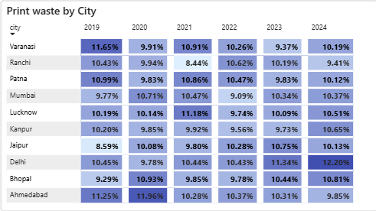
Print Waste Analysis
Delhi shows a sharp upward trend, rising from 9.91% (2019) to 12.20% (2024)—highest in the dataset.
Ahmedabad peaked in 2020 (11.96%), then gradually declined, suggesting effective waste control measures.
Varanasi and Patna remain consistently high, averaging around 10.5%, with minimal year-to-year variation.
Bhopal and Mumbai maintain low and stable waste levels, indicating efficient print management.
Jaipur and Kanpur show a gradual increase, especially post-2022—potential areas for intervention.
Cities with rising waste trends (e.g., Delhi, Jaipur) may benefit from targeted audits and digital transition initiatives.
Stable performers like Mumbai and Bhopal could serve as benchmarks for best practices in print management.
The overall range across cities is narrow (8.4%–12.2%), but even small improvements can lead to significant cost and sustainability gains

Slide 15
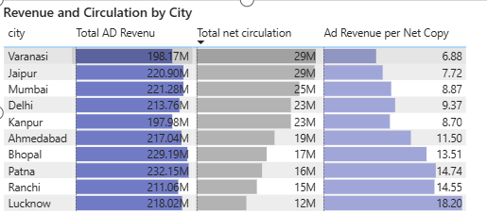
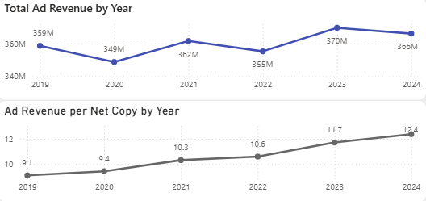
City-Level Ad Revenue Performance
Lucknow tops efficiency ₹18.18 per copy with lowest circulation (12M).
Ranchi & Patna Strong revenue per copy (₹16.54, ₹14.51) despite smaller reach.
Mumbai & Delhi High total revenue (~₹220M) but moderate efficiency (~₹8.9).
Ahmedabad & Bhopal Punching above weight with ₹11.50+ per copy.
High revenue per copy signals premium ad strategy or niche targeting.
Ad Revenue and ROI Performance by Year
Total ad revenue peaked in 2023 at ₹370M; overall trend is stable with minor dips.
Revenue per net copy surged from ₹9.1 (2020) to ₹12.4 (2024)—a 36% increase in monetization efficiency.
2020 dip recovered strongly, signaling improved pricing strategy and audience targeting.

Slide 16
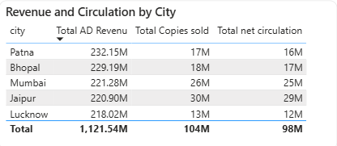
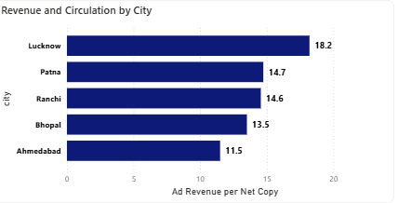
City-Level Ad Revenue Performance
Across the top five cities, ad revenue and print circulation move broadly in the same direction. Cities like Jaipur and Mumbai, which have higher net circulation (29M and 25M respectively), also show relatively high ad revenues (₹220M–₹221M).
Conversely, cities with lower circulation, such as Lucknow (12M), generate slightly lower ad revenues (₹218M).
This indicates a moderate positive correlation between circulation and ad revenue — as circulation increases, ad revenue also tends to increase.
Top cities with Circulation ROI
Lucknow leads with ₹18.2 per copy—highest ROI despite lowest circulation.
Patna & Ranchi follow closely at ₹14.7 and ₹14.6—strong monetization from lean distribution.
Bhopal & Ahmedabad show solid returns (₹13.5 and ₹11.5)—efficient ad strategies in mid-tier markets.

Slide 17
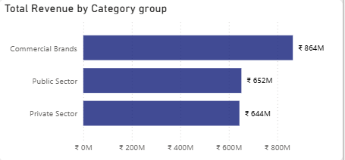
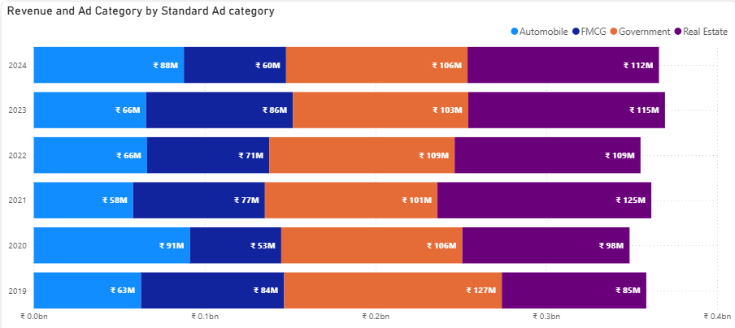
Revenue by Category Group
Commercial Brands dominate with ₹864M—highest revenue contributor.
Public Sector (₹652M) and Private Sector (₹644M) are nearly tied, but trail behind.
Indicates strong brand investment in print media vs institutional spend.
Ad Revenue by Category (2019–2024)
Real Estate & Government consistently lead, peaking at ₹115M+ annually.
Automobile shows volatility, dropping from ₹91M (2020) to ₹66M (2023), then rebounding in 2024.
FMCG remains flat at ₹60M across all years—stable but under-leveraged

Slide 18
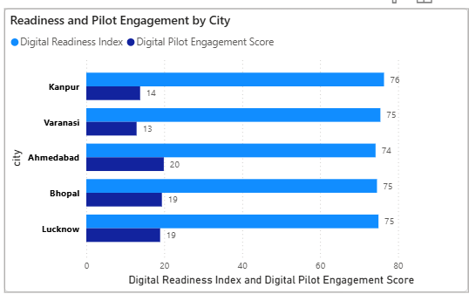
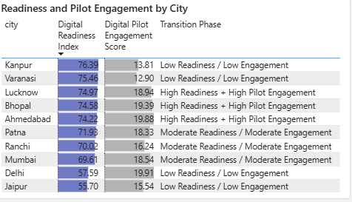
Top cities with Digital Readiness vs Pilot Engagement
Kanpur & Lucknow score highest on readiness (76), but show low pilot engagement (14 & 19).
Ahmedabad stands out with highest engagement (20) despite slightly lower readiness (74).
Gap between readiness and action suggests need for better activation strategies.
Transition Phase Summary
High Readiness + High Engagement: Lucknow, Bhopal, Ahmedabad — ready to scale digital pilots.
Moderate Readiness / Engagement: Patna, Ranchi — emerging potential, needs support.
Low Readiness / Low Engagement: Delhi, Jaipur, Mumbai, Kanpur, Varanasi — foundational work needed.

Slide 19
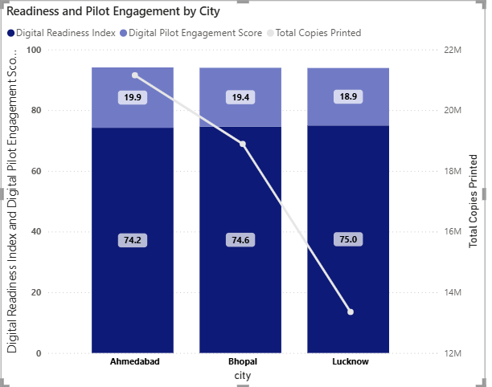
Digital Relaunch City Prioritization
All three cities show high digital readiness and similar pilot engagement. However, print circulation is lowest in Lucknow, indicating the strongest decline and therefore the greatest urgency to transition.
Ahmedabad and Bhopal also show strong readiness and engagement, making them suitable for Phase 1 of the digital relaunch, with Lucknow being the top priority.

Slide 20
Phased Digital Transition – Readiness to Long-Term Growth
Phase 1 – Immediate (0–6 Months)
Focus on high-readiness cities first (pilot programs on Lucknow, Bhopal, Varanasi).
Launch WhatsApp bulletins, mobile-optimized e-paper, flexible subscriptions.
Launch “beta features” like instant notifications & interactive polls
Collect data and feedback to fine-tune before expansion.
Phase 2 – Medium Term (6–18 Months)
Expand digital initiatives to mid-readiness cities.
Strengthen mobile app experience and add personalized news feeds.
Introduce more subscription bundles and loyalty programs.
Phase 3 – Long Term (18–36 Months)
Full digital integration across all regions.
Invest in advanced analytics, AI personalization & video studios.
Launch new monetization streams – podcasts, events, pay-per-article, city-specific premium content.
Consolidate advertiser trust with transparent, city-level performance reports.

Slide 21
Bharat Herald regain advertiser trust in key cities or categories
Use cities like Lucknow, Ranchi, Patna with high ad revenue per copy as case studies to prove campaign effectiveness
From 2019 to 2024, Real Estate and FMCG consistently lead ad revenue across years. Focus on these categories for long-term partnerships, while revitalizing Automobile with fresh formats (e.g., interactive ads, regional showcases) to reverse its plateau.
Reward repeat clients with priority placements, bundled packages, and exclusive access to high-engagement zones

Slide 22
Content Format or Delivery Changes to Boost Engagement
Feedback shows users love WhatsApp format but complain about load times and font size on mobile web.
Bounce rates are highest where content loads slowly or isn’t optimized.
Mobile-first e-papers: reduce file size, optimize images.
Micro-content delivery: short bulletins, notifications, reels/short videos.
Personalized push notifications by city or category.
Test lighter progressive web apps for low-bandwidth regions.

Slide 23
Subscription Bundling, Loyalty, Pay-per-Article Models for Revenue Recovery
High-engagement users on Mobile App Beta and WhatsApp Push are likely to pay for premium content or ad-free experiences.
Pay-per-article works for occasional readers; bundles for loyal ones.
Pilot bundles: News + Local + Lifestyle + Podcasts at one price.
Introduce a loyalty program: reward repeat readers with credits, discounts, early access.
Offer micropayments/pay-per-article for casual users — no barrier to entry.

Slide 24
Leverage Local Influencers or Journalists to Re-establish Credibility
Engagement is often highest in cities with strong local identity.
People trust local voices more than corporate brands.
Identify top 3–4 high-engagement cities.
Partner with local journalists, bloggers, radio hosts to co-create content.
Feature them prominently on your platforms — “By [Local Voice]” branding.
Run city-level newsletters or WhatsApp channels curated by local experts.

Slide 25
The Times of India Group (India) Challenges:
Diversified print + digital brands, high mobile consumption in India.
What they did:
TOI+ (premium digital subscription) for ad-free experience and exclusive articles.
Strong mobile app push with city-specific notifications.
Experimented with WhatsApp bulletins and audio news for regional markets.
Result:
Growing digital subscriber base in metros.
Advertisers attracted to high-value urban audiences.
The New York Times (US) Challenges:
Declining print revenue and subscription base.
Needed to rebuild advertiser confidence and attract digital audiences.
What they did:
Subscription Bundling: Digital + Cooking + Games + Audio (NYT Audio) to create a sticky ecosystem.
Mobile-first redesign: Faster loading, app push notifications, visually rich stories.
Data-driven personalization: Recommended articles, newsletters.
Influencer-style journalists: Certain columnists and newsletters built loyal followings (like Ezra Klein, The Morning Newsletter).
Result:
More than 10 million digital subscribers by 2023.
Higher engagement per user and steady advertising growth on digital platforms.

Slide 26
THANK YOU

