Slide 1
SVYASA -Basics of Engineering-
Lecture Notes - ALU
By
BANESORI AYEKPAM
Asst. Professor (BTECH)

Slide 2
ALU – Arithmetic Logic Unit
Internal component of CPU or microprocessor
CPU (Central Processing unit – brain of computer) consists of Control Unit, Arithmetic Logic Unit and Memory Unit.
ALU is the mathematical brain in CPU.
While CU decodes instruction and controls operation, ALU performs the actual operation.
Two main operations: Arithmetic and Logic operations.

Slide 3
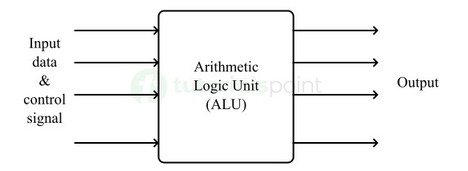
ALU Block Diagram
Receives Input Data from input data path and Control Signals from Control Unit. They specify what to perform.
Execution of the operation once received, selects appropriate functional components among AU, LU, Comparison Unit, Shift Unit to perform specific task.
Notes:
suraj

Slide 4
ALU is a part of each microprocessor chip.
ALU is a digital electronic circuit that performs Arithmetic and Logical operations.
Arithmetic: Addition, Subtraction, Multiplication, Division.
Logical: Comparison (>, <, =, <=, >=), AND, OR, NOT, Bit Shifting, Rotate, etc.
It is also in GPUs (Graphics Processing Unit) which is important for high end computational operations like Gaming, Machine Learning, etc.
ALU consists of different logic gates.

Slide 5
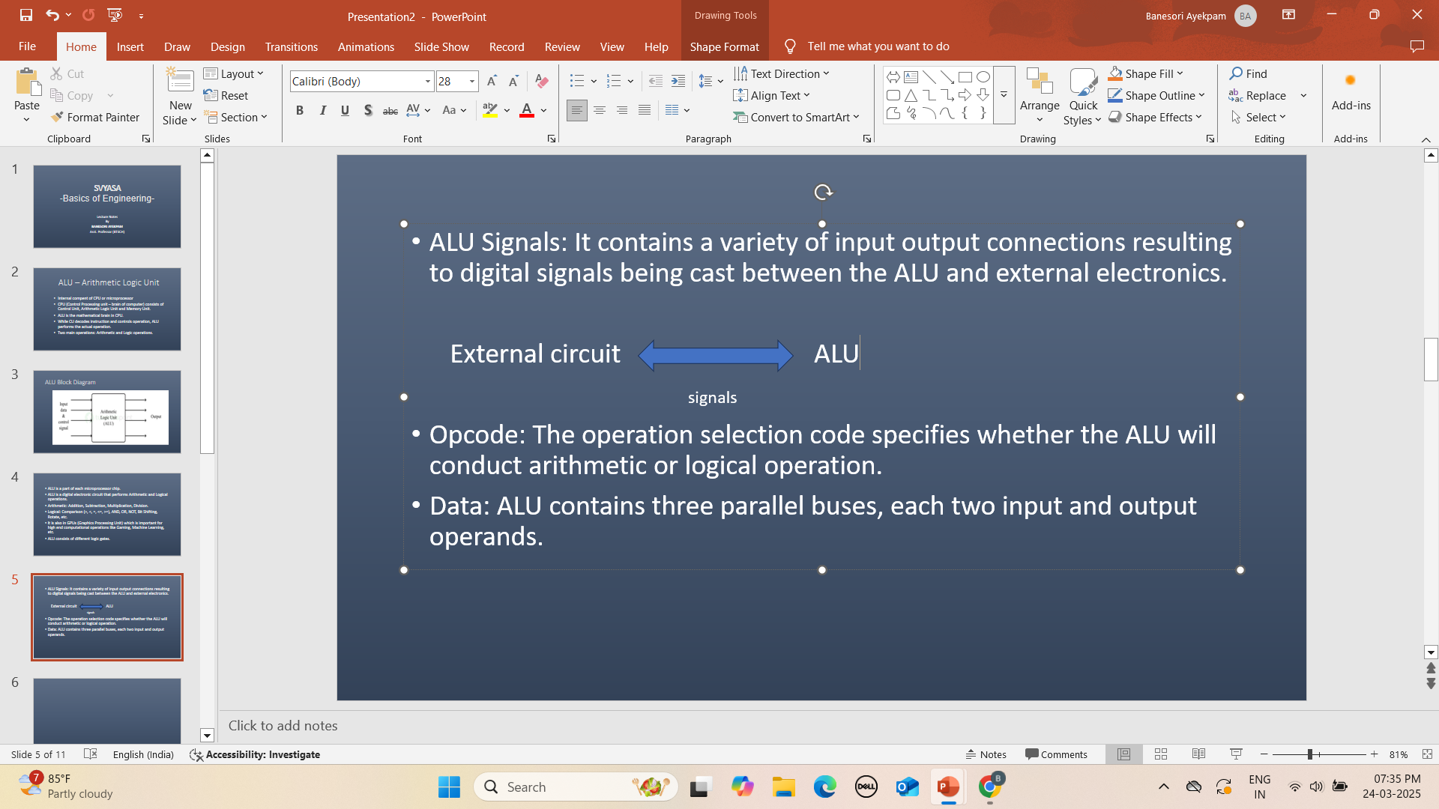
ALU Signals: It contains a variety of input output connections resulting to digital signals being cast between the ALU and external electronics.
Opcode: The operation selection code specifies whether the ALU will conduct arithmetic or logical operation.
Data: Basic ALU contains three parallel buses, two for input operands and one for output result. These buses are incharge of same amount of signals.

Slide 6
Two Main Components of ALU:
Arithmetic Unit :
Adder – Binary adder (addition of two or more binary numbers), half adder, full adder, ripple carry adder, parallel adder.
Subtractor – For subtraction and uses 2’s complement to perform subtraction on binary numbers.
Multiplicator & Divider – For advanced processing techniques like iterative and parallel processing.
Logic Unit : Logic Gates like AND, OR, NOT, NAND, NOR, XOR, XNOR combine to perform complex operations. Also, LU is a Boolean & Comparison operational units.
Note: You can add control circuits, registers, buses and accumulator as components as well. Accumulator is a registor that hold result of ALU operations.

Slide 7
PROS of ALU
High performance parallel architecture and app support.
Ability to carry out instruction on a large no. of items and has a high level precision.
Can combine two arithmetic operations in the same code: A+B*C
Fast rapid result produced swiftly.
Less costly and low no. of logic gates required.
CONS of ALU
Floating variables have higher delays.
If memory space if fixed, bugs would appear in results.
Circuits are complex and principle of pipelining difficult to understand.
Inconsistencies in latencies (delays) are known drawback.
Rounding off which reduces precision.

Slide 8
Functions of ALU:
Arithmetic Operations: Performs mathematical computations like +, - , *, / of binary numbers.
Logical Operations: Decision making and data manipulation using AND, OR, NOT, etc.
Comparison operations: Decision making with =, !=, >, <, etc.
Shift Operations: Manipulation of binary data at bit level to optimize arithmetic calculations with Shift Left, Shift Right operations. This is useful for multiplication and division.

Slide 9
Data Path: ALU + Registers+ Buses
Data Path is the collection of functional units that move data within the processor together.
Register: Small amount of Storage available to the CPU, can be accessed really fast.
Bus: Parallel electrical wires with multiple hardware connection and is a communication system that transfers data between components inside a computer or between computers with protocols inside. Three types – Address Bus, Data Bus, Control Bus.

Slide 10
Address Bus – One way bus, transfers memory address from processor to storage.
Data Bus – Bi-directional and carries data between processor and other components.
Control Bus – Uni-directional, carries control signals from processor to components. Also carries clock pulses.

