Slide 1

Cyber security
Wireless network Security Assessment

Slide 2

Cyber security
What is Cyber Security?
Cybersecurity is the practice of protecting systems, networks, and programs from digital attacks. These cyberattacks are usually aimed at accessing, changing, or destroying sensitive information; extorting money from users via ransomware; or interrupting normal business processes.

Slide 3
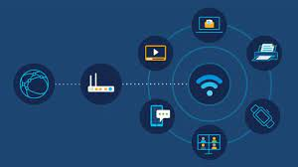
Wireless networking
Wireless networks are computer networks that are not connected by cables of any kind. The use of a wireless network enables enterprises to avoid the costly process of introducing cables into buildings or as a connection between different equipment locations. The basis of wireless systems are radio waves, an implementation that takes place at the physical level of network structure.

Slide 4
Information gathering
This information-gathering process can be both automated and manual and can involve techniques such as port scanning, vulnerability scanning, social engineering, OSINT (open-source intelligence), passive reconnaissance, and active reconnaissance. Information Gathering is the act of gathering different kinds of information against the targeted victim or system.
Email Footprint Analysis.
DNS Information Gathering.
WHOIS Information gathering.
Information Gathering for social Engineering Attacks.
Emerging Trends And Technologies In Information.

Slide 5
Email Footprint Analysis
In this method, a hacker can trace an email and get information from it. Email foot printing gives us information regarding the sender’s email, name, location, IP address, etc. We can use the following tools, among others, for email foot printing Yes ware Polite Mail Read Notify Mail Tracker Pro, etc.
Email foot printing refers to collecting information from emails by monitoring the email delivery and inspecting the headers.
It is also possible to track emails using various tracking tools. Email tracking tools have the capability of tracking emails and inspecting their headers to extract useful information. The sender is notified of the email being delivered and opened by the recipient.
Foot printing is the first step, during which the hacker gathers as much information as possible to find ways to enter a target system. For successful foot printing, the attacker needs to first check the visibility of the target and see how to gather related information on the internet through open sources.
objectives of foot printing are to: Learn security posture Analyze the security posture of the target, find loopholes, and create an attack plan. Identify focus area Using different tools and techniques, narrow down the range of IP addresses.

Slide 6
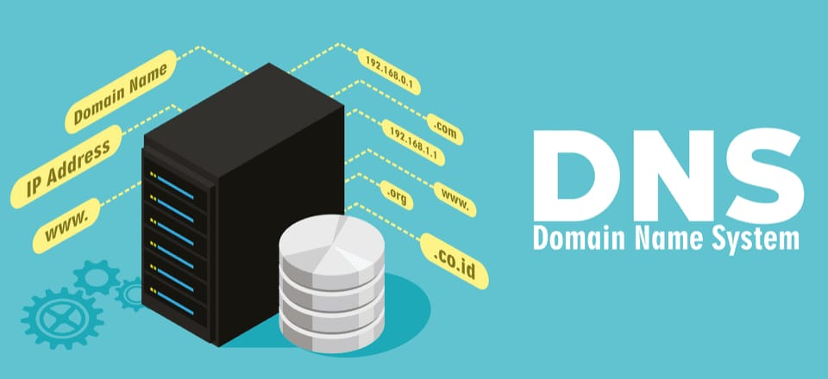
Domain name system
DNS information gathering In sum, the Domain Name System is the protocol that makes the Internet usable by allowing the use of domain names . DNS is widely trusted by organizations, and DNS traffic is typically allowed to pass freely through network firewalls. However, it is commonly attacked and abused by cybercriminals. As a result, the security of DNS is a critical component of network security.
Domains: A domain is a logical group of computers in a large network. ...
Distributed Database: A distributed database is an archive of information about the computers in a network.
Name Servers: A name server contains address information about other computers on the network.

Slide 7
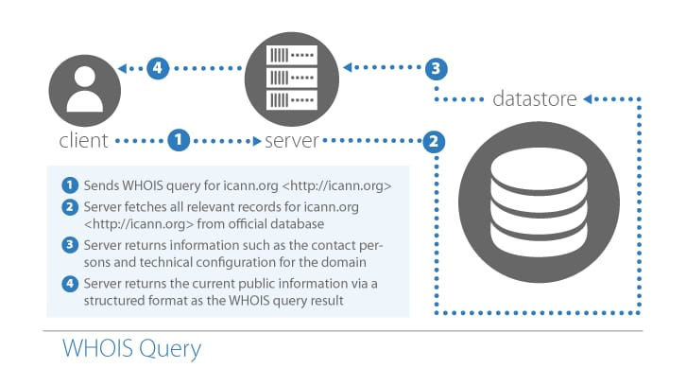
Whois information gathering
WHOIS is a widely used Internet record listing that identifies who owns a domain and how to get in contact with them. The Internet Corporation for Assigned Names and Numbers (ICANN) regulates domain name registration and ownership. Whois records have proven to be extremely useful and have developed into an essential resource for maintaining the integrity of the domain name registration and website ownership process."

Slide 8
Information gathering for engineering attacks
Information gathering plays a crucial part in preparation for any professional social engineering engagement. Information gathering is the most time-consuming and laborious phase of the attack cycle but is often a major determinant of the success or failure of the engagement. The professional social engineer must be aware of if the following:
Information-gathering tools freely available online
Online locations that house valuable pieces of data
Software to aid in finding and collating the data
The value or use of seemly insignificant data which collected online, over the phone, or in-person.
There are many different ways to gain access to information on an organization or individual. Some of these options require technical skills while others require the soft skills of human hacking. Some options are fine to use from any location with internet access. While others can only be done in-person at a specific location. There are options that require no more equipment than a voice, options that only require a phone, and still others that require sophisticated gadgets.

Slide 9
Emerging Trends And Technologies in Information Gathering
In addition to the mentioned tech trends, computing power, big data analytics, extended reality, digital trust, new energy solutions, 5G, and sustainable tech are among the emerging technologies that will give you a competitive advantage.
Technological innovations elevate much of the progress in the corporate industry. The cut-throat competition requires companies to stay tuned with technologies and pursue digital transformation. Suppose you consider incorporating a new piece of software or hardware; the question is not if you should implement it: instead, it is how quickly you should do it!
Adopting new technology is critical for business growth.
Using technology to its full potential will allow you to meet consumer-changing demands.
There are around 5.6 billion internet users worldwide. An online business presence will open the gate to serving more customers.
The Information Technology realm is brutal, to say the least. What you once regarded as a phenomenal solution will become old news in a flash. You must prepare and keep pace with the most recent trends to take the lead in market growth. As numerous products and services continue to shape the digital world, many new technologies wait for their debut to take it by storm.

Slide 10
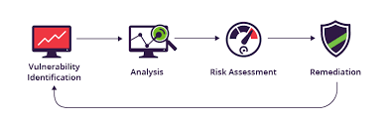
Vulnerability Identification
Vulnerability Identification is vital to proactively protect your IT system rather than reactively cleaning up after an attack. The vulnerability identification process enables you to identify and understand weaknesses in your system, underlying infrastructure, support systems, and major applications.
The four continuous stages of identification, prioritization, remediation, and reporting are essential for an effective vulnerability management process. A vulnerability is a flaw or weakness in a system that, if exploited, would allow a user to gain unauthorized access to conduct an attack.

Slide 11
Identify and Name Each Vulnerability
Identification
The first step to successful vulnerability management is discovering the vulnerabilities that exist within your systems. Because of the sheer volume of vulnerabilities in today’s environments, the most popular way this is done is through vulnerability scanning, which uses automated tools to detect and classify system weaknesses. Vulnerabilities are then mapped to asset inventories so that vulnerabilities can be effectively prioritized based on the assets they impact, and remediation teams can pinpoint the systems that need remediation.
Prioritization
Once vulnerabilities are detected, the next step is to prioritize which ones are the most important to remediate. Modern vulnerability scanning tools will provide suggestions for prioritization based on the Common Vulnerability Scoring System (CVSS) rating of the vulnerability. A vulnerability’s CVSS score is the severity score assigned to it as part of its record in the Common Vulnerabilities and Exposures (CVE) database, a standardized database of known vulnerabilities.
Remediation
Once you have prioritized which vulnerabilities pose a threat to your business, you want to take steps to remediate them. Remediation is taking action to eliminate the vulnerability, such as applying a patch, in the case of third-party software. Remediation is generally the preferred long-term course of action, but it is not always an option, which is where mitigation comes into play.
Reporting
Lastly, you want to make sure that your remediation efforts have worked by conducting a follow-up assessment after actions have been taken. You’ll never be able to completely eliminate all vulnerabilities from your environment, but you do want to have metrics in place for determining the success of your vulnerability management program.

Slide 12
Assign a common Weakness Enumeration code to Each Vulnerability
CWE vulnerabilities are software and hardware systems flaws that lead to security issues if left unattended. The CWE database categorizes over 600 class and base-level weaknesses, with the most severe types listed under CWE Top 25. The database lists vulnerabilities along with their impacts, helps organizations understand the attack surface, and identifies approaches to harden underlying systems.
Out-of-Bounds Write (CWE-787)
This security weakness arises when the application writes data outside the boundaries of an intended input buffer. The weakness may also be caused when the application executes pointer arithmetic or alters an index to reference a location outside the memory buffer. This memory corruption often leads to unintended code execution, a crash, or corruption of data.
Out-of-Bounds Read (CWE-125)
The CWE-125 vulnerability arises when the application can read data outside the boundaries of the intended output buffer. Adversaries can read sensitive information from out-of-bounds memory to obtain secret values that can be used to bypass authentication mechanisms and exploit other weaknesses for further reach.
improper Neutralization of Input (CWE-79)
Also known as Cross-Site Scripting (XSS), this vulnerability occurs when an adversary can inject malicious code into websites, typically using browser-side scripts.
Improper Input Validation (CWE-20)
The CWE-20 weakness occurs in applications that accept input data but do not validate appropriately whether the supplied input has the properties required for secure processing. When the application receives an altered control flow path, an attacker can craft unexpected inputs that access a limited resource or remote code execution.

Slide 13
Open Web Application Security Project(oWASP)
The OWASP API Security Project has just released an updated version of the OWASP Top 10 for APIs.
A lot has changed in the field of API Security since the first edition was published four years ago (2019). Updating the list required us to keep up with new trends and talk to security experts from different industries to make the information more accessible to everyone.
The 2023 list is a result of the amazing effort put in by the OWASP community and project contributors.
Here are three new trends from the list
Authorization remains the biggest challenge in API Security. Three out of the top five items are related to authorization (access control). Modern API-based applications are becoming increasingly complex, with thousands of API endpoints and countless parameters.
We’ve added a new item called “Unrestricted Access to Sensitive Business Flows” to address emerging risks like Scalping and Fake Account Creation. This trend highlights the importance of not only secure coding but also secure planning and design when building a new application.
Server Side Request Forgery (SSRF) has been added to the list. While SSRF is not a new vulnerability, it has become more prevalent and severe in API-based applications.

Slide 14
Business impact Assessment
A business impact analysis (BIA) is a systematic process to determine and evaluate the potential effects of an interruption to critical business operations as a result of a disaster, accident or emergency. A BIA is an essential component of an organization's business continuity plan (BCP).
Conduct A thorough Analysis of the potential business impact of each vulnerability:
o conduct an effective Impact Analysis, use the following steps:
Prepare for Impact Analysis. The first step is to gather a good team, with access to the right information sources. ...
Brainstorm Major Areas Affected. ...
Identify All Areas. ...
Evaluate Impacts. ...
Manage the Consequences.
What is an example of a business impact analysis?
For example, a manufacturing company could create a BIA to measure how losing a key supplier would affect company operations and revenue. Simply put, a BIA identifies the operational and financial impacts of disruptions—like what would happen if your servers crashed or a global pandemic changed the market landscape.

Slide 15
Potential Consequences of Each Vulnerability
Understand The Potential consequences of Each vulnerability:
A vulnerability in security refers to a weakness or opportunity in an information system that cybercriminals can exploit and gain unauthorized access to a computer system. Vulnerabilities weaken systems and open the door to malicious attacks.
Vulnerability is characterised by a range of emotional and practical consequences, including heightened stress levels, time pressures, a lack of perspective, poor decision-making, an inability to plan ahead and foresee problems, and changing attitudes towards risk-taking.
By exploiting these vulnerabilities, a cyber threat actor can achieve various goals. A successful exploit could lead to an expensive and damaging data breach or enable an attacker to deploy ransomware or other malware within an organization's IT environment.

Slide 16
conducting Business Impact Assessment
1. Define objectives, goals, and scope
Businesses must be clear about their reasons for conducting an impact analysis. Think of it like any other project that requires planning and allocating resources.
. Assemble a team
Once you’ve ascertained the objectives and scope of the project, it’s time to assemble the dream team. People working with you should be experienced enough to take on the responsibilities of your BIA process.
3. Prioritize business processes
With your goals and team in place, the next step is to pick and prioritize business processes.
4. Gather data through questionnaires
A questionnaire is a standard BIA tool for gathering information from key stakeholders. It ensures consistency and creates a clear consensus for your action items.
5. Review collected data
Once the results of the questionnaire are in, document and review the collected data before analyzing it. You can do it manually or through an automated system, whichever works more efficiently for your team.
6. Create a BIA report
you need to create a BIA report to communicate your findings from the questionnaire with upper management.

Slide 17
Assessing The risk To The business
A risk is a situation that can either have huge benefits or cause serious damage to a small business’s financial health. Sometimes a risk can result in the closure of a business. Before taking risks at your business, you should conduct a risk analysis.
Step 1: Identify risks
The first step to managing business risks is to identify what situations pose a risk to your finances.
Step 2: Document risks
Once you have a list of potential business risks, define them in a document. Develop a process to weigh the effect of each risk.
Step 3: Appoint monitors
Identify individuals at your business who will keep an eye on and manage risks. The risk monitor might be you, a partner, or an employee.
Step 4: Determine controls
After understanding potential risks, figure out controls you can use to reduce them. Look at patterns over time to predict your income cycle. And, assess the impact risks have on your business.
Step 5: Review periodically
Your business risk assessment is not a one-time commitment. Review risk management processes annually to see how you handle risks. Also, look out for new risks that might not have been relevant in the previous assessment.

Slide 18
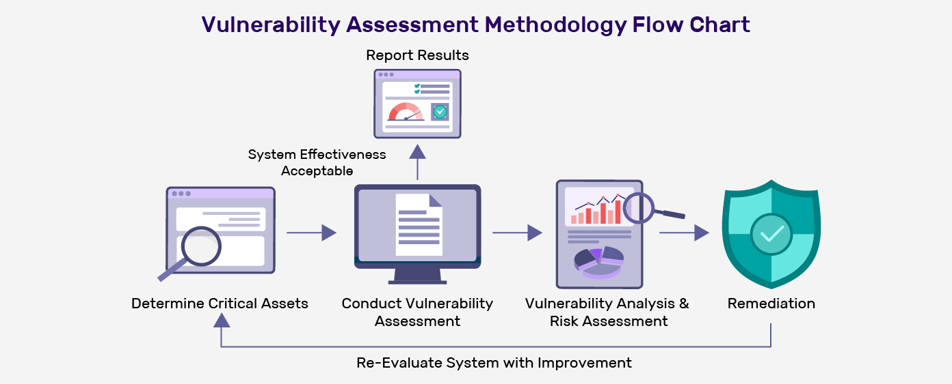
Vulnerability path and parameter identification
Methods For Identifying Vulnerability Paths and Parameters:
1. Determine Critical and Attractive Assets :The first step in vulnerability assessment is understanding your entire ecosystem and determining which networks and systems are more critical to your business operation.
2. Conduct Vulnerability Assessment: Actively scan your entire network or system through automated tools to identify security flaws and weaknesses.
3. Vulnerability Analysis and Risk Assessment: The next phase in the vulnerability assessment methodology is identifying the source and root cause of the security weakness identified in phase two.
4. Remediation :The main objective of this phase is the closing of security gaps. For each vulnerability identified, determine the effective path for mitigation.
5. Re-Evaluate: System with Improvements Once the security weaknesses are remediated, analyze the system with the proposed changes or upgrades.
6. Report Results The final phase in the security vulnerability assessment methodology is reporting the assessment result understandably.

Slide 19
Types of vulnerability paths and parameter
The four main types of vulnerabilities in information security are network vulnerabilities, operating system vulnerabilities, process (or procedural) vulnerabilities, and human vulnerabilities. 1. Network vulnerabilities are weaknesses within an organization’s hardware or software infrastructure that allow cyber attackers to gain access and cause harm.
2. Operating system (OS) vulnerabilities are exposures within an OS that allow cyber attackers to cause damage on any device where the OS is installed, because the system running the application is exposed, sometimes endangering the entire network.
3. Process vulnerabilities are created when procedures that are supposed to act as security measures are insufficient. One of the most common process vulnerabilities is an authentication weakness, where users, and even IT administrators, use weak passwords.
4. Human vulnerabilities are created by user errors that can expose networks, hardware, and sensitive data to malicious actors. They arguably pose the most significant threat, particularly because of the increase in remote and mobile workers. Examples of human vulnerability in security are opening an email attachment infected with malware.

Slide 20
Tools and techniques for identifying vulnerability paths and parameter
Vulnerability Scanning Test This test scans a system or network assets, such as servers, routers, and endpoints, to find potential security vulnerabilities.
2. Security Scanning Network security scanning is a systematic method to find vulnerabilities in a network, computer, or application.
3. Penetration Scanning Penetration testing (Pen Testing) is a type of security testing that attempts to find and exploit potential vulnerabilities in the system.
4. Risk Assessment Risk Assessment is a technique used to identify and prioritize potential risks to an organization or project
5. Security Audit An internal security audit is an in-depth look at the information security defenses of an organization.
6. Ethical Hacking Another type of tool for security testing is ethical hacking. The ethical hacker’s role is critical since it’s impossible to find all the vulnerabilities within a system through technical or manual testing alone.
7. Assessment of Posture A security posture assessment is a method used to analyze the current state of an organization’s security controls.

Slide 21
Best practices dor vulnerability path and parameter identification
Conduct Asset Discovery And Inventory
The most important step in vulnerability management is to conduct a comprehensive inventory of all authorized and unauthorized devices on the network, including all software installed on assert.
2. Classify Assets And Assign Tasks
After conducting an inventory of assets, it is essential to classify and rank them based on their true and inherent risk to the organization.
3. Run Frequent Automated Vulnerability Scanning
As part of continuous vulnerability management, organizations should run automated vulnerability scanning tools against all systems on the network on a frequent basis.
4. Prioritize Vulnerabilities And Take Corrective Actions
After the scan is complete, organizations must prioritize vulnerabilities based on their impact on the organization and take corrective actions accordingly.
5. Establish A Comprehensive Vulnerability Management Strategy
To effectively manage vulnerabilities, organizations need to establish a vulnerability management strategy that includes people, processes, and technology (PPT).

Slide 22
Challenges and limitations of vulnerability path and parameter identification
While vulnerability scanners are effective at identifying vulnerabilities, they have certain limitations that make them less effective when used as a comprehensive security solution which happens far too often at far too many organizations. Vulnerability scanners are limited in their ability to detect unknown vulnerabilities, as they rely on databases of known vulnerabilities to identify potential threats.
Another limitation of vulnerability scanners is they are only able to detect the vulnerabilities that are present on the system at the time of the scan. If a vulnerability is introduced after the scan has been completed, the scanner, obviously, won’t detect it. This means that organizations must regularly scan their systems to stay up to date on the latest threats, which can be cost prohibitive especially during financially difficult times.
Finally, vulnerability scanners can require a significant amount of time and resources to use effectively. The scans must be run regularly to detect new vulnerabilities, and the results must be carefully analyzed to identify potential threats and categorize them within the greater context of the business and its goals.
The Top Challenges Facing Vulnerability Management Teams
#1 Incomplete asset inventory.
#2 Overwhelming scope.
#3 Prioritizing vulnerabilities.
#4 Manual processes and lack of automated response.
#5 Monitoring and reporting.
#6 Lack of human resources.

Slide 23
Detail instruction for vulnerability reproduction
Importance of providing detailed instructions: -
Asset discovery and inventory IT is responsible for tracking and maintaining records of all devices, software, servers, and more across the company’s digital environment, but this can be extremely complex since many organizations have thousands of assets across multiple locations. That’s why IT professionals turn to asset inventory management systems, which help provide visibility into what assets a company has, where they’re located, and how they’re being used.
Vulnerability scanners Vulnerability scanners usually work by conducting a series of tests against systems and networks, looking for common weaknesses or flaws. These tests can include attempting to exploit known vulnerabilities, guessing default passwords or user accounts, or simply trying to gain access to restricted areas.
Patch management Patch management software is a tool that helps organizations keep their computer systems up to date with the latest security patches. Most patch management solutions will automatically check for updates and prompt the user when new ones are available. Some patch management systems also allow for deployment of patches across multiple computers in an organization, making it easier to keep large fleets of machines secure.
Configuration Management Security Configuration Management (SCM) software helps to ensure that devices are configured in a secure manner, that changes to device security settings are tracked and approved, and that systems are compliant with security policies. Many SCM tools include features that allow organizations to scan devices and networks for vulnerabilities, track remediation actions, and generate reports on security policy compliance.
Security incident and event management (SIEM) SIEM software consolidates an organization's security information and events in real time. SIEM solutions are designed to give organizations visibility into everything that is happening across their entire digital estate, including IT infrastructure. This includes monitoring network traffic, identifying devices that are trying to connect to internal systems, keeping track of user activity, and more.

Slide 24
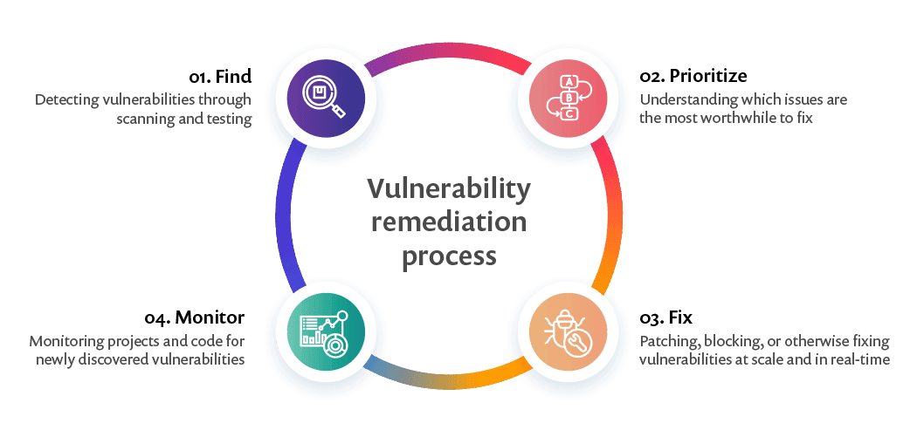
COMPONENTS OF A WELL WRITTEN VULNERABILITY REPRODUCTION INSTRUCTION
4 steps of the vulnerability remediation process
Find: Detecting vulnerabilities through scanning and testing
Prioritize: Understanding which vulnerabilities pose a real and significant risk
Fix: Patching, blocking, or otherwise fixing vulnerabilities at scale and in real-time
Monitor: Automatically monitor projects and code for newly discovered vulnerabilities, with real-time alerts and notifications via all the relevant channels.

Slide 25
BEST PRACTICES FOR WRITING EFFECTIVE VULNERABILITY REPRODUCTION INSTRUCTIONS
When writing a vulnerability report, it is necessary to provide as much information as possible to help the security team understand and quickly process the report, or it will end up taking longer for the bug to be fixed. From the Hacker One article.
Tools and techniques for verifying vulnerability fixes: -
1. Nikto2
Nikto2 is an open-source vulnerability scanning software that focuses on web application security. Nikto2 can find around 6700 dangerous files causing issues to web servers and report outdated servers-based versions. On top of that, Nikto2 can alert on server configuration issues and perform web server scans within a minimal time. Nikto2 does not offer any countermeasures for vulnerabilities found nor provide risk assessment features. However, Nikto2 is a frequently updated tool that enables a broader coverage of vulnerabilities.
2. Net sparker
Net sparker is another web application vulnerability tool with an automation feature available to find vulnerabilities. This tool is also capable of finding vulnerabilities in thousands of web applications within a few hours. Although it is a paid enterprise-level vulnerability tool, it has many advanced features. It has crawling technology that finds vulnerabilities by crawling into the application. Netsparker can describe and suggest mitigation techniques for vulnerabilities found. Also, security solutions for advanced vulnerability assessment are available.

Slide 26
Challenges and limitations of vulnerability reproduction instruction: -
1: Incomplete Asset Inventory
Many operating companies have very little asset inventory data. In most cases, asset data is limited to aging spreadsheets or incomplete data from a mix of sources, providing intermittent or spotty coverage.
: Identifying Vulnerabilities
Vulnerability scanning was designed to identify weaknesses of a system in order to quickly secure gaps in infrastructure from being exploited, but this provides greater challenges in OT than in IT.
3: Prioritizing Vulnerabilities
According to ESG Research, 34% of cyber security professionals reported their biggest vulnerability management challenge is prioritizing which vulnerabilities to remediate. With hundreds or thousands of vulnerabilities, it can feel a bit like playing whack-a-mole with no end in sight.
Timely Remediation of Vulnerabilities
Remediating vulnerabilities often comes in the form of patching – or updating software and bug fixes released by the vendor. If 60% of breaches involve vulnerabilities for which a patch was available but not applied, it seems like a simple and straightforward solution: Stay on top of available patches – right? Well, it is not that simple.

Slide 27
Importance of Comprehensive and detailed reporting
"Wireless network security primarily protects a wireless network from unauthorized and malicious access attempts. Typically, wireless network security is delivered through wireless devices (usually a wireless router/switch) that encrypts and secures all wireless communication by default. Even if the wireless network security is compromised, the hacker is not able to view the content of the traffic/packet in transit.
Key components of Comprehensive and detailed report on wireless security network
Firewalls, IPS, network access control (NAC), and security information and event management (SIEM) are the four most essential components of network security. Others include data loss prevention (DLP); antivirus and anti-malware software; application, web and email security; and more.
Strategies: WEP, WPA, and WPA2 are Wi-Fi security protocols that secure wireless connections. They keep your data hidden and protect your communications, while blocking hackers from your network. Generally, WPA2 is the best choice, even though it consumes more processing power to protect your network.
Challenges :Wireless network protocols also have some drawbacks, such as interference, latency, bandwidth, and range limitations. Wireless signals can be affected by physical obstacles, electromagnetic noise, or other wireless devices, resulting in lower quality or loss of connection.

Slide 28
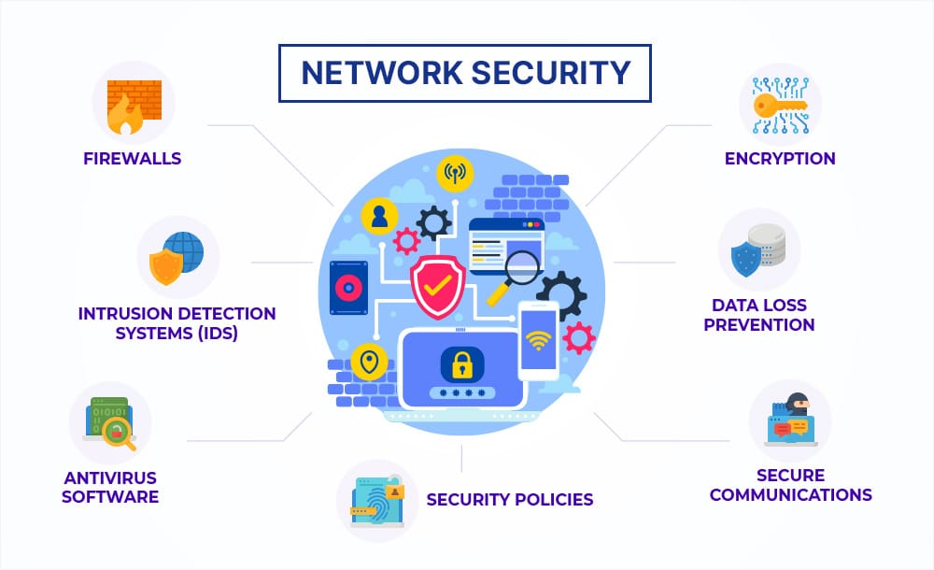
Network security
Best Practices Change default passwords Restrict access Encrypt the data on your network Protect your service set identifier Install a firewall Maintain antivirus software Use file sharing with caution Keep your access point software patched and up to date Connect using a Virtual Private Network

Slide 29

Impact of decision making
Decision making in wireless security network plays a very vital role. Decision making helps in protecting the security of wireless network. Some policies should be followed for the protection of wireless security network. Those policies are Secure communications, Using strong encryption, Changing the default work name etc.
The effects of good decision-making change the world around us. From deciding not to buy bottled water to combatting slavery and oppression, the values we have shape the decisions we make, and the decisions we make shape the world we live in.
Making good decisions in your life is a critical skill; in our good decision-making guide, we cover in detail the many ways we can improve our decision-making for better outcomes in life and work.

