Slide 1
Drug, Side Effects & Medical Condition Analysis
Data Analysis Project | Python & Visualization Tools
Presented By
Gowri Priya

Slide 2
Project Objective
Analyze drug-related data to extract insights on:
Ratings and Reviews
Side Effects
Associated Medical Conditions
Alcohol and Pregnancy Warnings

Slide 3
Tools & Technologies
Python (pandas, matplotlib, seaborn)
Jupyter Notebook
CSV Data Format
Data Visualization Techniques

Slide 4
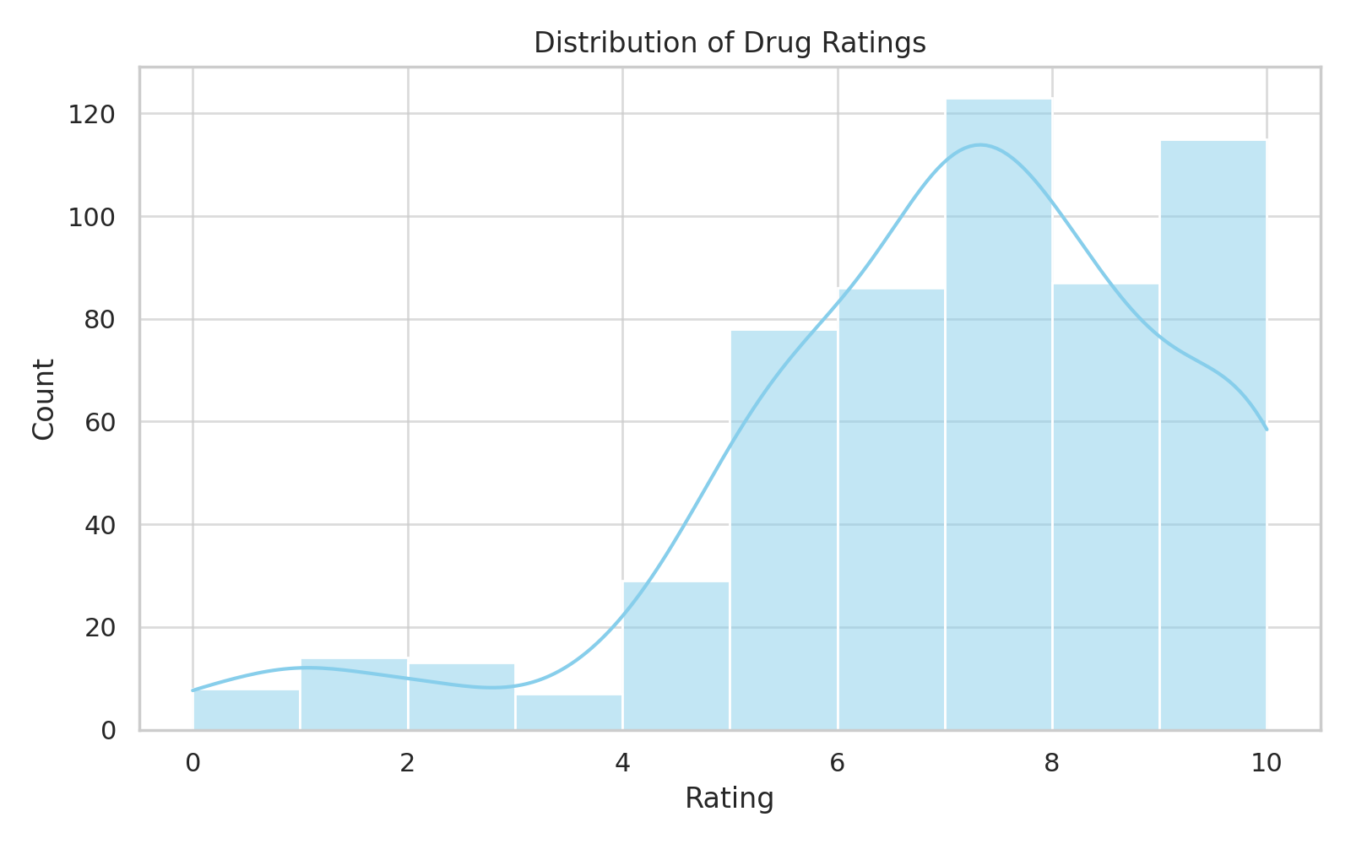
Drug Ratings Distribution
Most drugs are rated between 7–10.
Indicates high user satisfaction.

Slide 5
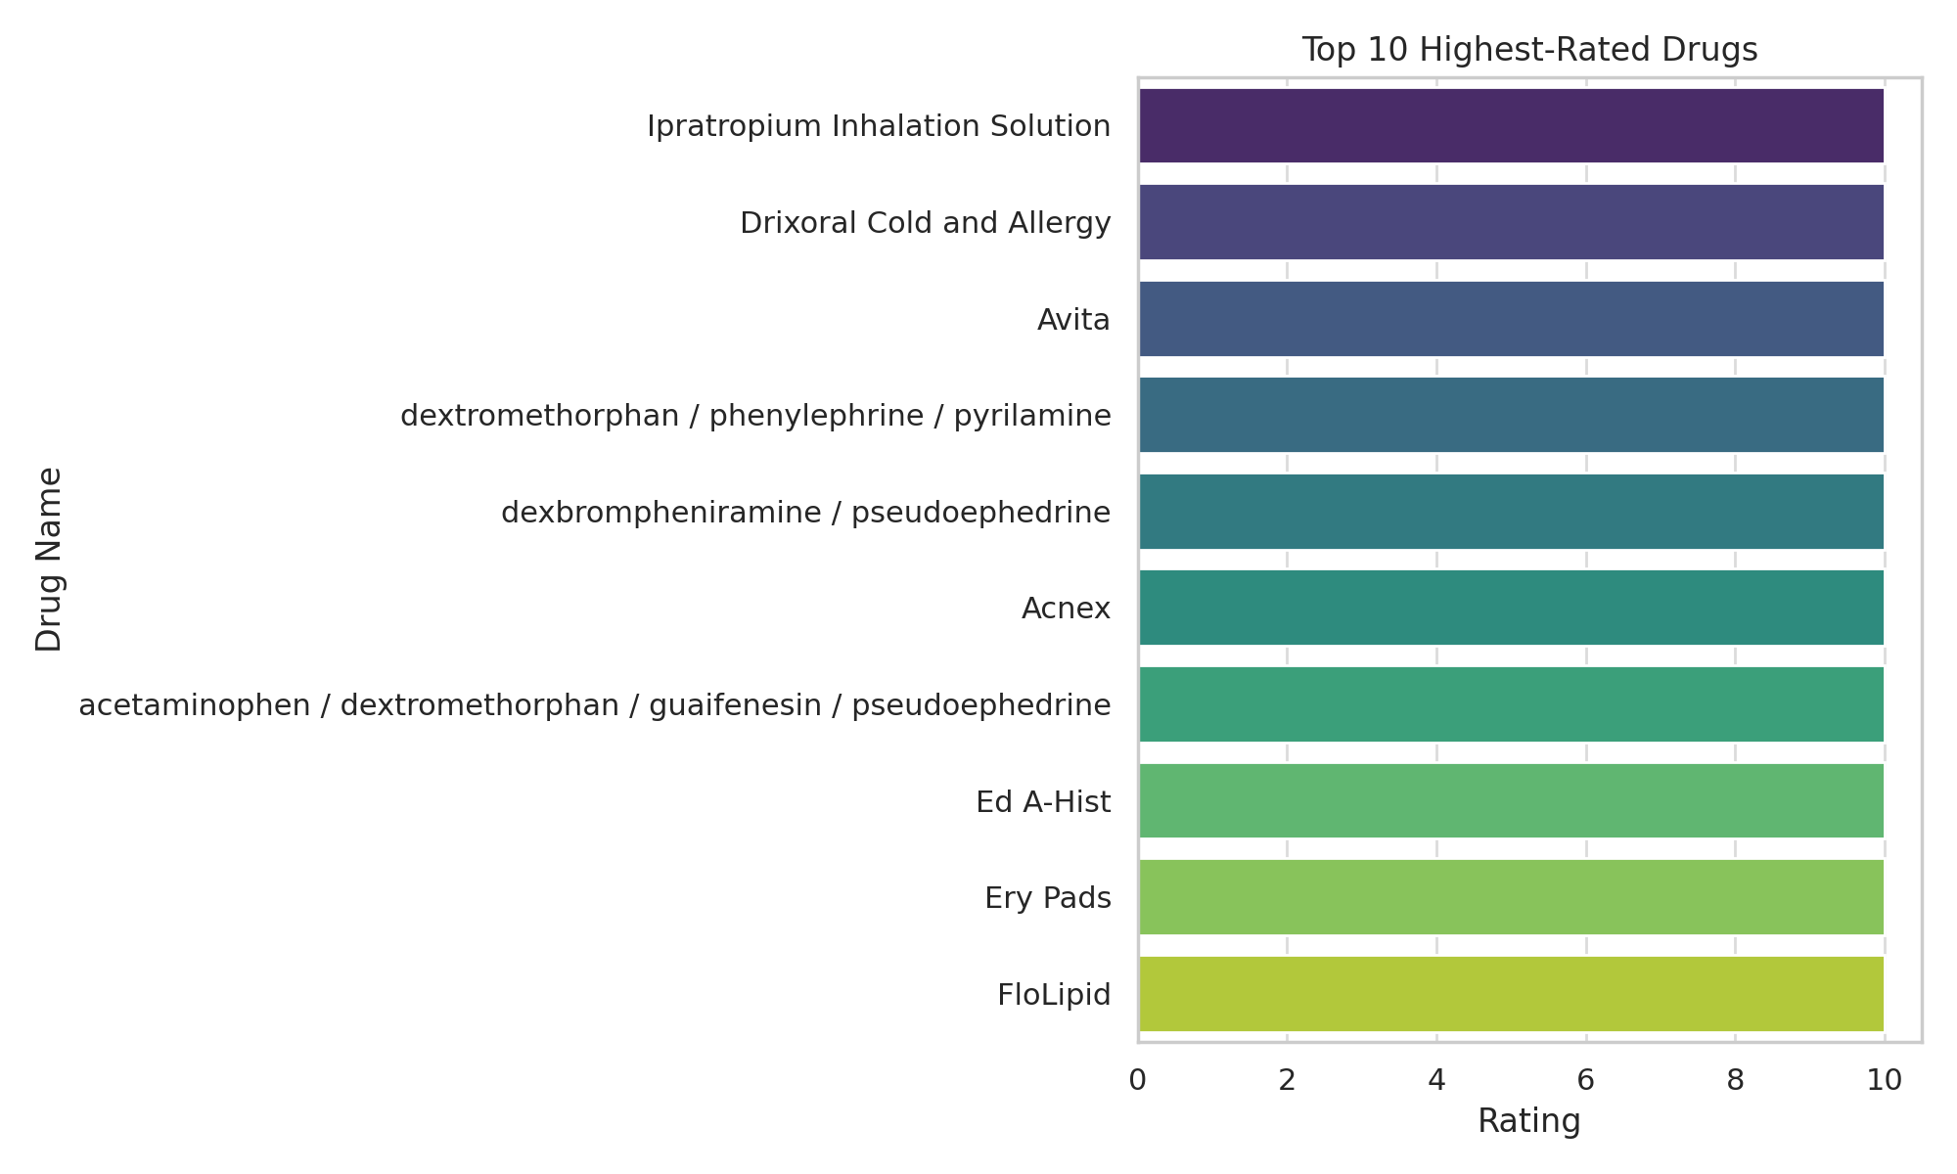
Top 10 Highest-Rated Drugs
Top-rated drugs have ratings above 9.
Most are backed by many user reviews.

Slide 6
Most Common Medical Conditions
Drugs most often treat:
- Depression
- Anxiety
- Pain
- Diabetes

Slide 7
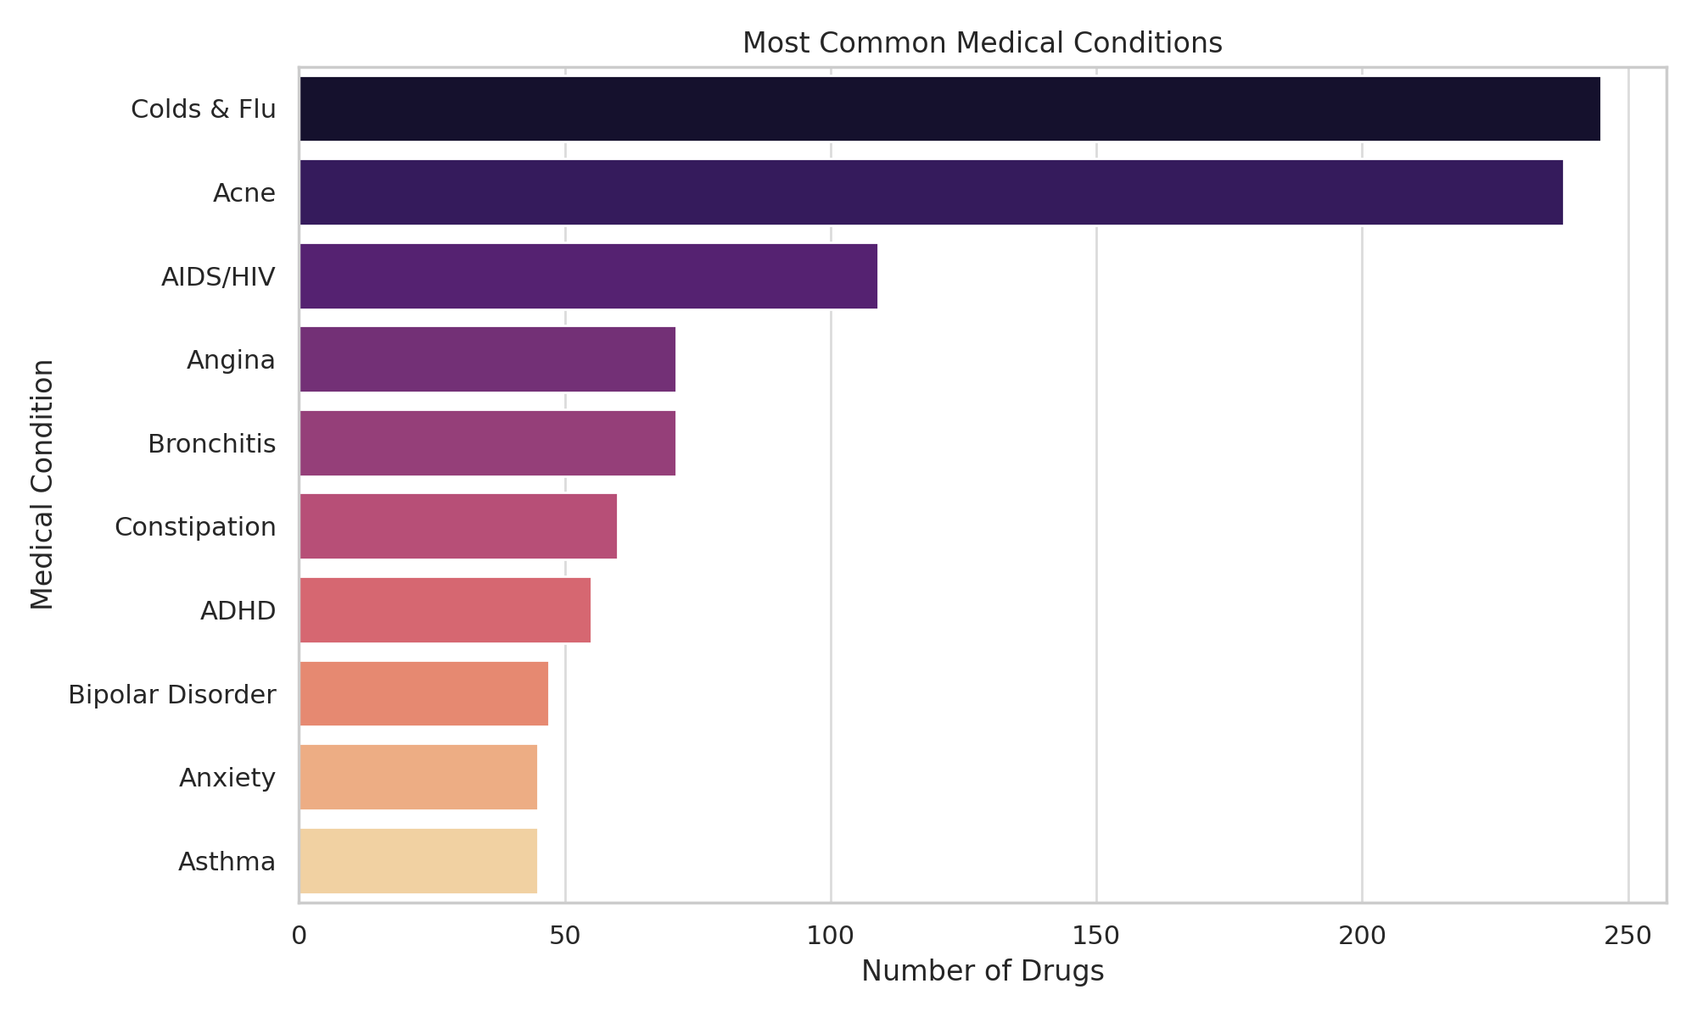

Slide 8
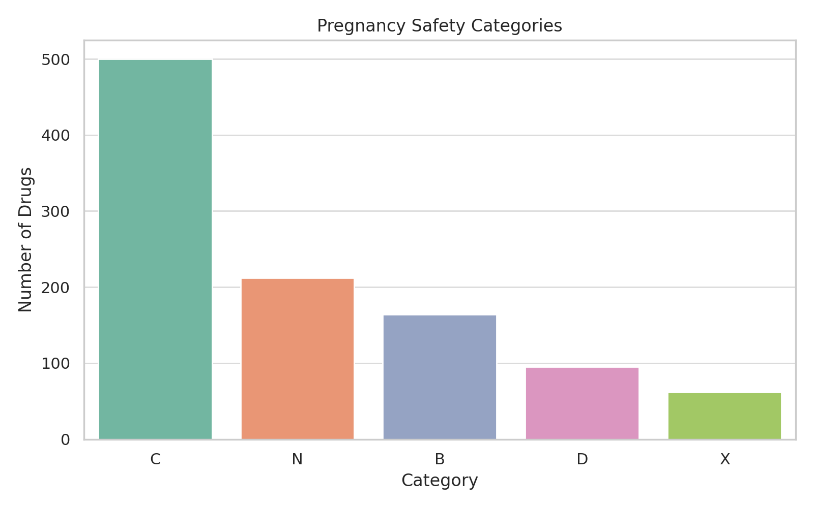
Pregnancy Safety Categories
Most drugs fall under Category C (risk not ruled out).
Very few are Category A (safe).

Slide 9
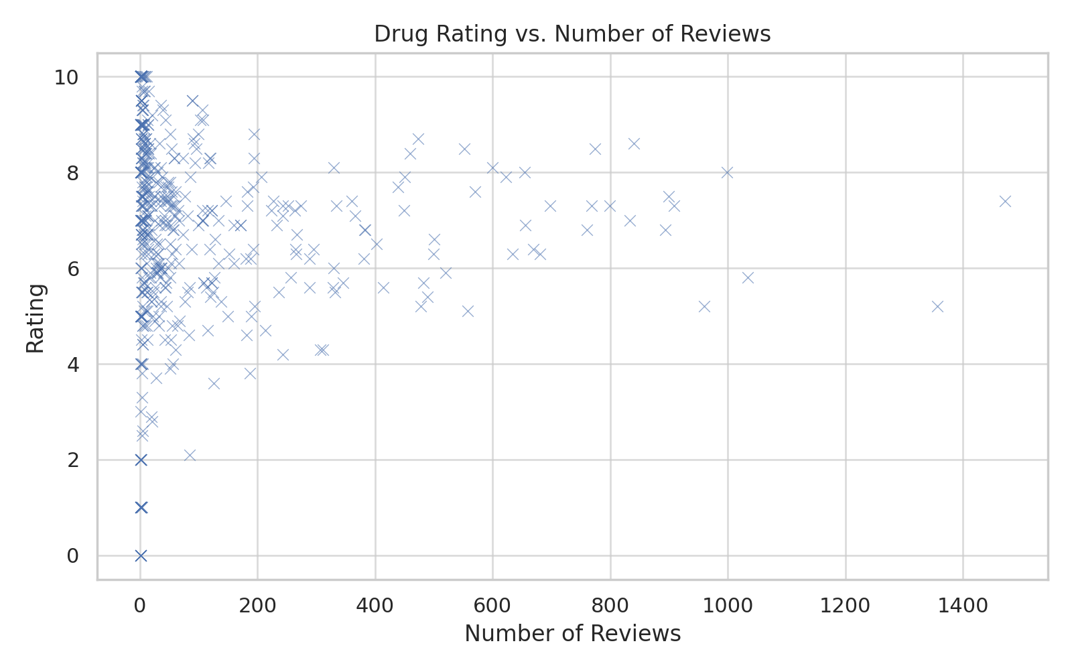
Ratings vs Number of Reviews
Drugs with more reviews tend to have more reliable average ratings.

Slide 10
Insights
Most top-rated drugs have scores above 9
Depression, anxiety, diabetes, and pain dominate conditions
Common side effects: nausea, headache, dizziness, fatigue
Alcohol warnings are common but don’t affect ratings
Category C is the most used in pregnancy classifications
More reviews = more trust in rating

Slide 11
Conclusion
Extracted valuable insights on drug safety and effectiveness
Identified patterns in medical conditions and side effects
Supports data-driven decisions in pharmaceutical studies

Slide 12
Thank You!

