Slide 1
R.GOWRI
Final Project
3/21/2024 Annual Review

Slide 2
PROJECT TITLE
Student Grade Prediction using single-layer ANN (Logistic Regression)

Slide 3
AGENDA
The aim of the project is to develop a logistic regression-based model to accurately predict student performance using various factors such as academic records, attendance, and study habits. By identifying students at risk of underperformance early on, the project aims to support educators in implementing timely interventions to improve academic outcomes. Ultimately, this project seeks to enhance educational processes by leveraging predictive analytics, contributing to the advancement of educational research and practice while fostering student success.

Slide 4

PROBLEM STATEMENT
Despite the wealth of data available on student performance, educational institutions often struggle to effectively leverage this information to identify students at risk of underperformance and implement timely interventions. The aim of this project is to develop a logistic regression-based predictive model that can accurately forecast student grades based on various factors such as academic records, attendance, and study habits.
By addressing this challenge, the project seeks to empower educators and administrators with actionable insights to support students effectively and improve overall academic outcomes. Additionally, the project aims to contribute to the advancement of educational research and practice by applying machine learning techniques to real-world educational challenges.

Slide 5

PROJECT OVERVIEW
Introduction:
In educational institutions, predicting student performance is crucial for identifying students who may require additional support or intervention. This project focuses on developing a logistic regression-based predictive model to forecast student grades based on various academic and non-academic factors. By leveraging machine learning techniques, the project aims to empower educators with actionable insights to enhance student support strategies and improve overall academic outcomes.
Visualization:
Visualization in the student grade prediction project involves histograms for grade and feature distributions, correlation heatmaps for feature relationships, scatter plots for feature analysis, and ROC and precision-recall curves for model evaluation. Feature importance plots highlight predictors, while confusion matrices visualize accuracy. Calibration curves assess reliability, and scatter plots compare predicted grades.

Slide 6
OBJECTIVE:
Develop a logistic regression model to predict student grades based on academic records, attendance, study habits, and other relevant factors.
Utilize historical student data to train and validate the predictive model, ensuring accuracy and reliability.
Explore the impact of different features on student grades and identify key factors influencing academic performance.
Provide educators with a user-friendly interface to input student information and obtain grade predictions in real-time.
Evaluate the effectiveness of the predictive model in identifying students at risk of underperformance and its impact on student outcomes.

Slide 7
YOUR SOLUTION AND ITS VALUE PROPOSITION
Solution:
The project provides a logistic regression model for predicting student grades based on academic records, attendance, and study habits. Leveraging historical data, the model ensures accurate predictions, enabling timely interventions for at-risk students. With a user-friendly interface, educators can obtain real-time predictions, facilitating proactive support strategies.
Value Proposition:
The model empowers educational institutions to enhance student support and improve academic outcomes. Early identification of at-risk students enables targeted interventions, while insights from feature analysis inform decision-making. The user-friendly interface streamlines prediction, optimizing educational strategies for better outcomes. Overall, the project offers a valuable tool for data-driven student support, enhancing education quality and student success.

Slide 8
The Wow Factor in Your Solution
Accuracy and Reliability: The logistic regression model ensures high accuracy and reliability in predicting student grades by leveraging historical data, fostering trust in recommendations.
Early Intervention: The model's ability to identify at-risk students early on provides a proactive approach to student support, allowing educators to intervene promptly and prevent potential underperformance.
Actionable Insights: Through feature analysis, the model uncovers key factors influencing student grades, offering actionable insights for tailored interventions.
Real-Time Predictions: The user-friendly interface enables educators to access real-time grade predictions easily, facilitating quick decision-making and timely actions.
Streamlined Processes: By integrating predictive analytics, the solution optimizes resource allocation, allowing educators to efficiently prioritize interventions and maximize impact.
Enhanced Education Quality: The solution contributes to education quality by improving academic outcomes and fostering student success through data-driven support strategies.

Slide 9
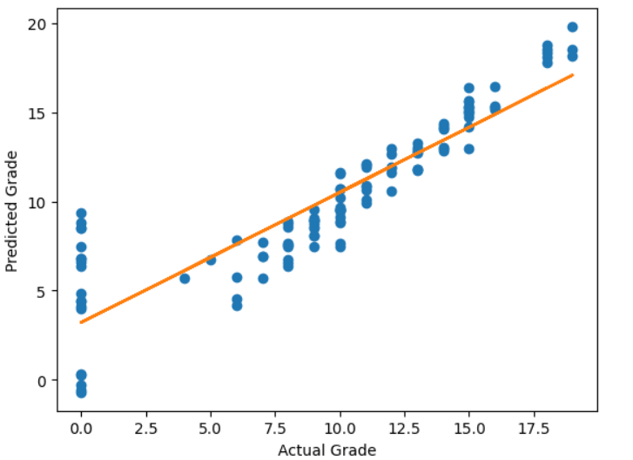
RESULTS
Student Grade Prediction

Slide 10
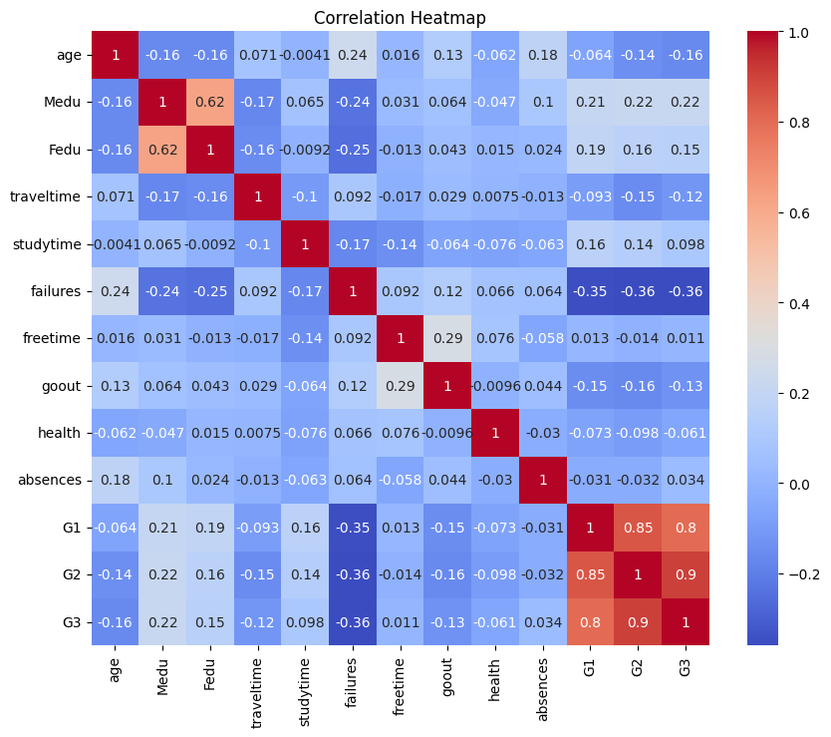
Results
DRIVE LINK:
https://colab.research.google.com/drive/1hI515s_G5KW4ZNi0rFVsR_oRhg2To4yJ#scrollTo=Pwi-DOgyqHRx

Slide 11
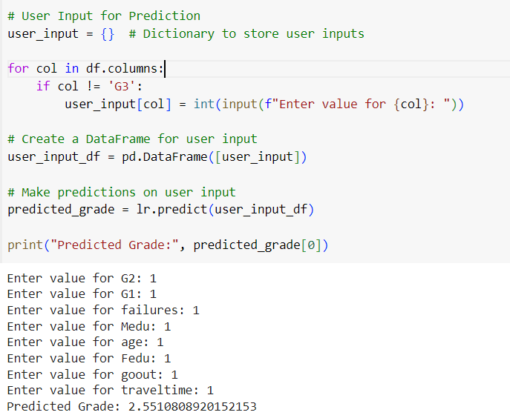
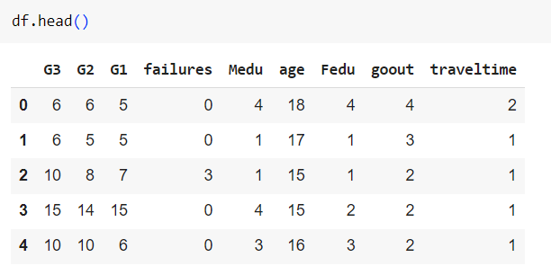
Model Prediction:

