Slide 1

FREIGHT ANALYSIS
Team Members:
Gowrisaranyan G
Edumudi Karteek
Mugesh S
Guided By:
Jayveer Nanda

Slide 2
Introduction
What is Freight Analysis?
Freight Analysis comes under supply chain management which can be defined as a systematic flow of materials, goods, and related information among suppliers, companies, retailers, and consumers.
Freight analysis generally integrates data from a variety of sources to create a comprehensive picture of freight movement among states and countries by all modes of transportation.
Starting with data from the Commodity Flow Survey (CFS) and international trade data from the Census Bureau, FAF incorporates data from agriculture, extraction, utility, construction, service, and other sectors.
Our 2012 freight analysis dataset provides estimates for tonnage, value, and ton-miles by regions of origin and destination, commodity type, and mode.

Slide 3
Challenges:
Business and industry have adopted just-in-time manufacturing and delivery strategies to increase productivity, reduce the cost of goods and services delivered to consumers, and remain competitive in global markets.
These logistics strategies depend on cost-effective and reliable freight transportation. However, we are seeing diminishing returns from past transportation investments, and transportation productivity is declining.
The increase in freight traffic will further strain the capacity of the nation’s highways, rail lines, and ports. Without additional capacity and greater productivity, freight transportation will not keep pace with economic growth.
As more data is generated, we will see more congestion, higher costs for goods and services, and a smaller share of global markets.

Slide 4

Objective: Describe and analyze the crucial factors that will cause a change in freight movement value in the U.S.A. The ultimate goal is to provide predictions on the value of the particular commodity which is transported within the states of the U.S.A and from the U.S.A to different countries in a year.
Data sources:
In order to get accurate value of the prices of movement of the goods, a Freight Analysis Framework dataset is collected from Federal Highway Administration website provided by U.S Department of Transportation.
Data description :
The dataset consists of 5,49,133 unique observations with 12 features(9-Categorical Features,3-Numerical Features).

Slide 5
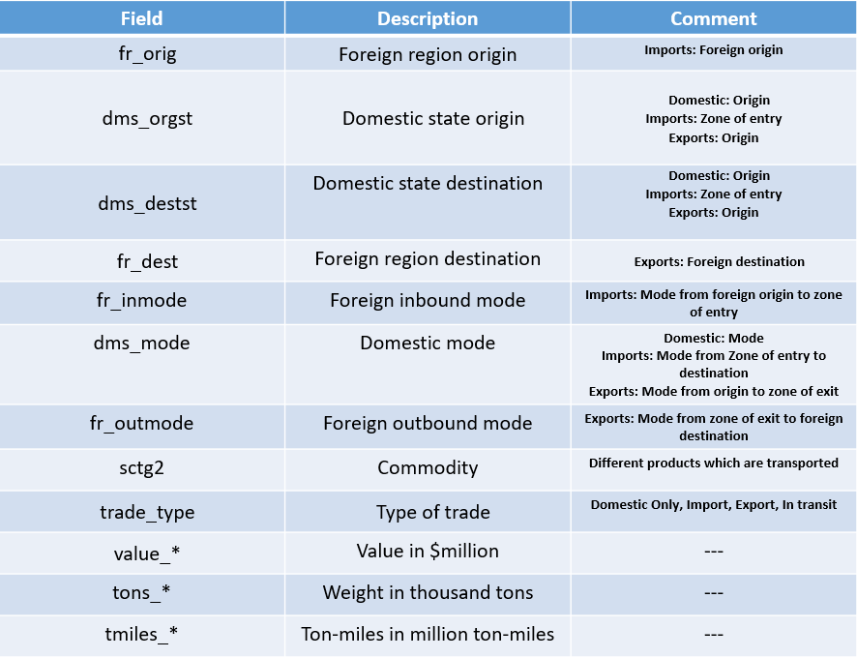
Features :

Slide 6
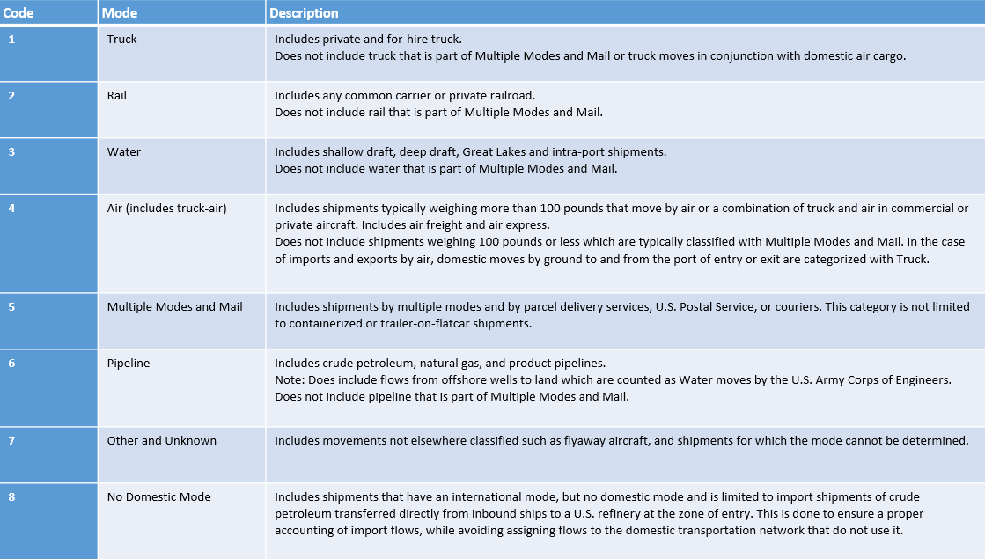
Mode of Transport:

Slide 7
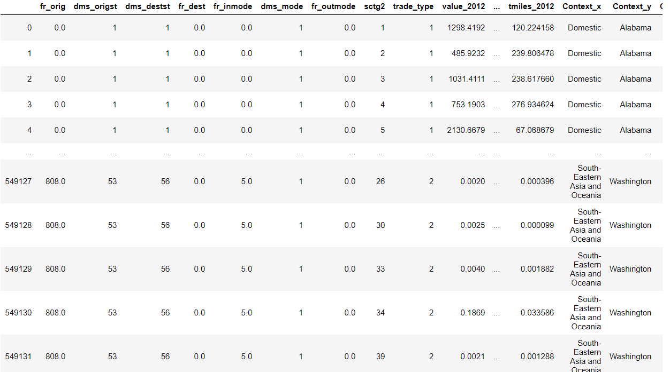
Data Wrangling
In our original dataset, all categorical columns were label encoded. So we converted label encoded into corresponding categories for EDA purposes.
Replaced Nan values with zero at some categorical columns to find the relationship between the variables exactly.

Slide 8
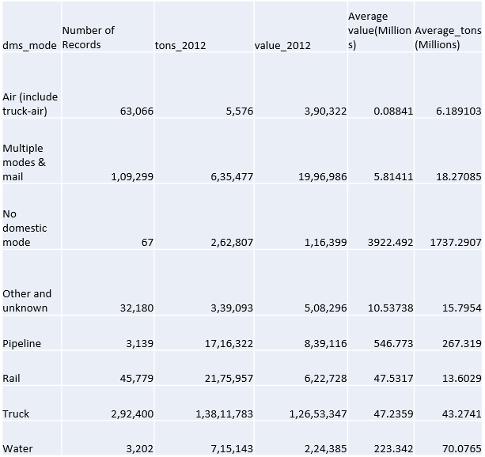
Transport Type vs Avg Value and Avg Tons

Slide 9
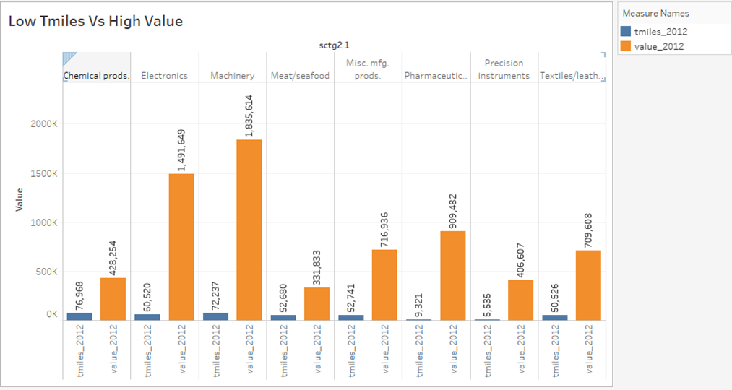
Low Miles vs High value on commodity
Even though machinery is transported less when compared to other commodities, we find that large amount of revenue is coming from this category.
Machinery is followed by electronics, Instruments and Textiles

Slide 10
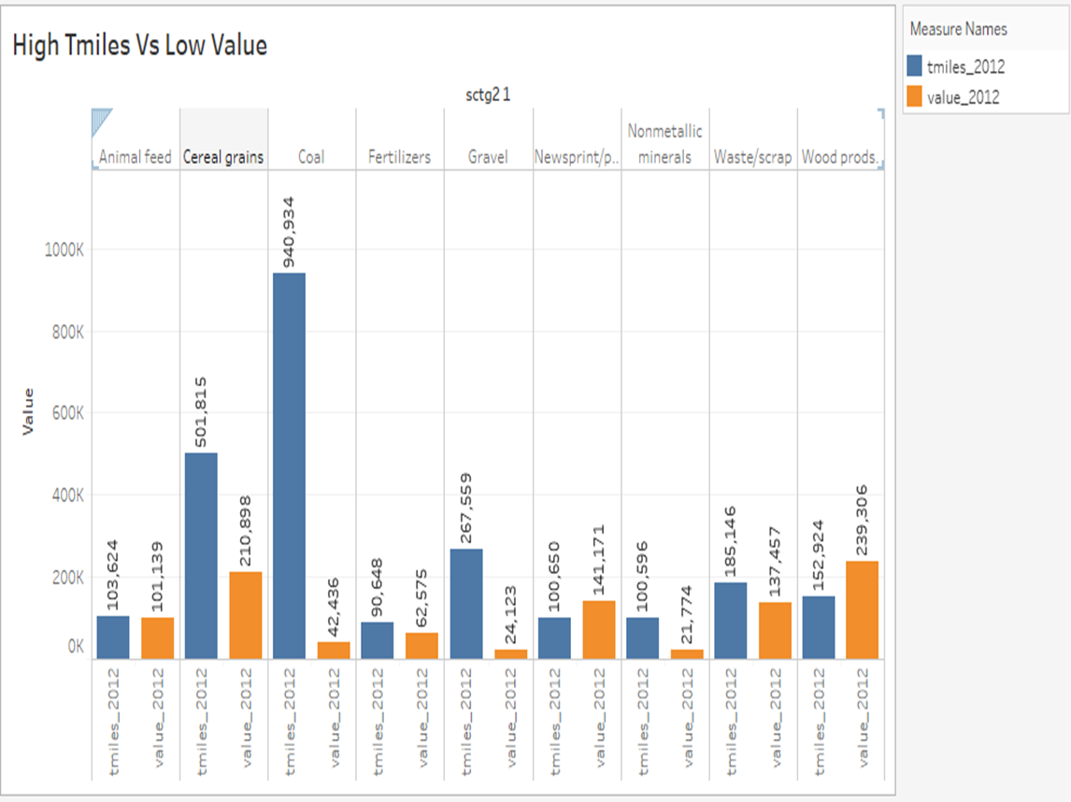
High Miles vs Low value on commodity
Chart explains about the low turnout of the value vs Maximum Tons_miles_2012 Covered by top 10 commodities.
Coal tops the list in terms of miles covered but it got one of the lowest revenue among other commodities.
Coal is followed by Cereal grains, Gravel, Waste/scrap and animal feed

Slide 11
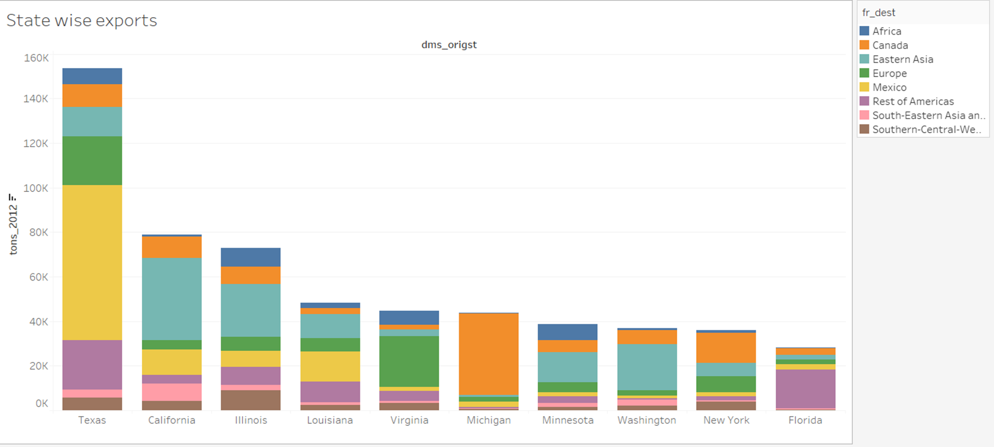
The bar plot visually represents the top ten states which exports maximum amount of goods(Thousands of tons) to different countries. Texas exports the maximum goods to different countries. Mexico is significant trading partner for the U.S.A

Slide 12
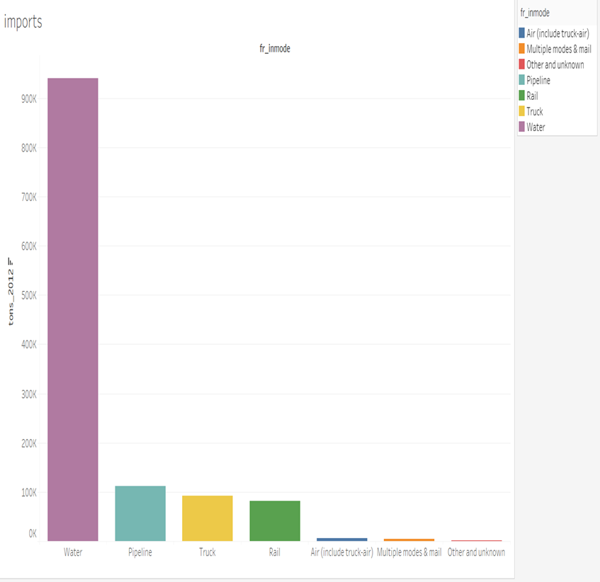
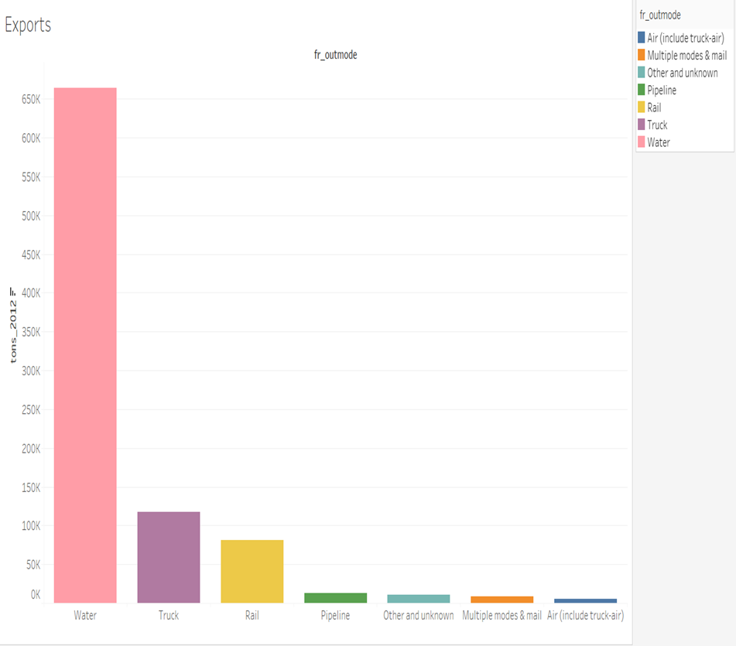
Comparison of fr_inmode and fr_outmode vs Ton_2012

Slide 13
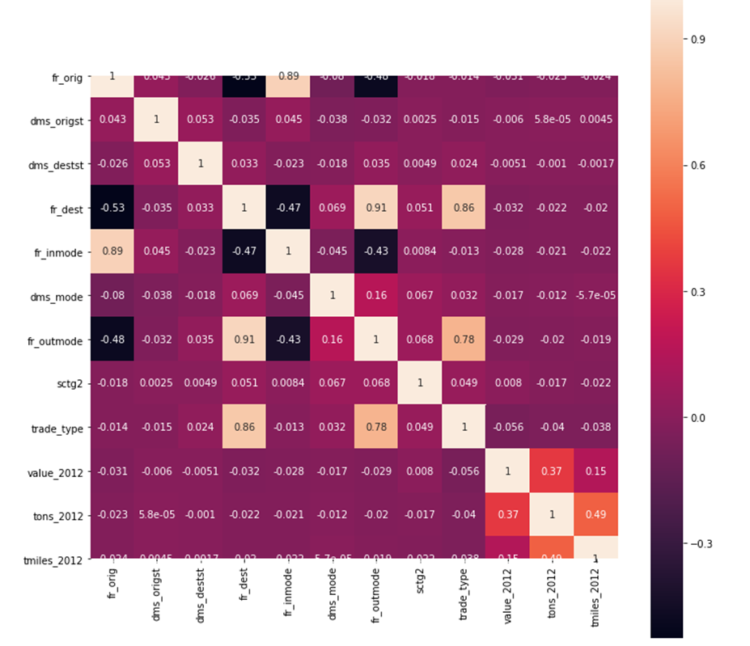
Heat map Observation:
Our target variable is Value_2012
We could not find correlation above 50% with target variable and predictor variables.

Slide 14
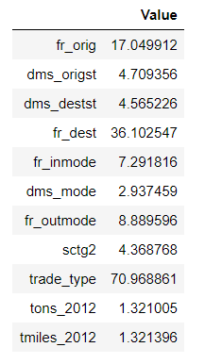
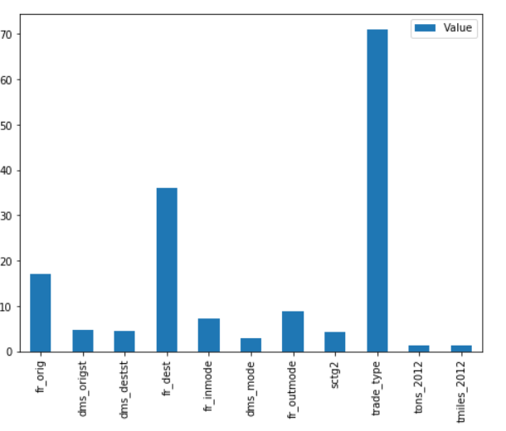
VIF(variance inflation factor)

Slide 15
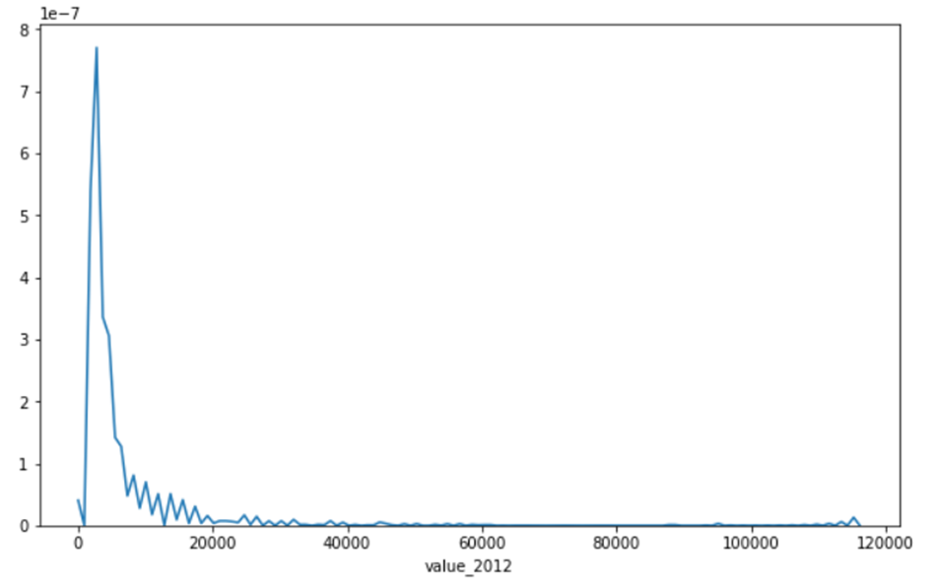
Distribution of Target Variable
The plot shows the distribution of target variable(Value_2012).It is extremely right skewed.
Shapiro Test results:
Test_stats, P_value =(0.0177, 0.0)

Slide 16
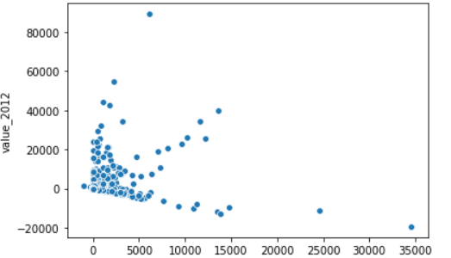
Relationship between target and predictor variables
A common use of the residuals plot is to analyze the variance of the error of the regressor. If the points are randomly dispersed around the horizontal axis, a linear regression model is usually appropriate for the data otherwise, a non-linear model is more appropriate.
Original predictor variables has a weak linear relationship with target variables.
This is evident when we plotted residual plot (predicted variables vs residual) [Note: Here predicted variables were found by Linear regression Method]

Slide 17
Supervised Learning Regression
We used three different methodologies to get best accuracy score on the target variable (Value_2012)
Since there was a outliers and extreme values in the main three columns value, tons and tmiles , we applied log transformation , sqrt transformation and polynomial techniques on variables to get desired results.
SQRT Transformation results(Default Parameters):
Name | Score | AVG_BIAS ERROR | AVG_VAR_ERROR
KNN | 0.512 | 0.487 | 0.022
RF | 0.757 | 0.242 | 0.042
LR | 0.115 | 0.885 | -

Slide 18
Preparing the model (SQRT -Transformation)
In running models(except Linear Regressor) with default parameters, we run it with only 50000 samples out of 5 lakh variables. This is done to save time.
We select RF from above model results because its showing reliable results on accuracy score K-fold test.
We tested RF with entire population to get best accuracy score. Before running the RF model multicollinearity columns were removed
RF(Default Model) RF(SQRT Variables)
RF(SQRT Variables-Best N estimators) Adaboost Regressor(Base Estimator- RF)
Model applied to Extreme Outliers (15 million to 1162 million)
RF(Best N estimators) Adaboost Regressor (Base Estimator- RF)
R Score | Bias Error | Var_Error
0.7277 | 0.272 | 0.0435
R Score | Bias Error | Var_Error
0.8699 | 0.132 | 0.045
R Score | Bias Error | Var_Error
0.8672 | 0.13 | 0.0055
R Score | Bias Error | Var_Error
0.886 | 0.114 | 0.044
R Score | Bias Error | Var_Error
0.8181 | 0.181 | 0.024
R Score | Bias Error | Var_Error
0.856 | 0.144 | 0.044

Slide 19
Regressor(Log Transformation)
Preparing the Best model
Applied fraction on dataset since our categorical column values is following pattern
Extreme rightly skewed values greater right whiskers are removed and selected values ranging from 100$ to 6.7 million$. Ended up with around 4 lakh records.
Skewness is reduced by applying log transformation.
Model | R2 Score | Train Score | Test Score
LinearRegression | 0.56 | 0.56 | 0.56
KNN | 0.82 | 0.88 | 0.82
DT | 0.79 | 1.00 | 0.79
RF | 0.89 | 0.98 | 0.88
BayesianRidge | 0.56 | 0.56 | 0.56

Slide 20
Cross Validation
Model | R2 Score | Train Score | Test Score
KNN | 0.83 | 0.85 | 0.82
DT | 0.79 | 1.00 | 0.78
RF | 0.89 | 0.98 | 0.88
BayesianRidge | 0.56 | 0.56 | 0.56

Slide 21
PCA with scaling
Model | R2 Score | Train Score | Test Score
KNN | 0.80 | 0.87 | 0.80
DT | 0.63 | 1.00 | 0.63
RF | 0.81 | 0.97 | 0.81
BayesianRidge | 0.56 | 0.56 | 0.56

Slide 22
Bagging
R2_score : 0.88
RMSE : 0.97
Train Score : 0.97
Test Score : 0.87
Bagging Regressor on KNN algorithm giving the best R2 score value on all algorithms.

Slide 23
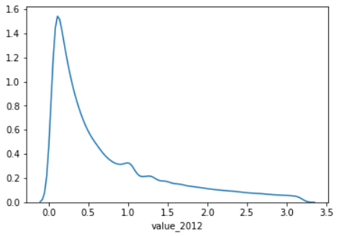
Process of Model Building using Polynomial Features
The data has been read and null values have been imputed with zeros. And the rows with value column having 0 have been removed.
All the integer columns have been compressed using cube root.
Outliers have been removed from the data for model building.
As we have less features in the dataset, we used polynomial features to increase the number and also to make new features stronger than the prior ones.
Out of 66 polynomial features we used Sequential Feature Selection with model as LR and found the top 15 features for further process.
Almost normal distribution can be seen in the data.
Out of 549132 values we built model with 457472 values.

Slide 24
Model Building and Accuracy score
Name | Cross Validation Score | Bias Error | Variance Error
Linear Regression | 0.821 | 0.179 | 0.115
Random Forest | 0.834 | 0.166 | 0.001
K-Nearest Neighbour | 0.812 | 0.188 | 0.013
Bagging Regressor | 0.841 | 0.159 | 0.001
Final Model in this process has been build using a function which returns the value which is the mean of values returned by RF, KNN, Bagging Regressor which gives an improved r2_score of 0.8524 and MSE of 0.082

Slide 25
Model Building and Accuracy score for outliers
Name | Cross Validation Score | Bias Error | Variance Error
Linear Regression | 0.564 | 0.436 | 0.138
Random Forest | 0.730 | 0.270 | 0.015
K-Nearest Neighbour | 0.618 | 0.382 | 0.016
Bagging Regressor | 0.749 | 0.251 | 0.015
Bagging Regressor has performed well in this data along with Random forest but the R-squared value is comparatively low but as this is a very rare case dealing with extreme values we have only limited customers asking for the results using this model.

Slide 26
Business Solutions
With the given data , we can predict the overall value of particular commodity, which is transported within USA and Outside the USA.
To make FAF a more effective tool, we can integrate with economic census that will provide the related information about economic conditions such as the increase in tax rates, petrol or diesel costs .
Create transparency wherever possible, to gain trust from the associated companies and partners.
This would help the supply chain planners to make effective use of FAF products with local understanding of freight activity.
FAF currently has no estimate by season. Volume of commodities to be moved varies by season, especially for agricultural products and goods that are sold mainly during holidays. Availability of routes also varies by season such as elimination of northern inland waterways by winter.
Significant portions of private truck facility can be taken into consideration as those lead to around 50 miles of distance and use of mileage.

Slide 27
Thank you

