Slide 1





”
HEXAWARE CODE & RISE PROGRAM
TECH BELIEVERS_PERI
“EMPOWERING EDUCATION WITH EVERY ASSESSMENT”
Notes:
null

Slide 2
TEAM DETAILS
TEAM NAME : TECH BELEIVERS_PERI
APPLICATION NAME: CAREER FIT
TEAM MEMBERS
E-MAIL ID
Archana B archucse1118@gmail.com
Dayana M dayanamageshwaran@gmail.com
Gowsalya D dgowsalya2019@gmail.com
Kavitha S sivakumarkavitha2003@gmail.com
Notes:
null

Slide 3
IMPACT / POTENTIAL VALUE OF CAREER FIT
Enhanced Learning Outcomes
Boosts retention through personalized assessments.
Visual: [Improvement Graph]
Increased Efficiency
Streamlines processes and reduces workload.
Visual: [Efficiency Icon]
Data-Driven Insights
Provides actionable analytics.
Visual: [Analytics Dashboard]
Scalability and Flexibility
Adapts to growth and varied needs.
Visual: [Scalability Diagram]
Improved Engagement
Interactive and gamified elements.
Visual: [Engagement Icon]
Notes:
null

Slide 4
THE SOLUTION PROPOSED BY OUR TEAM
Solution Highlights
Key Features
Customized Assessments
Tailored to educational goals.
Visual: [Customization Icon]
Real-Time Analytics
Instant performance insights.
Visual: [Analytics Icon]
Interactive Interface
User-friendly and dynamic.
Visual: [Interface Icon]
Scalable Architecture
Handles growth efficiently.
Visual: [Scalability Icon]
Custom Question Upload
Supports various question formats.
Visual: [Custom Question Icon]
AI-Powered Protection
Real-time monitoring and alerts.
Visual: [AI Protection Icon]
Security and Data Protection
Encryption and strict access controls.
Visual: [Security Icon]
Scalability and Efficiency
Automated reporting and large volume handling.
Visual: [Scalability Icon]
Notes:
null

Slide 5
TECHNOLOGIES USED IN OUR PROJECT
Backend - Python, Flask
Frontend - HTML, CSS, Javascript, ReactJs
Database - PostGreSQL
Design - Figma
ML - 1.Supervised Learnings
1.Random Forest
2.Gradient Boosting Machines(GBM)
3.Deep Neural Network (DNN)
2.Unsupervised Learnings
1.K-means Clustering
2.Hierarchical Clustering
3.Reinforcement Learning
1.Q - Learnings
2.Deep Q - Networks (DQN)
Natural Language Processing (NLP)
1.Support Vector Machine (SVM)
2.Naive Bayes
3.Transformer - Based models (BERT, GPT)
4.Conditional Random Fields (CRF)
5.BiLSTM - CRF
6.Recurrent Neural Network (RNN)
Notes:
null

Slide 6
GEN AI TOOL UTILIZATION
Natural Language Processing (NLP) Tools - Face Detection, Hugging Face
Machine Leaarning Tools - Scikit -Learning
Computer Vision and Proctoring Tools - OpenCV, Face Recognition
Audio Analysis Tools - Google Speech - to - Text API
Report Generation and Analysis - Matplotlib and Seaborn
Data Storage and Management - Firebase 0
Notes:
null

Slide 7
APPLICATION ARCHITECTURE
CAREER FIT
Candidate Page
Instructor Page
Admin Page
Login / Registration
Login
Login / Registration
Dashboard
Dashboard
Assessment Creation / preview
Assessment Management/ Creation
Pre-Assessment / Assessment
Dashboard
Proctoring / Monitoring
Admin RE & AI / Audit Logs
Proctoring / Assessment Result
Submit / Result
Notes:
null

Slide 8
FUNCTIONALITIES AND DESIGN DIAGRAM
COMPONENTS:
Load Balancer: Distributes traffic.
Web Servers: Frontend and application.
App Server: Core logic processing.
DB: Data storage (SQL/NoSQL).
Cache: Performance boost (Redis/Memcached).
Cloud: Scalable infrastructure.
Notes:
null

Slide 9
FUNCTIONALITIES
Assessment Creation:
Customizable Tools: Design and configure assessments.
Real-Time Feedback:
Instant Updates: Provide immediate feedback on submissions.
User Authentication:
Secure Access: Manage user login and permissions.
Data Management:
Storage & Retrieval: Handle user data and assessment results.
Notes:
null

Slide 10
DESIGN DIAGRAM
User Interface (web/mobile)
Application Server
Data
Storage
Cloud Infrastructure
(Scalable Hosting)
Analytics and Reporting
Notes:
null

Slide 11
HOW IT WORKS
User Login:
Access: Users log in through the web or mobile app.
Create Assessments:
Design: Educators set up and customize assessments.
Deliver Assessments:
Deploy: Assessments are assigned to students.
Submit & Evaluate:
Complete: Students submit answers; system evaluates automatically.
Feedback & Reporting:
Review: Instant feedback and detailed reports are provided.
Analytics & Insights:
Analyze: Generate insights and trends from performance data.
Notes:
null

Slide 12
WORK FLOW
User Login
Create Assessment
Deliver Assessment
Submit & Evaluate
Feedback & Reporting
Analytics & Insights
Notes:
null

Slide 13
INNOVATION AND CREATIVITY
Unique Features
Adaptive Learning: Personalized assessments.
Gamification: Engaging game-like elements.
Advanced Analytics: AI-driven insights.
Visual: [Icon/Screenshot]
Technological Innovations
AI & ML: Automated grading & feedback.
Cloud Integration: Scalable access.
Real-Time Processing: Instant feedback.
Visual: [Icon/Diagram]
3.Creative Solutions
UI Design: Intuitive and user-friendly.
Interactive Elements: Engages users.
Customizable Assessments: Flexible options.
Visual: [Mockup/Screenshot]
4.Impact on Users
Enhanced Learning: More engaging.
Efficiency: Streamlined processes.
Accessibility: Inclusive design.
Visual: [Impact Chart/Icon]
Notes:
null

Slide 14
SCALABILITY, PERFORMANCE AND SECURITY
Scalability
Description: Easily handle increasing numbers of users and data.
Visual: [Scalability Icon or Diagram]
Key Points:
Cloud-Based Infrastructure: Supports growing demand.
Load Balancing: Distributes traffic efficiently.
2. Performance
Description: Fast and reliable operation.
Visual: [Performance Icon or Diagram]
Key Points:
High-Speed Processing: Quick response times.
Security
Description: Protects user data and maintains integrity.
Visual: [Security Icon or Diagram]
Key Points:
Data Encryption: Secures sensitive information.
Access Controls: Restricts unauthorized access.
Regular Security Audits: Ensures compliance and security.
Notes:
null

Slide 15
BEST PRACTICE
User Experience (UX)
Description: Intuitive and user-friendly design.
Visual: [UX Icon]
Data Management
Description: Efficient handling and processing of data.
Visual: [Data Management Icon]
Performance Optimization
Description: Ensures fast response times and system efficiency.
Visual: [Performance Icon]
Notes:
null

Slide 16
INDUSTRY STANDARDS
ISO 27001
Description: Information security management.
Visual: [ISO 27001 Icon]
GDPR
Description: Data protection and privacy.
Visual: [GDPR Icon]
WCAG
Description: Web accessibility guidelines.
Visual: [WCAG Icon]
IEEE Standards
Description: Industry-wide engineering and technology standards.
Visual: [IEEE Icon]

Slide 17
CONSOLE AND OUTPUTS
System Logs
Logs system activities and errors.
Visual: [Sample Log Entry Screenshot]
User Activity
Records user actions and interactions.
Visual: [User Activity Log Screenshot]
Error Messages
Displays error messages and troubleshooting information.
Visual: [Error Message Screenshot]
4.Performance Metrics
Provides performance data and statistics.
Visual: [Performance Metrics Screenshot]
5Debugging Information
Offers detailed debugging information for developers.
Visual: [Debugging Info Screenshot]

Slide 18
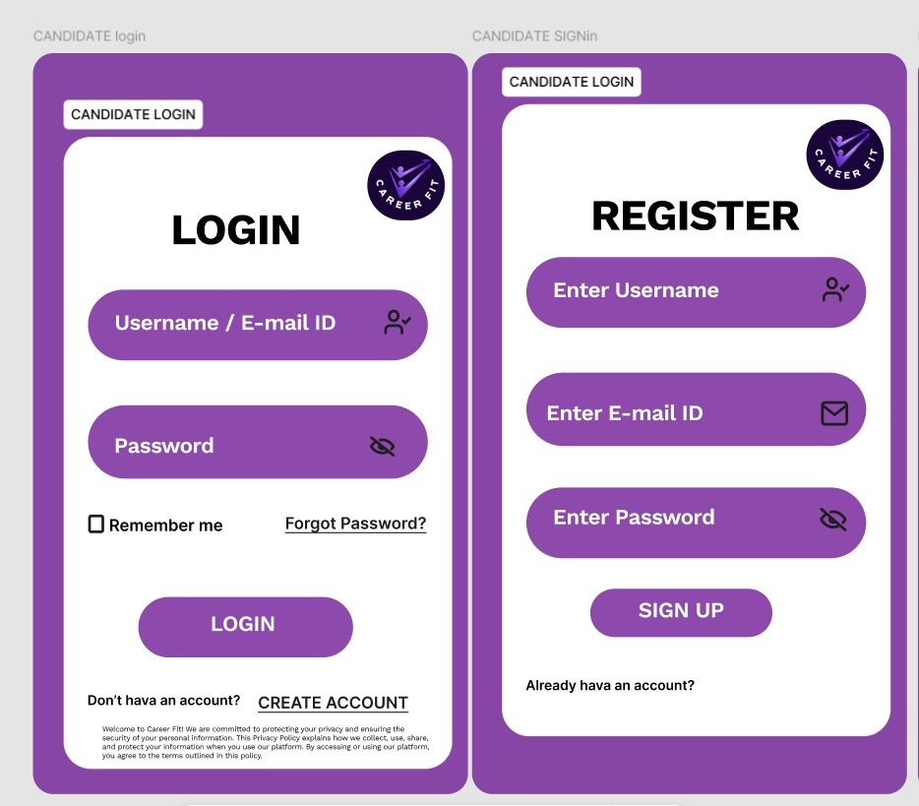
SAMPLE DESIGN CREATED BY FIGMA - Candidate

Slide 19
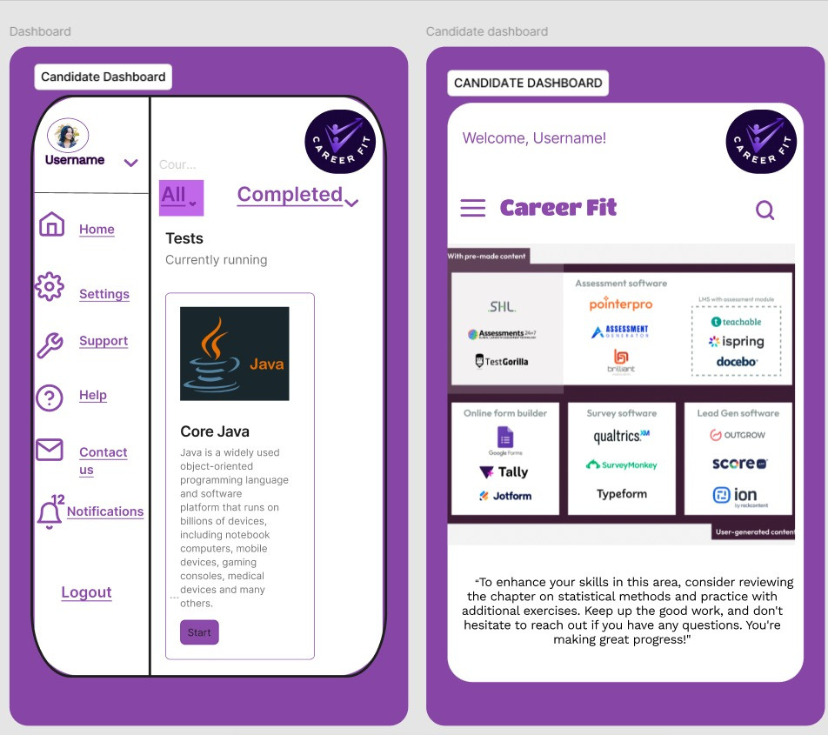
SAMPLE DESIGN CREATED BY FIGMA- Candidate

Slide 20
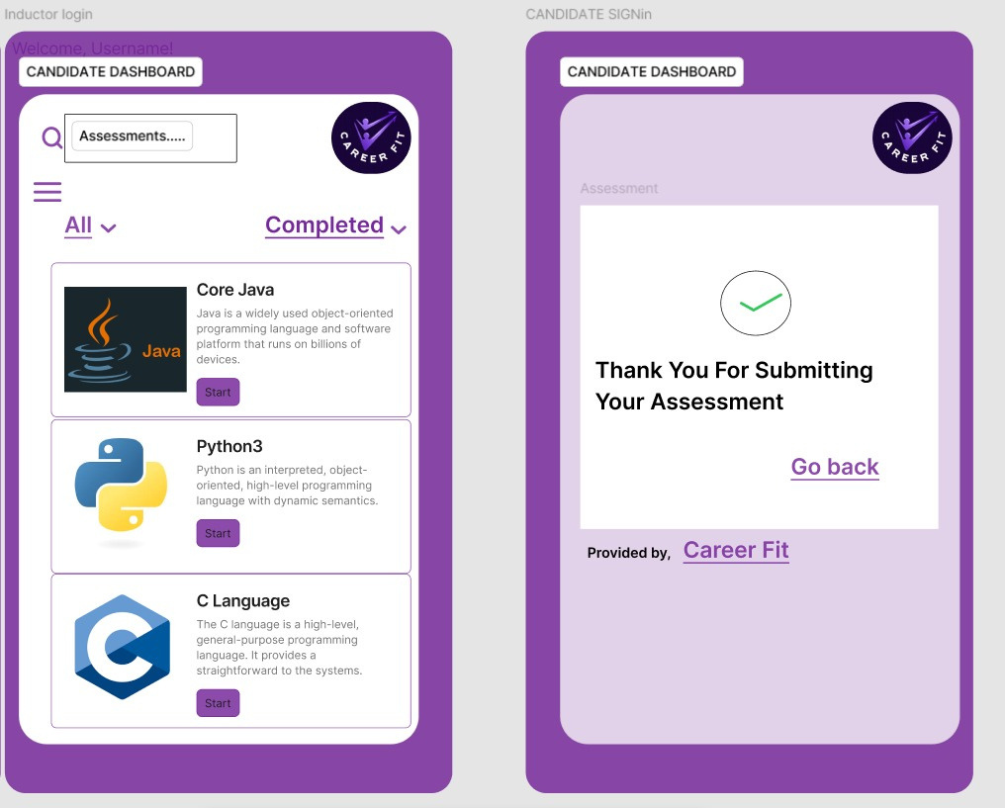
SAMPLE DESIGN CREATED BY FIGMA- Candidate

Slide 21
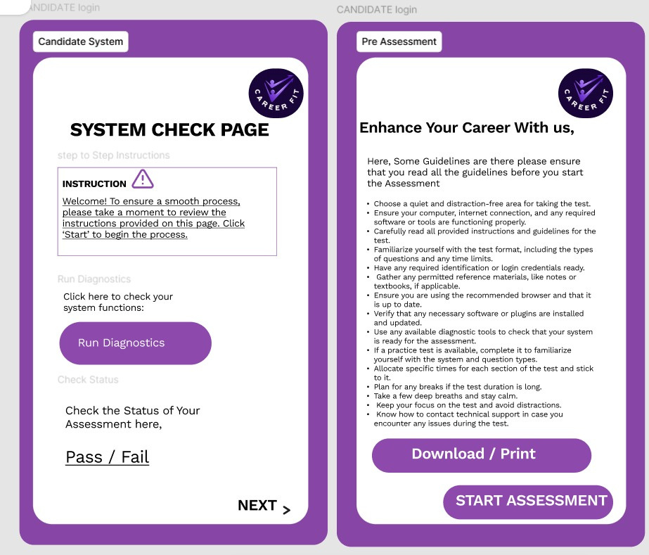
SAMPLE DESIGN CREATED BY FIGMA- Candidate

Slide 22
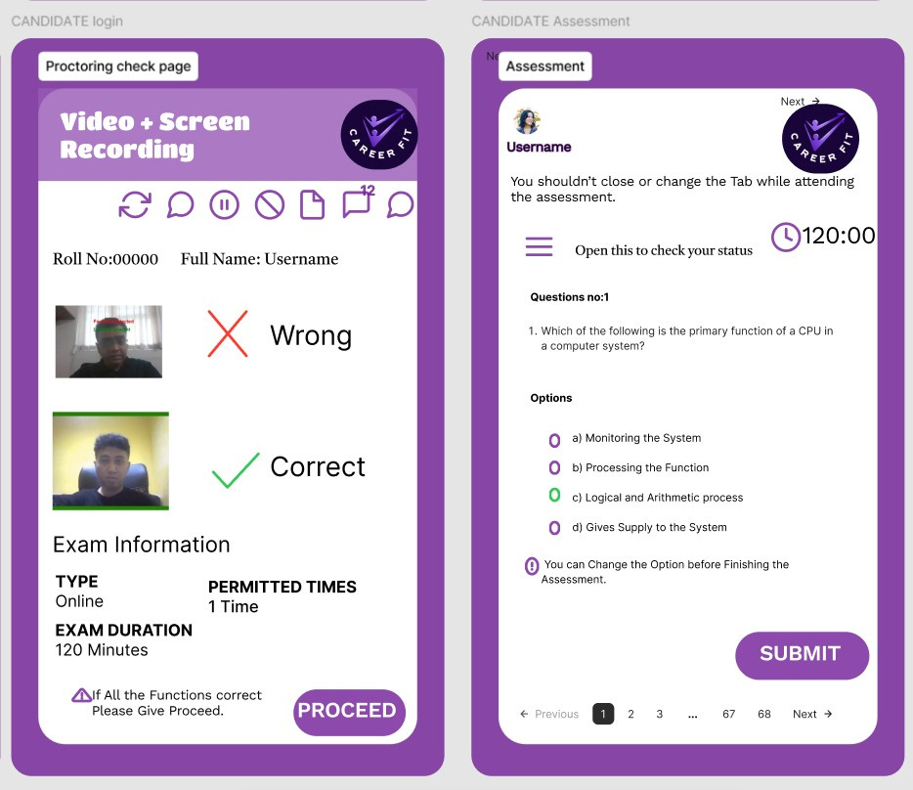
SAMPLE DESIGN CREATED BY FIGMA- Candidate

Slide 23
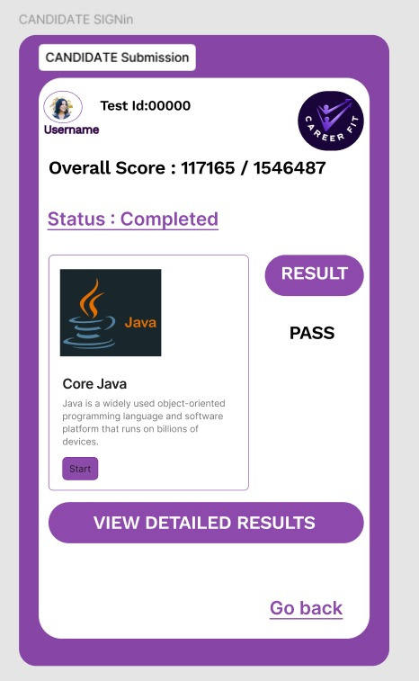
SAMPLE DESIGN CREATED BY FIGMA- Candidate

Slide 24
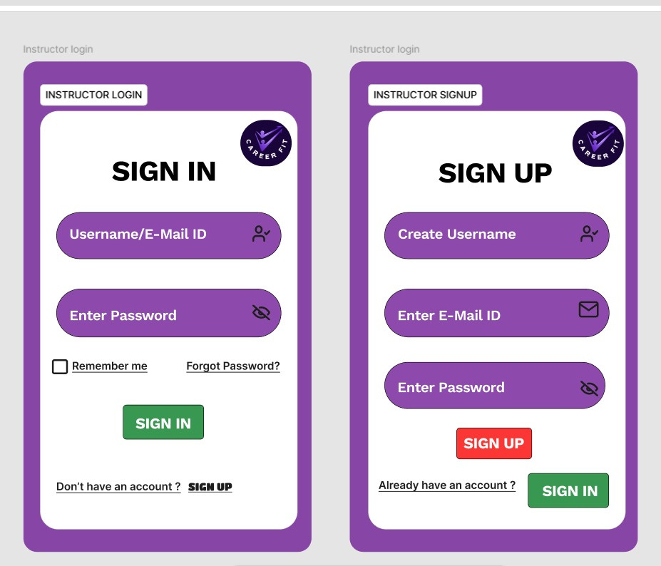
SAMPLE DESIGN CREATED BY FIGMA- Instructor

Slide 25
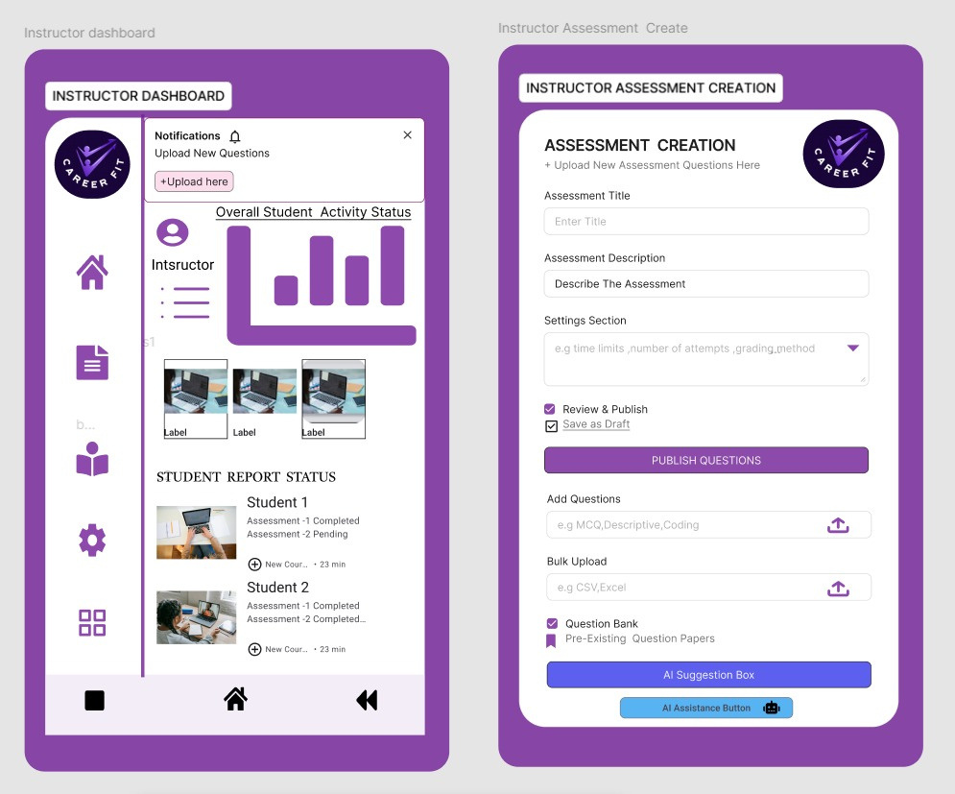
SAMPLE DESIGN CREATED BY FIGMA- Instructor

Slide 26
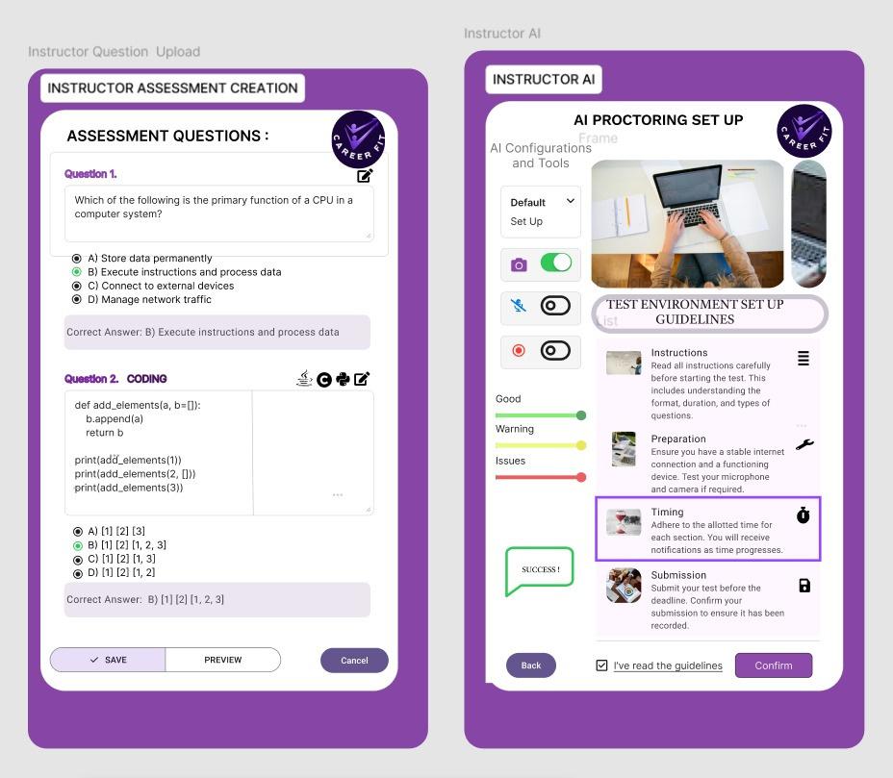
SAMPLE DESIGN CREATED BY FIGMA- Instructor

Slide 27
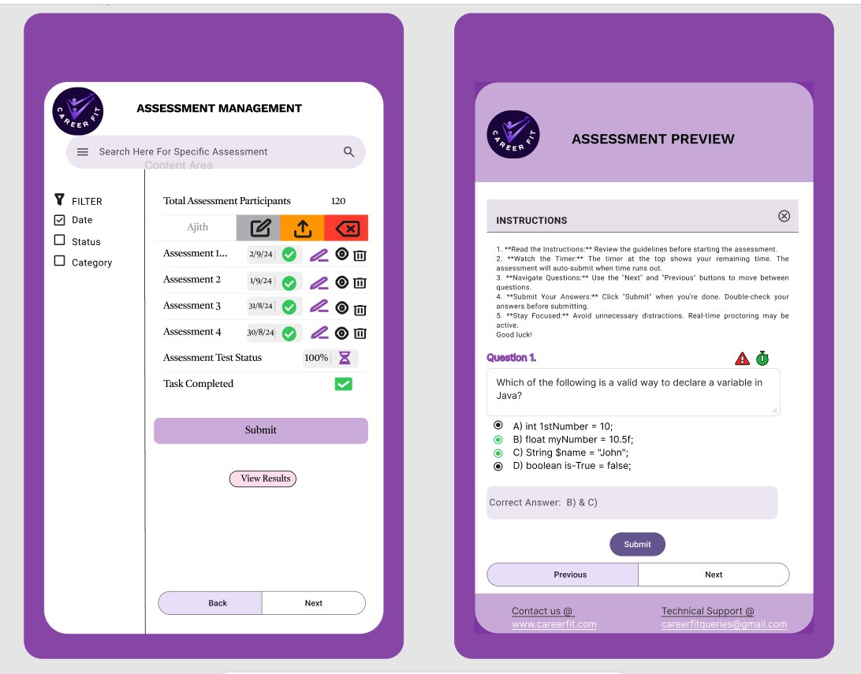
SAMPLE DESIGN CREATED BY FIGMA- Instructor

Slide 28
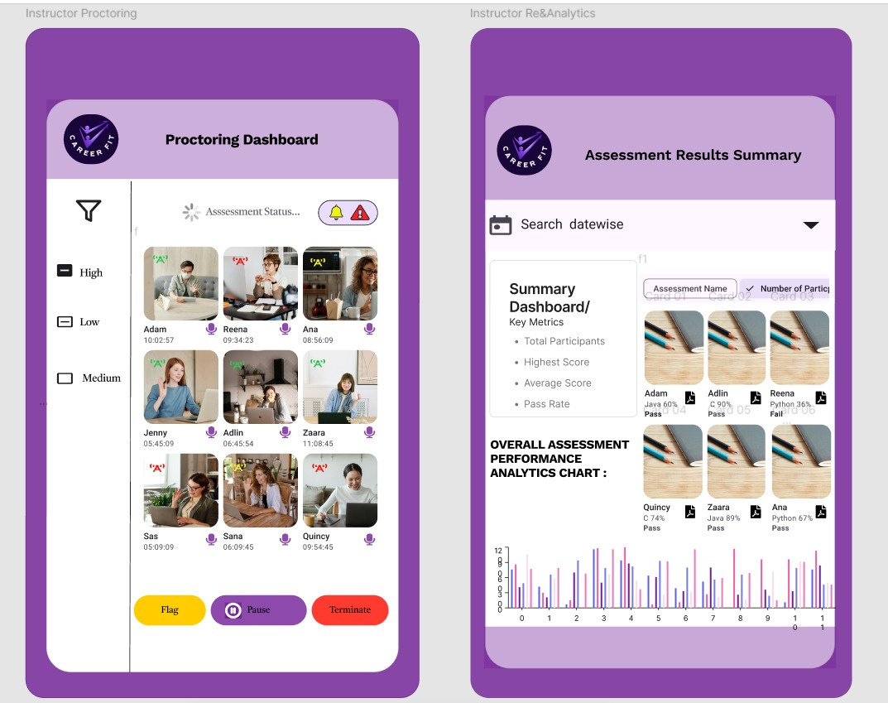
SAMPLE DESIGN CREATED BY FIGMA- Instructor

Slide 29
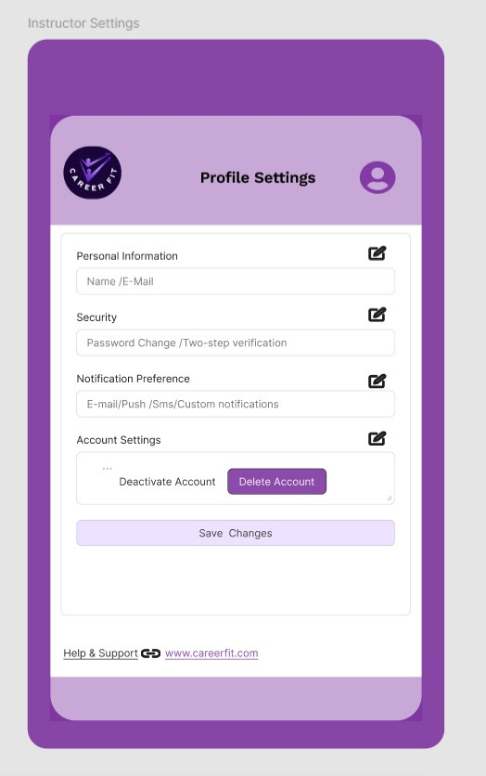
SAMPLE DESIGN CREATED BY FIGMA- Instructor

Slide 30
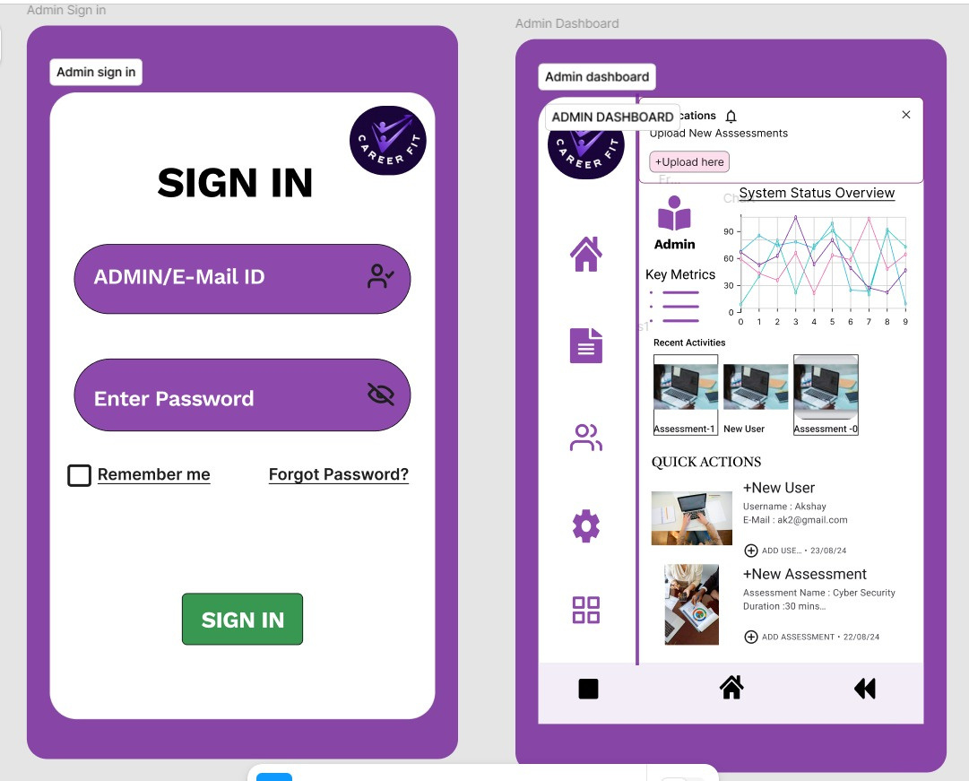
SAMPLE DESIGN CREATED BY FIGMA- ADMIN

Slide 31
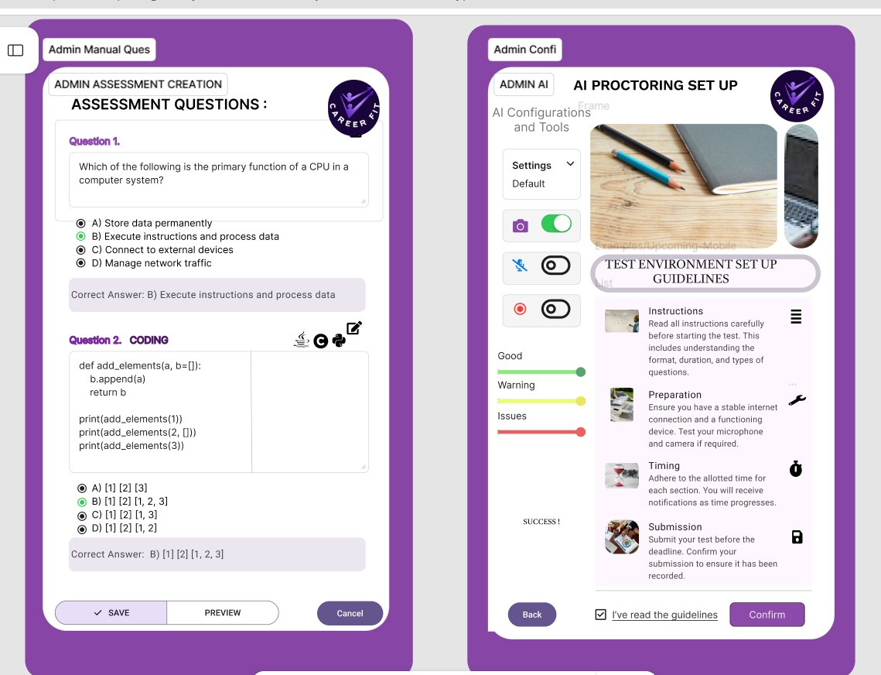
SAMPLE DESIGN CREATED BY FIGMA- Admin

Slide 32
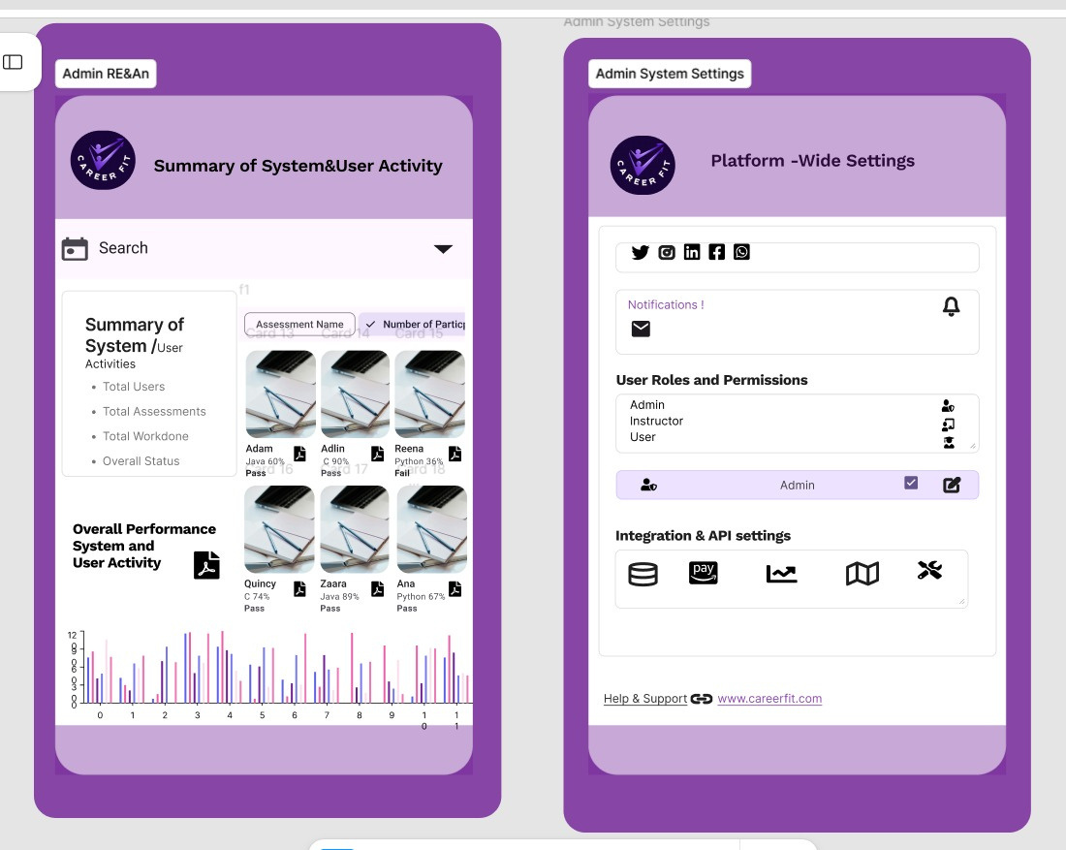
SAMPLE DESIGN CREATED BY FIGMA- Admin

Slide 33
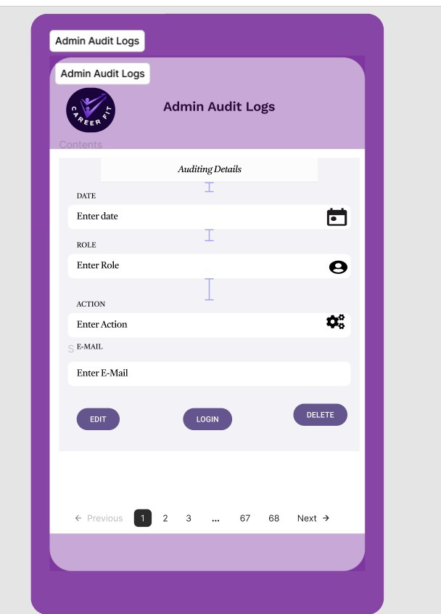
SAMPLE DESIGN CREATED BY FIGMA- Admin

Slide 34

THANK YOU!

