Slide 1
SMART VOTERS
TEAM MEMBERS FACULTY GUIDE
BALAJI.K SUGANTHI.A
GOWSALYA.M INDUSTRIAL MENTOR
MADHAN KUMAR.R YUKTHIKA
JAYADURAI.C

Slide 2
The main goal and objective of this Smart Voting System application are to help the organization in automating the entire manual process of the existing voting system. The voting system must be compatible with the multiuser environment. The Smart Voting System should be able to follow the entire detailed description of candidates and Voters.
ABSTRACT

Slide 3
In India, voting is been done only in booths arranged by the Election Commission.
EXISTING SYSTEM

Slide 4
A online voting system in Digital India in a simple and more easier way.
PROPOSED SYSTEM

Slide 5
DRAWBACKS OF EXISTING SYSTEM - Fake votes can be done. - Standing in queue for a long time. - Brainwashing for unwilling candidade. REFERNCE https://1000projects.org/smart-voting-system-php-website-android-app.html
LITERATURE REVIEW

Slide 6
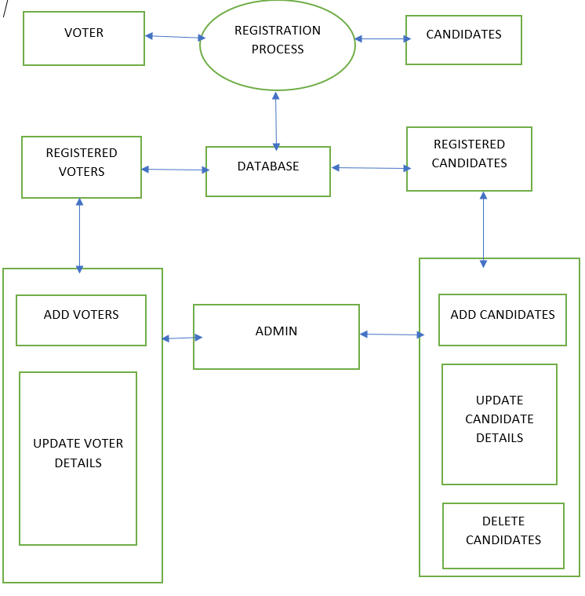
Architectural Design

Slide 7
Username & password Status Status Username & password
DFD-LEVEL 0
Voters
Online Voting Sysytem
Admin

Slide 8
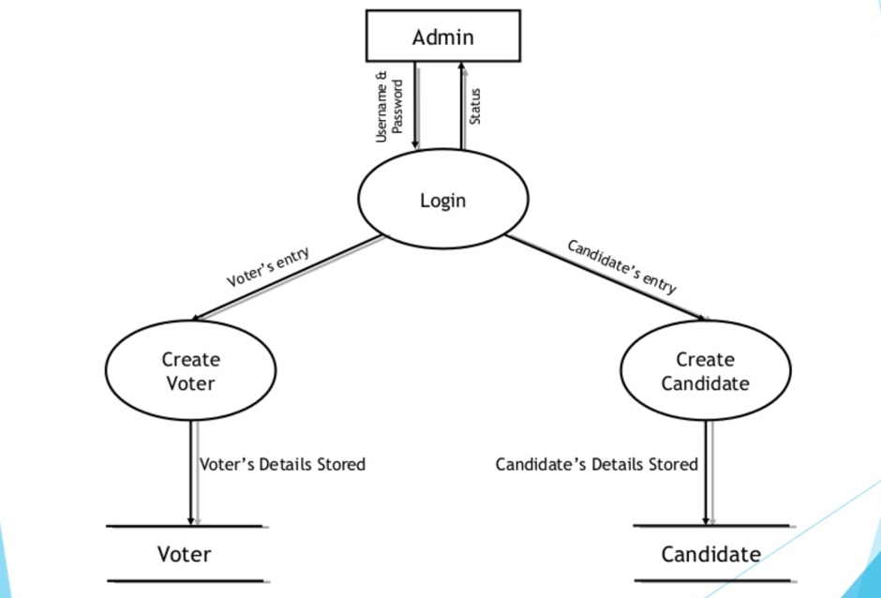
Dfd-level 2

Slide 9
Module 1 : REGISTRATION FORM. Module 2 : AADHAR CARD AND VOTER ID VERIFICATION. Module 3 : OTP MESSAGE AND FINAL CANDIDATE LIST.
MODULE SPLITUP

Slide 10
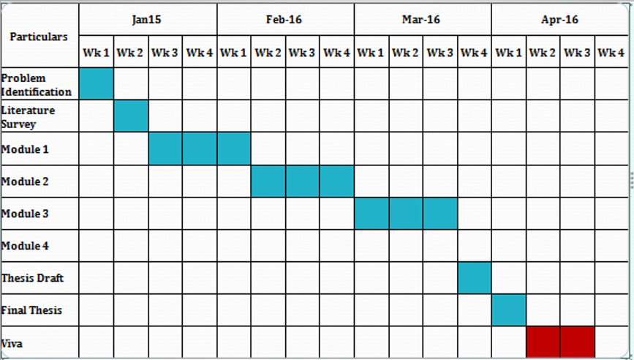
PROJECT PLANNER

Slide 11
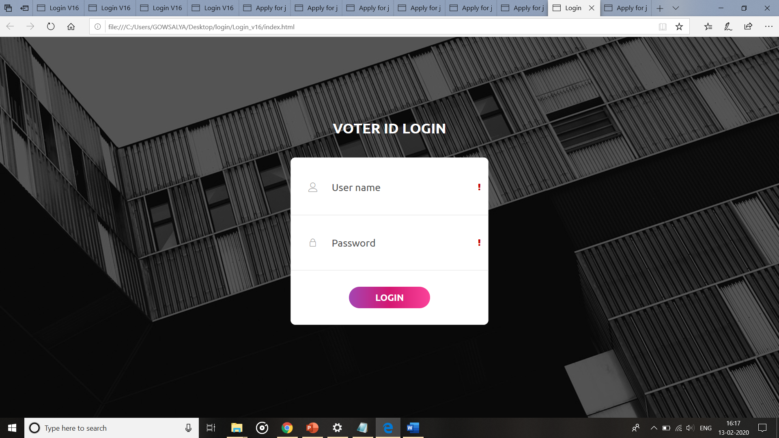
Login page
SCREENSHOT OF OUR PROTOTYPE

Slide 12
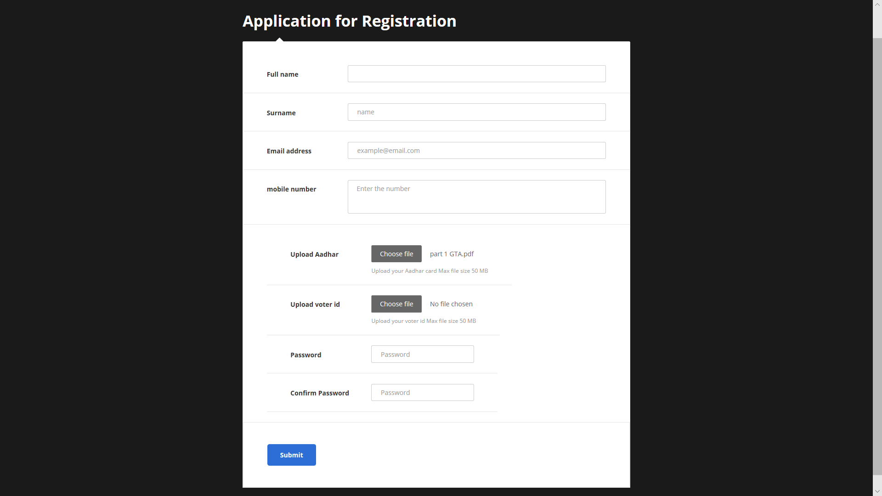
REGISTRATION PAGE

Slide 13
THANKYOU

