Slide 1
Logging

Slide 2
Need for logging
Logging is an important feature to trace back the errors.
  Applications may face errors which have to be debugged.
  Logs helps to get information about what is happening in the application with a record of errors and unusual circumstances.
System.out.print()
  Statements will be printed only on the console.
  When the console closes , automatically, all the logs will be lost.
  Logs will be not be stored permanently
  Displayed one by one
java.util.logging
  Java provides simplified way for logging using package

Slide 3
Logging Components
Logging components help the developer to create logs pass the logs to the respective destination and maintain proper format.
Loggers
  Responsible for capturing log records and passing them to the corresponding Appender.
Appenders or Handlers
  Responsible for recording log events to a destination.
  Appenders format events with the help of Layouts, before sending outputs.
Layouts or Formatters
  Responsible to determine how data looks when it appears in the log entry.

Slide 4
Logging Components
When an application makes a logging call, the Logger component records the event in a LogRecord
It forwards it to the appropriate Appender.
Then its formatted using the Layout
Can also use more than one Filters to specify which Appenders should be used for events.

Slide 5
Loggers
Loggers are Java objects which trigger log events,
  They generate Log Events and passing to the next component which is an Appender.
Can use multiple loggers in a single class to respond to various events or use Loggers in a hierarchy.
Named using the hierarchical dot-separated namespace.
  Logger names must be based on the class or the package name of the logged component.
Logger keeps a track of the nearest existing ancestor in the Logger namespace and also has a “Level” associated with it.

Slide 6
Create a Logger
Logger.getLogger()
  getLogger() method identifies the name of the Logger and takes string as a parameter.
  If a Logger pre-exists then, that Logger is returned, else a new Logger is created.
static Logger logger =
Logger.getLogger(Example.class.getName());

Slide 7
Example
  import java.util.logging.Logger;
  public class Invoice {
  private int invoiceNumber;
  private String customerName;
  static Logger log = Logger.getLogger(Invoice.class.getClass().getName());
  public Invoice() {
  super();
  log.info("Invoice Constructed");
  }
  }

Slide 8
Log Levels
Used to categorize the logs by their severity or the impact on the stability of the application.
Levels in descending order:
  SEVERE(HIGHEST LEVEL)
  WARNING
  INFO
  CONFIG
  FINE
  FINER
  FINEST(LOWEST LEVEL)
Two additional levels ALL and OFF used for logging all messages and disabling logging respectively.

Slide 9
Log Levels
  public static void main(String[] args) {
  log.setLevel(Level.INFO);
  log.severe("FATAL");
  log.warning("WARNING");
  log.info("INFO");
  log.fine("ERROR");
  }
Will Print all the messages
By Changing the level to SEVERE will print only severe message and not others

Slide 10
Configure Loggers
  private static Logger LOGGER;
  static {
  String path = TestGreeting.class.getClassLoader()
  .getResource("logging.properties")
  .getFile();
  System.setProperty("java.util.logging.config.file", path);
  LOGGER = Logger.getLogger(TestGreeting.class.getName());
  }

Slide 11
Configure Loggers
Loggers can be configured using a properties file.
logging. properties
  The file is created inside the src folder of the project.
  Its used to configure the logging settings
  handlers= java.util.logging.ConsoleHandler
  java.util.logging.ConsoleHandler.level = INFO
  java.util.logging.ConsoleHandler.formatter = java.util.logging.SimpleFormatter

Slide 12
Configure Loggers
To configure to store log messages in a text file
  handlers= java.util.logging.FileHandler
  .level=INFO
  java.util.logging.FileHandler.formatter = java.util.logging.XMLFormatter
  LOGGER = Logger.getLogger(TestGreeting.class.getName());
  FileHandler fileHandler = new FileHandler("myLogFile");
  LOGGER.addHandler(fileHandler);

Slide 13
Logging Frameworks
Can also use the logging framework to make the logging concept easy.
Popular logging framework used for logging:
Log4j:
  Apache Log4j is an open-source Java-based logging utility.
SLF4J:
  It stands for Simple Logging Facade for Java (SLF4J). It is an abstraction layer for multiple logging frameworks such as Log4j, Logback, and java.util.logging.
Logback:
  It is an open-source project designed as a successor to Log4j version 1 before Log4j version 2 was released.

Slide 14
STRINGS

Slide 15
Strings
Many characters join together to form a string.
  Collection of characters bound by double quotes (“”).
String are created in two ways
  Direct Initialization
    String message1= "Hello World";
    String message2 =“Hello World
No new objects are created.
  When the second line is executed the message2 instance points to the message1 object which was declared before.

Slide 16
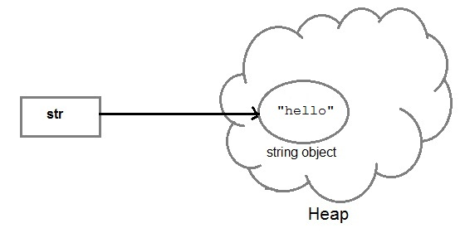
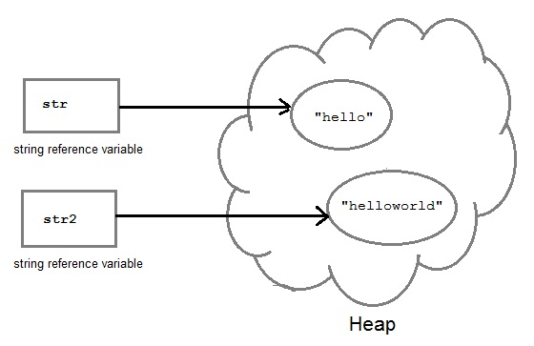
String Creation
String str= "Hello";
String str2=str;

Slide 17
Strings
  String a = "abcd";
  String b = "abcd";
  System.out.println(a == b); // True
  System.out.println(a.equals(b)); // True

Slide 18
Strings
Using constructor
  String myString = new String("Hello World")
A new space is allocated in heap regardless of the object exists in pool or not.
  JVM is forced to create a new string every time its executed
  String c = new String("abcd");
  String d = new String("abcd");
  System.out.println(c == d); // False
  System.out.println(c.equals(d)); // True

Slide 19
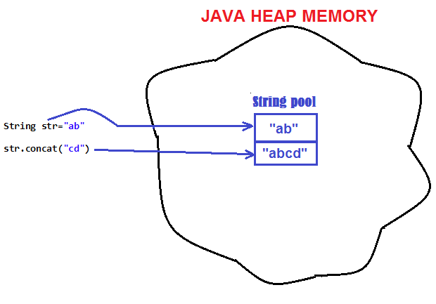
String are Immutable
Java String objects are immutable.
  Unmodifiable or unchangeable.
Once string object is created its data or state can't be changed
  A new string object is created.

Slide 20
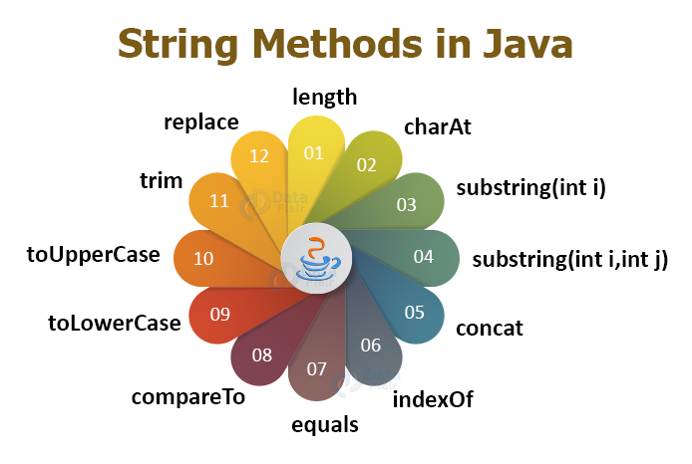

Slide 21
format()
format()
  returns a formatted string with specified format string, and arguments.
  Can concatenate and format the strings
public static String format(String form, Object... args)
  form : The format of the output string.
  Args: specifying the number of arguments for the format string.
    It may be zero or more.

Slide 22
Format() Example
  String message = "Hello World";
  String combined = String.format("Message is %S", message);
  System.out.println(combined);
  //Message is HELLO WORLD
  String combined = String.format("Message is %s", message);
  System.out.println(combined);
  //Message is Hello World
  String amount = String.format("Total Amount is %.2f", 47.65734);
  System.out.println(amount); // 47.66

Slide 23
Format Example
  String prefix = "Message is ";
  String suffix ="Hello World";
  String combined = String.format(
  "Combined : %1$s and %2$s",prefix, suffix);
  System.out.println(combined);
  Output:
  Combined Message is Hello World

Slide 24
Format Example
  int salary = 7500;
  String formatted = String.format("%07d", salary);
  System.out.println(formatted);
  Output:
  0007500
  String formatted = String.format(" Hexa Deciaml %x", salary);
  System.out.println(formatted);
  Output:
  Hexa Deciaml 1d4c
  String.format(" Octal Deciaml %o", salary);

Slide 25
  int mark1 = 46, mark2 = -56;
  String result;
  result = String.format("|%5d|", mark1);
  System.out.println(result); // | 46|
  result = String.format("|%05d|", mark1); // |00046|
  result = String.format("%+d", mark2); // -56
Negative value with ()
  result = String.format("%(d", mark1); // (56)

Slide 26
Java Collections Framework

Slide 27
Java Collection Framework
Provides tools to maintain data container of object
Alternative to the creation of custom data structures
Consists of interfaces and classes within the java.util package
java.util.Collection is the root interface for most of the Java collections
  There is no direct implementation
  Sub-interfaces are Set and List.
  Used to pass collections around and manipulate them

Slide 28
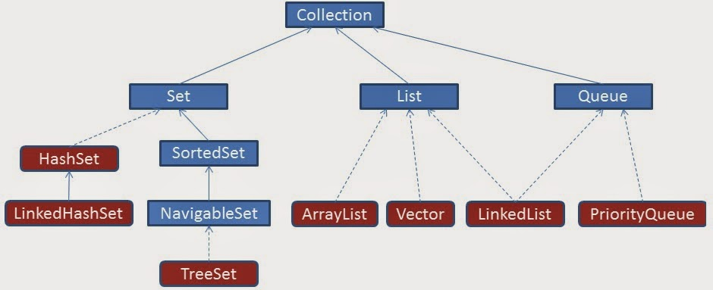
Collection Hierarchy

Slide 29
Collection categories
Ordered Collection
  The objects within the collection are maintained in a particular order or not
  When an object is added or removed from an ordered collection , the order is automatically maintained
Duplicate Elements
  Whether or not the collection allows duplicate objects
  Collection will automatically reject an attempt to add an object
Mapping of Key & Value
  Whether or not the collection maps a key to a particular object .
  This provides a means of quickly locating the object.
  Such collections do not allow duplicate objects

Slide 30
Collections
Lists
  List of things
  Classes that implement List Interface
Sets
  Unique things
  Classes that implement Set Interface
Maps
  Things with unique id
  Classes that implement Map Interface
Queues
  Things arranged in order
  Classes that implement Queue Interface

Slide 31
Methods in List Interface
void add(object o)
void addAll(Collection c)
void clear()
boolean contains(object)
Object get(int index)
int indexOf(object o)
ListIterator listIterator()
Object set (int index, Object element)

Slide 32
List Implementations
Array List
  a resizable-array implementation
    unsynchronized
Linked List
  a doubly-linked list implementation
  if elements frequently inserted/deleted within the List
    May provide better performance than ArrayList
  For queues and double-ended queues (deques)
Vector
  a synchronized resizable-array implementation of a List with additional "legacy" methods.

Slide 33
ArrayList
Permits all elements, including null.
  Dynamically add objects in the List.
  By default, creates an array of size 10.
  Adding or removing elements will automatically adjust the size
ArrayList()
  Constructs an empty list with an initial capacity of ten.
ArrayList(int initialCapacity)
  Constructs an empty list with the specified initial capacity.

Slide 34
Generics
Introduced in Java 5.0
Can put any Object in to Collections, because they hold Just Objects
  Type-safe Collections are created ,ensuring type-safety at compile time rather than run-time
Type erasure Applied For :
  Stronger type checks at compile time.
  Elimination of casts.
  The bytecode, contains only ordinary classes, interfaces, and methods.
  Type erasure ensures that no new classes are created for parameterized types;
    Generics incur no runtime overhead.

Slide 35
Generics
Creating an Instance of Classes of Generic Type
  ArrayList<Employee> alist=new ArrayList<Employee>();
    Employee ramesh = new Employee(101,”Ramesh”);
  alist.add(ramesh);
Stronger type checks at compile time.
A Java compiler applies strong type checking to generic code and issues errors if the code violates type safety.
Fixing compile-time errors is easier than fixing runtime errors, which can be difficult to find.

Slide 36
Two Schemes of Traversing Collections
for-each
  The for-each construct allows you to concisely traverse a collection or array using a for loop
for (Object o: collection)
  System.out.println(o);
Iterator
  An Iterator is an object that enables you to traverse through a collection and to remove elements from the collection selectively, if desired

Slide 37
ArrayList – Enhanced For Loop
  public void printElements()
  {
  for(Employee employee :list)
  {
  System.out.println(employee .getEmpname());
  System.out.println(employee .getEmpno());
  }
  }

Slide 38
The Iterator Interface
Provides for the one-way traversal of a Set or SortedSet collection (forward only)
Has several required methods but the most frequently used are:
Method
Usage
hasNext()
Returns true if the iteration has more elements
next()
Returns the next element in the iteration (as a generic Object)

Slide 39
Array List –with Iterator
public void dispalyArrayList()
{
Iterator<Employee> itr = alist.iterator();
while(itr.hasNext())
{
Employee empObj = itr.next();
System.out.println(empObj.getEmpname());
System.out.println(empObj.getEmpno());
}
}

Slide 40
Array List
When to use ArrayList
  To fetch data frequently
  Adding data is not so frequent activity.
When not to use ArrayList
  When the list is updated frequently

Slide 41
The ListIterator Interface
Extends the Iterator interface to provide for the two-way traversal of a List collection (forward and backward)
The most frequently used are:
Method | Usage
haxNext() | Returns true if this list iterator has more elements when traversing the list in the forward direction
hasPrevious() | Returns true if this list iterator has more elements when traversing the list in the backward direction
next() | Returns the next element in the list (as a generic Object)
previous() | Returns the previous element in the list (as a generic Object)

Slide 42
The Four Methods
Collections depends on :
  equals,
  compare
  compareTo,
  hashCode
Collection with some sort of membership test uses equals
Collection that depends on sorting requires larger/equal/smaller comparisons (compare or compareTo)
Collection that depends on hashing requires both equality testing and hash codes
While implementing hashCode, implement equals too.

Slide 43
Natural Ordering
Comparable implementations provide a natural ordering for a class, which allows objects of that class to be sorted automatically
If the List consists of String elements, it will be sorted into alphabetical order
String class implements the Comparable interface.
If the elements do not implement Comparable, Collections.sort(list) will throw a ClassCastException.

Slide 44
Comparable Interface
Implementing Comparable interface requires to implement the method compareTo()
Imposes a total ordering on the objects of each class that implements it.
The class's compareTo method is referred to as its natural comparison method.
public int compareTo(Object o)
  Compares this object with the specified object for order.
  Returns a negative integer, zero, or a positive integer as this object is less than, equal to, or greater than the specified object.

Slide 45
Implementing Comparable
  public class Book implements Comparable<Book>{
  private int bookno;
  private String bookname;
  private String author;
  public int compareTo(Book otherbook) {
  if(this.bookno<otherbook.bookno) return -1;
  if(this.bookno>otherbook.bookno) return 1;
  return 0;
  }
}
To Sort the ArrayList Using Comaprable the static method in the Collectins class is invoked
  Collections.sort(arrList);

Slide 46
Using a separate Comparator
Can put the comparison method in a separate class that implements Comparator instead of Comparable
The more flexible Comparator can also be used
Comparator is in java.util, not java.lang
Comparable requires a definition of compareTo but Comparator requires a definition of compare

Slide 47
Implementing Comparator
  import java.util.Comparator;
  public class BookNumberComp implements Comparator<Book>
  {
  public int compare(Book obj1, Book obj2) {
  if(obj1.getBookno()<obj2.getBookno())return -1;
  if(obj1.getBookno()>obj2.getBookno())return 1;
  return 0;
  }
  }

Slide 48
Implementing Multiple Comparators
  public class BookNumberComp implements Comparator<Book>
  {
  public int compare(Book obj1, Book obj2) {
  if(obj1.getBookno()<obj2.getBookno())return -1;
  if(obj1.getBookno()>obj2.getBookno())return 1;
  return 0;
  }
  }
  public class BookNameComp implements Comparator<Book>
  {
  public int compare(Book obj1, Book obj2) {
  String bk1 = obj1.getBookname();
  String bk2 = obj2.getBookname();
  return bk1.compareTo(bk2);
  }
  }

Slide 49
Collections.Sort() with Comparator
public static void main(String[] args) {
ArrayList<Book> bkList = new ArrayList<Book>();
Book bk1 = new Book(23,"java","kathy sierra");
Book bk2 = new Book(101,"j2ee","james gosling");
Book bk3 = new Book(11,"struts","haffzel manning");
bkList.add(bk1);
bkList.add(bk2);
bkList.add(bk3);
BookComparators bc = new BookComparators();
Collections.sort(bkList, bc);
for(Book bk:bkList)
{
System.out.println(bk.getBookno());
}
}

Slide 50
When to use each
The Comparable interface is simpler and less work
  The Object of the class implements Comparable
  A public int compareTo(Object o) method is overriden
  When no argument constructor is used in TreeSet or TreeMap
The Comparator interface is more flexible but slightly more work
  Many different classes that implement Comparator
  Sorting the TreeSet or TreeMap differently with each comparator
  TreeSet or TreeMap are Constructed using the comparator

Slide 51
Interface Set
Extends Collection
An unordered collection of objects
  can grow as needed
  easy to add/delete
  API independent of implementation (HashSet, TreeSet)
  Elements have no positions
  Duplicate entries not allowed

Slide 52
TreeSet
A balanced binary tree implementation
Imposes an ordering on its elements
The elements in the TreeSet are sorted in ascending element order, sorted according to the natural order of the elements
It can be sorted by the comparator provided at set creation time
TreeSet instance performs all key comparisons using its compareTo (or compare) method,

Slide 53
Hash Set
Non Duplicate
Un-Ordered
Internally uses HashMap.
  Adds a value in 'map' by calling put(E,o);
  They Key E is the element passed in add
  'o' as the value which is a dummy Object created by doing Object o = new Object;
    Its common for all key's entered in HashMap 'map’.
Checks the Key is already present by calling the equals method of 'element'.

Slide 54
equals” operation of “Set” Interface
Set also adds a stronger contract on the behavior of the equals and hashCode operations,
Set instances to be compared meaningfully even if their implementation types differ
Two Set instances are equal if they contain the same elements
The equality is determined by equals and hashcode Implementation

Slide 55
Hash Set – Duplicates Not Allowed
  public static void main(String args[]) {
  HashSet<Book> hs = new HashSet<Book>();
  Book b1= new Book(100,"java","herbert");
  Book b2 = new Book(101,"j2ee","kathy siera");
  Book b3 = new Book(101,"j2ee","kathy siera");
  hs.add(b1);
  hs.add(b2);
  for(Book bk:hs)
  {
  System.out.println(bk.getBookno());
  System.out.println(bk.getBookname());
  }
  }

Slide 56
Tree Set With Comparators
Tree Set Class overloaded constructors one without argument and another one which takes comparator as arguments.
  BookComparators bc = new BookComparators();
  TreeSet<Book> tscomp = new TreeSet<Book>(bc);
  Book bk1 = new Book(23,"java","kathy sierra");
  Book bk2 = new Book(101,"j2ee","james gosling");
  Book bk3 = new Book(11,"struts","haffzel manning");
  tscomp.add(bk1);
  tscomp.add(bk2);
  tscomp.add(bk3);
  }

Slide 57
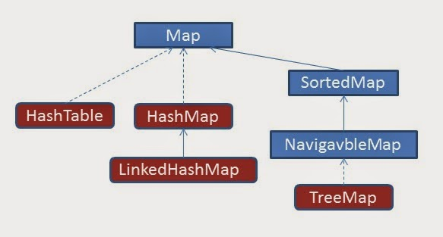
Collection Hierarchy- Map

Slide 58
Why Map is not Extending Collection
Maps work with key/value pairs
  They map keys to values.
Its content can be viewed
  As a set of keys,
  A collection of values
  A set of key-value mappings.
Mappings are not collections and collections are not mappings.
Maps can be viewed as Collections of keys, values, or pairs
It has Collection view operations
  keySet, entrySet, and values

Slide 59
Map
interface Map (does not extend Collection)
An object that maps keys to values
Ordering may be provided by implementation class, but not guaranteed
Methods to Add and Get Objects
  Object put( Object key, Object value)
  Object get( Object key)
Iterators for keys, values, (key, value) pairs

Slide 60
Map Implementations
Hash Map
  A hash table implementation of Map
  Supports null keys & values
  Not Ordered
Tree Map
  A balanced binary tree implementation
  Imposes an ordering on its elements based on comparable/compartor
Hash table
  Synchronized hash table implementation of Map interface.
  Doesn't support null keys and values

Slide 61
Hash Map
Works on the principal of hashing.
It stores values in the form of key-value pair
  Access a value by providing the key.
The 'key' element should implement equals() and hashcode() method.
HashMap stores key-value pair in Map.Entry static nested class implementation.

Slide 62
Working of Hash Map
put()
  Invoked by passing key-value pair,
  The Entry is stored in the LinkedList, so if there is an already existing entry, it uses equals() method to check if the passed key already exists, if yes it overwrites the value else it creates a new entry and stores this key-value Entry.
get()
  Invoked by passing Key,
  It uses the hashCode() to find the index in the array and then use equals() method to find the correct Entry and return its value.

Slide 63
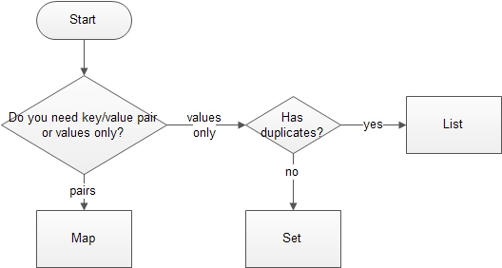
Deciding the Collection Interface

