Slide 1
TEAM BLAK_CLOVER TEAM MEMBERS
GODREIGN ELGIN Y BE CSE(AIML)
GOWTHAAM J BE CSE(AIML)
POOVENTHIRA R BE CSE(AIML)
RAJ KUMAR S BE CSE(AIML)

Slide 2
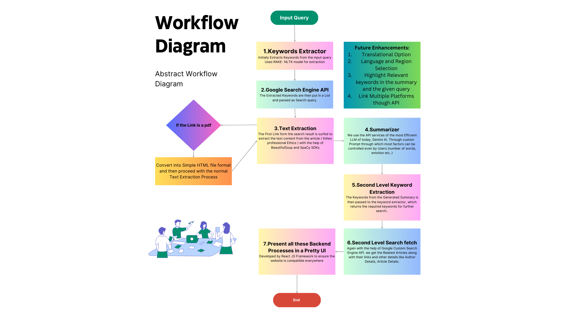

Slide 3

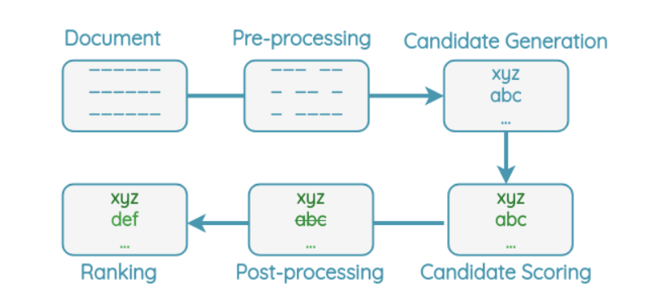

Key Words-Extraction- RAKE-nltk Language Processing:-
We also ensure that the keywords fed into the API are meaningful by intelligently splitting the input, considering stop words, and lemmatizing the words to obtain their base form. This approach enhances the accuracy and relevance of the extracted keywords, improving system performance.

Slide 4
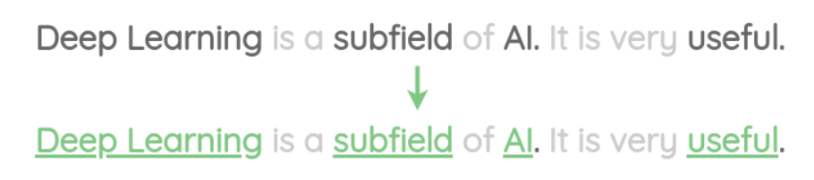
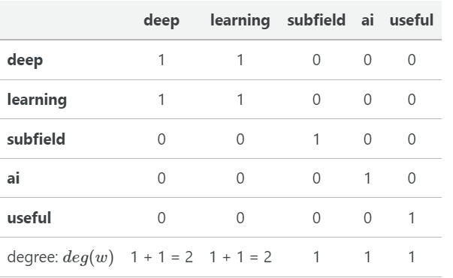
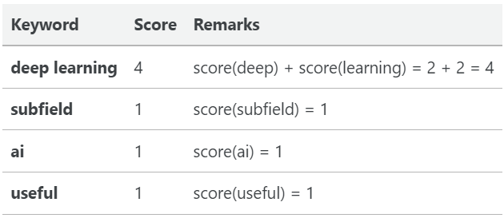
Key Words-Extraction- RAKE-nltk Language Processing:-
Candidate Scoring:
Final Ranking:
Final Score = deg(word)
freq(word)

Slide 5
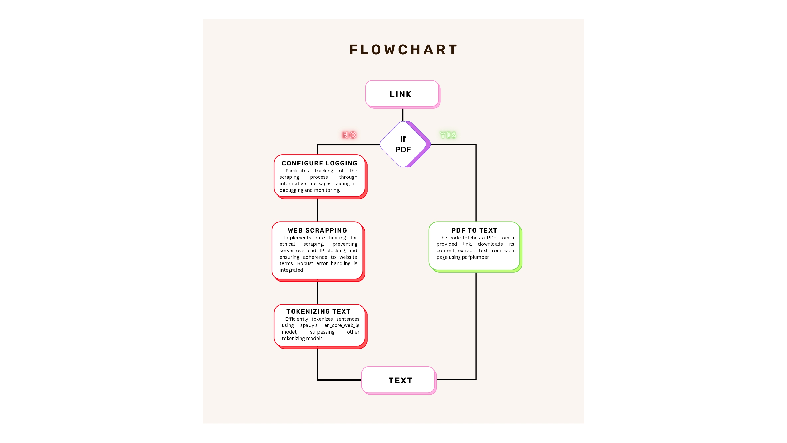

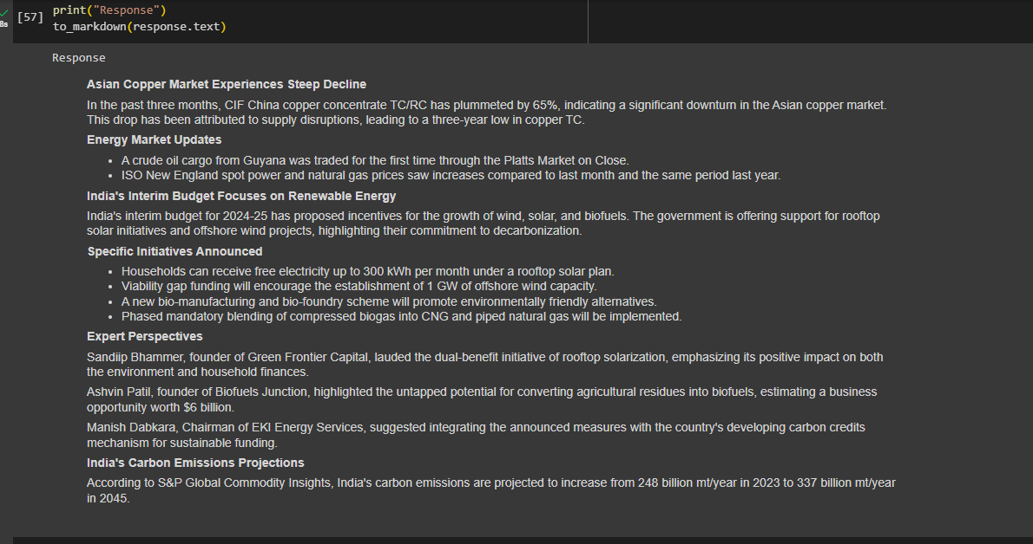
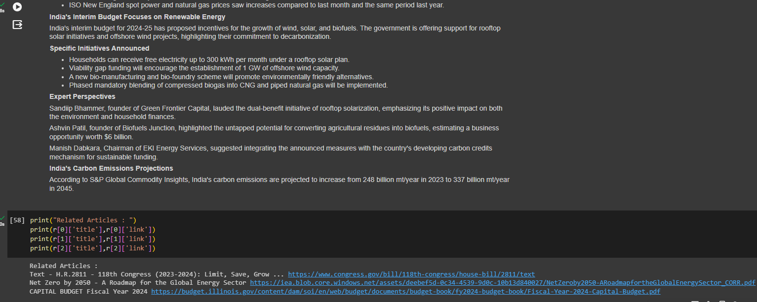
Screenshot of the Working Model

