Slide 1

SMART INDIA HACKATHON 2026
ROVION: AI-Assisted Air-to-Ground Search and Rescue System
Problem Statement ID – SIH26218
Problem Statement Title- Student Innovation-There is a need to design drones and robots that can solve some of the pressing challenges of India such as handling medical emergencies, search and rescue operations, etc.
Theme- Robotics and Drones
PS Category- Hardware
Team ID- 155820
Team Name- ROVION SOLUTIONS

Slide 2
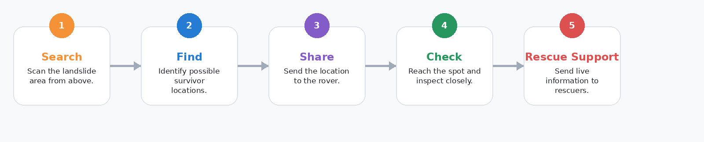
ROVION: AI-Assisted Air-to-Ground Search and Rescue System
ROVION SOLUTIONS
Proposed Solution:
• Drone scans the landslide area from above.
• AI marks possible survivors.
• Target location is sent to the rover.
• 6WD rover reaches the spot over rough ground.
• Camera/PIR checks closely and sends live data.
Innovation / Uniqueness:
• Fast aerial search + close ground confirmation.
• Air-to-ground target handoff.
• 6WD rover designed for rough terrain.
• Human makes the final rescue decision.
Problem:
Landslides make rescue slow and risky. Survivors may be hidden in unstable areas where rescuers cannot enter immediately.
Our Idea:
ROVION uses a drone to search first and a 6-wheel rover to check closely. It gives rescuers location, video and sensor data before they enter danger zones.

Slide 3
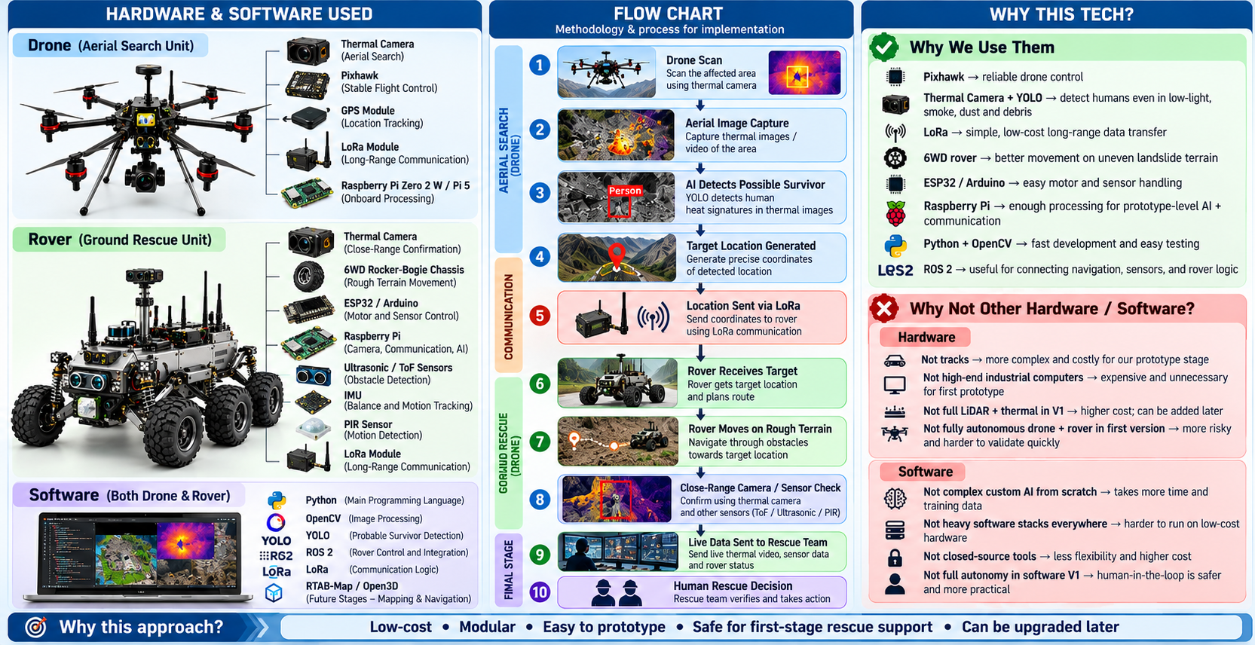
TECHNICAL APPROACH
ROVION SOLUTIONS

Slide 4
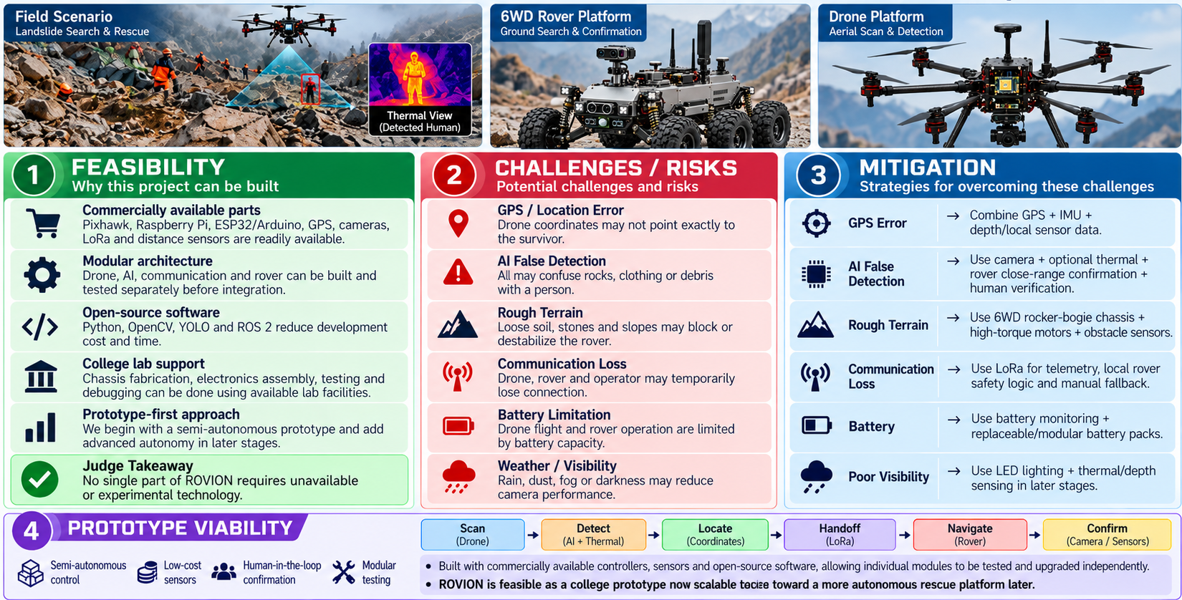
FEASIBILITY AND VIABILITY
ROVION SOLUTIONS

Slide 5
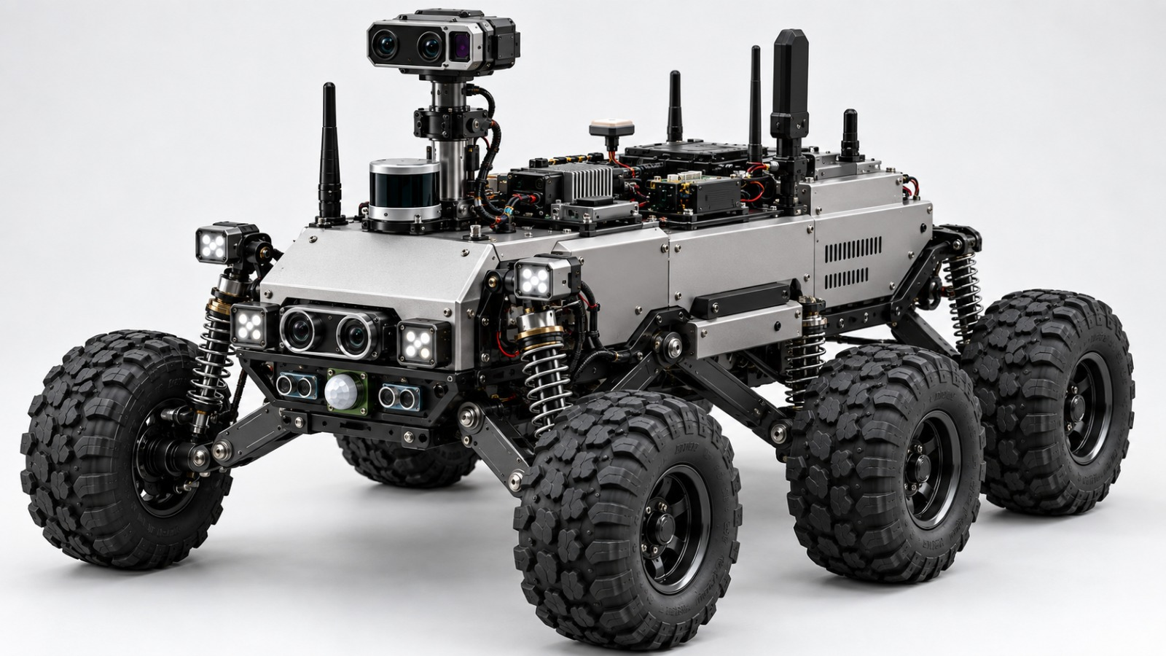
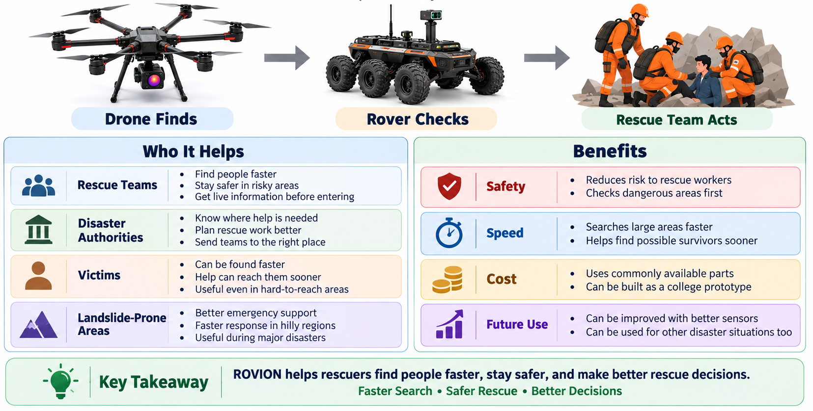
IMPACT AND BENEFITS
ROVION SOLUTIONS

Slide 6
RESEARCH AND REFERENCES
ROVION SOLUTION
1. Problem / Concept Validation:
. Huang et al. (2024) — UAV + UGV for Search and Rescue: FPGA-based UAV and UGV for Search and Rescue Applications: A Case Study
This paper uses UAV + UGV + YOLO + RGB/thermal imaging for survivor detection, which strongly supports our overall ROVION architecture.
Link: https://www.researchgate.net/publication/384511724_FPGA-based_UAV_and_UGV_for_search_and_rescue_applications_A_case_study
Henriques et al. (2024) — Flying + Ground Robot Team: Camera-based Mapping in Search-and-Rescue via Flying and Ground Robot Teams
This research combines flying and ground robots for victim localization, tracking, and terrain mapping. It directly supports our drone finds → rover checks workflow.
Link: https://www.researchgate.net/publication/383265651_Camera-based_mapping_in_search-and-rescue_via_flying_and_ground_robot_teams
2. Technical Feasibility:
Yeom (2024) — Thermal Drone Human Detection: Thermal Image Tracking for Search and Rescue Missions with a Drone
The study uses thermal imaging + YOLO to detect and track people during search-and-rescue missions. This supports our 6-wing drone with a thermal camera.
Link: https://www.researchgate.net/publication/378025885_Thermal_Image_Tracking_for_Search_and_Rescue_Missions_with_a_Drone
Manuel et al. (2024) — LoRa Disaster Communication: A LoRa-Based Disaster Management System for Search and Rescue Mission
This research studies LoRa-based communication for SAR robots when normal communication infrastructure may be damaged. This supports our drone–rover–operator telemetry link.
Link: https://www.researchgate.net/publication/382676934_A_LoRa-Based_Disaster_Management_System_for_Search_and_Rescue_Mission
3. Design & Application Validation:
Human-in-the-Loop UAV–UGV Coordination 2024 — Distributed Adaptive Cooperative Control for Human-in-the-Loop Heterogeneous UAV-UGV Systems.
This IEEE research specifically studies UAV + UGV coordination while keeping a human in the control loop, which matches our decision to keep final rescue decisions with the operator
rather than making the system fully autonomous.
Link: https://www.researchgate.net/publication/379973690_Distributed_Adaptive_Cooperative_Control_for_Human-in-the-Loop_Heterogeneous_UAV-UGV_Systems_with_Prescribed_Performance
b) Multi-Robot Mission Planning : 2024 — Toward a Generic Framework for Mission Planning and Execution with a Heterogeneous Multi-Robot System
This work deals with coordinating UAVs and UGVs in dynamic and unstructured environments. That supports our system architecture where the drone and rover have different roles but work toward one rescue mission.
Link : https://www.researchgate.net/publication/385332124_Toward_a_Generic_Framework_for_Mission_Planning_and_Execution_with_a_Heterogeneous_Multi-Robot_System

