Slide 1
SQL (STRUCTURED QUERY LANGUAGE)
MySQL DATABASE

Slide 2
CLASSIFICATION
SQL PLUS
DDL
DML
DCL
TCL
CREATE
ALTER
DROP
SELECT
INSERT
UPDATE
DELETE
GRANT
REVOKE
COMMIT
ROLLBACK
SAVEPOINT
SET RANSACTION

Slide 3
DDL (DATA DECLARATION LANGUAGE)

Slide 4
CREATE TABLE STATEMENT
The SQL CREATE TABLE Statement
The CREATE TABLE statement is used to create a new table in a database.
Syntax
CREATE TABLE table_name ( column1 datatype, column2 datatype, column3 datatype, .... );
The column parameters specify the names of the columns of the table.
The datatype parameter specifies the type of data the column can hold (e.g. varchar, integer, date, etc.).

Slide 5
SQL CREATE TABLE Example
The following example creates a table called "Persons" that contains five columns: PersonID, LastName, FirstName, Address, and City:
Example:
CREATE TABLE Persons ( PersonID int, LastName varchar(255), FirstName varchar(255), Address varchar(255), City varchar(255) );

Slide 6
SQL ALTER TABLE Statement
The ALTER TABLE statement is used to add, delete, or modify columns in an existing table.
The ALTER TABLE statement is also used to add and drop various constraints on an existing table.
ALTER TABLE - ADD Column
To add a column in a table, use the following syntax:
ALTER TABLE table_name ADD column_name datatype;
Example
ALTER TABLE Customers ADD Email varchar(255);

Slide 7
ALTER TABLE - DROP COLUMN
ALTER TABLE - DROP COLUMN
To delete a column in a table, use the following syntax (notice that some database systems don't allow deleting a column):
ALTER TABLE table_name DROP COLUMN column_name;
The following SQL deletes the "Email" column from the "Customers" table:
Example
ALTER TABLE Customers DROP COLUMN Email;

Slide 8
SQL DROP TABLE Statement
The DROP TABLE statement is used to drop an existing table in a database.
Syntax
DROP TABLE table_name;
Example:
The following SQL statement drops the existing table "Shippers":
DROP TABLE Shippers;

Slide 9
DML (DATA MANIPULATION LANGUAGE)

Slide 10
SQL INSERT INTO Statement
It is possible to write the INSERT INTO statement in two ways:
1. Specify both the column names and the values to be inserted:
INSERT INTO table_name (column1, column2, column3, ...)
VALUES (value1, value2, value3, ...);
2. If you are adding values for all the columns of the table, you do not need to specify the column names in the SQL query. However, make sure the order of the values is in the same order as the columns in the table. Here, the INSERT INTO syntax would be as follows:
INSERT INTO table_name
VALUES (value1, value2, value3, ...);

Slide 11
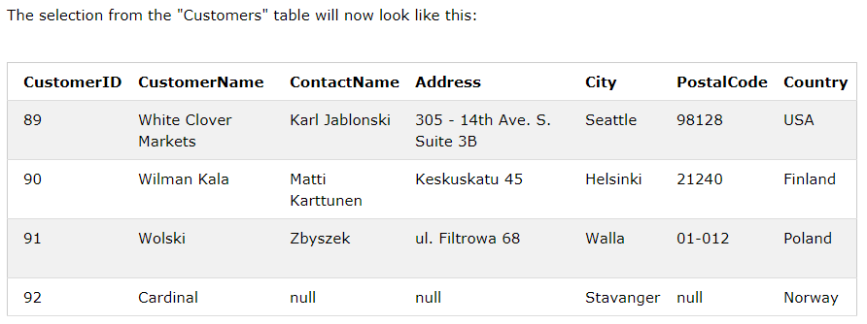
SQL INSERT INTO Statement
INSERT INTO Example
The following SQL statement inserts a new record in the "Customers" table for all columns:
INSERT INTO Customers
VALUES (’92’, 'Cardinal', 'Tom B. Erichsen', 'Skagen 21', 'Stavanger', '4006', 'Norway');
Insert Data Only in Specified Columns
It is also possible to only insert data in specific columns.
The following SQL statement will insert a new record, but only insert data in the "CustomerName", "City", and "Country" columns (CustomerID will be updated automatically):
INSERT INTO Customers (CustomerName, City, Country)
VALUES ('Cardinal', 'Stavanger', 'Norway');

Slide 12
SQL UPDATE Statement
The UPDATE statement is used to modify the existing records in a table.
UPDATE Syntax
UPDATE table_name
SET column1 = value1, column2 = value2, ...
WHERE condition;
Note: Be careful when updating records in a table! Notice the WHERE clause in the UPDATE statement. The WHERE clause specifies which record(s) that should be updated. If you omit the WHERE clause, all records in the table will be updated!
Example
UPDATE Customers SET ContactName = 'Alfred Schmidt', City= 'Frankfurt' WHERE CustomerID = 1;

Slide 13
SQL DELETE Statement
The SQL DELETE Statement
The DELETE statement is used to delete existing records in a table.
DELETE Syntax
DELETE FROM table_name WHERE condition;
Note: Be careful when deleting records in a table! Notice the WHERE clause in the DELETE statement. The WHERE clause specifies which record(s) should be deleted. If you omit the WHERE clause, all records in the table will be deleted!
Example
DELETE FROM Customers WHERE CustomerName='Alfreds Futterkiste';

Slide 14
SQL SELECT Statement
The SQL SELECT Statement
The SELECT statement is used to select data from a database.
The data returned is stored in a result table, called the result-set.
Syntax
SELECT column1, column2, ...
FROM table_name;
Here, column1, column2, ... are the field names of the table you want to select data from. If you want to select all the fields available in the table, use the following syntax:
SELECT * FROM table_name;
Example:
SELECT CustomerName, City FROM Customers;

Slide 15
DCL (Data Control Language)

Slide 16
DCL(Data Control Language)
DCL includes commands such as GRANT and REVOKE which mainly deal with the rights, permissions and other controls of the database system. Examples of DCL commands:
GRANT-gives user’s access privileges to the database.
REVOKE-withdraw user’s access privileges given by using the GRANT command.

Slide 17
tCL (TRANSACTION Control Language)

Slide 18
TCL
TCL commands deal with the transaction within the database.
Examples of TCL commands:
COMMIT– commits a Transaction.
ROLLBACK– rollbacks a transaction in case of any error occurs.
SAVEPOINT–sets a savepoint within a transaction.
SET TRANSACTION–specify characteristics for the transaction.

Slide 19

THANK YOU AND SEE YOU AGAIN

