Slide 1
AlphaPulse: Portfolio Risk & Return Analysis Dashboard

Slide 2
PROBLEM & OBJECTIVE
Problem:
Difficulty in analyzing portfolio risk and returns
Market uncertainty affects decision-making
Objective:
Analyze risk and return
Understand asset correlation
Predict future performance

Slide 3
USE CASE
Designed for asset management firms
Helps in portfolio risk assessment
Supports better investment decisions

Slide 4
TECH STACK
Python (data processing)
NumPy (statistical calculations)
Tableau (visualization)

Slide 5
WORKFLOW
Data Collection
Data Preprocessing
Risk Analysis
Simulation
Visualization

Slide 6
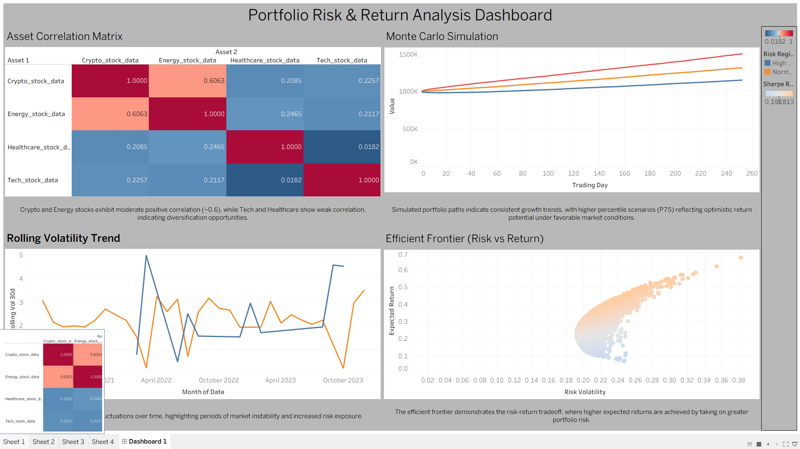
DASHBOARD OVERVIEW
Correlation Matrix
Monte Carlo Simulation
Rolling Volatility
Efficient Frontier

Slide 7
KEY ANALYSIS
Correlation Matrix
Shows relationships between assets
Helps in diversification
Rolling Volatility
Measures risk over time
Identifies unstable market periods
Monte Carlo Simulation
Simulates future portfolio scenarios
Shows uncertainty in returns
Efficient Frontier
Shows risk vs return tradeoff
Identifies optimal portfolios

Slide 8
KEY INSIGHTS
Insights:
Low correlation improves diversification
High volatility indicates higher risk
Portfolio shows growth potential with uncertainty
Higher return requires higher risk

Slide 9
CONCLUSION
Provides clear financial insights
Helps in decision-making
Combines analytics with visualization

