Slide 1
MARKETING AND RETAIL ANALYSIS PROJECT MILESTONE -1

Slide 2
PROBLEM STATEMENT
An automobile parts manufacturing company has collected data of transactions for 3 years.
It is required to make insights about their data and their customers. And also make RFM analysis to find the best, loyal and lost customer for the company

Slide 3
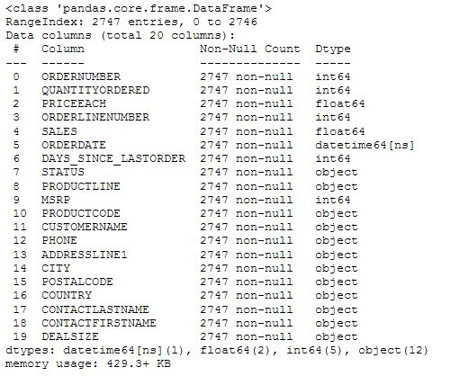

Slide 4
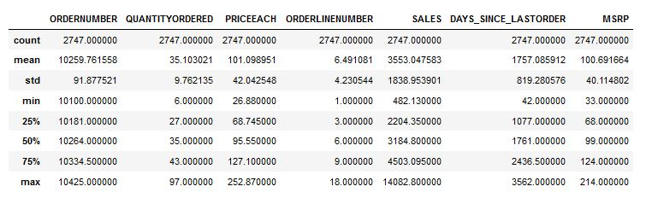

Slide 5
Shape of the Dataset:(2747x20)
It is dataset which contain sales data of a automobile parts company which sells components for Trains, ships, Trucks, Busses, Cars and Motor cycles
It also provides customer details and their country of origin.
It also show all trends across sales for three years.
Here Tableau is used to perform Exploratory Data Analysis

Slide 6
Exploratory Data Analysis

Slide 7
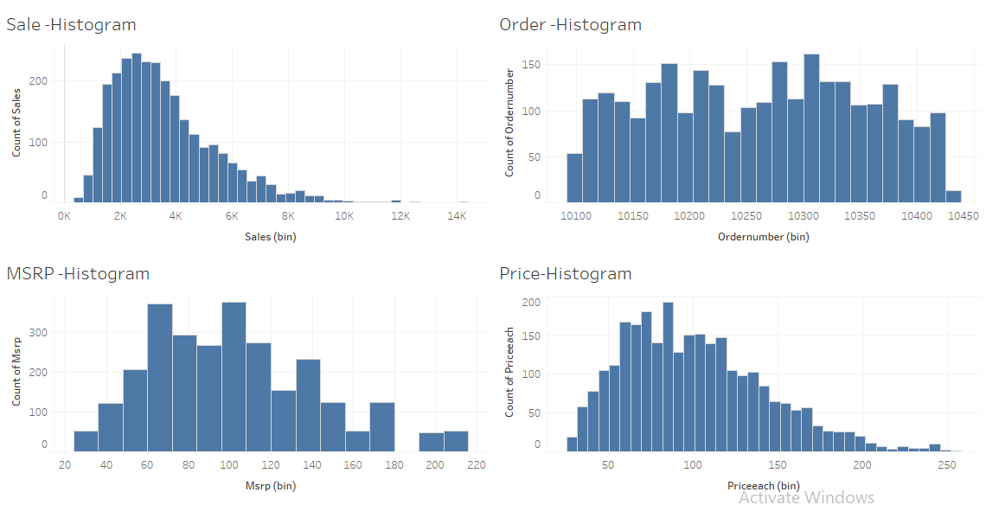
Uni-varaite Analysis

Slide 8
INFERENCE
From this Uni-varaite analysis we can visualize
That
1.Sales and price data are normally distributed but both are positively skewed.
2.A bulk of product are in the price range of 50 to 150$
3.Also most of the sales are within the range of 0 to 4000$

Slide 9
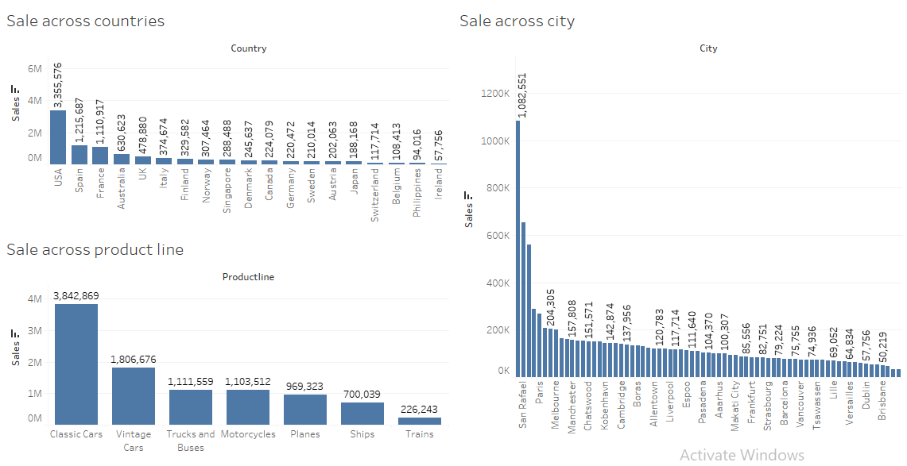
Bi-variate analysis

Slide 10
INFERENCE
In this we can visualize that
Highest sales is from USA while second being Spain and France. Also Net sales in USA is almost double that of Spain.
While Ireland has lowest net sales compared to other countries.
Contrary to the country ,the data shows that Madrid and San Raphael the 2 cities in Spain has the highest sales. While 3rd being New York City which is half the net sales of Madrid.
Classic and Vintage cars product lines make up for 70% of the total sales across all the product lines.
Sales of components for trains is very low.

Slide 11
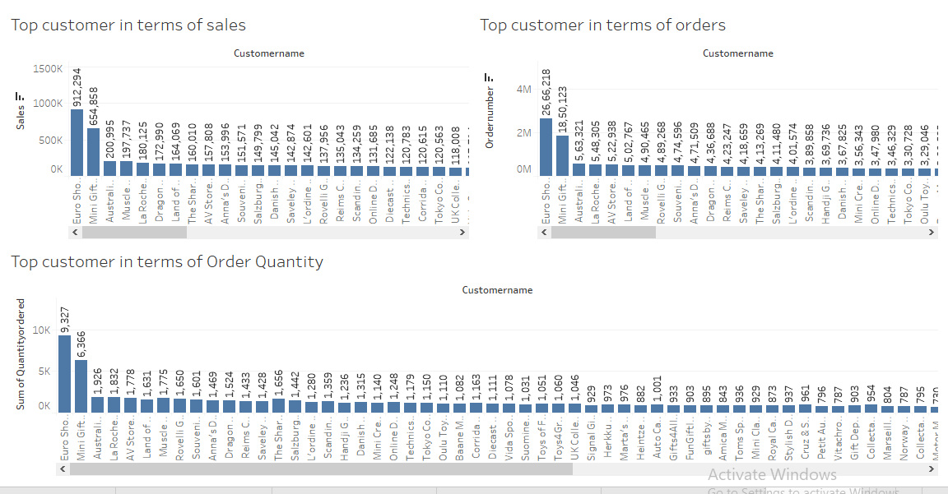
Top Customers

Slide 12
INFERENCE
In this we can visualize that
The top customers in terms of sales and order quantity being the same i.e Euro Shopping Channel.
This also shows that two countries USA and Spain has 37 of the total 89 customers.

Slide 13
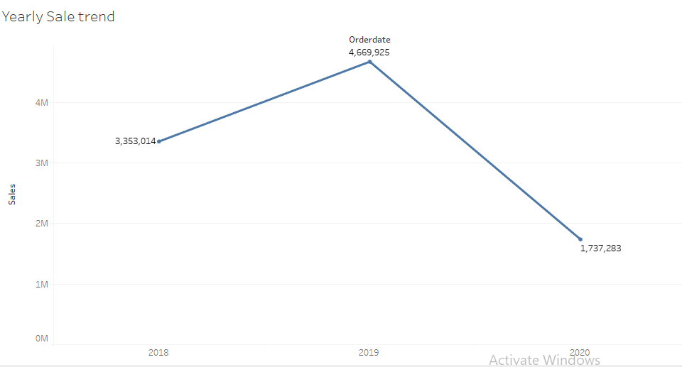
Yearly Trend

Slide 14
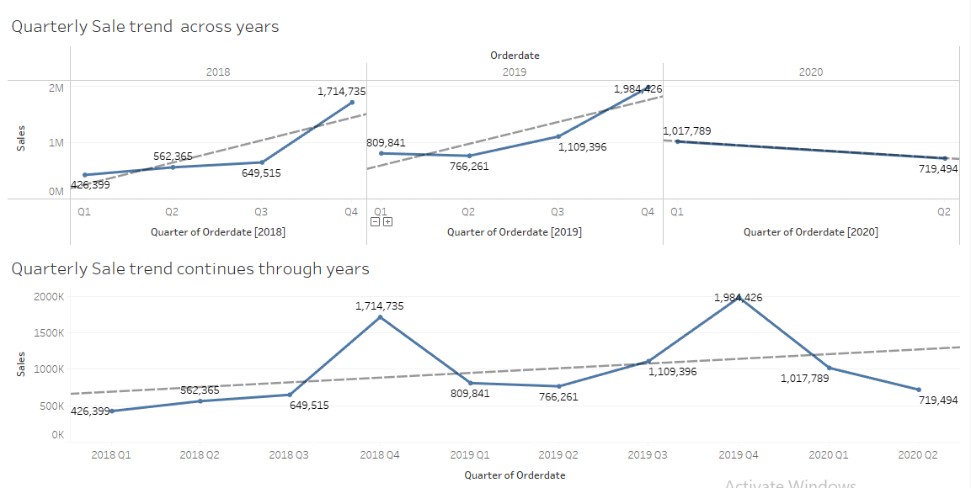
Quarterly Trend

Slide 15
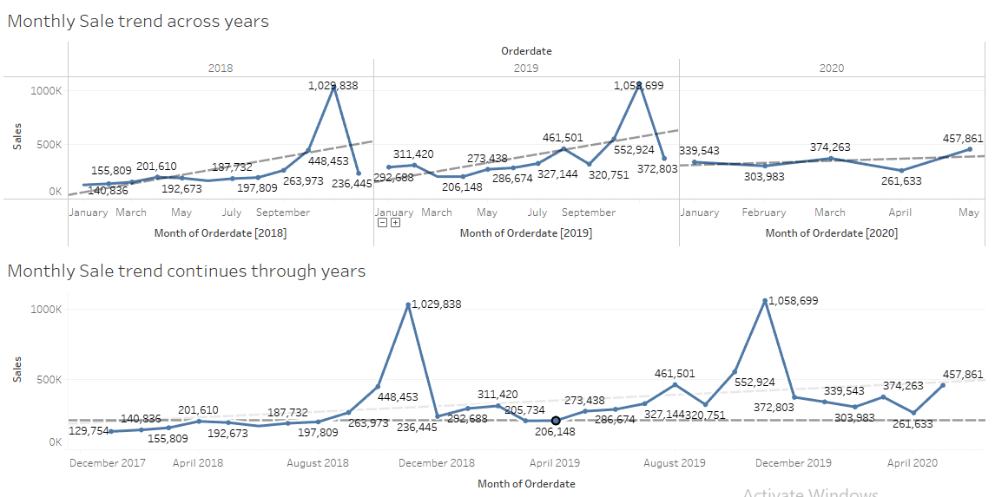
Monthly Trend

Slide 16
INFERENCE
The yearly trend shows a steep drop in the year 2020.
Quarterly trend show a upward trend till Jan 2020 while there is a steep decline in sales in Feb of 2020
It also shows a Seasonality it the sales in both 2018 and 2019.
Monthly Trend shows a steep increase in the months on November and December in both the year 2018 and 2019.
Here the seasonality is more visual if focused for individual year.
The trend is neither in decline nor in raise when the data is spread across all the three years.

Slide 17
RFM ANALYSIS

Slide 18
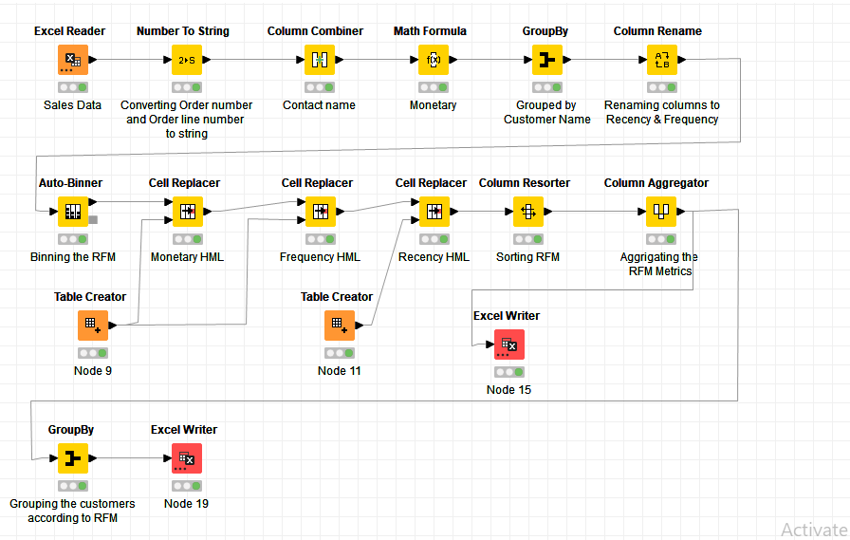
KNIME Work Flow

Slide 19
Work Flow - KNIME
KNIME tool is used for RFM Analysis
RFM is analyzed from the given dataset using variables such as order quantity, price, order number and days since last order.
Data set is grouped by Customer Name.
Monetary is calculated by multiplying Order quantity and Price each.
Frequency is calculated from Order Number.
Recency is calculated by taking minimum of Days since last order
Using Autobinner three types of bins are binned for Recency, Frequency and monetary using percentile of 25,75 and 100
Using Table creator and cell replacer metric such as High, Medium and Low replaced the bins created .

Slide 20
Work Flow – KNIME(cont)
Using column sorter and column Aggregator the RFM columns are sorted and aggregated into single column.
Excel writer is used to store the aggregated file in Excel format.
Then Group by tool is used to group the customers according to the RFM aggregation .
Excel writer is used to store the aggregated file in Excel format in the same file as separate sheet.
From the RFM , 4 types of customers are segmented as Segments 1,2,3 and 4

Slide 21
Segment using RFM
SEGMENT 1
High_High_High | 11 | 12%
High_Medium_High | 1 | 1%
Medium_High_High | 7 | 8%
 |  | 21%
SEGMENT 2
High_Medium_Medium | 9 | 10%
Medium_High_Medium | 2 | 2%
Medium_Medium_High | 1 | 1%
Medium_Medium_Medium | 19 | 21%
 |  | 35%
SEGMENT 3
High_Low_Medium | 1 | 1%
Low_High_High | 2 | 2%
Medium_Low_Medium | 4 | 4%
Low_Medium_Medium | 8 | 9%
 |  | 17%
SEGMENT 4
High_Low_Low | 1 | 1%
Low_Low_Low | 10 | 11%
Low_Low_Medium | 1 | 1%
Low_Medium_Low | 1 | 1%
Medium_Low_Low | 10 | 11%
 |  | 26%

Slide 22
Segment 1
Segment 1 denotes customers with high Recency , Frequency and Monetary.
These customers are highly loyal and best customers the company have.
They constitute 21% of their entire customer base.
It is recommended to give them more discounts and other offers to keep them as golden customers

Slide 23
Segment 2
They constitute the major portion of customer base of the company .
They are mostly in medium range in Recency, Frequency or monetary. As they are silver customers
These are the customer which requires most of promotion and marketing to make them more frequent and spend more.
It is recommended to make more targeted offers and promotions to make them golden customers.

Slide 24
Segment 3
These customers are bronze customer and they constitute 17 % of all customers of the company.
Some of the customer in this segments have very high chance of becoming silver or gold customer as they have high frequency and monetary.
It is recommended to give them more offers such as free delivery etc to make upgrade to segment 1 or 2 .

Slide 25
Segment 4
These are low level customer with very low RFM metric. They constitute around 26 percent.
Even though some have high recency they have very low frequency and spend low on monetary.
They are not loyal customers so it is recommended to not spend more time on the customers in this segments.

Slide 26
Output table with Customer Names
RFM Combination | CUSTOMERNAME | Count
High_High_High | Anna's Decorations, LtdAustralian Collectors, Co.Euro Shopping ChannelLa Rochelle GiftsLand of Toys Inc.Mini Gifts Distributors Ltd.Online Diecast Creations Co.Salzburg CollectablesSouveniers And Things Co.Technics Stores Inc.The Sharp Gifts Warehouse | 11
High_Low_Low | Australian Gift Network, Co | 1
High_Low_Medium | Lyon Souveniers | 1
High_Medium_High | Diecast Classics Inc. | 1
High_Medium_Medium | Auto Canal PetitBaane Mini ImportsCollectables For Less Inc.FunGiftIdeas.comGift Depot Inc.Gifts4AllAges.comOulu Toy Supplies, Inc.Quebec Home Shopping NetworkUK Collectables, Ltd. | 9
Low_High_High | Dragon Souveniers, Ltd.Rovelli Gifts | 2
Low_Low_Low | Alpha CognacAuto-Moto Classics Inc.Bavarian Collectables Imports, Co.Clover Collections, Co.Double Decker Gift Stores, LtdGift Ideas Corp.Iberia Gift Imports, Corp.Mini Auto WerkeRoyale BelgeSignal Collectibles Ltd. | 10
Low_Low_Medium | Diecast Collectables | 1
Low_Medium_Low | Australian Collectables, Ltd | 1
Low_Medium_Medium | Blauer See Auto, Co.Cruz & Sons Co.Enaco DistributorsMarseille Mini AutosNorway Gifts By Mail, Co.Signal Gift StoresStylish Desk Decors, Co.Toys4GrownUps.com | 8
Medium_High_High | AV Stores, Co.Danish Wholesale ImportsL'ordine SouveniersMuscle Machine IncReims CollectablesSaveley & Henriot, Co.Scandinavian Gift Ideas | 7
Medium_High_Medium | Handji Gifts& CoMini Creations Ltd. | 2
Medium_Low_Low | Atelier graphiqueAuto Assoc. & Cie.Boards & Toys Co.CAF ImportsCambridge Collectables Co.Daedalus Designs ImportsMicroscale Inc.Online Mini CollectablesOsaka Souveniers Co.West Coast Collectables Co. | 10
Medium_Low_Medium | Classic Legends Inc.Mini CaravySuper Scale Inc.Volvo Model Replicas, Co | 4
Medium_Medium_High | Corrida Auto Replicas, Ltd | 1
Medium_Medium_Low | Classic Gift Ideas, Inc | 1
Medium_Medium_Medium | Amica Models & Co.Canadian Gift Exchange NetworkCollectable Mini Designs Co.Heintze CollectablesHerkku GiftsLa Corne D'abondance, Co.Marta's Replicas Co.Mini ClassicsMotor Mint Distributors Inc.Petit AutoRoyal Canadian Collectables, Ltd.Suominen SouveniersTekni Collectables Inc.Tokyo Collectables, LtdToms Spezialitten, LtdToys of Finland, Co.Vida Sport, LtdVitachrome Inc.giftsbymail.co.uk | 19
 |  | 89

Slide 27
Inferences from RFM Analysis
From the inference we can conclude that the category of RFM
High-High-High. They are
Anna's DecorationsLtd,
Australian Collectors,
Co.Euro Shopping Channel,
La Rochelle,
GiftsLand of Toys Inc.
Mini Gifts Distributors Ltd.
Online Diecast Creations co

Slide 28
Inferences from RFM Analysis
Customers on the verge of churings have 1 or more lows in their RFM
Metric.
Toys4GrownUps.com
Stylish Desk Decors Co.
Signal Gift Stores
Norway Gifts By Mail Co.
Marseille Mini Autos

Slide 29
Inferences from RFM Analysis
Lost customers are in the category of Low-Low-Low in their RFM.
They are
Alpha Cognac
Auto-Moto Classics Inc.
Bavarian Collectables Imports Co.
Clover Collections Co.
Double Decker Gift Stores, Ltd

Slide 30
Inferences from RFM Analysis
Loyal customers have atleats 1 High or 2 or more mediums in their
RFM Metric. They are
Amica Models & Co.
Canadian Gift Exchange Network
Collectable Mini Designs Co.
Heintze Collectables
Herkku Gifts

Slide 31
Thank you

