Slide 1
SECURE DATA HIDING IN IMAGES USING STEGANOGRAPHY
CAPSTONE PROJECT
Presented By
Student Name : Boyina Gowtham
College Name & Department : Maharaj Vijayaram Gajapathi Raj
College of Engineering & CSE

Slide 2
OUTLINE
Problem Statement
Technology used
Wow factor
End users
Result
Conclusion
Git-hub Link
Future scope

Slide 3
Problem Statement
The problem is to securely and secretly transmit sensitive information in an era of heightened surveillance. Creating effective steganographic methods to hide secret messages inside digital images, undetectable and unbreakable, is essential. This is vital for journalists in censored areas, military and police operations, medical data privacy, copyright protection, and enabling people to share personal information secretly..

Slide 4
Technology used
Python : The primary programming language used to develop the application, providing the foundation for all functionalities.
Tkinter : A GUI toolkit for Python, used to create the user interface for image selection, message input, and encoding/decoding actions.
OpenCV (cv2) : A computer vision library used to read, write, and manipulate images for embedding and extracting messages.
Cryptography (cryptography library) : Used to encrypt and decrypt messages, ensuring secure communication within the steganography process.

Slide 5
Wow factors
Text Widget for Message Input :
The application uses a multi-line Text widget for entering secret messages, allowing users to embed longer or formatted text compared to a single-line input field.
Dynamic Message Length Handling :
The length of the secret message is stored in the first pixel of the image, enabling efficient decoding without requiring prior knowledge of the message size.
Error Handling for Image Size :
The program calculates the maximum allowable message length based on the image dimensions and prevents encoding if the message exceeds this limit, ensuring data integrity.
Support for Loading Messages from Files :
Users can load secret messages directly from text files, making it convenient to handle large or pre-written content without manual typing.

Slide 6
End users
Privacy-Conscious Individuals
Example : A journalist hiding sensitive information in an image to share with a trusted source.
Cybersecurity Enthusiasts
Example : A student experimenting with steganography techniques for a cybersecurity project.
Digital Forensics Professionals
Example : A law enforcement officer analyzing images for hidden data during a cybercrime investigation.
General Public
Example : A user embedding secret notes in images for fun or personal communication with friends.

Slide 7

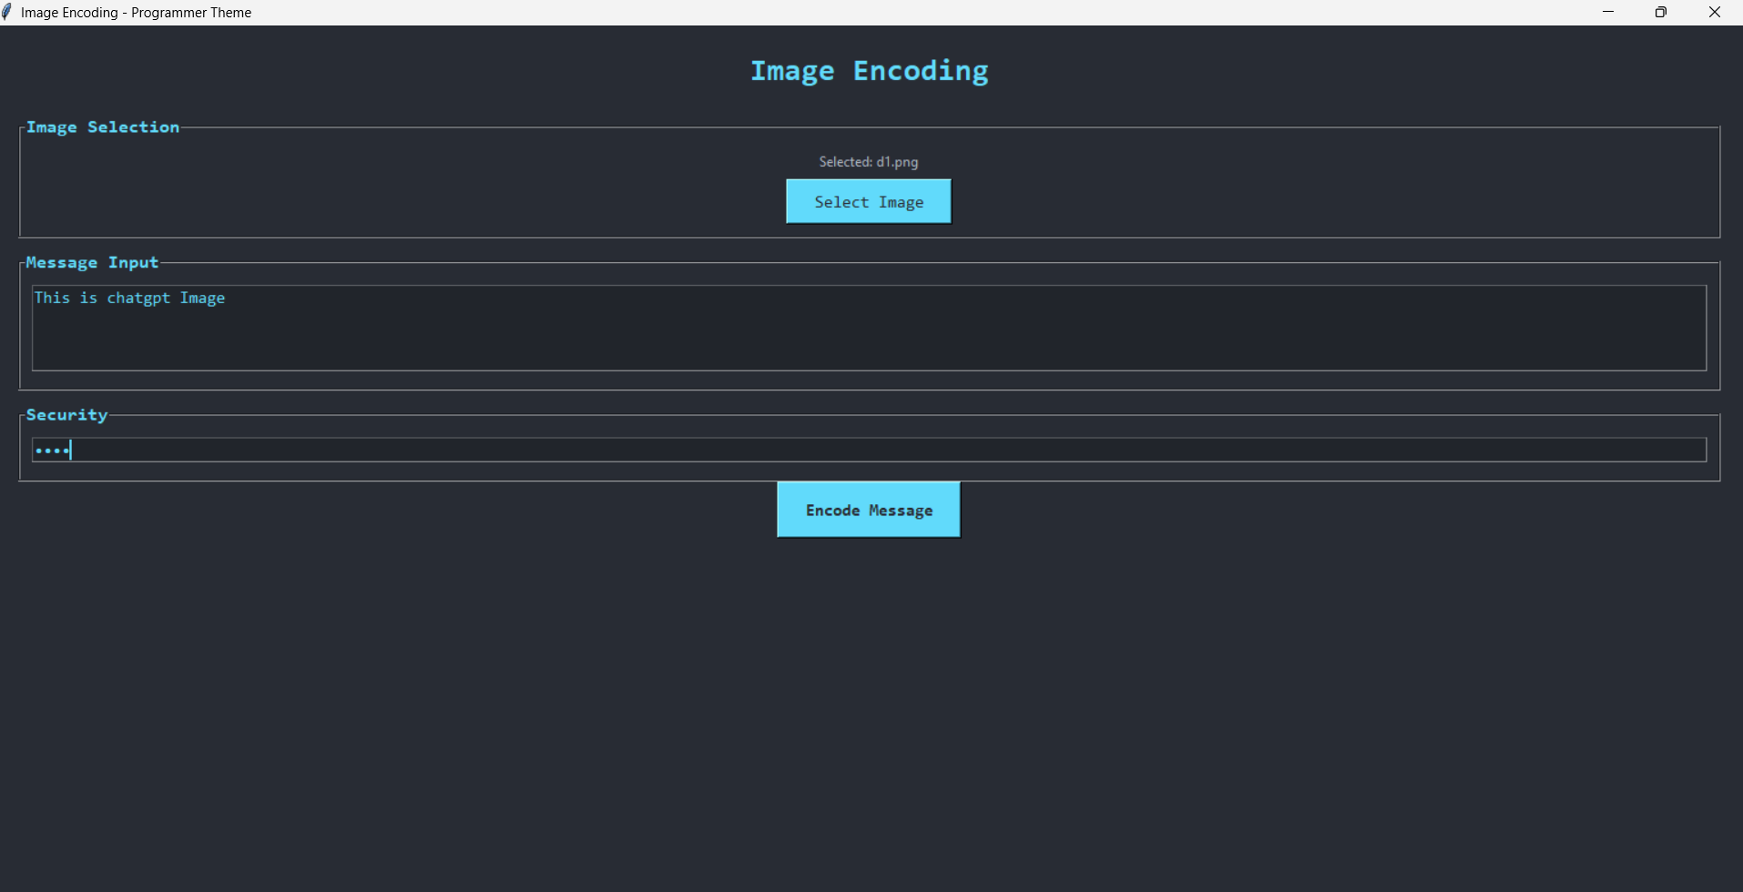
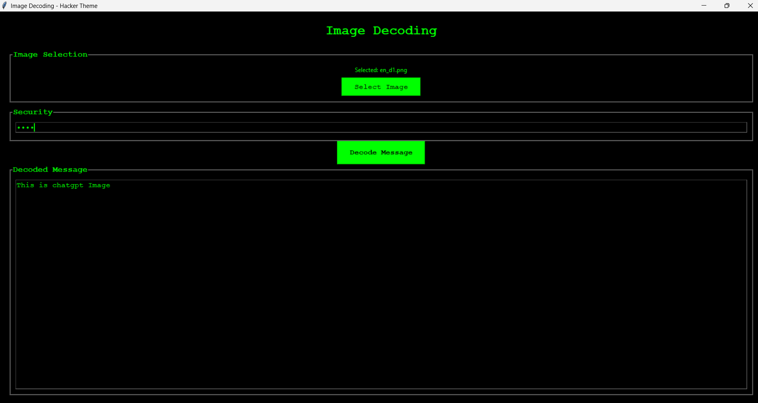
Results
Image used : The Text Encrypted: This is chatgpt image
Output: encrypt.py
Output: decrypt.py

Slide 8
Conclusion
The Image Steganography project successfully addresses the need for secure and covert communication by enabling users to embed secret messages into images using the Least Significant Bit (LSB) technique. Built with Python’s tkinter for an intuitive GUI and OpenCV for image manipulation, the application provides a user-friendly platform for encoding and decoding hidden messages. Key features such as dynamic message length validation, error handling for image size constraints, and support for loading messages from text files enhance its functionality and reliability. While the password field remains unused in the current implementation, it lays the groundwork for future enhancements like encryption integration. This tool caters to a diverse audience, including privacy-conscious individuals, cybersecurity enthusiasts, and digital forensics professionals, offering a practical solution for secure data embedding and extraction. Overall, the project demonstrates the potential of steganography as a powerful and accessible method for confidential communication.

Slide 9
GitHub Link
GitHub Repo Link

Slide 10
THANK YOU

