Slide 1
SMRITI
internal knowledge agent
01 / 12
Smriti
The internal knowledge agent that refuses to guess.
Multimodal RAG for banks, insurers, and other regulated enterprises.
Why now
Compliance teams can't ship copilots that hallucinate. We built one that doesn't.
2026

Slide 2
SMRITI
internal knowledge agent
02 / 12
What is Smriti
Plain English, no acronyms.
An AI search box
for everything your company has ever written, screenshotted, or recorded.
One answer, one citation
an employee types a question in plain English and gets a single answer, with a citation to the exact file and section it came from.
It says no when it should
if the answer isn't in the company's own documents, Smriti says so. It does not make one up.
It runs on the customer's own servers
in their VPC, behind their firewall. No data ever leaves. No SaaS, no third-party API.
Not ChatGPT for work. Not a Copilot wrapper. Not a vector DB with a UI. A grounded, auditable, on-prem knowledge agent.

Slide 3
SMRITI
internal knowledge agent
03 / 12
Why we built it
I was the analyst waiting days for an answer. Smriti is what I wished existed.
The founder's story
What this means
During Covid I worked remotely at Accenture on insurance claims workflows. I had no idea how those workflows actually ran. The knowledge lived in senior heads, not anywhere I could reach.
▸ The pain is personal, not researched. The founder was the blocked analyst.
▸ Built for the person waiting on a senior, not the exec buying a tool.
▸ Data sovereignty is the founding constraint, not a feature bolted on later.
▸ AI is now widely available. The open question is who owns how your data is used. Smriti keeps that ownership in the customer's hands.
I would wait whole days for a senior to answer a single question. They wanted to help, but they were tangled in their own deliverables and could not.
Worse, I kept hitting the same errors other developers had already hit. Each one needed a senior to confirm the fix. More days lost, on repeat.
Smriti is what I wished existed then: the team's knowledge in one place, answerable in seconds, with sensitive data never leaving the company intranet.

Slide 4
SMRITI
internal knowledge agent
04 / 12
The problem
Every regulated enterprise has the same problem.
Knowledge is everywhere
Employees can't find it
Generic copilots can't ship
RBI memos in drives. KYC flow in Confluence. Org chart in a PNG. Compliance briefing in a video. None of it is searchable together.
Finding the right document is slow and manual, scattered across formats and systems. A regulated answer needs a citation, not a vibe.
Off-the-shelf LLMs hallucinate regulatory citations. Compliance teams block the rollout. AI budgets stay unspent.

Slide 5
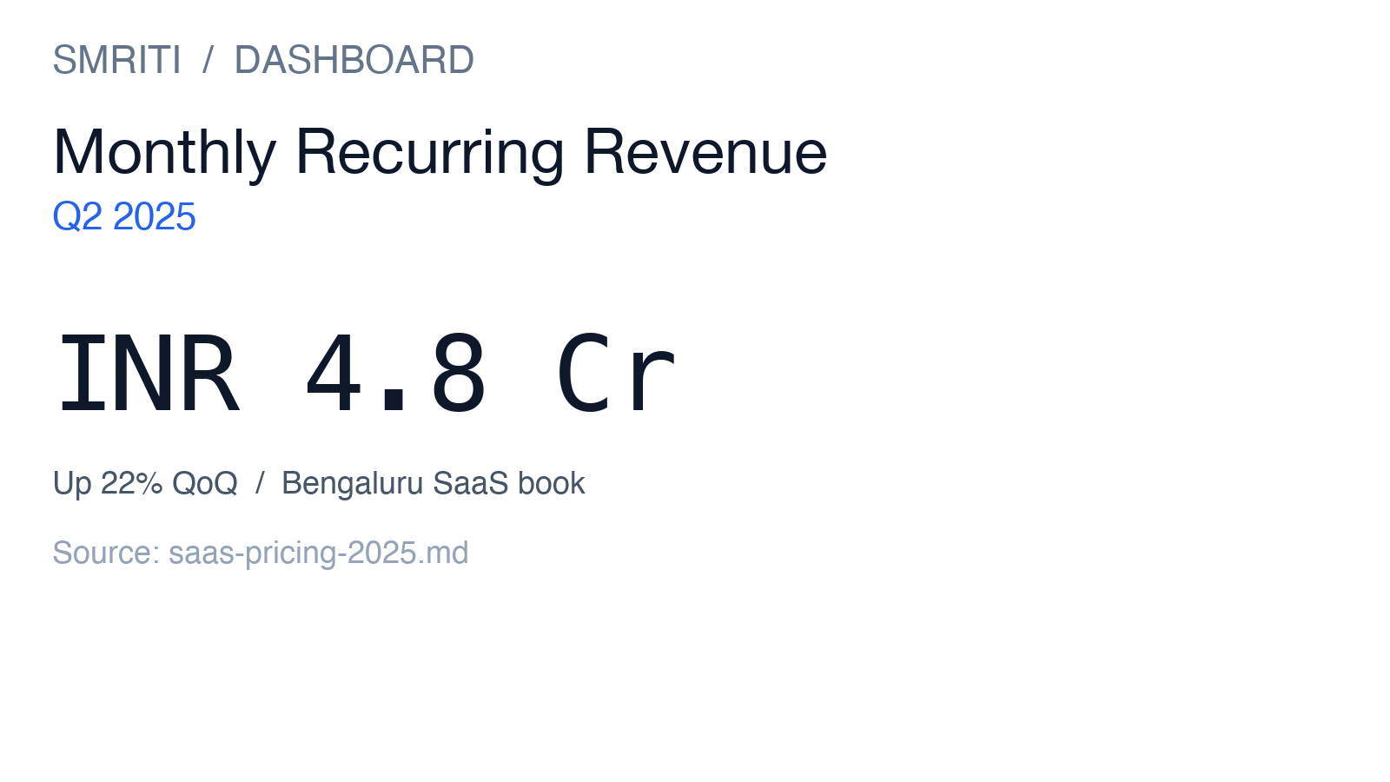
SMRITI
internal knowledge agent
05 / 12
The product
One agent that reads everything the company knows, and only answers from it.
Reads screenshots, PDFs, and narrated video, like a person would.
What it does
▸ Indexes markdown, PDFs, images, video, audio, and code into one pgvector store
▸ Hybrid retrieval: dense vectors plus full-text, fused and re-ranked
▸ ReAct agent reasons across the corpus with five read-only tools
▸ Two-layer grounding check on every answer, claims must appear in source
▸ Refuses cleanly when the answer isn't in the corpus
▸ Returns a citation for every fact, not a vibe

Slide 6
SMRITI
internal knowledge agent
06 / 12
Why now
The window is open, on both sides of the ocean.
Federal + state + sectoral
RBI + SEBI + IRDAI
United States
India
▸ OCC SR 11-7 (model risk management): examiners now apply it to third-party AI. A bank that ships a copilot with no audit trail or refusal log risks a Matter Requiring Attention.
▸ SEC cybersecurity disclosure rules: put the CISO on the hook for AI data flows. Copilots that call home fail on day one. Smriti is single-tenant, no egress.
▸ NIST AI RMF plus the GenAI Profile: the de facto standard for federal procurement and the largest US banks. Smriti maps directly to VALIDATE and VERIFY.
▸ State insurance regulators (NAIC model bulletin on AI): pushing insurers toward documented AI governance and impact assessments.
▸ RBI: digital lending and AI/ML supervisory expectations now require explainability, auditability, and an AI use-case inventory for NBFCs.
▸ RBI expects a documented review process for any AI-assisted decisioning on credit, KYC, or customer service. A hallucinated answer fails this on its face.
▸ SEBI: AI/ML in markets is pushing broker-dealers, mutual funds, and RTAs to formalize AI governance. Smriti's citation-first, refusal-aware design fits directly.
▸ IRDAI: AI use by insurers requires documented model governance, periodic validation, and a human-in-the-loop for material decisions.

Slide 7
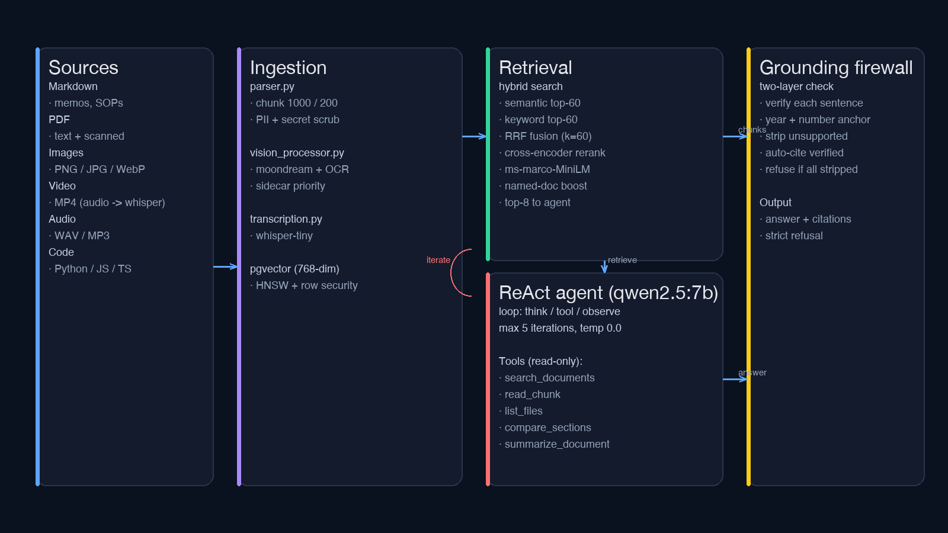
SMRITI
internal knowledge agent
07 / 12
How it works
Sources to ingest to vector store to ReAct agent to grounded response.

Slide 8
SMRITI
internal knowledge agent
08 / 12
The moat
Anyone can wrap an LLM. We make it safe to put in front of a regulator.
Four things that don't exist in a wrapper
What it looks like in practice
▸ Claim-level grounding: every number, date, and name is verified against the source, then a second guard re-checks concrete claims
▸ Strict refusal: no answer beats a wrong answer in a regulated workflow
▸ Sidecar priority: human-written markdown wins over the vision model's interpretation
▸ On-prem, no egress: data stays in the customer's VPC, no telemetry, no sub-processors
Q: What was our Q2 MRR figure in crores?
“Q2 MRR was INR 4.8 Crore, up 22% QoQ. [Source: multimedia/dashboard-mrr-q2.md | Section 1]”
Q: What is the revenue of Tesla?
“I don't have that information from the indexed documents. No relevant content was found that supports an answer.”

Slide 9
SMRITI
internal knowledge agent
09 / 12
The proof: measured, not claimed
64-question evaluation on a public 819-document benchmark. Zero fabricated answers.
100%
Never made things up.
Across 64 questions and 4 test types, every answer was either cited to a real source or honestly refused. Zero invented facts, the property regulated buyers need.
Answerable
Out-of-corpus
Trick questions
Two-document
30 Qs
19 Qs
12 Qs
3 Qs
100%
100%
100%
100%
Cited the real source, or said “I don't have that.”
Refused to guess on things it couldn't know.
Real topic, absent detail, no invented specifics.
Synthesized and cited both required sources.
Found the right document: 90%
A weaker Smriti refuses more. It never degrades into guessing.
The 10% are wrong-source citations, real documents, just not the perfect one. Never a fake source. Improving: 53% then 73% then 90%.
Public benchmark, not customer data; per-pilot numbers established on each customer's corpus. Recall not yet formally measured; answer-coverage proxy reported instead.

Slide 10
SMRITI
internal knowledge agent
10 / 12
Live demo
A real query, end to end, fully grounded.
1. Ask
“What is the current status of the Pine Labs webhook incident?”
Routes to the agent over a single REST call.
2. Retrieve
search_documents(query='Pine Labs webhook', category='multimedia') → top hit: incident-status-board.md → read_chunk → verbatim text
Hybrid retrieval, not just a vector lookup.
3. Answer
“The Pine Labs webhook outage is P1 OPEN with an ETA of approximately 4 hours from July 15, 2025. [Source: multimedia/incident-status-board.md | Section 1]”
Grounding check passes, every claim is verbatim in the source.

Slide 11
SMRITI
internal knowledge agent
11 / 12
Traction & next steps
Working product, one warm enterprise lead, compliance-ready architecture.
Product
Compliance-ready
Enterprise lead
Live
Built
1
Multimodal RAG, on-prem, end to end.
OIDC SSO, RBAC, audit log, SBOM, no egress.
Global medtech (CGM), HIPAA-regulated.
Where we are
▸ Working product: 819-doc public benchmark, 64-question eval, 100% cite-or-refuse, 90% retrieval precision.
▸ One warm enterprise lead: a global medtech / CGM company, HIPAA-regulated, wants a compliance review before any real data.
▸ Pilot scope proposed: internal knowledge retrieval over non-clinical documents (SOPs, quality, policies), not clinical decision support.
▸ Compliance gaps already closed: OIDC/JWKS SSO, admin/user RBAC, append-only audit log, SBOM, security posture doc.

Slide 12
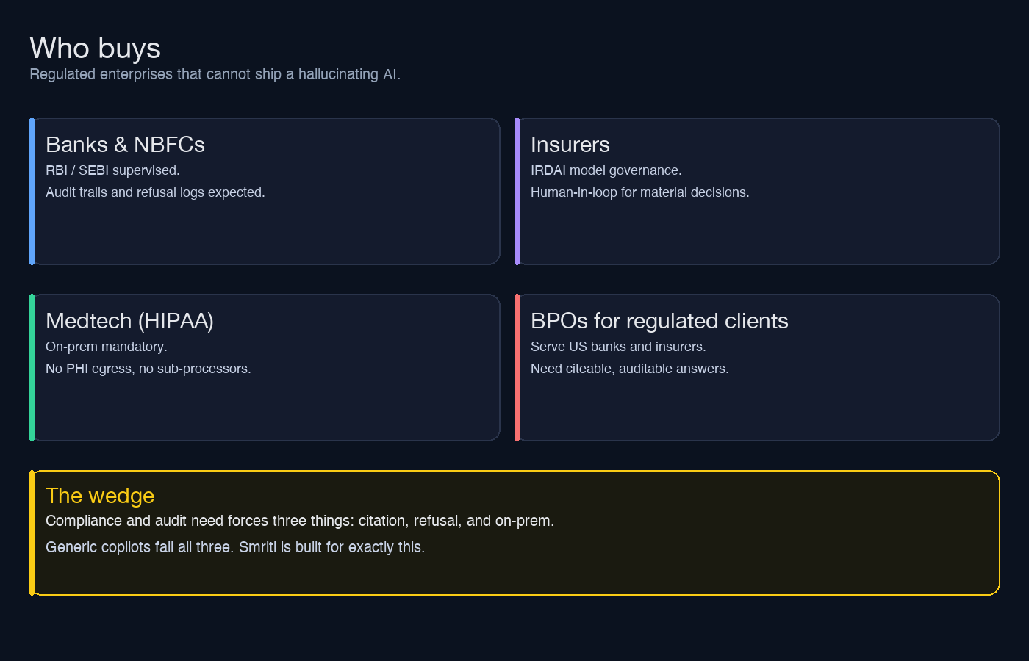
SMRITI
internal knowledge agent
12 / 12
Market & business model
Per-seat pricing, anchored on the audit need.
Proposed pricing
$30 / seat / mo
Minimum $60K annual contract.
Land & expand
▸ Land: 1 team, ~50 seats
▸ Expand: compliance, legal, ops
▸ Upsell: on-prem hosting + audit API

