Slide 1

27 MARKETS
Trade Beyond Limits
Client Relationship Management (CRM)
Back-Office Platform — What It Includes & Why We Are Building It
Prepared for: 27 Markets
Prepared by: Core Care Consultancy
Date: 2026-06-22 | Version 1.0

Slide 2
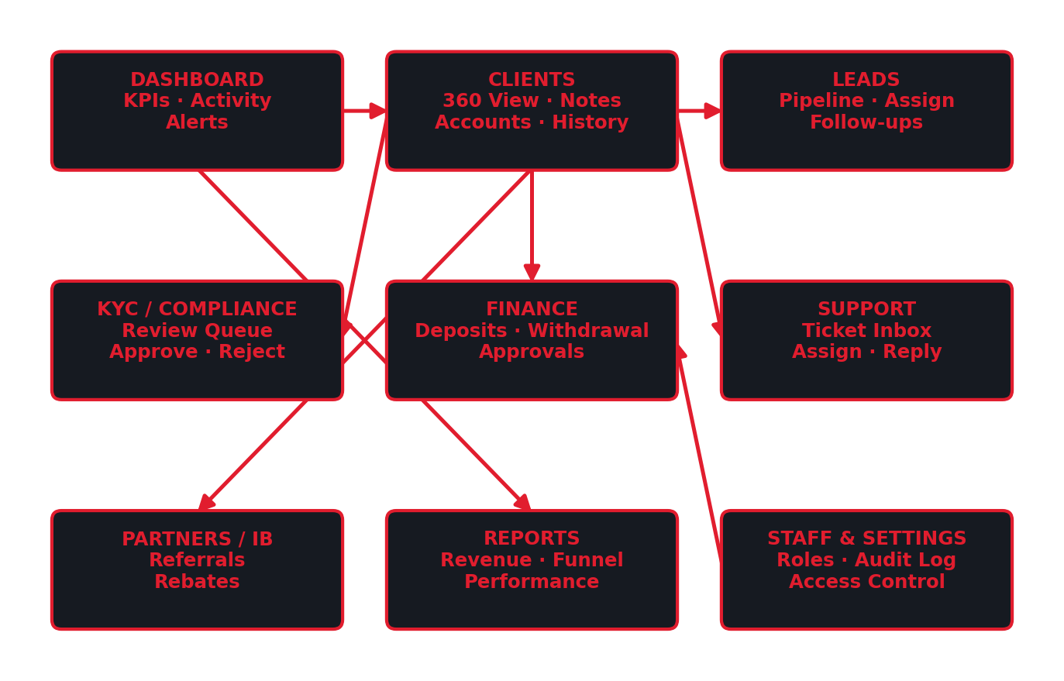
OVERVIEW
What Is the CRM?
The private, secure back-office your team uses to run the business — the other half of the platform clients never see. One place to manage leads, clients, verification, money, support, and partners.
The CRM modules, organised around the client.
27 Markets — CRM (Back-Office) Overview | Prepared by Core Care Consultancy

Slide 3
THE BUSINESS CASE
Why We Are Building It
▸ One source of truth — Every lead, client, document, payment, and conversation in one place — no scattered spreadsheets.
▸ More conversions, more revenue — Leads are captured, assigned, and followed up systematically, so more visitors become funded clients.
▸ Regulatory compliance — A KYC review queue and a complete audit trail keep the business inspection-ready.
▸ Financial control & safety — No money moves without staff review — withdrawals are held and approved by finance.
27 Markets — CRM (Back-Office) Overview | Prepared by Core Care Consultancy

Slide 4
THE BUSINESS CASE (CONTINUED)
Why We Are Building It
▸ Operational visibility — Live dashboards show deposits, withdrawals, pending work, and team performance at a glance.
▸ Better client service — Staff see a client’s full history instantly, resolving requests faster and more personally.
▸ Accountability & security — Role-based access (Admin / Agent) plus an audit log — every action is recorded.
▸ Built to scale — From hundreds to thousands of clients on the same system; manual methods would break.
27 Markets — CRM (Back-Office) Overview | Prepared by Core Care Consultancy

Slide 5
MODULES
What the CRM Includes
Module | What your team can do
Dashboard | Key numbers and pending work — new clients, KYC to review, withdrawals to approve, open tickets.
Clients (360 View) | Full profile, accounts, balances, KYC status, transactions, notes, and activity history.
Leads | A visual pipeline: capture, assign to agents, and track follow-ups to conversion.
KYC / Compliance | Review identity documents in a queue and approve or reject them.
Finance | See deposits and approve or reject withdrawals; controlled manual adjustments (Admin).
Accounts | View trading accounts; suspend, activate, or change leverage.
Support | A shared ticket inbox — assign, reply, and keep internal notes.
Partners / IB | Partners and the clients they referred, with rebate tracking.
Reports | Deposits, withdrawals, net flow, conversion, and agent performance.
Staff & Settings | Manage staff, assign Admin/Agent access, review the audit log (Admin).
27 Markets — CRM (Back-Office) Overview | Prepared by Core Care Consultancy

Slide 6
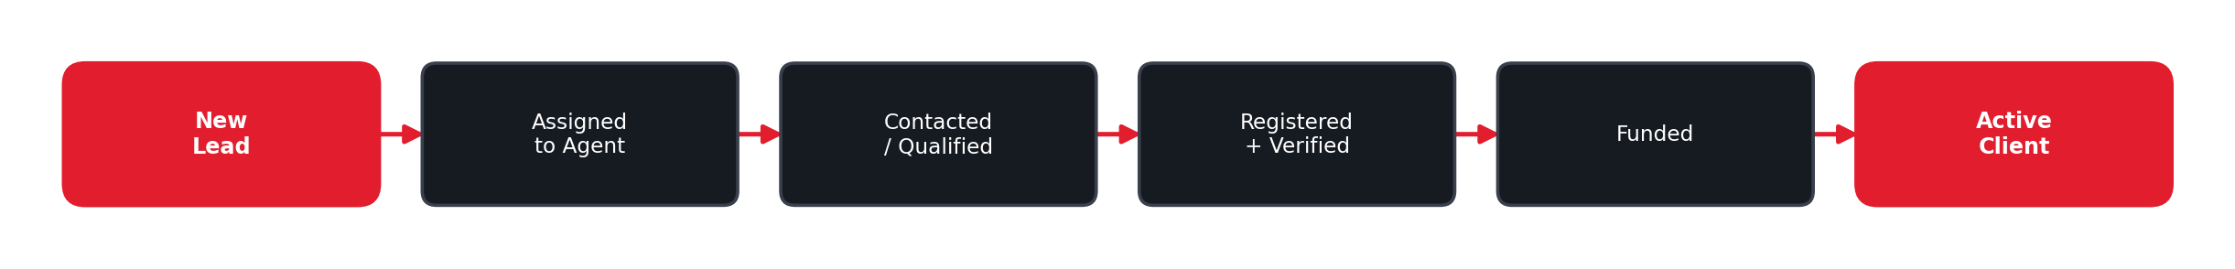
GROWTH
Lead & Sales Pipeline
Leads are captured automatically from the website and demo requests, assigned to an agent, and tracked through clear stages until they fund and trade — so no opportunity is missed.
From new lead to funded, active client.
27 Markets — CRM (Back-Office) Overview | Prepared by Core Care Consultancy

Slide 7
EVERYTHING ON ONE SCREEN
The Client 360° View
▸ Personal profile and contact details.
▸ All trading accounts with live balances.
▸ KYC verification status and uploaded documents.
▸ Full deposit, withdrawal, and transfer history.
▸ Internal staff notes and the complete activity timeline.
27 Markets — CRM (Back-Office) Overview | Prepared by Core Care Consultancy

Slide 8
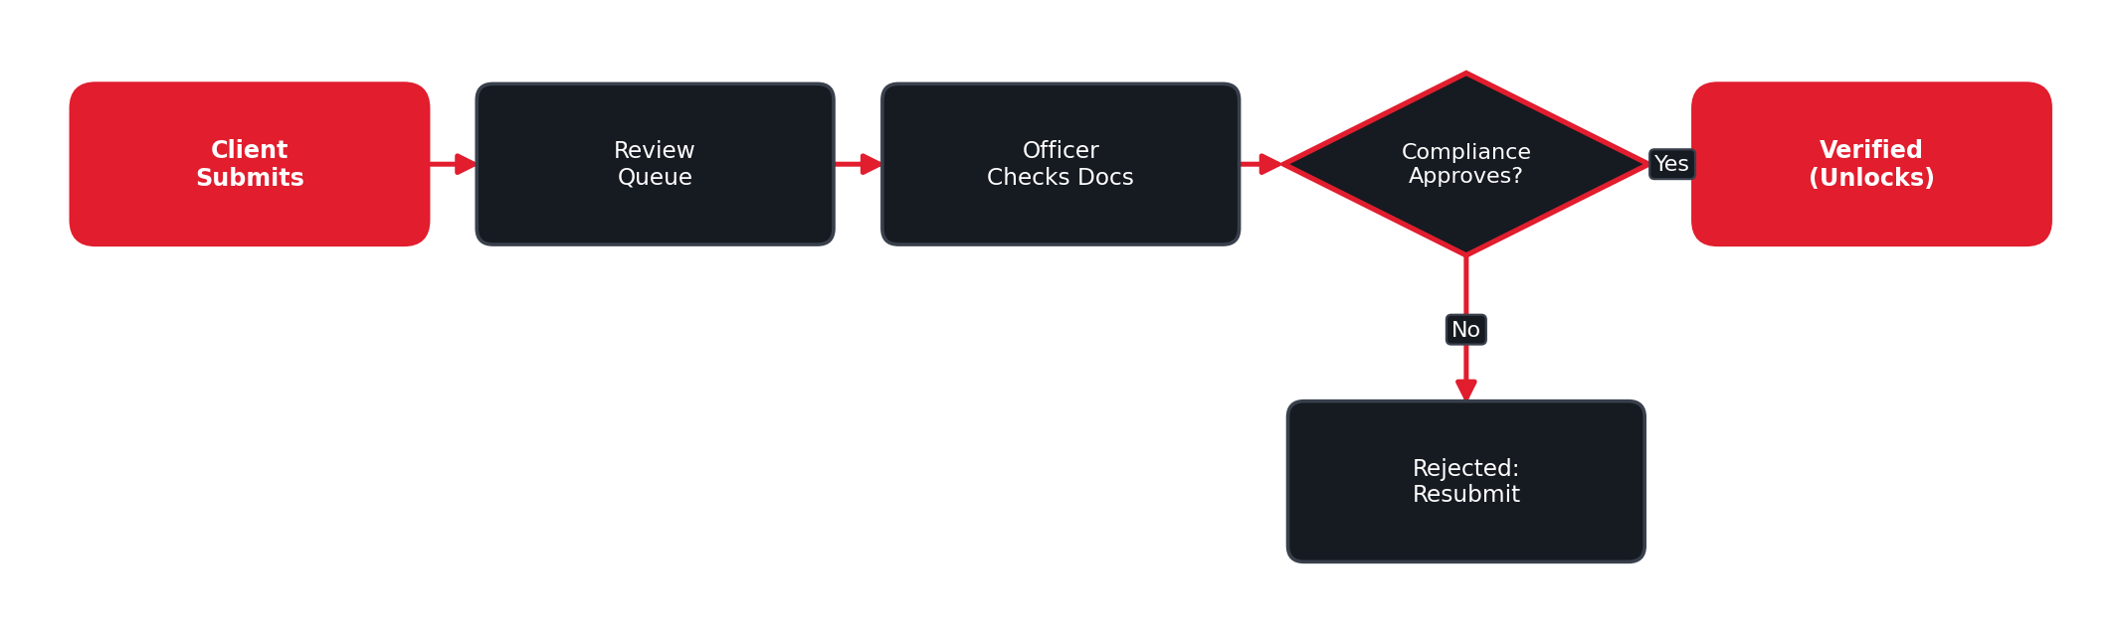
SAFETY & COMPLIANCE
KYC & Compliance Review
Submissions land in a queue; compliance approves or rejects. Withdrawals stay locked until verified.
27 Markets — CRM (Back-Office) Overview | Prepared by Core Care Consultancy

Slide 9
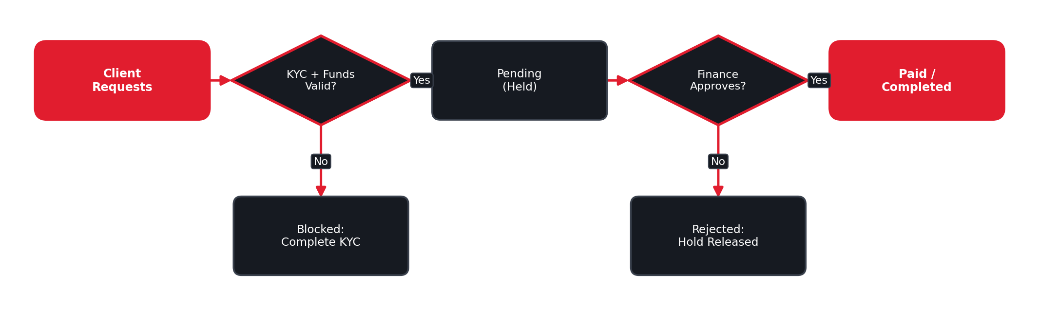
MONEY SAFETY
Finance & Withdrawal Approvals
Every withdrawal is checked, held, and approved by finance before any payout.
27 Markets — CRM (Back-Office) Overview | Prepared by Core Care Consultancy

Slide 10
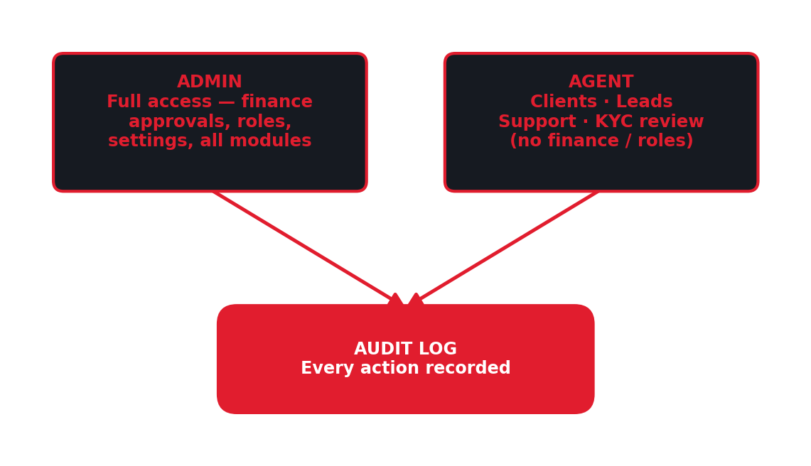
ACCOUNTABILITY
Staff Roles & Access Control
▸ Admin: full access — finance approvals, staff/role management, settings, all modules.
▸ Agent: clients, leads, support, KYC review — no finance approvals or role changes.
▸ Audit log: every state-changing action recorded with who, what, and when.
27 Markets — CRM (Back-Office) Overview | Prepared by Core Care Consultancy

Slide 11
PHASED DELIVERY
How We Will Build It
Phase | Delivered
1 | Foundations — staff roles (Admin/Agent), secure access, and the admin shell.
2 | Dashboard with live numbers and recent activity.
3 | Clients (360 view + notes) and the KYC review queue.
4 | Finance (withdrawal approvals) and account administration.
5 | Leads pipeline and the support desk.
6 | Partners, reports, staff/settings, audit log, and final polish.
27 Markets — CRM (Back-Office) Overview | Prepared by Core Care Consultancy

Slide 12
PLEASE NOTE
Important Note — Costs & Go-Live
▸ Current stage — This build runs on simulated data for demonstration. Live money movement is not active yet.
▸ Going live — Full launch once the trading platform, payment gateways, identity-verification provider, and licensing are connected.
▸ Third-party costs — Identity checks, email/SMS, and payment reconciliation rely on paid third-party services, billed by each provider.
▸ Future phases — Marketing automation, a full IB commission engine, and granular roles are planned later and quoted separately.
27 Markets — CRM (Back-Office) Overview | Prepared by Core Care Consultancy

Slide 13
THE CONTROL CENTER
Summary
The CRM is the control center of 27 Markets. It turns scattered, manual work into one secure system where leads convert faster, clients are served better, money moves only with proper approval, and the business stays compliant and fully auditable — with complete operational visibility today and a foundation that scales as 27 Markets grows.
Prepared by Core Care Consultancy
27 Markets — CRM (Back-Office) Overview | Prepared by Core Care Consultancy

