Slide 1



2160710
Distributed Operating System
Unit-4
Processes and Processors in Distributed Systems
Prof. Rekha K. Karangiya
9727747317
Rekha.karangiya@darshan.ac.in

Slide 2
Topics to be covered
Threads
System Model
Processor Allocation
Scheduling in Distributed Systems
Load Balancing and Sharing Approach
Fault Tolerance
Real Time Distributed Systems
Process Migration and Related Issues

Slide 3
What is Process?
Process is a program under execution.
Process is an abstraction of a running program.
Process is an instance of an executing program, including the current values of the program counter, registers & variables.
Each process has its own virtual CPU.
Real CPU switches back and forth from process to process called multiprogramming.

Slide 4
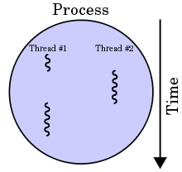
What is Threads?
Thread is a light weight process created by a process.
Thread is a single sequence of execution within a process.
Thread has it own.
Program counter that keeps track of which instruction to execute next.
System registers which hold its current working variables.
Stack which contains the execution history.
Processes are generally used to execute large, ‘heavyweight’ jobs such as working in word, while threads are used to carry out smaller or ‘lightweight’ jobs such as auto saving a word document.
A thread shares few information with its peer threads (having same input) like code segment, data segment and open files.

Slide 5
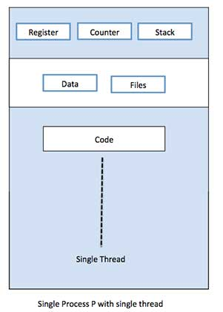
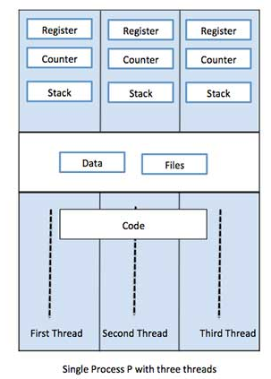
Single Thread VS Multiple Thread

Slide 6
Similarities between Process & Thread
Like processes threads share CPU and only one thread is running at a time.
Like processes threads within a process execute sequentially.
Like processes thread can create children.
Like a traditional process, a thread can be in any one of several states: running, blocked, ready or terminated.
Like process threads have Program Counter, Stack, Registers and State.

Slide 7
Dissimilarities between Process & Thread
Unlike processes threads are not independent of one another.
Threads within the same process share an address space.
Unlike processes all threads can access every address in the task.
Unlike processes threads are design to assist one other. Note that processes might or might not assist one another because processes may be originated from different users.

Slide 8
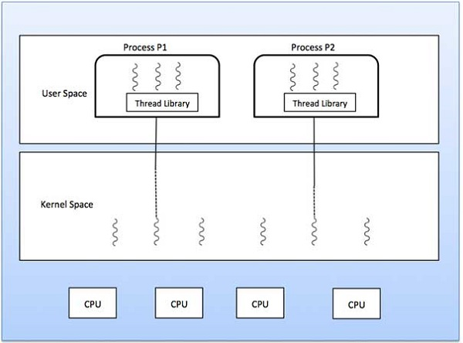
Types of Threads
Kernel Level Thread
User Level Thread
User
Level
Threads
Kernel
Level
Threads

Slide 9
Types of Threads
$$\text{USER} \text{LEVEL} \text{THREAD}$$ | $$\text{KERNEL} \text{LEVEL} \text{THREAD}$$
User thread are implemented by users. | Kernel threads are implemented by OS.
OS doesn’t recognized user level threads. | Kernel threads are recognized by OS.
Implementation of User threads is easy. | Implementation of Kernel thread is complex.
Context switch time is less. | Context switch time is more.
Context switch requires no hardware support. | Context switch requires hardware support.
If one user level thread perform blocking operation then entire process will be blocked. | If one kernel thread perform blocking operation then another thread with in same process can continue execution.
Example : Java thread | Example : Window Solaris

Slide 10
Models for Organizing Threads
Depending on the application’s needs the threads of a process of the application can be organized in different ways.
Threads can be organized by three different models.
Dispatcher/Worker model
Team model
Pipeline model

Slide 11

Dispatcher/Worker Model
In this model, the process consists of a single dispatcher thread and multiple worker threads.
The dispatcher thread:
Accepts requests from clients.
Examine the request.
Dispatches the request to one of the free worker threads for further processing of the request.
Each worker thread works on a different client request.
Therefore, multiple client requests can be processed in parallel.
Requests
Port
Dispatcher Thread
Worker Thread
Worker Thread
Worker Thread
Server process for processing incoming requests

Slide 12
Team Model
In this model, all threads behave as equal.
Each thread gets and processes clients requests on its own.
This model is often used for implementing specialized threads within a process.
Each thread of the process is specialized in servicing a specific type of requests like copy, save, autocorrect.
Requests
Port
Type 1
Type 2
Type 3
Thread
Thread
Thread

Slide 13
Pipeline Model
This model is useful for applications based on the producer-consumer model.
The output data generated by one part of the application is used as input for another part of the application.
The threads of a process are organized as a pipeline.
The output data generated by the first thread is used for processing by the second thread, the output of the second thread is used for third thread, and so on.
The output of the last thread in the pipeline is the final output of the process to which the threads belong.
Requests
Port
Thread
Thread
Thread

Slide 14
Designing Issues in Thread Package
A system that supports thread facility must provide a set of primitives to its users for threads-related operations.
These primitives of the system are said to form a thread package.
Some of the important issues in designing a thread package are:
Thread Creation
Thread Termination
Thread Synchronization
Thread Scheduling
Signal Handling

Slide 15
Thread Creation
Threads can be created either statically or dynamically.
Static :
The number of threads of a process remains fixed for its entire lifetime.
Memory space is allocate to each thread.
Dynamic:
The number of threads of a process keeps changing dynamically.
Threads are created as and when it is needed during the process life cycle.
It exit when task is completed.
Here the stack size for the threads is specified as parameter to the system call for thread creation.

Slide 16
Thread Termination
Threads may terminate or never terminate until life cycle of process.
Thread termination can be done as follows:
Thread destroys itself on task completion by making an EXIT call.
Thread is killed from outside using KILL command with thread identifier as parameter.
In some process, all its threads are created immediately after the process start and then these threads are never killed until the process terminates.

Slide 17
Thread Synchronization
Since threads belongs to same process share the same address space, thread synchronization is required to ensure that multiple threads don’t access the same data simultaneously.
For example:
If two threads want to increment the same global variable with in the same process.
One thread should have exclusive access to shared variable, increment it, and then pass control to the other thread.
It mean that only one thread can execute in critical region at any instance of time.

Slide 18
Thread Scheduling
Another important issue in designing threads package is to decide an appropriate scheduling algorithm.
Thread packages provide calls to give the users the flexibility to specify the scheduling policy to be used for their applications.
Some of the special features for threads scheduling that may be supported by a threads package are as follows:
Priority assignment facility
Flexibility to vary quantum size dynamically
Handoff scheduling
Affinity scheduling

Slide 19
Signal Handling
Signals provide software-generated interrupts and exceptions.
Interrupts are externally generated disruptions of a thread or process.
Exceptions are caused by the occurrence of unusual conditions during a thread's execution.
The two main issues associated with handling signals in a multithreaded environment are as follows:
A signal must be handled properly no matter which thread of the process receives it.
Signals must be prevented from getting lost when another signal of the same type occurs in some other thread before the first one is handled by the thread in which it occurred.

Slide 20
Signal Handling
An approach for handling the former issue is to create a separate exception handler thread in each process.
Exception handler thread of a process is responsible for handling all exception conditions occurring in any thread of the process.
An approach for handling the latter issue is to assign each thread its own private global variables for signaling exception conditions.

Slide 21
Scheduling in Distributed Systems
A resource manager schedules the processes in a distributed system to make use of the system resources.
Scheduling is to optimize resource usage, response time, network congestion. It can be broadly classified into three types:
Task assignment approach
In which each process is viewed as a collection of related tasks.
These tasks are scheduled to suitable nodes so as to improve performance.
Load-balancing approach
In which all the processes submitted by the users are distributed among the nodes of the system to equalize the workload among the nodes.

Slide 22
Scheduling in Distributed Systems
Load-sharing approach
Which simply attempts to conserve the ability of the system to perform work by assuring that no node is idle while processes wait for being processed.

Slide 23

Task Assignment Approach
Each process is divided into multiple tasks.
These tasks are scheduled to suitable processor to improve performance.
It requires characteristics of all the processes to be known in advance.
This approach does not take into consideration the dynamically changing state of the system.
In this approach, a process is considered to be composed of multiple tasks and the goal is to find an optimal assignment policy for the tasks of an individual process.

Slide 24
Assumptions For Task Assignment Approach
A process has already been split into pieces called tasks.
The amount of computation required by each task and the speed of each processor are known.
The cost of processing each task on every node of the system is known.
The Inter process Communication (IPC) costs between every pair of tasks is known.
Other constraints, such as resource requirements of the tasks and the available resources at each node, precedence relationships among the tasks, and so on, are also known.

Slide 25
Task Assignment Approach Algorithms
Graph Theoretic Deterministic Algorithm
Centralized Heuristic Algorithm
Hierarchical Algorithm

Slide 26
Graph Theoretic Deterministic Algorithm
A system with M CPUs and N processes has any of the following three cases:
M=N: Each process is allocated to one CPU.
M>N: Some CPUs may remain idle (free) or work on earlier allocated processes.
M<N: There is a need to schedule processes on CPUs, and several processes may be assigned to each CPU.
The main objective of performing CPU assignment is to:
Minimize IPC cost.
Obtain quick turnaround time.
Achieve high degree of parallelism for efficient utilization.
Minimize network traffic.

Slide 27
Graph Theoretic Deterministic Algorithm- Example
There are two nodes, {N1, N2} and six tasks {T1, T2, T3, T4, T5, T6}.
Inter-task communication cost
Execution costs
 | T1 | T2 | T3 | T4 | T5 | T6
T1 | 0 | 6 | 4 | 0 | 0 | 2
T2 | 6 | 0 | 8 | 12 | 3 | 0
T3 | 4 | 8 | 0 | 0 | 11 | 0
T4 | 0 | 12 | 0 | 0 | 5 | 0
T5 | 0 | 3 | 11 | 5 | 0 | 0
T6 | 12 | 0 | 0 | 0 | 0 | 0
 | N1 | N2
T1 | 5 | 10
T2 | 2 | ∞
T3 | 4 | 4
T4 | 6 | 3
T5 | 5 | 2
T6 | ∞ | 4
Task T6 cannot be executed on node N1 and task T2 cannot be executed on node N2 since the resources they need are not available on these nodes.

Slide 28
Graph Theoretic Deterministic Algorithm- Example
Serial assignment, where tasks T1, T2, T3 are assigned to node N1 and tasks T4, T5, T6 are assigned to node N2:
Execution cost, X = X₁₁ + X₂₁ + X₃₁ + X₄₂ + X₅₂ + X₆₂
= 5 + 2 + 4 + 3 + 2 + 4 = 20
Communication cost, C = C₁₄ + C₁₅ + C₁₆ + C₂₄ + C₂₅ + C₂₆ + C₃₄ + C₃₅ + C₃₆
= 0 + 0 + 12 + 12 + 3 + 0 + 0 + 11 + 0 = 38.
Hence total cost = 58.

Slide 29
Graph Theoretic Deterministic Algorithm- Example
Optimal assignment, where tasks T1, T2, T3, T4, T5 are assigned to node N1 and task T6 is assigned to node N2.
Execution cost, X = X₁₁ + X₂₁ + X₃₁ + X₄₁ + X₅₁ + X₆₂
= 5 + 2 + 4 + 6 + 5 + 4 = 26
Communication cost, C = C₁₆ + C₂₆ + C₃₆ + C₄₆ + C₅₆
= 12 + 0 + 0 + 0 + 0 = 12
Hence Total cost = 38

Slide 30
Graph Theoretic Deterministic Algorithm- Example
A
4
B
5
C
3
3
2
3
5
G
H
4
3
2
2
4
D
5
E
4
F
Processes are represented as nodes A, B, C, D, E, F, G and H.
Arcs between sub-graphs represent network traffic and their weights represent IPC costs.
Total network traffic is the sum of the arcs intersected by the dotted cut lines.

Slide 31
Graph Theoretic Deterministic Algorithm- Example
Partition 1
Partition 2
A
4
B
5
C
A
4
B
5
C
3
3
2
3
3
3
2
3
G
H
G
H
5
3
4
5
3
4
2
2
4
2
2
4
D
5
E
4
F
D
5
E
4
F
CPU 1
CPU 2
CPU 1
CPU 2
Partition 1
CPU 1 runs A,D,G
CPU 2 runs B,E,F,H and C
Network traffic= 4+3+2+5=14
Partition 2
CPU 1 runs processes A,D,E,G,B
CPU2 runs processes H,C and F
Network traffic= 5+2+4=11
Thus partition 2 communication generates less network traffic as compared to partition 1.

Slide 32
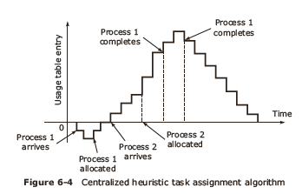
Centralized Heuristic Algorithm
It is also called Top down algorithm.
It doesn’t require advance information.
Coordinator maintains the usage table with one entry for every user (processor) and this is initially zero.

Slide 33
Centralized Heuristic Algorithm
Usage table entries can either be zero, positive, or negative.
Zero value indicates a neutral state.
Positive value implies that the machine is using system resources.
Negative value means that the machine needs resources.

Slide 34
Hierarchical Algorithm
Level 3
Committee of Deans
Deans
Level 2
Dept. Heads
Level 1
Workers
Process hierarchy is modelled like an organization hierarchy.
For each group of workers, one manager machine (department head) is assigned the task of keeping track of who is busy and who is idle.
If the system is large, there will be number of department heads, so some machines will function as “deans”.

Slide 35
Hierarchical Algorithm
Each processor maintains communication with one superior and few subordinates.
When a dean or department head stops functioning (crashes), promote one of the direct subordinates of the faulty manager to fill in for the boss.
The choice of which can be made by the subordinates themselves.

Slide 36
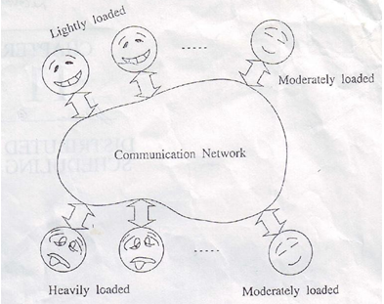
Load Balancing Approach
Need for good resource allocation scheme for Distributed Systems.

Slide 37
Load Balancing Approach
The distribution of loads to the processing elements is simply called the load balancing.
The goal of the load balancing algorithms is to maintain the load to each processing element such that all the processing elements become neither overloaded nor idle.
Each processing element ideally has equal load at any moment of time during execution to obtain the maximum performance (minimum execution time) of the system.

Slide 38


CPU Scheduling ‐ Conventional
Issue: In multiprogramming environment (with single CPU), which job is scheduled to the processor NEXT?
Need: To allocate the job for execution.
Different Scheduling Techniques:
First Come First Serve
Priority Based
Round Robin Based
Multi Level Feedback Queues
Jobs

Slide 39





Load(Job) Scheduling
Issue: In distributed environment, which job is scheduled to which distributed processor?
Need: To allocate the job for execution.
JOB
?
JOB
.
.
.
JOB

Slide 40


Load Balancing
Issue: Redistribution of processes/task in the DCS.
Redistribution: Movement of processes from the heavily loaded system to the lightly loaded system.
Need: To improve the Distributed Systems throughput.
?
Process
?
Process

Slide 41
Classification of Load Balancing
Load Balancing
Static
Dynamic
Deterministic
Heuristic/Probabilistic
Centralized
Distributed

Slide 42
Static Load Balancing
In static algorithm the processes are assigned to the processors at the compile time according to the performance of the nodes.
Once the processes are assigned, no change or reassignment is possible at the run time.
Number of jobs in each node is fixed in static load balancing algorithm.
Static algorithms use only information about the average behavior of the system, ignoring current state of the system.
The static load balancing algorithms can be divided into two sub classes:
Optimal static load balancing (Deterministic)
Sub optimal static load balancing (Probabilistic)

Slide 43
Static Load Balancing
Optimal Static Load Balancing Algorithm
If all the information and resources related to a system are known optimal static load balancing can be done.
Sub optimal static load balancing Algorithm
Sub-optimal load balancing algorithm will be mandatory for some applications when optimal solution is not found.

Slide 44
Deterministic vs Probabilistic
Deterministic algorithms are suitable when the process behavior is known in advance.
If all the details like list of processes, computing requirements, file requirements and communication requirements are known prior to execution, then it is possible to make a perfect assignment.
In the case load is unpredictable or variable from minute to minute or hour to hour, a Probabilistic/heuristic processor allocation is preferred.

Slide 45
Dynamic Load Balancing
In dynamic load balancing algorithm assignment of jobs is done at the runtime.
In DLB jobs are reassigned at the runtime depending upon the situation.
The load will be transferred from heavily loaded nodes to the lightly loaded nodes.
No decision is taken until the process gets executed.
This strategy collects the information about the system state and about the job information.
As more information is collected, the algorithm can make better decision.

Slide 46
Centralized Vs Distributed
$$\text{Centralized} \text{Load} \text{Balancing}$$ | $$\text{Distributed} \text{Load} \text{Balancing}$$
Scheduling decision is carried out at one single node called the centralized node. | Scheduling decision is carried out at different nodes called the Distributed nodes.
Every information is available at a single node. | Information is distributed at different nodes.
Centralized approach leads to a bottleneck as number of requests increases. | Distributed approach handle the multiple requests by physically distributing among various nodes.
If centralized server fails, all scheduling in the system will fails. | If any node fails, all scheduling will be handled by other nodes.

Slide 47
Centralized Load Balancing

Slide 48
Distributed Load Balancing
?
Process
?
Process

Slide 49
Cooperative Vs Non-Cooperative
$$\text{Distributed} \text{Load} \text{Balancing}$$ | $$\text{Distributed} \text{Load} \text{Balancing}$$
In Cooperative Algorithm distributed entities cooperate with each other to make scheduling decisions. | In Non-cooperative algorithm the individual entities make independent scheduling decisions.
Cooperative algorithms are more complex. | Non-cooperative algorithms are easier.
Cooperative algorithms are stable. | Non-cooperative algorithms may not be stable.
It involve large overhead than non-cooperative algorithms. | It involve minor overhead.

Slide 50
Issues in Designing Load Balancing Algorithms
Load estimation: determines how to estimate the workload of a node in a distributed system.
Process transfer: decides whether the process can be executed locally or remotely.
Static information exchange: determines how the system load information can be exchanged among the nodes.
Location policy: determines the selection of a destination node during process migration.
Priority assignment: determines the priority of execution of a set of local and remote processes on a particular node.
Migration limiting policy: determines the total number of times a process can migrate from one node to another.

Slide 51
Issues in Designing Load Balancing Algorithms
Load estimation :
Memoryless method
Pastrepeats
Neither the method of counting the total number of process or nor the method of taking sum of the remaining service times of all processes is suitable.
Acceptable method for load estimation is to measure the CPU utilization of the nodes.
CPU utilization as a load indicator.

Slide 52
Issues in Designing Load Balancing Algorithms
Process transfer:
Threshold value is used to decide whether a node is lightly or heavily loaded.
Thresholds, perhaps in terms of number of tasks, are generally used. (Another threshold can be processor utilization).
When a load on a node exceeds a threshold T, the node becomes a sender. When it falls below a threshold, it becomes a receiver.

Slide 53
Issues in Designing Load Balancing Algorithms
Static information exchange:
Periodic broadcast: May not be adaptive. Collection may be done at high loads worsening system performance.
Broadcast when State-change: only when state changes by a certain degree.
On-Demand exchange: only when a node is highly or lightly loaded, i.e., when a node becomes a potential sender or receiver.
Exchange by polling: it can search for suitable partner by randomly polling the other nodes one by one.

Slide 54
Issues in Designing Load Balancing Algorithms
Location policy:
Threshold: A destination node is selected at random. This continue until either a suitable node is found or the number of probes exceeds a static probe limit(threshold).
Shortest: : Poll a set of nodes. Select the receiver with shortest task queue length.
Bidding:
Manager : A node having a process in need of location to execute.
Contractor: A node that is able to accept the remote process.
Pairing: Two nodes that differ greatly in load are temporarily paired with each other and load balancing is carried out between them.

Slide 55
Issues in Designing Load Balancing Algorithms
Priority assignment policies:
Selfish: Local processes are given higher priority.
Altruistic: Remote process are given higher priority.
Intermediate: Depends on number of local processes and the number of remote processes.
Local processes >= remote process
local processes are given higher priority.
Remote processes > local processes
remote process are given higher priority.

Slide 56
Issues in Designing Load Balancing Algorithms
Migration limiting policy:
Uncontrolled: A process may be migrated any number of times.
Controlled: Use a migration count parameter to fix a limit on the number of times a process may migrate.

Slide 57
Benefits of Load Balancing
Load balancing improves the performance of each node and hence the overall system performance will improve.
Load balancing reduces the job idle time.
Small jobs do not suffer from long starvation.
Extensibility and incremental growth.
Maximum utilization of resources.
Higher throughput.
Response time becomes shorter.

Slide 58
Load Sharing Approach
Load sharing algorithms ensure that no node is idle or heavily loaded.
Policies for load sharing approach are the same as load balancing polices.
The priority assignment policies and the migration limiting policies are same as load balancing algorithms.
They differ in load estimation policy, process transfer policy, location policy and state information exchange.

Slide 59
Issues in Designing Load Sharing Algorithms
Load estimation Policies: ensures that no node is idle while process wait for service at some other node.
CPU utilization as a load indicator.
Process transfer policies:
All-or-nothing strategy.
A node becomes a candidate for accepting a remote process only when it has no process.
A node becomes a candidate for transferring a process only when it has more than one process.
Some algorithms uses threshold value 2 instead of 1.

Slide 60
Issues in Designing Load Sharing Algorithms
State information exchange policies:
A node needs to know the state of other nodes only when it is either overloaded or underloaded.
Broadcast when state changes.
Poll when state changes.

Slide 61
Issues in Designing Load Sharing Algorithms
Location policies:
The location policy decides the sender node or the receiver node of a process that is to be moved within the system for load sharing.
The location policies are of the following types:
Sender-initiated policy: In which the sender node of the process decides where to send the process.
Node with the higher load(sender) initiate the load balancing process.
Receiver-initiated policy: In which the receiver node of the process decides from where to get the process.
Under loaded node(receiver) initiate the load balancing process. Receiver try to get the task from overloaded node, sender.

Slide 62

Sender Initiated Location Policy
In the sender-initiated location policy, heavily loaded nodes search for lightly loaded nodes to which work may be transferred.
In this method, when a node's load becomes more than the threshold value, it either broadcasts a message or randomly probes the other nodes one by one to find a lightly loaded node that can accept one or more of its processes.
If a suitable receiver node is not found, the node on which the process originated must execute that process.
Want you please,
Take a process
Please take some work
I'm Overloaded
Help me
Please
Help!
Machine decides that it has too much work

Slide 63

Receiver Initiated Location Policy
In this policy lightly loaded nodes search for heavily loaded nodes from which processes can be accepted for execution.
When the load on a node falls below a threshold value, it broadcasts a probe message to all nodes or probes nodes one by one to search for a heavily loaded node.
Some heavily loaded node may transfer one of its process if such a transfer does not reduce its load below normal threshold.
I have nothing
to do
Need CPU cycles? Just call
I’m free
I’m bored
Need Help??
Machine advertises its availability

Slide 64
Process Migration
Process migration is a specialized form of process management whereby processes are moved from one computing environment to another.
Process migration is the relocation of a process from its current location(the source node) to another node(the destination node).
Process migration is classified into two types:
Non-preemptive: Process is migrated before execution start in source node.
Preemptive: Process is migrated during its execution.

Slide 65
Process Migration Mechanism
Source
node
Destination
node
Time
Process P1
in execution
Execution
Suspended
Freezing
Time
Transfer of
control
Execution
resumed
Process P1 in
execution
Process migration involves the following major steps:
Selection of a process that should be migrated.
Selection of the destination node to which the selected process should be migrated.
Actual transfer of the selected process to the destination node.

Slide 66
Desirable Features of a Good Process Migration Mechanism
Transparency
Object access level transparency: access to objects such as files and devices can be done in a location-independent manner.
System call and inter process communication level transparency: migrated process does not continue to depend upon its originating node.
Minimal Interference
Minimizing the freezing time of the process being migrated.
Minimal Residual Dependencies
Migrated process should not continue to depend on its previous node.

Slide 67
Desirable Features of a Good Process Migration Mechanism
Efficiency
The main sources of inefficiency are as follows:
The time required for migrating a process.
The cost of locating an object.
The cost of supporting remote execution.
Robustness
The failure of a node other than the one on which a process is currently running should not in any way affect the accessibility or execution of that process.
Communication between coprocesses of a Job
During parallel processing, coprocesses should be able to directly communicate with each other irrespective of their locations.
All these costs should be kept minimum.

Slide 68
Process Migration Mechanisms
Freezing the process on its source node and restarting it on its destination node.
Transferring the process's address space from its source node to its destination node.
Forwarding messages meant for the migrant process.
Handeling communication between cooperating processes that have been separated as a result of process migration.

Slide 69
Freezing and Restarting a Process
Mechanisms for freezing and restarting a process:
Immediate and delayed blocking of the process
Fast and slow I/O operations
Information about open files
Reinstating the process on its destination nodes.

Slide 70
Address Space Transfer
Address space transfer mechanisms:
Information to be transferred from source node to destination node
process state information
Process address space
Possible to transfer the address space without stopping its execution.
Not possible to resume execution until the state information is fully transferred.

Slide 71
Address Space Transfer
Three methods for address space transfer
Total freezing
Pretransferring
Transfer on reference

Slide 72
Address Space Transfer
Total freezing:
Execution is stopped while its address space is being transferred.
Simple and easy to implements.
Process is suspended for a long time during long migration.
Not suitable for interactive process.
Source
node
Destination
node
Suspended
Transfer of
address space
Migration decision
Freezing
time
resumed

Slide 73
Address Space Transfer
Pretransferring:
Address space is transferred while the process is still running on the source node.
Initial transfer of the complete address space followed by repeated transfers of the pages modified during previous transfer.
Remaining modified pages are transferred after the process is frozen for transferring its state information.
Freezing time is reduced.
Total time of migration is increased due to the possibility of redundant page transfer.
Source
node
Destination
node
Transfer of
address space
Migration decision
Suspended
Freezing
time
resumed

Slide 74
Address Space Transfer
Transfer on reference:
A page of the address space is transferred from its source node to destination node only when referenced.
Demand-driven copy-on-reference approach.
Not efficient in terms of cost.
Imposes continued load on process’s source node.
Results in failure if source node fails or reboots.
Source
node
Destination
node
Suspended
Migration decision
Freezing
time
On-demand
transfer
resumed

Slide 75
Message Forwarding Mechanisms
Message forwarding mechanisms:
Three types of messages:
Received when the process execution is stopped on the source node and has not restarted on the destination node.
Received on the source node after the execution started on destination node.
Sent to the migrant process after it started execution on destination node.

Slide 76
Message Forwarding Mechanisms
Resending Messages:
Origin
Sender
Receiver
Resend
Migrate
Resend again
Dest 1
Migrate again
Dest 2

Slide 77
Message Forwarding Mechanisms
Ask origin site:
Origin
Sender
Receiver
Send
Migrate
Dest 1
Forward
Migrate again
Dest 2

Slide 78
Message Forwarding Mechanisms
Link traversal:
Origin
Sender
Receiver
Send
Link
Migrate
Forward
Send
Dest 1
Link
Migrate again
Forward
Dest 2

Slide 79
Message Forwarding Mechanisms
Link update:
Origin
Sender
Receiver
Send
New location
New location
Migrate
Send
Dest 1
Send
Migrate again
Current location
Dest 2

Slide 80
Mechanisms for Handling Coprocesses
Mechanisms for handling coprocesses communication:
Disallowing separation of coprocesses.
Home node or origin site concept.

Slide 81
Advantages of Process Migration
Reducing average response time of processors.
Speeding up individual jobs by migrating to the different nodes of the system and to execute concurrently.
Gaining higher throughput by using a load-balancing policy.
Utilizing resources effectively.
Reducing network traffic.
Improving system reliability by migrating a critical process to a node whose reliability is higher.
Improving system security by migrating sensitive processes and run on a secure node that is not directly accessible to general users.

Slide 82

Fault Tolerance
The main objective of designing a fault tolerance system is to ensure that the system operates correctly even in presence of faults.
Distributed system made up of independent computers connected over the network, can fail due to fault in any of hardware components or software components.

Slide 83
Component Faults
The computer is made up of :
Hardware components: processors, memory, I/O devices etc.
Software components: OS, application programs, database etc.
Component faults can be classified as:
Transient faults
Intermittent faults
Permanent faults

Slide 84
Faults Classification: Transient Faults
It can occur suddenly, disappear, and may not occur again if the operation is repeated.
For example:
During heavy traffic in network, a telephone call is misroute but if call is retried, it will reach destination correctly.

Slide 85
Faults Classification: Intermittent Faults
These faults occur often, but may not be periodic in nature.
For example:
The loose connection to network switch may cause intermittent connection problems.
Such faults are difficult to diagnose.
During debugging process, it is possible that the fault may not be detected at all.

Slide 86
Faults Classification: Permanent Faults
These faults can be easily identified and the components can be replaced.
For example:
Software bug or disk head crash causes permanent faults.
These faults can be identified and corresponding action can be taken.

Slide 87
System Failures
Hardware or software faults can be classified as:
Fail silent faults/fail stop faults:
Faulty processor stop responding to any input and doesn’t produce further output.
It intimates to the system that it is no longer functioning.
Byzantine faults:
Faulty processor continues to run but produces wrong output.
These failures are difficult to handle, because detection itself is painstaking task.

Slide 88
Redundancy
Technique to handle fault tolerance is Redundancy.
Types of Redundancy are as follows:
Information redundancy
Extra bits are added to data to handle fault tolerance by detecting errors.
Time redundancy
An action performed once is repeated if needed after a specific time period.
For example, if an atomic transaction aborts, it can be executed without any side effects.
Time redundancy is helpful when the faults are transient or intermittent.

Slide 89
Redundancy
Physical redundancy
Extra equipment's are added to enable the system to tolerate faults due to loss or malfunction of some components.
For example extra stand by processors can be used in the system.

Slide 90
Real Time Distributed System
External
Devices
D
D
D
D
D
D
Actuator
(Sender)
Sensor
(Receiver)
C
C
C
C
C
C
C
Computer
Network
A Distributed real-time computer system
It is developed by collection of computers in a network.
Some of these are connected to external devices that produce or accept data or expect to be controlled in real time.
Computers may be tiny microcontrollers or stand-alone machines.
In both cases they usually have sensors for receiving signals from the devices and actuators for sending signals to them.
The sensors and actuators may be digital or analog.

Slide 91
Real Time Distributed System
External
Devices
D
D
D
D
D
D
Actuator
(Sender)
Sensor
(Receiver)
C
C
C
C
C
C
C
Computer
Network
A Distributed real-time computer system
It splits into two types:
Soft real time system: Missing an occasional deadline is all right.
For example, personal computer, audio and video systems.
Hard real time system: Even a single missed deadline in a hard real-time system is unacceptable.
For example, missile launching system and satellite system.

Slide 92
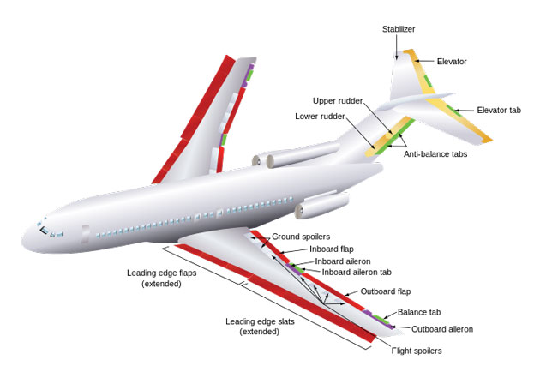
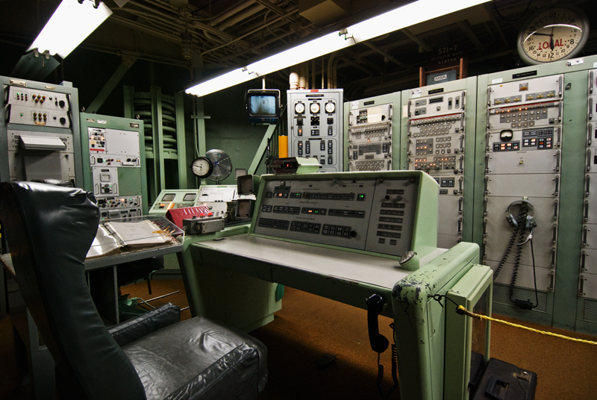



Example of Real Time Distributed System
Some of the examples of Real time distributed systems are as follows:
Computers embedded in television sets and video recorders.
Computers controlling aircraft ailerons and other parts.
Automobile subsystems controlled by computers.
Military computers controlling guided antitank missiles.
Computerized air traffic control system.

Slide 93
End of Unit-4
Unit 4: Processes and processors in DOS 93 Darshan Institute of Engineering & Technology

