Slide 1
Expert System Development Tools

Slide 2
Introduction
During the last decades ES evolved from a laboratory curiosity into a valuable tool for assisting human decision making.

Slide 3
Software Classification:
Technology Levels
Specific expert systems
Shells
Support tools
Hybrid Systems (environments)
Programming languages
NEW
  Object-oriented Programming (OOP)
  Internet/Web/Intranet-based Tools
Decision Support Systems and Intelligent Systems, Efraim Turban and Jay E. Aronson
6th ed, Copyright 2001, Prentice Hall, Upper Saddle River, NJ

Slide 4
Software Classification:
Technology Levels
(Figure 14.2)
Expert System Applications (Specific ES)
Shells
Hybrid Systems
Support Tools, Facilities,
and Construction Aids
Programming Languages
Decision Support Systems and Intelligent Systems, Efraim Turban and Jay E. Aronson
6th ed, Copyright 2001, Prentice Hall, Upper Saddle River, NJ

Slide 5
Expert System Development Tools
Language: Development time, convenience, maintainability, efficiency and speed determine what language software is written in.
Tool: A language plus
  utility programs to facilitate development (debugging, file management, code generators, text and graphics editors, etc.)
  aids for knowledge acquisition, knowledge validation and verification and construction of interfaces to other software packages

Slide 6
Expert System Development Tools
Hybrid Systems: consist of several support tools and programming languages.
Shell: A special purpose tool designed for certain types of application in which the user must only supply the knowledge base (EMYCIN).

Slide 7
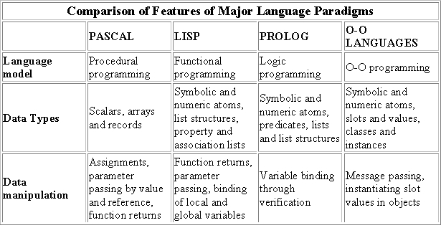
Language

Slide 8
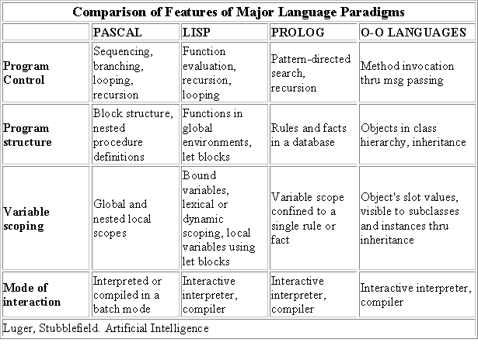
Language

Slide 9
Language
Using a language provides flexibility.
Once you know what features are needed for the system, you can generate the required code.
On the down-side, you need to develop the entire infrastructure, including the traditional subsystems such as the inference engine and explanation facility (OPS provides many of the needed facilities).
You will also need, obviously, proficiency in the chosen language

Slide 10
Preferred Languages in Developing ES:
LISP - list processing language (MIT). John McCarthy, 1950s
In the U.S., LISP was the language of choice.
Powerful in its symbolic processing capability, but difficult to master.
The many dialects of LISP were the source of migraines for researchers who looked to exchange code.
Fortunately, this situation improved in mid-1970s with the introduction of a LISP standard called Common LISP -- the aspirin of choice for LISP programmers.

Slide 11
Preferred Languages in Developing ES
PROLOG - logical programming language. Marseille, France, 1970.
Researchers in the U.K. and Japan adopted PROLOG for developing intelligent programs.
It was also the language chosen in Japan for the Fifth Generation effort. Based in a formal well-understood logic, PROLOG offers a language to develop exact deductive programs.
Like LISP, PROLOG required a disciplined student to master it, thus limiting the number of competent programmers.

Slide 12
Preferred Languages in Developing ES
OPS, Official Production System, has been a very popular choice of expert system developers. OPS is a product of the Instructable Production System Project at CMU back in 1975.
It was used by John McDermott to create one of the classic expert systems called R1 (later called XCON), to help DEC configure VAX computer systems.
Over the years various versions of OPS emerged, the latest being OPS/R2, which supports backward chaining and objects with inheritance.

Slide 13
Preferred Languages in Developing ES
Given the complexities of these two languages, AI research was confined principally to the academic world during the 1960s and 1970s.
Also, since these systems were built from scratch, development time was large

Slide 14
Expert System Shells
MYCIN (Shortliffe, 1976) was developed at Stanford University
MYCIN took approximately 20 person-years to complete. The system was written in INTERLISP, a dialect of the LISP programming language.

Slide 15
Expert System Shells
During the work on MYCIN, a large amount of LISP code was written for different modules:
  Knowledge base
  Inference engine
  Working memory
  Explanation facility
  End-user interface
Toward the end of the project, the MYCIN developers realized that because the knowledge on infectious diseases was separate from its control, then the code written for the other modules should be portable to other applications.

Slide 16
Expert System Shells
By removing the knowledge about infectious blood diseases, a system known as EMYCIN (van Melle, 1979) was formed. EMYCIN is a domain-independent version of MYCIN that contains all of MYCIN except its knowledge about infectious blood disease.
EMYCIN facilitated the development of other expert systems, such as PUFF (Aikens et al., 1983), an application for the diagnosis of pulmonary problems.
PUFF was produced in about 5 person-years.

Slide 17
EXPERT SYSTEM SHELL ARCHITECTURE
System interface
External
Programs
Working memory
Explanation Facility
Knowledge Base
Inference Engine
Developer’s interface
User Interface
Knowledge
Engineer
User
Notes:
Knowledge base contains higly specialized knowledge on the problem area as provided by the expert. Includes problem facts, rules, concepts and relations.
Inference engine is the knowledge processor, modeled after the expert’s reasoning, that works with available information on a given problem, coupled with the knowledge stored in the knowledge base, to draw conclusions or recommendations.
Working memory contains the facts entered by the user or inferred by the expert system during a consultation.
User interface is the vehicle through which the user views and interacts with the system.
Developer interface is the vehicle through which the knowledge engineer develops the system.
Explanation facility provides explanations on the reasoning of the system.
System interface links the expert system to external programs such as databases, spreadsheets, algorithms, etc., that work in a support role for the system.

Slide 18
Shells and Environments
Expert systems components
  1. Knowledge acquisition subsystems
  2. Inference engine
  3. Explanation facility
  4. Interface subsystem
  5. Knowledge base management facility
  6. Knowledge base
Decision Support Systems and Intelligent Systems, Efraim Turban and Jay E. Aronson
6th ed, Copyright 2001, Prentice Hall, Upper Saddle River, NJ

Slide 19
Shell Concept for Building
Expert Systems (Figure 14.3)
Tip of the
iceberg
Knowledge
base
(rules)
Consultation
manager
Knowledge base
editor and debugger
Shell
Explanation
program
Knowledge base
management facilities
Inference
engine
Decision Support Systems and Intelligent Systems, Efraim Turban and Jay E. Aronson
6th ed, Copyright 2001, Prentice Hall, Upper Saddle River, NJ

Slide 20
Classification of Tools
Rule Based Tools
Rule-based tools use if-then rules to represent knowledge.
These rules are processed through a backward or forward chaining process, or a combination of the two (called bidirectional inference).
Some tools permit the coding of inexact rules and inexact inferencing, possibly using confidence factors and processing methods found in the certainty theory,

Slide 21
Classification of Tools
Rule-Based Shells
Exsys
InstantTea
XpertRule KBS
G2
Guru
K-Vision
CLIPS
JESS
ESTA
Decision Support Systems and Intelligent Systems, Efraim Turban and Jay E. Aronson
6th ed, Copyright 2001, Prentice Hall, Upper Saddle River, NJ

Slide 22
Classification of Tools
Frame-based Tools
Today's frame-based tools share many common points with object-oriented programming.
The advantage that these tools have over the base language approach is that they enable the coding of knowledge in a natural symbolic language style versus the more rigid syntax of an object-oriented programming language.
Though rule-based tools dominated the 1980s, frame-based ones are dramatically picking up steam during the 1990s

Slide 23
Classification of Tools
Fuzzy Logic Tools
Fuzzy logic expert system tools represent knowledge in fuzzy rules and fuzzy sets.
They include statements that contain fuzzy variables with corresponding fuzzy values that are represented mathematically in a fuzzy set.
It is most widely used in the area of control systems. Common sense control rules are usually easy to generate.

Slide 24
Classification of Tools
Induction Tools
Induction tools generate rules from examples. They are products of AI research in machine learning.
A developer enters a large set of examples from the domain under consideration, where each example contains values for a set of domain features, and a single result characterizing the example.
The induction tool then uses an algorithm, such as ID3, to generate a rule or a decision tree.
In operation, a user enters information about a current problem and the system then determines the probable result.
Notes:
ID3 (Iterative Dichotomiser 3) is an algorithm used to generate a decision tree invented by Ross Quinlan
The ID3 algorithm can be summarized as follows:
Take all unused attributes and count their entropy concerning test samples
Choose attribute for which entropy is minimum
Make node containing that attribute

Slide 25
Classification of Tools
Case Based reasoning Tools (CBR)
In practice, they serve a role similar to induction tools in that they use past experiences (cases) to solve current problems.
Given an input specification of a problem, the system will search its case memory for an existing case that matches the input specification. It may find an exact match and immediately go to a solution.
Even if an exact match can't be found, the system applies a matching algorithm in order to find a case that is most similar to the input specification.

Slide 26
Domain Specific Tools
Domain | Description
Control | Governing system behavior to meet specifications
Design | Configuring objects under constraint
Diagnosis | Inferring system malfunctions from observables
Instruction | Diagnosing, debugging, and repairing student behavior
Interpretation | Inferring situation description from data
Monitoring | Comparing observations to expectations

Slide 27
Domain Specific Tools
Domain | Description
Planning | Selecting and sequencing activities according to a set of constraints to achieve a goal
Prediction | Inferring likely consequences of given situations
Prescription | Recommending solution to system malfunction
Selection | Identifying best choice from a list of possibilities
Simulation | Modeling the interaction between system components

Slide 28
Choosing a Tool
KNOWLEDGE BASE
Knowledge representation This facility defines how you can represent the knowledge (e.g., rules, frames, decision trees).
Inexact reasoning.
Procedural processing capability Functions might be needed, or in a frame-based system, methods required to support message-passing

Slide 29
Choosing a Tool
INFERENCE AND CONTROL PROCESS
Chaining. When selecting a chaining method, consider the problem-solving activity to be programmed. For example, backward chaining is a good choice for diagnostic and prescription problems, while forward chaining applies well to design and planning ones.
Agendas. Some shells permit you to define an agenda of activities for the expert system to perform. This agenda might be a series of goals that a backward chaining system is instructed to pursue in a predefined sequence, or, the shell may permit the agenda to be executed in an intelligent fashion, where certain tasks are performed conditionally based on the system's findings.

Slide 30
Choosing a Tool
INFERENCE AND CONTROL PROCESS
Meta-rules. It is usually used to direct the processing of the other knowledge into a new area on the basis of discovered information.
Nonmonotonic reasoning. This type of reasoning allows for changes in the reasoning for changes in a given fact. It not only permits the retraction of the given fact, it also causes the retraction of all other facts that were dependent on the changed fact. This requires that the shell has an additional record-keeping facility called a truth maintenance system (Dolye, 1979). Non-monotonic reasoning is valuable in planning, design, or scheduling applications.

Slide 31
Choosing a Tool
EXPLANATION FACILITY
An explanation facility provides a transparency to the expert system's reasoning. This is of particular importance in interactive systems, where the user might want to know why a given question is being asked, or how the provided result was obtained.

Slide 32
Choosing a Tool
DEVELOPER INTERFACE
Knowledge base creation
  Debugging utilities.
    rule-tracing.
    incremental compilation
On-line help.

Slide 33
Choosing a Tool
USER INTERFACE
Display type. The early expert systems all relied on a text-based display. Questions were posed to the user in text and answers were provided via keyboard typing or by selecting from a menu. Today, most shells provide a graphical-user-interface (GUI)
Information entry. There is a wide range of methods by which the user can enter information into the system. It may be as simple as typing an answer to some question, or as extensive as filling out an entire form.

Slide 34
Choosing a Tool
USER INTERFACE
Interface control. The user must always feel in control of the session. This includes an easy way of starting and ending a session, and readily accessible ways of activating needed control during the session.

Slide 35
Choosing a Tool
SYSTEM INTERFACE
Most shells offer an open architecture that permits the developed system to share information with external software such as databases, spreadsheets, and procedural programs like C and Fortran.
Being able to embed an expert system within an established software environment greatly enhances its applicability and improves its portability between applications.

Slide 36
Choosing a Tool
HARDWARE
The platform on which the expert system will be developed and, if different, where it will be run, is a major consideration when selecting a shell.
Overall, the platforms can be divided into four general categories:
  personal computers,
  workstations,
  Web servers, and
  minicomputers or mainframe computers.
The majority of expert systems have been developed on a PC.

Slide 37
Choosing a Tool
SUPPORT
Documentation.
Example programs.
Training.
Help-desk services

Slide 38
Choosing a Tool
COST
Licensing costs. License agreement prohibits the copying of the software and requires that it be used on only one computer. In the event the shell will need to be used on several computers at the same site, purchasing a site license may be the way to go.
Distribution costs. When the shell is used to develop an expert system to be used on other computers, possible distribution costs should also be considered.

Slide 39
Support Tools
Tools are available for building the various parts of a complex system
Knowledge acquisition
  ACQUIRE (www.aiinc.ca) assists in knowledge acquisition
  EZ-Xpert (www.ez.xpert.com) Once the knowledge is encoded in it, it is capable of generating 26 different format expert system knowledge base files, including 8 language shells (in 2000)
  Automated knowledge acquisition tools: CBR: Easy Reasoner (Halley Enterprise Inc.) uses associative memory to learn in the process mining data into decision trees.
Knowledge verification
System interface constructors
  ActiveAgentX fully supports Microsoft’s component object module (COM) and integrates into Windows application software

Slide 40
Hybrid Systems (environments)
They enable complex multiple-knowledge representation systems to be built faster than they would if only the programming languages were used.
Toolkits – from which the programmer selects the appropriate tools for appropriate tasks
  ART (Brightware inc.) contains modules from which an inference engine can be built.
    A module for handling measures of uncertainty
    A module for handling probabilities (Bayesian procedure)
  Common KADS Workbench
  TestBench
Notes:
CommonKADS is the leading methodology to support structured knowledge engineering. It has been gradually developed and has been validated by many companies and universities in the context of the European ESPRIT IT Programme. It now is the European de facto standard for knowledge analysis and knowledge-intensive system development,

