Slide 1
Student details
Name : Adapa Gowtham Sri
Skills build Email : adapagowtham6@gmail.com
College : Aditya College of Engineering
College state : Andhra Pradesh
Internship domain : APSSDC Eduent foundation
Start and end date : 07/06/2024 – 12/07/2024
College email ID : 22MH1A04F2@acoe.edu.in

Slide 2
Project title : Hiding a text in an image using Steganography

Slide 3
Problem statement
In today’s digital age secured communication is crucial. And the digital is not all safe and secure all the time
Traditional encryption methods encrypt the message content into a secure form of data, but when we see that encrypted data we can see that its hiding something. The hackers these days have the tools that can easily decode the encrypted data which makes some of the traditional method obsolete.
Challenge : The challenge here is to implement a robust and a user friendly solution to create a program that hides a text data into an image without drastically changing the image file. And to confuse the hackers that there is no sign of communication.

Slide 4
Agenda
Project overview
Who are the End users?
Solution and value proposition
Customization of the project
Modeling of the project
Results
Resulting images
GitHub link for the project

Slide 5
Project overview
What is digital steganography and the types?
It is the process of concealing of data in a computer file in such a manner that it is not evident to the human eye.
Types of steganography :
Text steganography, Image steganography, Audio steganography, Video steganography.
The steganography method that I chose for the project
I chose image steganography for this project.
I have developed a python based steganography tool for hiding text information in images and also extracting the hidden text information from the encoded images.
The program utilizes Least Significant Bit insertion technique to encode and decode the data in the images. The LSB bits of the RGB color channels of the image are modified to encode the information into the image. As only the LSB bits are modified the changes are invisible to the human naked eye.

Slide 6
Who are the end users ?
Individuals : regular individual people can use this program for personal communication containing sensitive information.
Journalists : Usually journalists deal with very sensitive information on a regular basis and they are being constantly monitored, so this program can help them communicate with sources or associates which involves highly sensitive information
Businesses : Businesses have there success secrets that they don’t want the competition to know, so businesses can use this program to communicate about the operations involving that success secret.
Intelligence agencies : Almost all the work that the intelligence agencies involve classified information, the agencies can use the program to communicate with high security.
Benefits of the program:
The program provides a extra layer of security beyond encryption, hiding the existence of communication happening in the first place.

Slide 7
Solution and value proposition
Solution:
Steganography on the other hand is fairly an old method of encryption but is one of the best methods in the digital world. The problem in the most of the encryption methods is that we can see that there is a secret message hidden in the data. But steganography hides the data in file formats like text, audio video and image in such a way that humans cant tell that there is something hidden in the files.
Value proposition:
Easy to use interface : The interface is user friendly, accessible to technical and non technical users.
Secure message hiding : Makes changes to the medium (image) to hide the data using LBS insertion method so that the change is invisible to the naked human eye.
Password protection : Adds an extra layer of security to the encryption.
Final value : Provides a balance of security, usability and accessibility to the user for various needs. And the security provided by the program is very high unlike other encryption methods.

Slide 8
Customization of the project
XOR operation : Implemented a simple yet effective encryption using XOR with a password
Custom conversion tables : Created dictionaries for fast character to ASCII and ASCII to character conversions.
OpenCV integration : Utilized OpenCV for efficient image reading and writing.
End of message marker : Added “#####” as a reliable message terminator.
Error handling : Checks if the file given as input exists or not, checks for user input is valid or not.
User feedback : Showing a “successful encryption” in case of a proper encryption and showing errors like “ image not found (or) wrong password (or) check the file path” to give the user some feedback for better user experience.

Slide 9
Modeling
Encoding and decoding flow :
Libraries used : I have used two libraries, cv2 and os libraries. The cv2 libraire is used for the image processing to get the pixel data of the image and also to read and write the images. The os libraire to open the image with encrypted data for inspection by the user.
Functions :
dataconv() for the conversion of text data, the characters into ASCII and vice versa ASCII to characters.
encode() for the encoding of the text into image, in this function the image file. The message and the password are given as input. Using cv2 libraire we read the image and encode the ASCII converted data into the RGB color channels using XOR operation and generating the image with the encoded data.
decode() for the decoding of the data from the encrypted image. The encrypted image and the required password to decode are given as input. If the password matches the input image is read and the ASCII data encoded into the RGB values are decoded and converted into characters and shows the hidden message. If the password is wrong or the image doesn't have any hidden message “wrong password or no message” message is shown.
main() gives the user the choice to choose to encode or decode.
Encoding :
User input
Read image
Embed message
Save image
Decoding :
User input
Read image
Extract message
Display message

Slide 10
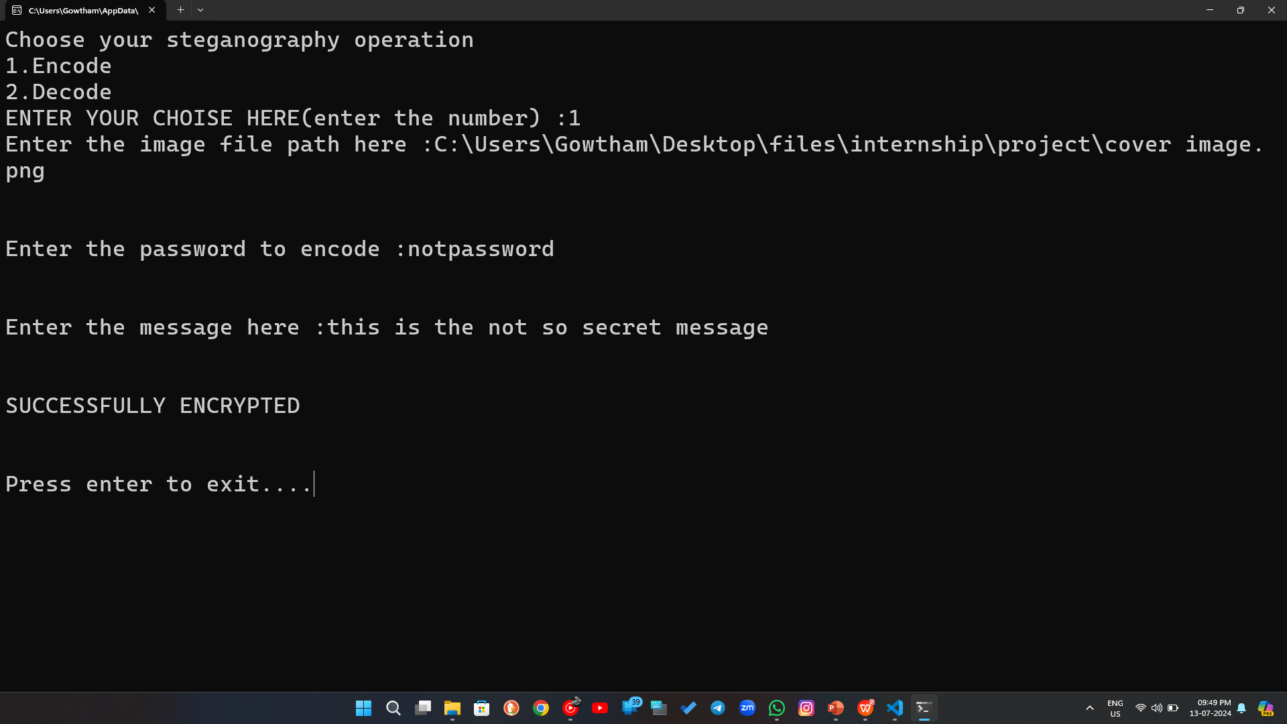
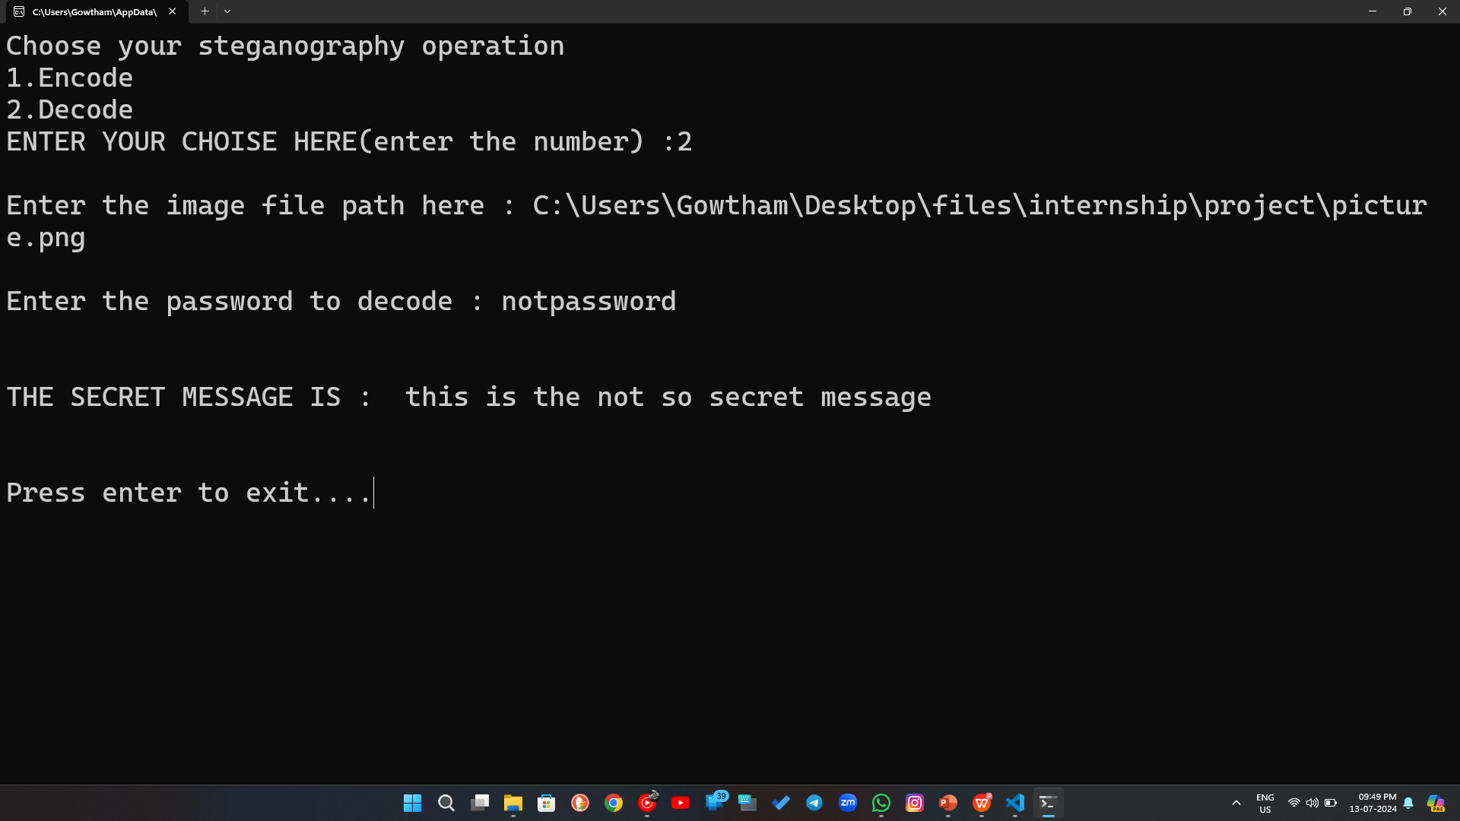
Results
Encoding operation
Decoding operation

Slide 11


Resulting images
Original image
Modified image
As you can see there is no difference in the above images, but in reality the modified image contains the hidden message. We just cant see it. You can try it your self by access the GitHub link in the end.

Slide 12
GitHub link of the project
https://github.com/Gowtham1221/cybersecurity-internship

