Slide 1
GCCX GLOBAL AI FULL-STACK ENGINEER INTERN — ROUND 1
Candidate Triage Operations Platform
Fast Algorithmic Screening, 3NF SQLite Persistence & Grounded Gemini Decision Support
Fast Candidate Ranking
100k synthetic dataset; 102 ms Top-100 early exit (~2x speedup / 2.59x median)
3NF Normalized Storage
SQLite WAL mode, cascade deletions, non-destructive re-seeding
Live Grounded Gemini AI
gemini-3.8-flash structured fit summary & interview probing flags
Production Test Suite
75 passing automated tests (65 backend in ~25s, 10 frontend in ~2.8s)
Notes:
Welcome everyone. Recruiters today triage hundreds of applicants using spreadsheets and gut feel. Our goal was to build a functional candidate triage prototype combining fast in-memory ranking with evidence-grounded AI decision support.
We made two foundational architectural decisions upfront: first, recruiter triage decisions must persist non-destructively across server restarts; second, the single AI feature should directly solve the recruiter's hardest problem—evaluating applicant qualifications against a specific job description with verifiable evidence and explicit gap analysis.

Slide 2
CONTEXT & REQUIREMENTS
SLIDE 02 / 08
The Problem, Scope & Core Assumptions
Transitioning recruiters from static spreadsheets to a reliable, persistent triage operations platform
The Core Problem & Mandate
The Problem: Recruiters triage hundreds of candidates across static spreadsheets with subjective gut-feel, slow screening cycles, and no persistent decision tracking.
Full-Stack Dashboard: Provide interactive multi-criteria filtering, debounced search, and immediate triage mutations (Untriaged -> Shortlisted / Rejected).
Normalized Persistence: Implement a relational SQLite backend that persists recruiter actions non-destructively across server restarts.
Targeted AI Feature: Integrate exactly ONE high-value LLM capability rather than scattered gimmicks.
Scalable Ranking: Implement and evaluate deterministic candidate ranking across a 100,000 synthetic candidate benchmark.
Key Architectural Assumptions
Non-Destructive Seeding: Re-seeding SQLite from JSON must update biographical data on conflict but deliberately omit the status column, preserving recruiter decisions across restarts.
3NF Relational Modeling: Normalize candidate skills into a dictionary and many-to-many junction table to guarantee relational integrity, eliminate duplicate tags, and support fast indexed queries.
High-Leverage AI Value: Evidence-grounded candidate-fit evaluation against recruiter job descriptions delivers 10x higher triage value than generic semantic search over 48 mock candidates.
Zero External Test Calls: Automated test suites must run 100% deterministically with mocked provider responses to avoid token costs and internet dependencies.
Notes:
Recruiters today triage hundreds of applicants using spreadsheets and gut feel. Our goal was to deliver a functional candidate triage prototype: responsive UI, normalized SQLite persistence, fast algorithmic ranking, and exactly one high-value live LLM feature.
We established three core assumptions: first, database re-seeding must never overwrite recruiter status decisions; second, SQLite must be modeled in 3NF with indexed foreign keys rather than storing flat JSON; and third, the AI feature should focus squarely on qualification gap analysis against specific job descriptions rather than generic search.

Slide 3
SYSTEM ARCHITECTURE
SLIDE 03 / 08
Full-Stack Architecture & Normalized Data Layer
Layered TypeScript monorepo with 3NF relational schema and strict validation
Layered TypeScript Monorepo
Frontend Workspace: React 18 + Vite with accessibility-conscious styling, debounced filtering, KPI metrics, and slide-out candidate details drawer.
Backend Workspace: Express 4 + Node.js 22 with dependency-injected database and Gemini AI service layers.
Defensive Validation: Cross-parameter range checks (min_experience <= max_experience), pagination bounds, and consistent error envelopes ({ error: { code, message } }).
3NF Relational Database Schema
candidates Table: Core biographical data, years experience, source, notes, applied date, and persistent triage status.
skills Table: Global dictionary of unique technical skills with NOCASE unique constraints.
candidate_skills Table: Many-to-many junction table with cascade deletion and foreign keys (cleaned on re-seed).
B-Tree Indexes: Targeted indexes on status, target_role, source, years_experience, and applied_date.
High-Performance REST Endpoints (Single-Query Aggregations)
GET /api/candidates: Paginated search and filtering with SQL parameters and SQL-injection-safe queries.
GET /api/stats: Aggregate triage counts (Total, Untriaged, Shortlisted, Rejected) via a single GROUP BY query.
GET /api/roles & /sources: Distinct filter discovery endpoints eliminating full candidate sampling.
PATCH /api/candidates/:id/status & POST /api/ai/candidate-fit: Instant triage state updates and grounded Gemini fit evaluations.
Notes:
Let's examine the system architecture. Rather than treating SQLite as a flat JSON store, we modeled a normalized Third Normal Form schema with a dedicated skills dictionary and foreign-key junction table. This gives us clean relational integrity, eliminates duplicate skills, and provides fast indexed lookups.
Our seed script is idempotent: it updates biographical records on conflict but deliberately omits the triage status column, preserving recruiter decisions across restarts. We also added dedicated single-query endpoints for triage stats, roles, and sources, eliminating client-side polling overhead.

Slide 4
HIGH-SCALE ALGORITHMS
SLIDE 04 / 08
Candidate Ranking at Scale: Bucket Sort vs. Inverted Index
Evaluating 100,000 synthetic candidates with deterministic multi-tier tie-breaking
Algorithm Design & Complexity
Problem Mandate: Rank 100,000 candidates by distinct required skill overlap with deterministic tie-breaking.
Skill Intersection: Distinct set matching: duplicate candidate or query skills never inflate match scores.
Bucket Partitioning: Partitions candidates into R+1 score buckets in O(N * S_c) linear time.
Deterministic Tie-Breaker: Score (desc) -> Experience (desc) -> Name (asc) -> ID (asc).
Honest Benchmark (100,000 Candidates, Node v22)
Baseline Full Array Sort: 265.00 ms median (272.73 ms mean) — O(N * S_c + N log N).
Bucket Sort Full Rank: 253.88 ms median (279.97 ms mean) — ~1x speedup (no significant gain because all non-empty buckets must still be sorted in full).
Bucket Sort Top-100 Early Exit: 102.18 ms median (134.23 ms mean) — ~2x speedup (2.03x mean, 2.59x median) because it skips lower score buckets.
Architectural Next Step: Inverted Skill Index
The Inverted Index Advantage: For repeated queries over an existing corpus, an Inverted Index (Map<skill, candidateId[]>) is structurally superior: candidates with zero matching skills are never touched, dropping query time to O(sum |Postings(R_j)|).
Production Recommendation: Use Bucket Sort for one-off dynamic batches; use an Inverted Index in memory for interactive recruiter search.
Notes:
In Task 2a, we tackled ranking candidates at scale. The naive baseline sorts all 100,000 candidates with an O(N log N) comparator. Our Bucket Sort partitions candidates by distinct skill matches in linear time.
Here are the honest benchmark numbers: if you sort all 100,000 candidates, Bucket Sort gives about 1x—virtually no speedup over baseline sorting—because every non-empty bucket still has to be sorted with the tie-breaker. But for Top-K queries where a recruiter only needs the top 100 matches, early exit skips sorting lower buckets entirely, giving a real ~2x speedup (2.59x median).
If we were building this for repeated production queries, we would implement an Inverted Index, which skips candidates with zero matches without even an O(N) scan.

Slide 5
AI-ASSISTED ENGINEERING
SLIDE 05 / 08
Task 2b: AI Code Review & Senior Engineering Reflection
Dissecting realistic AI code defects and establishing defensive engineering standards
Defect Analysis in Flawed AI Code
Fatal Boundary Crash: i <= candidates.length off-by-one boundary caused a fatal TypeError crash on the last iteration.
Global Scope Leak: i = 0 undeclared loop counter leaked into the global namespace.
Type Error on Score: score = c.skills.filter(...) assigned an array of strings instead of a numeric count.
Comparator NaN Invalidation: matches.sort((a,b) => a.score - b.score) performed array subtraction, resulting in NaN and broken non-deterministic sorting.
Missing Normalization: Ignored skill casing, allowed duplicate candidate skills to inflate score, and had no deterministic tie-breaker.
Corrected Module & Key Takeaway
matchCandidatesFixed.ts: Implemented strict TypeScript types, case-normalization, distinct set intersection, and deterministic 4-tier descending sort.
Dual-Algorithm Parity Tests: Wrote automated tests validating invariant parity and deterministic output between baseline and optimized modules.
Senior Engineering Reflection: "A developer who glanced at the AI output without reading line-by-line would see syntax that looked reasonable, but ship code that immediately crashed in production with an off-by-one exception, failed to compute numeric scores, and produced non-deterministic sorting due to NaN array arithmetic."
AI-Native Takeaway: AI accelerates boilerplate in minutes, but human verification, strict typing, and automated testing are non-negotiable.
Notes:
Task 2b was a realistic assessment of reviewing AI code. The snippet looked plausible at first glance, but contained two fatal bugs and several design smells: an undeclared loop variable, an off-by-one loop boundary that crashes with a TypeError on the last candidate, an array assigned to score, and array subtraction in the comparator that evaluates to NaN.
Our takeaway is fundamental to AI-native engineering: AI is exceptional at accelerating boilerplate, but blind acceptance without rigorous line-by-line verification, typing, and automated testing introduces silent, catastrophic failures.

Slide 6
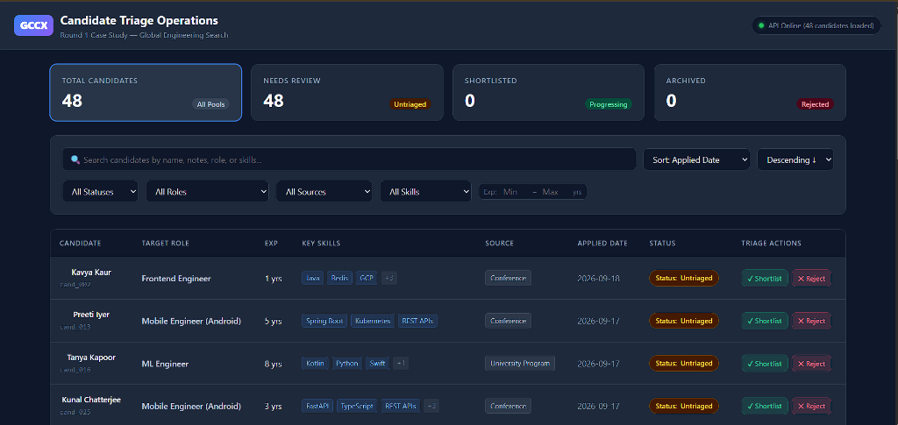
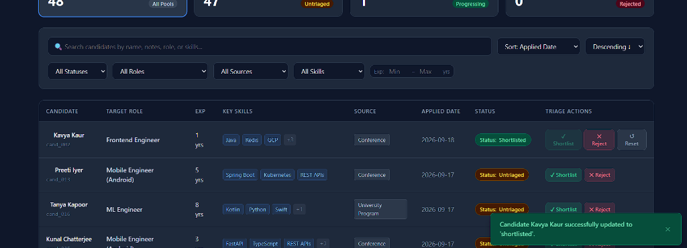
INTERACTIVE DEMO
SLIDE 06 / 08
Live Walkthrough: Recruiter Operations Dashboard
High-contrast dark-mode interface with instant status KPI tracking and optimistic triage mutations
Recruiter Operational Capabilities
Real-Time KPI Cards: Live aggregate counters (48 Total, Needs Review, Shortlisted, Archived) with single-click status filtering.
Multi-Criteria Filter Bar: Debounced search across candidate names, notes, roles, and skills; range sliders for experience.
One-Click Triage Actions: Instant Shortlist, Reject, or Reset buttons mutating SQLite via PATCH /api/candidates/:id/status.
Optimistic Feedback: Immediate UI status badge update with animated toast notification and counter synchronization.
Accessibility Conscious: Full keyboard navigation, semantic table roles, ARIA labels, and high-contrast styling.
Notes:
Here is the live recruiter operations dashboard in action. At the top, we see real-time status KPI cards displaying 48 total candidates. As recruiters apply filters or search for specific skills, the candidate table updates instantly with debounced queries.
When a recruiter clicks 'Shortlist' or 'Reject', the state persists immediately to SQLite via PATCH /api/candidates/:id/status. As seen in the bottom screenshot, a green toast notification confirms 'Candidate Kavya Kaur successfully updated to shortlisted', and the Shortlisted KPI counter increments to 1 without requiring a full page refresh.

Slide 7
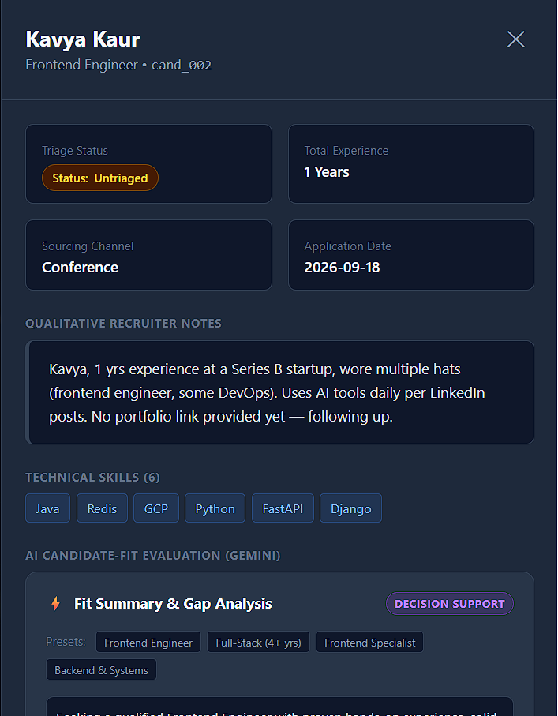
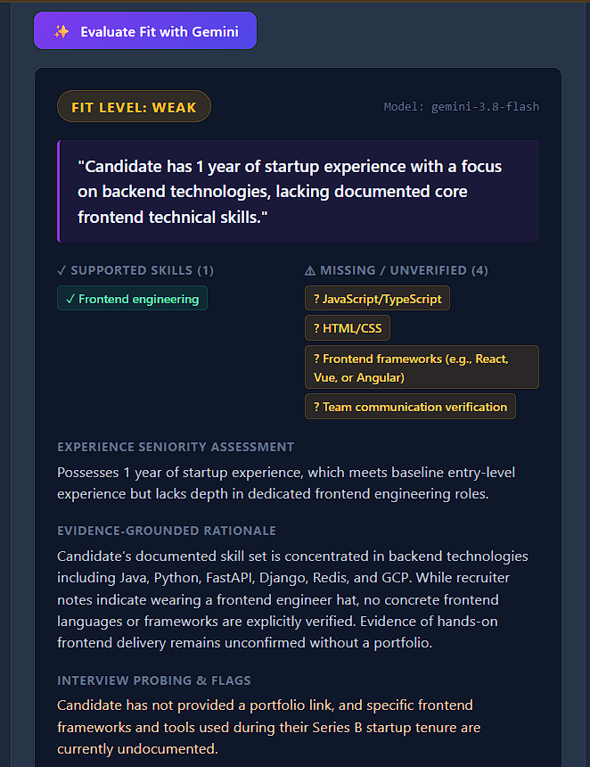
GENERATIVE AI INTEGRATION
SLIDE 07 / 08
Live AI Evaluation: Evidence-Grounded Gemini Candidate Fit
Targeted gap analysis and interview probing flags powered by gemini-3.8-flash
AI Defensive Architecture
Zero-Hallucination Retrieval: Candidate facts, experience, and notes are fetched strictly from SQLite on the server; client cannot spoof profile data.
Prompt Injection Defense: XML fencing (<job_description>, <candidate_profile>) mitigates prompt injection attacks.
Structured Output: Enforces strict JSON schema: Fit Level (Strong, Moderate, Weak), Supported Skills, Missing Gaps, Experience Assessment, and Interview Probing Flags.
Recruiter Decision Support: AI does NOT make automated rejection decisions; it surfaces concrete evidence gaps (e.g. 'Lacks documented frontend frameworks') for human recruiter probing.
Provider Resilience: 100% mocked automated tests covering 429 rate limits, 503 auth failures, 422 safety blocks, and 502 malformed outputs.
Notes:
Here is our single implemented AI feature in the live application. When the recruiter opens a candidate drawer, they select a job description preset—like Frontend Engineer—and trigger 'Evaluate Fit with Gemini'.
The backend retrieves verified profile facts directly from SQLite, wraps user inputs in XML fence tags to mitigate prompt injection, and calls gemini-3.8-flash with a structured JSON schema.
As shown on screen for Kavya Kaur, Gemini correctly classifies the fit as WEAK. Notice why: although she has 1 year at a startup, her documented skills are backend technologies like Java, Python, and Redis, lacking verified React or TypeScript. Rather than a black-box score, it provides specific interview probing questions for the recruiter.

Slide 8
SCALE & FUTURE VISION
SLIDE 08 / 08
Scaling to 3,000 Candidates/Week & Production Roadmap
Practical engineering judgment under 2-engineer/2-week constraints and sprint roadmap
Scaling to 3,000/Wk (2 Devs, 2 Weeks)
The #1 Defensible Risk: Skill tag vocabulary variance ('Postgres' vs 'RDBMS'). A naive top-10% keyword pre-filter creates severe false negatives, silently rejecting non-traditional candidates.
Per-Requisition Intake: Candidates apply across distinct roles; ingest asynchronously via BullMQ/Redis buffer (~430 candidates/day).
Recruiter-Selected Triage: Present ranked candidates per open role; allow recruiters to select candidate batches for LLM evaluation rather than an automated top-10% cutoff.
Hashed Evaluation Caching: Cache fit evaluations by SHA256(candidateId + jdHash) in Redis to eliminate redundant token consumption.
Audit Logging & Compliance: Maintain append-only triage audit trail ensuring compliance with NYC Local Law 144 / EEOC guidelines.
Next 2-Week Production Sprint
Inverted Skill Index: Build an in-memory inverted index for sub-10ms candidate search across high-volume corpora.
Local Vector Search: Integrate sqlite-vss embeddings over qualitative recruiter notes to surface soft-skill matches.
Two-Way ATS Sync: Webhook integrations with Greenhouse and Lever for automated candidate imports and two-way status export.
Persistent Evaluation Store: Create an evaluations table in SQLite to persist LLM fit summaries and track recruiter agreement rates over time.
Foundation Delivered: 75 automated tests (65 backend in ~25s, 10 frontend in ~2.8s), zero failures, production build verified.
Notes:
In Task 4, leadership asked how to scale this to 3,000 candidates a week with 2 engineers in 2 weeks. Our judgment starts by identifying the fatal flaw of a naive approach: if you use a raw keyword tag pre-filter to drop 90% of applicants, you will silently reject qualified candidates because resumes have varied terminology like 'Postgres' versus 'RDBMS'.
So instead of an automated global top-10% cutoff, we build an asynchronous ingestion queue per requisition, and let recruiters manually select batches of candidates to evaluate with Gemini. Combined with hashed caching in Redis and bulk audit logs, this gives recruiters speed without biased auto-rejections.
To conclude, we delivered a complete TypeScript monorepo, 75 passing tests, honest benchmark data, an accessible React dashboard, and a grounded Gemini integration—achieved with disciplined scope and defensible code. Thank you!

