Slide 1
FIP – T3 (FUNDAMENTALS OF IMAGE PROCESSING)
Name: P.Manmohan
Reg.no:231FA18167
Section: E

Slide 2
Digital Image Processing Concepts
Adjacency, Connectivity, Distance Measures, and Sampling Effects

Slide 3
Pixel Adjacency & Connectivity
• Adjacency: Relationship between neighboring pixels.
• 4-Adjacency: Pixels connected through horizontal/vertical neighbors.
• 8-Adjacency: Pixels connected through horizontal, vertical, and diagonal neighbors.
• Connectivity: Refers to a set of pixels being connected through adjacency.

Slide 4
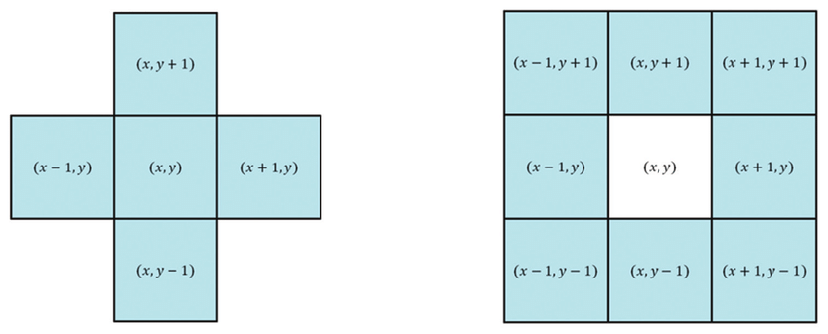
4-Adjacency vs 8-Adjacency
• 8-Adjacency: Includes diagonals as neighbors. • 4-Adjacency: Only left, right, top, bottom pixels are neighbors.
• Connectivity differs from adjacency: Connectivity refers to linked regions, while adjacency refers to immediate neighbors.
Diagram:

Slide 5
Pixel Distance Measures
1. Euclidean Distance: Straight-line distance.
Formula: d = √((x2-x1)² + (y2-y1)²)
2. City-block (Manhattan) Distance: Path along grid lines.
Formula: d = |x2-x1| + |y2-y1|
3. Chessboard Distance: Max of coordinate differences.
Formula: d = max(|x2-x1|, |y2-y1|)

Slide 6
Distance Example: Pixels (2,3) & (7,8)
Euclidean = √((7-2)² + (8-3)²) = √(25 + 25) = 7.07
City-block = |7-2| + |8-3| = 10
Chessboard = max(5,5) = 5
→ Euclidean is best for real distances.
→ City-block useful in grid-based movement.
→ Chessboard for maximum step distance.

Slide 7
Sampling Rate & Resolution
• Sampling rate: 50 samples/inch → 100 samples/inch.
• Doubling sampling rate increases spatial resolution.
• File size increases (~4x, since both dimensions doubled).
• Higher resolution captures more detail.
• After quantization: Better quality preserved, since finer details are represented more accurately.

Slide 8


