Slide 1
Climate-Aware Spread Prediction of Leaf Disease using Transfer Learning
Neural Networks and Deep learning - (19CSE456)
CSE22014 - GOWTHAM
CSE22017 - HARISH
CSE22069 - KARTHIK

Slide 2
Problem Statement
Traditional leaf disease detection systems stop at image classification and fail to consider environmental factors that directly influence disease spread.
Since most plant diseases thrive under specific climate conditions, ignoring these parameters limits the actual system’s prediction.
Farmers require a model that not only identifies diseases accurately but also predicts the likelihood of spread based on real-time weather data, enabling proactive crop protection and efficient resource use.

Slide 3
Abstract
This project presents an intelligent system that not only detects plant leaf diseases from images but also predicts their potential spread based on local climatic conditions. Using transfer learning with the EfficientNetB0 model, the system identifies diseases such as Blight, Rust, Mildew, Leaf Spot, and Mosaic Virus from diverse plant types. The model’s outputs are combined with weather parameters like temperature, humidity, and rainfall forecasts to estimate disease progression probability. This climate-aware approach supports farmers in making timely decisions for disease prevention and management, improving crop health and yield while minimizing pesticide misuse.

Slide 4
Literature Review
S.No | Type & Year | Paper Title | Summary | Gaps / Limitations
1 | Journal (2025) | Using Deep Learning for Image-Based Plant Disease Detection | Demonstrates large-scale CNN classification of 54,000+ leaf images across multiple crops and diseases using the PlantVillage dataset. Achieved very high accuracy and proved the potential of deep learning for automated disease detection. | Evaluated only on lab-quality images; poor performance on real-field data. Lacks explainability and robustness testing.
2 | Journal (2024) | Deep Learning Models for Plant Disease Detection and Diagnosis: A Review | Provides a comparative review of CNN architectures, transfer learning, and preprocessing methods for plant disease diagnosis. Highlights trends, datasets, and performance metrics used in prior research. | Limited focus on field datasets and explainable AI. Overemphasis on benchmark datasets without real-world validation.
3 | Conference (2024) | Deep Learning for Cassava Disease Detection (Transfer Learning Approach) | Utilizes pretrained CNNs (InceptionV3, ResNet) for cassava leaf disease classification. Achieves high accuracy even with a limited dataset through transfer learning. | Model accuracy drops when applied to unseen environments. Dataset diversity and lighting variation not addressed.
4 | Journal (2024) | LeafGAN: An Effective Data Augmentation Method for Practical Plant Disease Diagnosis | Introduces LeafGAN, a GAN-based augmentation technique that synthesizes diseased leaf images for minority classes. Improves CNN accuracy and balances dataset classes. | GAN-generated images can contain unrealistic features. Tested on limited plant species and disease types.

Slide 5
Literature Review
S.No | Type & Year | Paper Title | Summary | Gaps / Limitations
5 | Journal (2023) | Attention-based CNN for precise plant disease classification | Introduces spatial and channel attention modules into CNN backbones to focus the model on disease regions (lesions). Reports improved precision/F1 on multiple leaf datasets and better localization of discriminative areas. | Attention adds computation and may overfit when dataset is small; improvement on real-world noisy images is modest if background bias exists.
6 | Conference (2023) | Lightweight CNN architecture for tomato leaf disease classification (edge deployment) | Proposes a compact CNN designed for mobile/edge inference (reduced parameters and FLOPs) and reports competitive accuracy while enabling real-time inference on smartphones. | Trade-off between size and accuracy for fine-grained/rare classes; robustness under varied field conditions not deeply evaluated.
7 | Journal (2023) | Hybrid Deep Learning Model for Crop Leaf Disease Detection | Combines CNN feature extractor with an LSTM/sequence module (or attention) to model multi-scale/contextual patterns across leaf patches; shows gains vs plain CNNs for some datasets. | Increased model complexity and inference latency; benefit depends on dataset and may not justify extra cost for deployment.
8 | Journal (2023) | Automated Plant Disease Detection Using Transfer Learning with CNNs | Thorough study fine-tuning multiple pretrained models (ResNet, Inception, MobileNet) on leaf datasets; quantifies how model depth, preprocessing and augmentation affect accuracy and generalization. | Transfer learning helps but domain shift remains; small classes and imbalanced datasets still problematic without careful augmentation or re-sampling.

Slide 6
Literature Review
S.No | Type & Year | Paper Title | Summary | Gaps / Limitations
9 | Conference (2022) | Tomato Leaf Disease Detection Using YOLOv5 (detection + classification) | Uses an object-detection framework to both localize lesion regions and classify disease types in tomato leaves; provides bounding-box level annotations and shows advantages for mixed-leaf images. | Detecting very small lesions or overlapping leaves remains hard; requires laborious bounding-box annotation and may miss subtle diffuse symptoms.
10 | Journal (2022) | Explainable/Interpretable Deep Models for Plant Disease Classification | Applies explainability techniques (Grad-CAM, concept attribution) to show which image regions or visual concepts drive CNN decisions; helps identify dataset biases (background, leaf stems) and build trust for agronomists. | Interpretability methods are post-hoc and don’t necessarily improve robustness; explanations can be coarse and misleading with noisy labels or occlusions.
11 | Journal (2020) | Crop Leaf Disease Detection Using Hybrid CNN–Transformer Architecture | Proposes a hybrid deep learning model that integrates CNN layers for feature extraction with Vision Transformer (ViT) blocks for global context understanding. Achieves improved classification accuracy on multiple leaf disease datasets compared to pure CNNs. | Requires large datasets and high computation for transformer training. Limited testing on mobile or low-power devices.
12 | Journal (2020) | Plant Disease Detection and Classification: A Systematic Literature Review | Reviews more than 120 studies on image-based plant disease detection. Categorizes research by dataset, architecture, and evaluation metrics. Summarizes recent trends like GAN-based augmentation and attention mechanisms. | Many studies rely on publicly available datasets; lack of unified benchmark and real-time evaluation across varied field conditions.

Slide 7
Technologies Used
Programming Language: Python
Frameworks: TensorFlow / Keras
Model Architecture: EfficientNetB0 (Transfer Learning)
Weather Data Source: OpenWeatherMap API / Local weather dataset (temperature, humidity, rainfall)
Data Processing: Pandas, NumPy, OpenCV
Visualization & Analysis: Matplotlib, Seaborn
Machine Learning (Prediction): Scikit-learn Regression / Forecast-based Risk Model
Environment: Jupyter Notebook / Google Colab
Deployment (Optional): Flask / Streamlit Web App

Slide 8
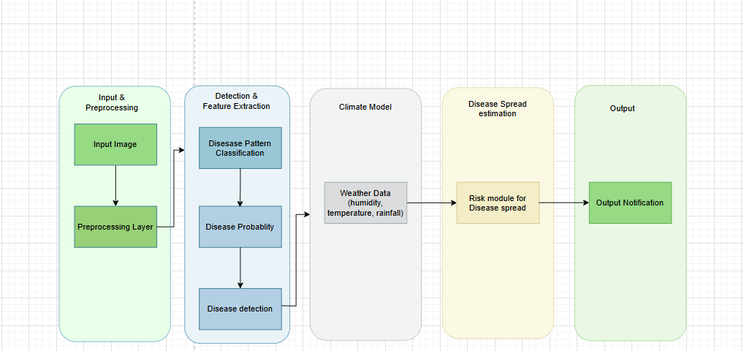
Architecture Diagram

Slide 9
References
1. S. Mohanty, D. P. Hughes, and M. Salathé, “Using deep learning for image-based plant disease
detection,” Frontiers in Plant Science, vol. 7, p. 1419, 2016.
2. Q. H. Cap, D. T. Linh, V. H. Nguyen, and Y. H. Kim, “LeafGAN: An effective data augmentation
method for practical plant disease diagnosis,” Computers and Electronics in Agriculture, vol. 185,
p. 106143, 2021.
3. M. Brahimi, K. Boukhalfa, and A. Moussaoui, “Deep interpretable architecture for plant diseases
classification,” Computers and Electronics in Agriculture, vol. 170, p. 105254, 2020.
4. M. Abade, A. Ferreira, and A. Medeiros, “Plant diseases recognition on images using convolutional
neural networks: A systematic review,” Computers and Electronics in Agriculture, vol. 185, p.
106125, 2021.
5. M. T. Ahmed, S. U. Khan, and A. Yousaf, “Less is more: Lightweight deep neural architecture for
tomato leaf disease classification,” Computers and Electronics in Agriculture, vol. 194, p.
106780, 2022.
6. R. Saleem, M. M. Asif, and M. U. Saleem, “Leaf image-based plant disease identification using
color and texture features,” International Journal of Advanced Computer Science and
Applications (IJACSA), vol. 12, no. 1, pp. 135–141, 2021.

Slide 10
References
7. Y. Xihua, “Review on convolutional neural network (CNN) applied to plant leaf disease
classification,” Agriculture, vol. 11, no. 8, p. 707, 2021.
8. M. Saleem, A. Potgieter, and R. Arif, “Plant disease detection and classification by deep learning,”
Electronics, vol. 10, no. 12, p. 1388, 2021.
9. A. B. Kale, B. T. Gaikwad, and P. S. Pawar, “Plant disease detection and classification: A
systematic literature review,” Sensors, vol. 23, no. 10, p. 4769, 2023.
10. R. Singh and A. Kumar, “An effective approach based on a novel DeepPlantNet model for plant
leaf disease classification,” Frontiers in Plant Science, vol. 14, p. 1212747, 2023.
11. A. Das, A. K. Saha, and S. S. Mandal, “Detection and classification of leaf disease using deep
learning,” Materials Today: Proceedings, vol. 62, pp. 5553–5558, 2022.
12. N. Sharma, S. Jain, and R. Gupta, “Crop leaf disease detection using hybrid deep learning model,”
Multimedia Tools and Applications, vol. 82, pp. 10479–10500, 2023.

