Slide 1
MAIN Project Project Title: Customer churn Analysis
Name : Gowtham K
Register No: 22235136
School of Computing Sciences
DEPT: Information technology
2nd year MSc data science & Business analytics

Slide 2
Abstract
PowerCo is a major gas and electricity utility that supplies to corporate, SME (Small & Medium Enterprise), and residential customers. The power-liberalization of the energy market in Europe has led to significant customer churn, especially in the SME segment. In an increasingly competitive energy market, customer retention has become a critical focus for PowerCo's sustained growth and profitability.
PowerCo, facing the prospect of customer attrition, is operating in an industry characterized by evolving consumer preferences, regulatory changes, and the emergence of alternative energy solutions. To interpret this business context, a comprehensive analysis considers factors such as market dynamics, competitive landscape, customer behavior, and the company's existing strategies.
The study identifies the primary drivers contributing to customer churn, encompassing factors such as service quality, pricing structures, customer engagement, and technological advancements. Understanding these factors forms the basis for strategic interventions aimed at enhancing customer satisfaction and loyalty.
Recommendations include the implementation of targeted customer engagement initiatives, personalized communication strategies, and the adoption of innovative technologies to improve service delivery and customer experience. Additionally, the development of flexible pricing models and the introduction of loyalty programs are proposed to incentivize customer retention.
The analysis draws on industry best practices, case studies, and data-driven insights to formulate a holistic strategy tailored to PowerCo's specific challenges. The objective is to empower PowerCo to not only retain its existing customer base but also to position itself as a preferred choice in a rapidly evolving energy landscape.
By embracing a customer-centric approach and leveraging data analytics, PowerCo can proactively address the identified issues, foster customer loyalty, and ultimately secure its market position. The implementation of these recommendations is expected to enhance PowerCo's competitive advantage and ensure sustainable growth in the dynamic energy market.

Slide 3
Project Purpose
The purpose of the project is to conduct a comprehensive analysis of customer churn for PowerCo, a major gas and electricity utility that supplies to corporate, small, and medium-sized enterprise (SME) customers. In the context of a rapidly evolving energy market, characterized by increased competition and changing consumer preferences, the project aims to address the following objectives:
Understand Market Dynamics: Analyze the factors contributing to customer churn within the SME segment, considering the evolving energy market landscape, regulatory changes, and emerging alternative energy solutions.
Identify Key Drivers of Churn: Determine the primary factors influencing customer churn, including service quality, pricing structures, customer engagement, and technological advancements.
Develop Strategic Interventions: Formulate recommendations and strategies aimed at improving customer satisfaction and loyalty, with a focus on targeted customer engagement initiatives, personalized communication strategies, and innovative technology adoption.
Enhance Competitiveness: Implement flexible pricing models, introduce loyalty programs, and leverage data analytics to retain existing customers and position PowerCo as a preferred choice in the dynamic energy market.
Utilize Data-Driven Insights: Draw insights from industry best practices, case studies, and data analytics to tailor strategies specifically to PowerCo's challenges and customer needs.

Slide 4
TOOLS & TECHNIQUES
Python: Python programming language as the primary tool for data preprocessing analysis
Data type conversion 0: to convert a datetime feature to datetime data type,
Label Encoder: A label encoder is a tool used in machine learning and data preprocessing tasks, particularly in the context of supervised learning algorithms. Its primary purpose is to convert categorical labels into numerical values.
Random Forest Classifier: Random Forest Classifier is a ensemble learning method that constructs multiple decision trees during training and outputs the mode of the classes (classification) or the mean prediction (regression) of the individual trees.
Data-set description
Data Set Name: client_data, price_data
Source: BCG X, From PowerCo
Purpose:
Format: CSV (Comma-Separated Values)
Size: client_data :14606 rows × 26 columns (3,79,756 datas) price_data :193002 rows × 8 columns (15,44,016 datas)

Slide 5
Columns:
client_data.csv
● id = client company identifier ● activity_new = category of the company’s activity ● channel_sales = code of the sales channel ● cons_12m = electricity consumption of the past 12 months ● cons_gas_12m = gas consumption of the past 12 months ● cons_last_month = electricity consumption of the last month ● date_activ = date of activation of the contract ● date_end = registered date of the end of the contract ● date_modif_prod = date of the last modification of the product ● date_renewal = date of the next contract renewal ● forecast_cons_12m = forecasted electricity consumption for next 12 months ● forecast_cons_year = forecasted electricity consumption for the next calendar year ● forecast_discount_energy = forecasted value of current discount ● forecast_meter_rent_12m = forecasted bill of meter rental for the next 2 months ● forecast_price_energy_off_peak = forecasted energy price for 1st period (off peak) ● forecast_price_energy_peak = forecasted energy price for 2nd period (peak) ● forecast_price_pow_off_peak = forecasted power price for 1st period (off peak) ● has_gas = indicated if client is also a gas client ● imp_cons = current paid consumption ● margin_gross_pow_ele = gross margin on power subscription ● margin_net_pow_ele = net margin on power subscription ● nb_prod_act = number of active products and services ● net_margin = total net margin ● num_years_antig = antiquity of the client (in number of years) ● origin_up = code of the electricity campaign the customer first subscribed to ● pow_max = subscribed power ● churn = has the client churned over the next 3 months
price_data.csv
● id = client company identifier ● price_date = reference date ● price_off_peak_var = price of energy for the 1st period (off peak) ● price_peak_var = price of energy for the 2nd period (peak) ● price_mid_peak_var = price of energy for the 3rd period (mid peak) ● price_off_peak_fix = price of power for the 1st period (off peak) ● price_peak_fix = price of power for the 2nd period (peak) ● price_mid_peak_fix = price of power for the 3rd period (mid peak)

Slide 6
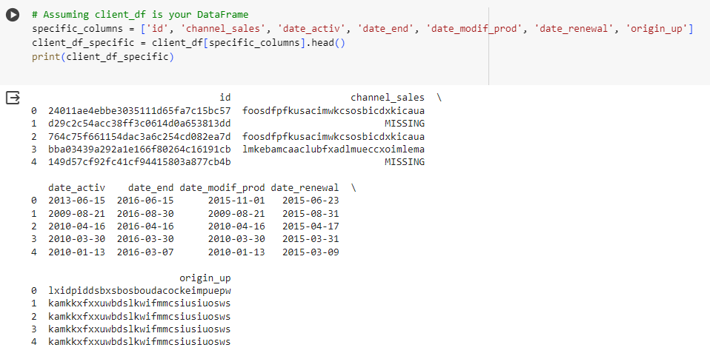
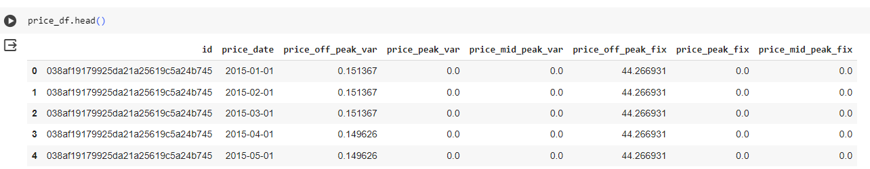
Dataset
client_data
price_data

Slide 7
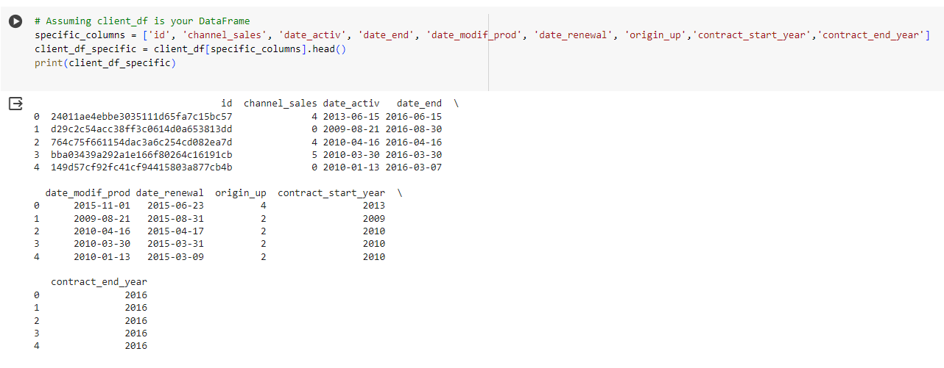
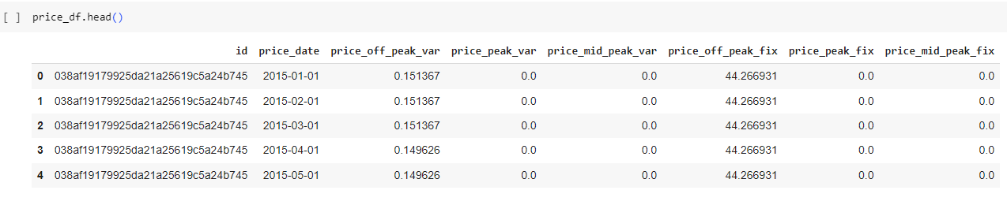
Data preprocess
Data type conversion , Label Encoding
client_data
price_data

Slide 8
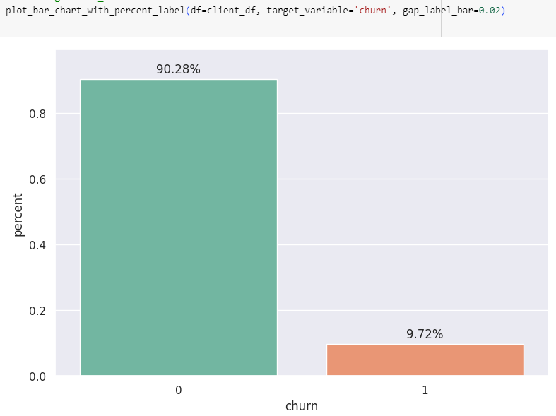
Exploratory data analysis
Around 9.72% of the customers change their providers.

Slide 9
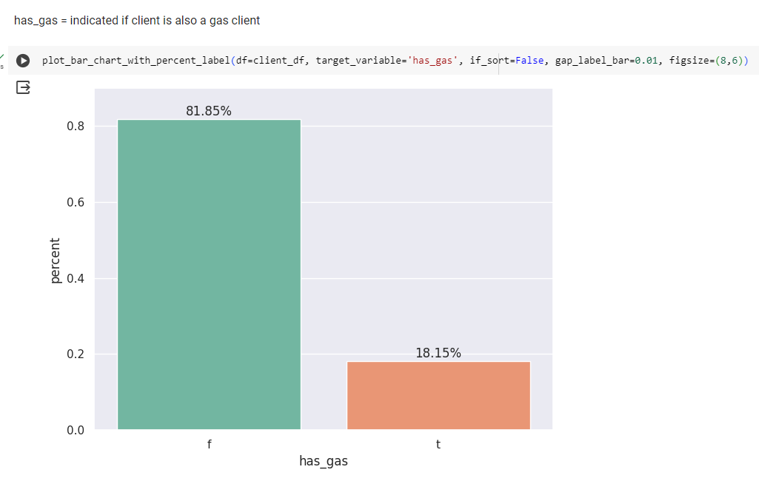
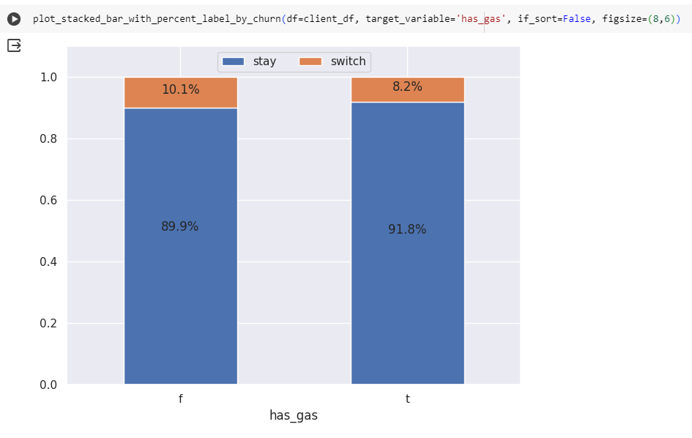
Only 18.15% of the clients were also gas clients.
Electricity clients are more likely to churn than Electricity and gas clients.

Slide 10
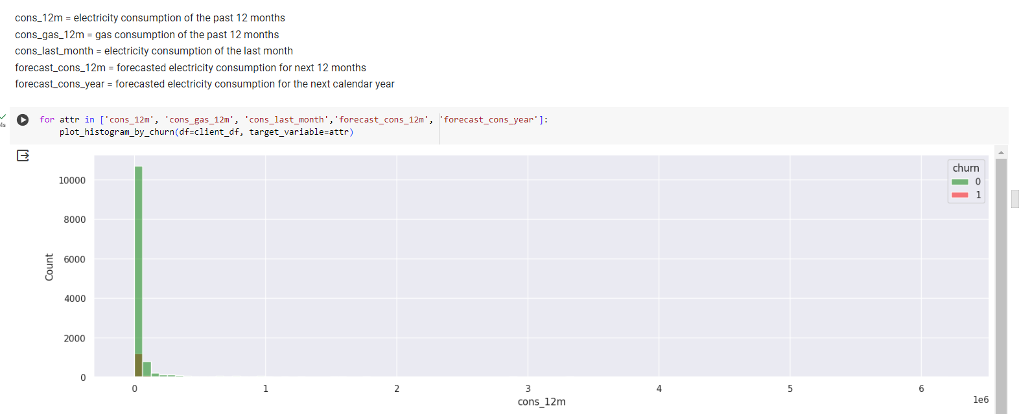
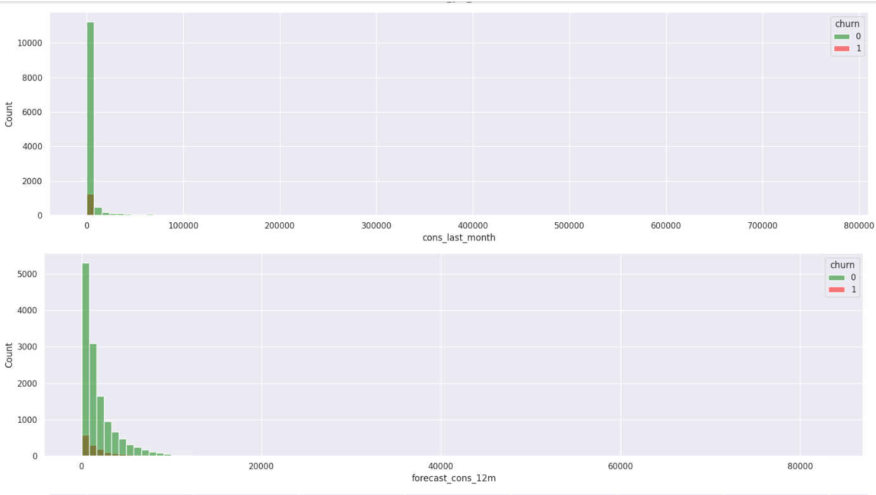
Histograms of continous numeric features

Slide 11
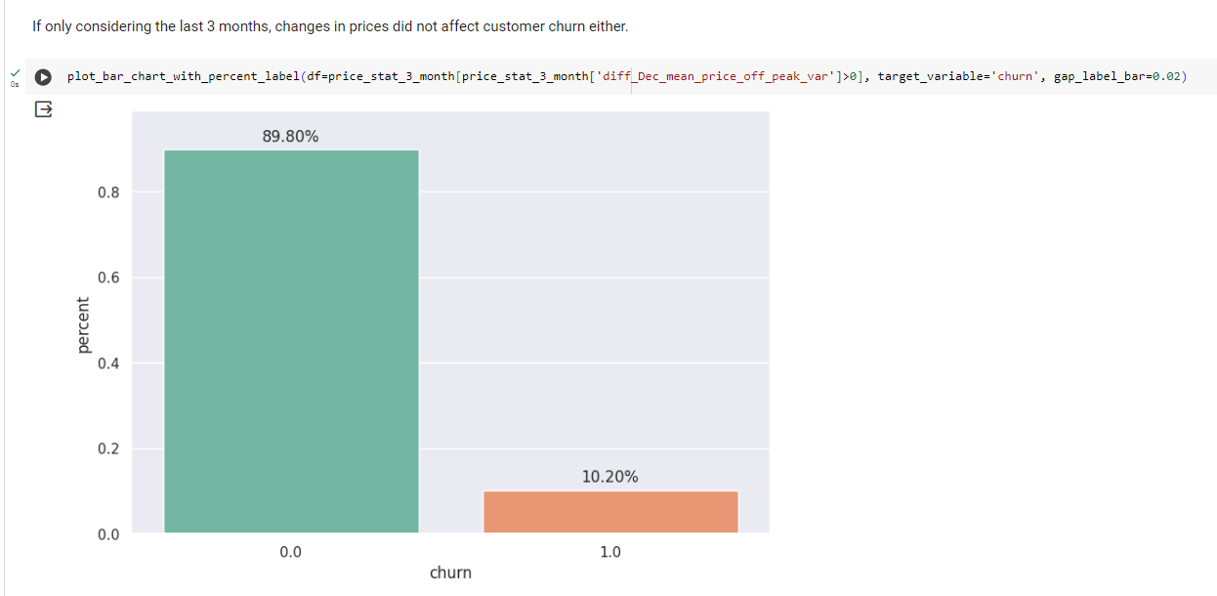
customers sensitivity to price.
From all results above, we can conclude customers were not sensitive to prices.

Slide 12
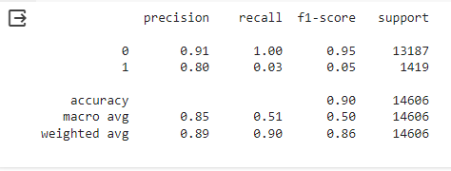
Machine Learning Model
The Random Forest Classifier is a popular machine learning algorithm used for classification tasks. It belongs to the ensemble learning family, which means it builds multiple decision trees and merges them together to get a more accurate and stable prediction
Accuracy: the proportion of correctly classified instances.
Precision: the number of true positive predictions divided by the total number of positive predictions.
Recall: The number of true positive predictions divided by the total number of actual positive instances
F1-Score: The harmonic mean of precision and recall, which balances precision and recall.

Slide 13
Impact of a 20% Discount
By applying the 20% discount to predicted churning customers, the analysis showed an overall increase in expected profit.
The discount strategy resulted in a net positive impact on profitability, indicating its potential effectiveness in retaining customers and maximizing revenue.
Breakdown of Customer Responses:
Among the predicted churning customers, a portion responded positively to the discount, leading to an increase in expected profit.
Conversely, some customers showed a negative response to the discount, resulting in a decrease in expected profit for those individuals.
The analysis further categorized customers into those whose expected profit increased and those whose expected profit decreased after applying the discount.
By summing up the net impact across all predicted churning customers, the analysis provided an estimation of the total extra profit generated from implementing the discount strategy.

Slide 14
Conclusion:
The analysis highlights the need for continuous monitoring and adaptation of retention strategies. Market dynamics and customer preferences may change over time, necessitating ongoing optimization of discount strategies to maintain competitiveness and profitability.
Overall, by leveraging advanced analytics and machine learning techniques, businesses can gain valuable insights into customer churn dynamics and implement proactive measures to enhance customer retention and drive sustainable growth.

