Slide 1
AI-Based IT Helpdesk Ticket Analysis & Resolution Prediction
Python Data Analysis Project
INDUSTRY
STUDENT NAME
IT Helpdesk / IT Support
Gowtham M
STUDENT ID
COURSE
AF05309798
AIML
ORGANIZATION
BATCH CODE
Anudip Foundation
ANP-D7444

Slide 2
Industry Overview
Industry: IT Helpdesk / IT Support
What IT helpdesks do
Why data analysis is useful
IT helpdesk systems handle technical issues and support requests.
Each request is recorded and tracked as a ticket.
Tickets move from creation to resolution.
Large volumes of support tickets are generated.
Ticket data holds issues, priority, projects, comments, contributors and resolution time.
Analysis helps reveal ticket patterns and resolution behavior.
Ticket attributes available for analysis
Issue type
Priority
Project
Comments
Contributors
Resolution time

Slide 3
Problem Statement
IT organizations handle a large volume of helpdesk tickets related to technical issues and support requests. However, analyzing these tickets manually makes it difficult to identify recurring problems, understand resolution patterns, and estimate how long a new ticket may take to resolve.
This project focuses on analyzing IT helpdesk ticket data to understand ticket patterns, priority, issue types, project-wise ticket distribution, and resolution time.
Why is it important?
Manual analysis of large ticket datasets is difficult.
Understanding resolution patterns supports support analysis.
Ticket patterns can be studied through structured data analysis.
Who is affected?
IT organizations
IT helpdesk / support teams
Teams that handle and resolve support tickets

Slide 4
Project Objectives
1
Understand the structure and quality of the IT helpdesk ticket dataset.
2
Clean and prepare relevant ticket data for analysis.
3
Analyze ticket priority, issue types, and project-wise ticket distribution.
4
Calculate and analyze ticket resolution time.
5
Visualize important patterns using Matplotlib.
PROJECT WORKFLOW
Industry Selection
Problem Identification
Dataset Collection
Data Cleaning
Data Transformation
Data Analysis
Data Visualization
Insights
Recommendations

Slide 5
Proposed Solution & Analysis Questions
Use Python-based data analysis to clean, transform, analyze, and visualize IT helpdesk ticket data.
ANALYSIS QUESTIONS
Q1
How are tickets distributed across different priority levels?
Pandas
Q2
What are the most common issue types?
Data loading, cleaning, filtering, grouping, and date processing
Q3
How are tickets distributed across projects?
NumPy
Q4
What is the resolution time of the tickets?
Statistical calculations
Q5
How does resolution time vary across ticket priorities?
Matplotlib
Data visualization
Q6
How does resolution time relate to comments and contributor count?

Slide 6
Dataset Information
DATASET
MAIN FILE
ROWS
ORIGINAL COLUMNS
Help Desk Tickets
issues.csv
66,691
58
Important features used in Sprint 1 (file format: CSV)
Description
id
issue_proj
The dataset contains IT helpdesk ticket information.
Sprint 1 uses selected fields: ticket identification, project, contributors, issue type, priority, creation date, resolution date, resolution information, status, and comments.
issue_contr_count
issue_type
issue_priority
issue_created
issue_resolution_date
issue_resolution
issue_status
issue_comments_count
Dataset source: Not specified in the provided project information.

Slide 7
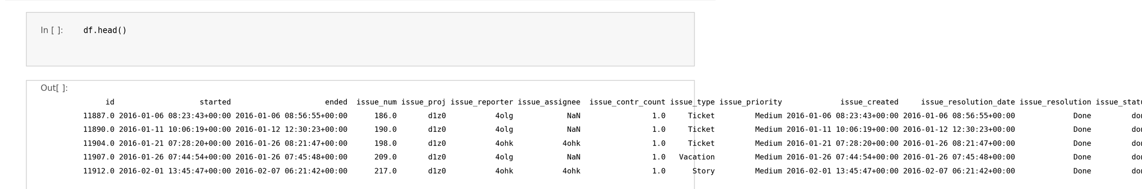
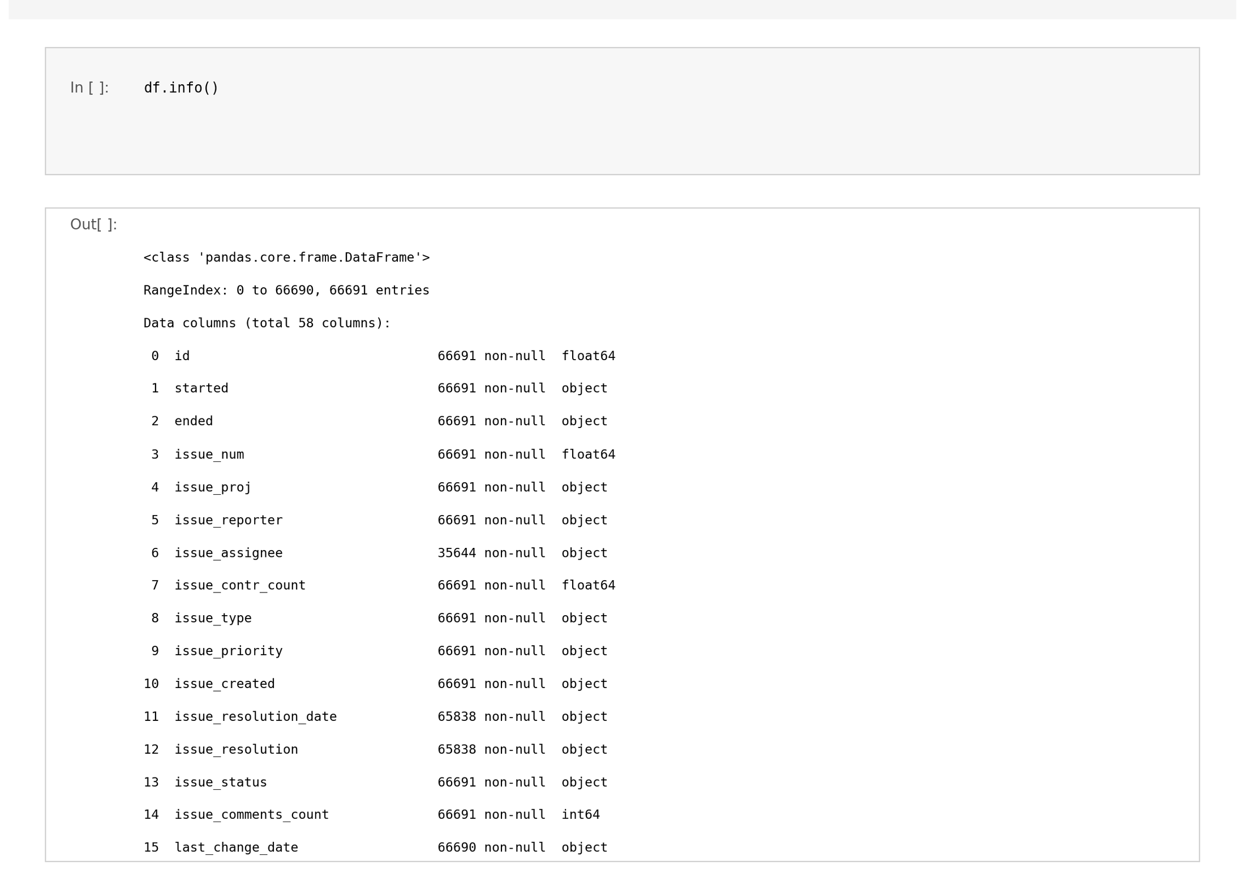
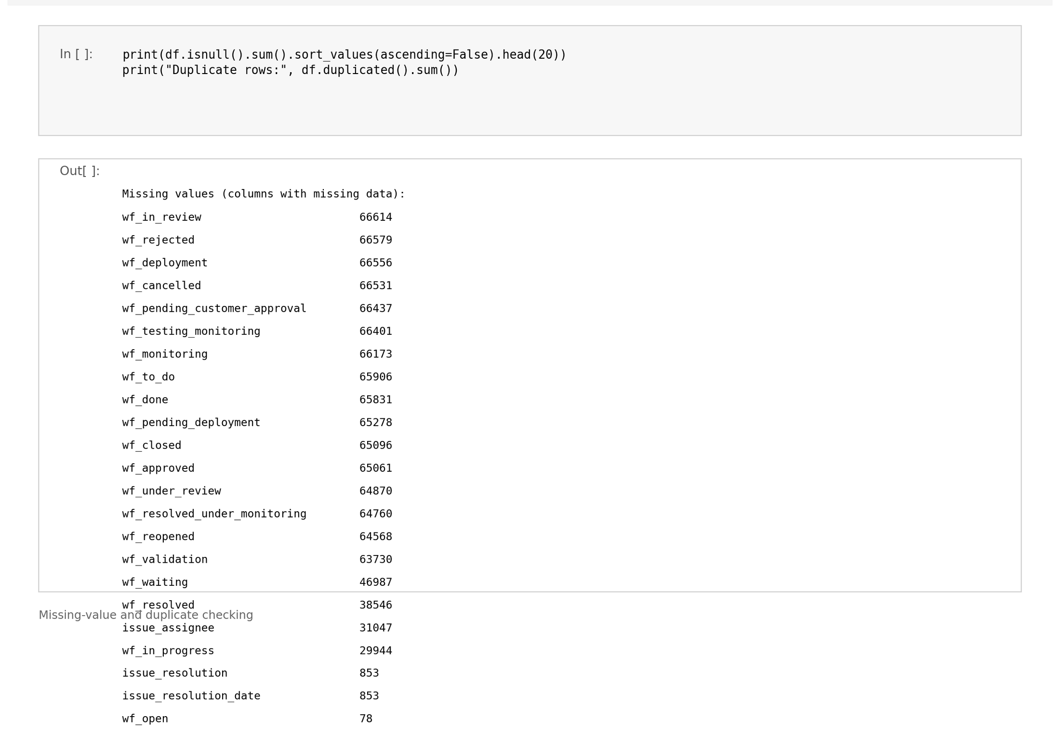
Data Collection & Understanding
What was done with Pandas
Dataset: Help Desk Tickets; main file issues.csv
Shape checked: 66,691 rows × 58 columns
Initial rows inspected (head)
Dataset info and descriptive statistics examined
Duplicate records checked: 0 duplicate rows
Missing values checked: issue_resolution_date and issue_resolution each have 853 missing; other selected columns have 0
Visible data types: id, issue_contr_count = float64; issue_comments_count = int64; date columns = object (text) before conversion
Relevant columns selected for Sprint 1
df.head() (first columns shown)
df.info() (first rows shown)
Missing-value checking

Slide 8
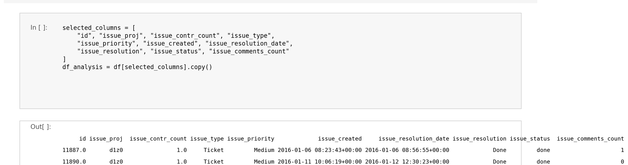
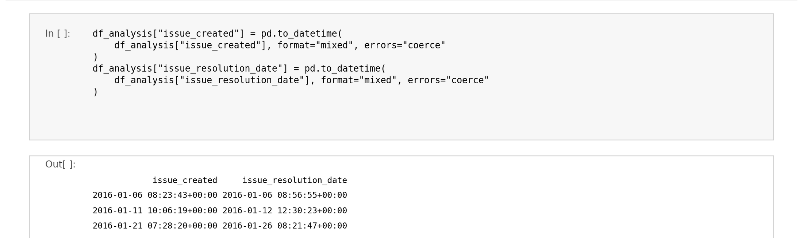
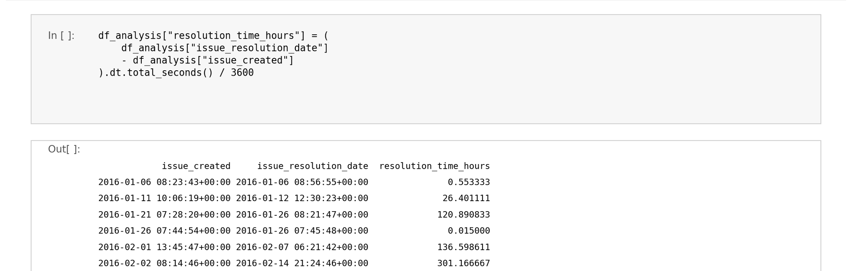
Data Cleaning & Transformation
1
Selected relevant columns from the original dataset.
2
Converted issue_created into datetime format.
3
Converted issue_resolution_date into datetime format.
4
Calculated resolution_time_hours.
5
Negative resolution-time values treated as invalid and set to missing.
6
Created a month column from issue_created for monthly analysis.
RESOLUTION TIME FORMULA
Resolution Time = Issue Resolution Date − Issue Created Date
Result: resolution_time_hours. Cleaned data = selected columns + resolution_time_hours + month.

Slide 9
Exploratory Data Analysis
Ticket Priority
Issue Type
Project-wise
Counts via Pandas value_counts()
Ticket distribution by issue type
Ticket volume across projects
Resolution Time Statistics
Resolution Time by Priority
Resolution Time by Issue Type
NumPy: mean, median, minimum, maximum, standard deviation
Grouped by priority: count, mean, median
Grouped by issue type: count, mean, median
Comments & Resolution Time
Contributors & Resolution Time
Monthly Ticket Analysis
Relationship between comment count and resolution time
Contributor count and resolution time
Ticket volume grouped by month

Slide 10
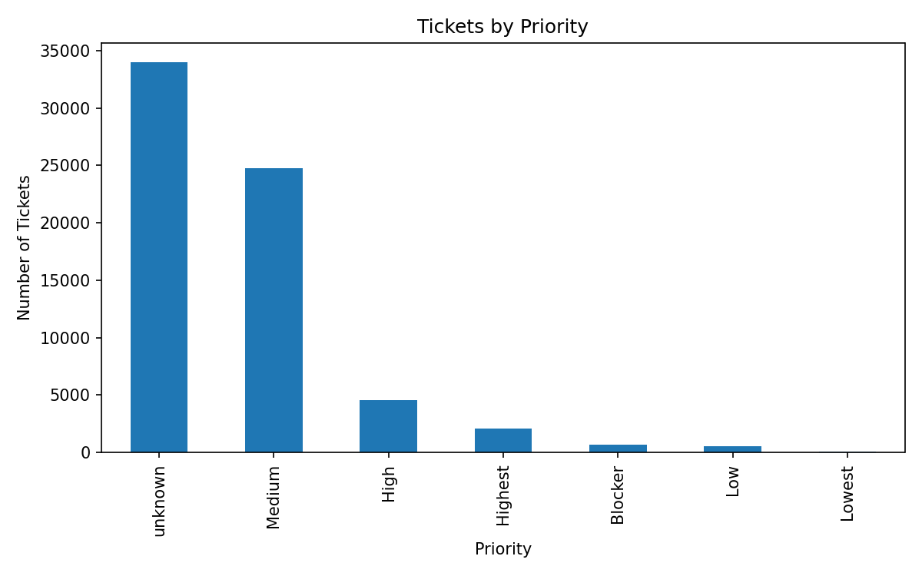
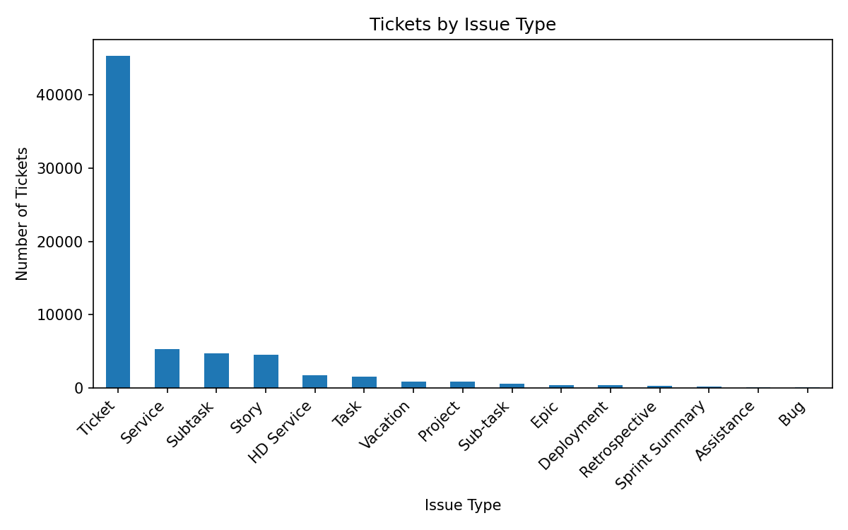
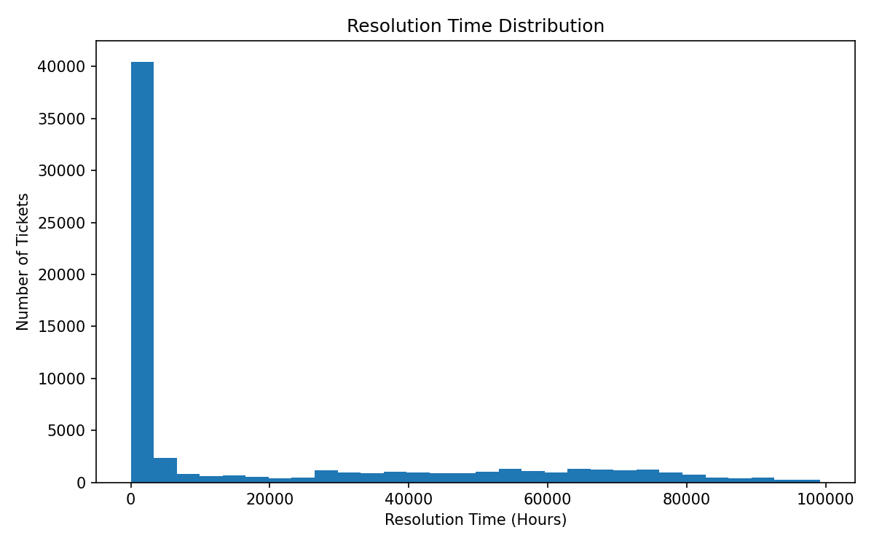
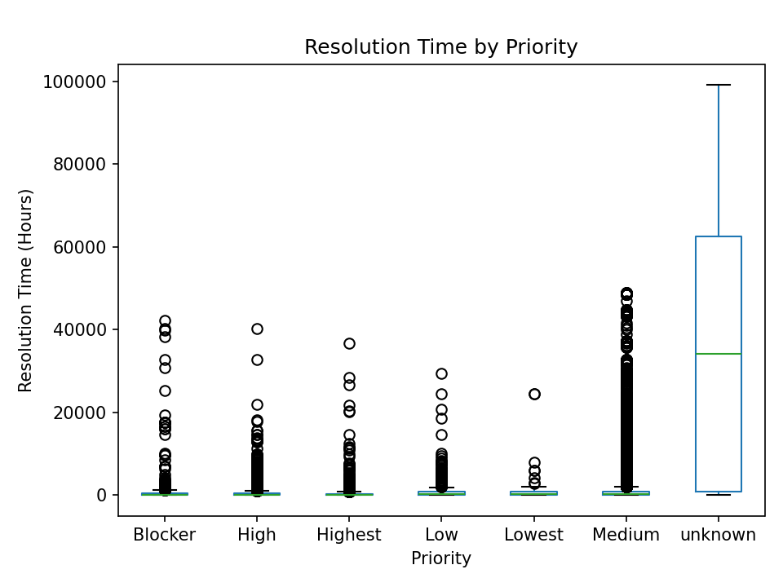
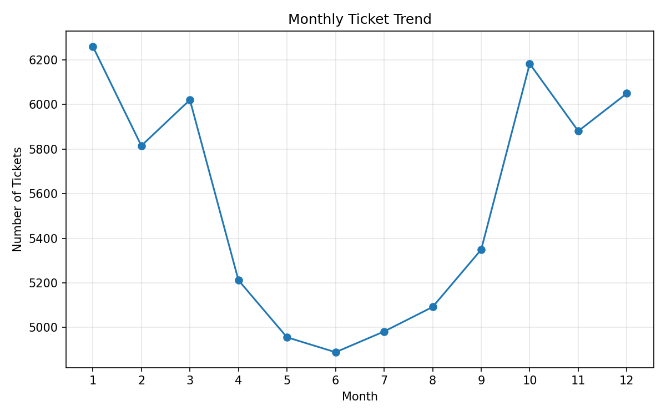
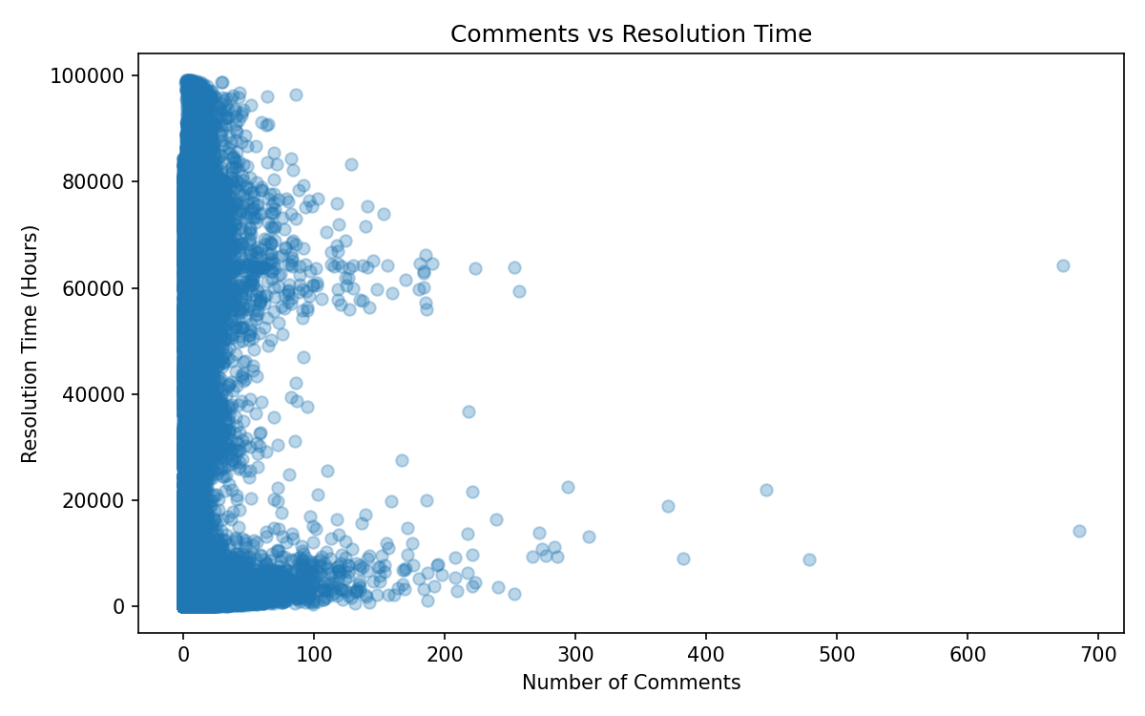
Data Visualization
Tickets by Priority
Tickets by Issue Type
Purpose: Show ticket distribution across priorities.
Shows: Bar chart of ticket counts per priority.
Insight: 'unknown' is the largest group (33,965), then Medium (24,788).
Purpose: Show ticket distribution across issue types.
Shows: Bar chart of ticket counts per issue type.
Insight: "Ticket" dominates (45,275); Bug is smallest (53).
Resolution Time Distribution
Resolution Time by Priority
Purpose: Show how resolution time is distributed.
Shows: Histogram of resolution time in hours.
Insight: Most tickets fall in the lowest bin; a long tail reaches ~99,000 h.
Purpose: Compare resolution time across priorities.
Shows: Box plot of resolution time per priority.
Insight: 'unknown' has a far higher median (34,149 h) than other priorities (91–238 h).
Monthly Ticket Trend
Comments vs Resolution Time
Purpose: Show ticket volume across months.
Shows: Line chart of tickets per month.
Insight: Highest in month 1 (6,261); lowest in month 6 (4,889).
Purpose: Examine comments vs resolution time.
Shows: Scatter plot of comments against hours.
Insight: No clear linear pattern; most tickets have few comments.

Slide 11
Key Insights & Recommendations
Insights (from notebook outputs)
Recommendations
Priority: 'unknown' 33,965 tickets, Medium 24,788, Lowest 84.
Issue type: "Ticket" accounts for 45,275 of 66,691.
Projects: t.n2 has the most tickets (2,213), then C06hg2xcu (1,994).
Resolution time (65,838 resolved tickets): mean 18,482.5 h, median 837.8 h, max 99,220.5 h, std 27,805.7 h; mean far above median.
By priority: 'unknown' median 34,149 h; all other priorities 90.6–238.5 h.
By issue type: Subtask has the highest mean (51,587 h); Assistance the lowest (306.8 h).
Monthly: highest in month 1 (6,261), lowest in month 6 (4,889).
Comments show no consistent trend with mean resolution time; 1-contributor tickets average 22,092 h vs 818 h for 2 contributors.
Review why 33,965 tickets have 'unknown' priority; this group also has the longest resolution times.
Report median alongside mean for resolution time, as the distribution is strongly skewed.
Comments / contributors / monthly volume: Further analysis is required before making a specific recommendation.

Slide 12
Conclusion
Summary
Future Scope
IT helpdesk ticket dataset analyzed using Python.
Relevant data cleaned and transformed.
Priority, issue type, projects, resolution time, comments, contributors and monthly volume analyzed.
Resolution time calculated from ticket creation and resolution dates.
NumPy: statistics | Pandas: processing | Matplotlib: visualization
The cleaned and analyzed dataset can support future work on resolution-time prediction.
No machine-learning model was built in Sprint 1.
Overall, the project establishes a structured data-analysis foundation for understanding IT helpdesk ticket patterns and resolution behavior.

