Slide 1

BUILD FAST WEB
Manual work in,
digital systems out.
Websites, business software, ERPs and AI automation for schools, colleges, clinics, fuel stations, hotels, traders and agencies.
Gowtham · Founder
hello@buildfastweb.in
buildfastweb.in
Tamil Nadu, India · Working with businesses across India, UAE & the US
Notes:
Opening line: I build the software that runs a business day to day — and the website that brings it customers. This deck walks through what I have already built and what I can build for you.

Slide 2
Three things I build
Most clients start with one and come back for the next.
01
02
03
Websites & web apps
Custom business software
AI & automation
Marketing sites, landing pages for ads, e-commerce stores and customer portals — fast, search-ready and built to convert visitors into enquiries.
ERPs and operations systems: school, college, clinic, fuel station, hotel, inventory, society, agency. Registers and Excel files replaced by one system.
AI receptionist on your phone line, chatbots on your site, WhatsApp auto-replies, payment reminders and follow-up sequences that never forget.
20+
25+
08
03
Clients served
Projects delivered
Industries
Countries
Education · fuel retail · healthcare · field services · hospitality · retail & e-commerce · real estate · agencies
buildfastweb.in · hello@buildfastweb.in · +91 97895 02278
02
Notes:
Keep this short — the detail comes in the system slides.

Slide 3
Systems already running
Delivered work — every one of these is live or in daily use.
Velammal Institute of Technology
Online admission portal
PSR Petrol Pump
Fuel station operations
Asian Pest Control
Field-service CRM + site
Guppy's World
Store with online payments
AntHands
Store + workshop booking
Royal Fins
E-commerce store
Lobes
E-commerce platform
Snap Tales
Gifts store + event booking
Sticky Moments
Custom gift store
Tvoy Dom
Rental marketplace, Russia
The same team builds it, launches it, trains your staff and answers the phone afterwards — you deal with one person, not a ticket queue.
Client names and systems as delivered. Screens in this deck are product views of these systems with sample data.
buildfastweb.in · hello@buildfastweb.in · +91 97895 02278
03

Slide 4
What I am actually replacing
Every project starts the same way — with the registers and the WhatsApp groups.
HOW IT RUNS TODAY
AFTER THE SYSTEM GOES LIVE
—
Registers, notebooks and paper files
One system your whole team logs into
—
Twelve Excel sheets, none of them current
Live numbers — attendance, sales, dues, stock
—
Job instructions over WhatsApp groups
Work assigned, tracked and closed inside the system
—
Bills and receipts written by hand
GST-ready invoices and receipts generated in seconds
—
Payment follow-ups nobody remembers to make
Reminders that go out automatically, every time
—
Missed calls that quietly become lost customers
Every call and enquiry answered in seconds, day or night
Nothing is thrown away on day one — existing data is migrated in, and staff are trained on a call they can record.
buildfastweb.in · hello@buildfastweb.in · +91 97895 02278
04

Slide 5
01
School ERP
College ERP
Admission system
Systems I build
for your industry
Clinic & hospital management
Petrol pump software
Ten operations systems, already designed and proven. Yours is configured to how you actually work — not the other way round.
Restaurant POS & digital menu
Hotel & booking system
Inventory, quotation & billing
buildfastweb.in · hello@buildfastweb.in · +91 97895 02278
05

Slide 6
The ready-made systems
Each one is a working product — we configure and extend it for your business instead of starting from a blank page.
School ERP
College ERP
Admission system
Clinic & hospital
Petrol pump
Admissions, attendance, fees, exams, timetable, parent portal
Departments, semesters, internal marks, hostel, placements
Online applications, documents, merit list, seat allotment
Appointments, patient records, billing, lab, pharmacy
Shifts, nozzle sales, tank stock, credit customers, salary
Restaurant POS
Hotel & booking
Inventory & billing
Society management
Agency & projects
Billing, KOT, QR menu, delivery, item-wise reports
Live availability, bookings, check-in, folio billing
Stock, batches, quotation to invoice, GST, receivables
Maintenance billing, visitors, complaints, resident app
Leads, projects, milestones, invoices, payment tracking
Not on this list? Slide 27 shows how any business system gets built from the same set of parts.
buildfastweb.in · hello@buildfastweb.in · +91 97895 02278
06

Slide 7
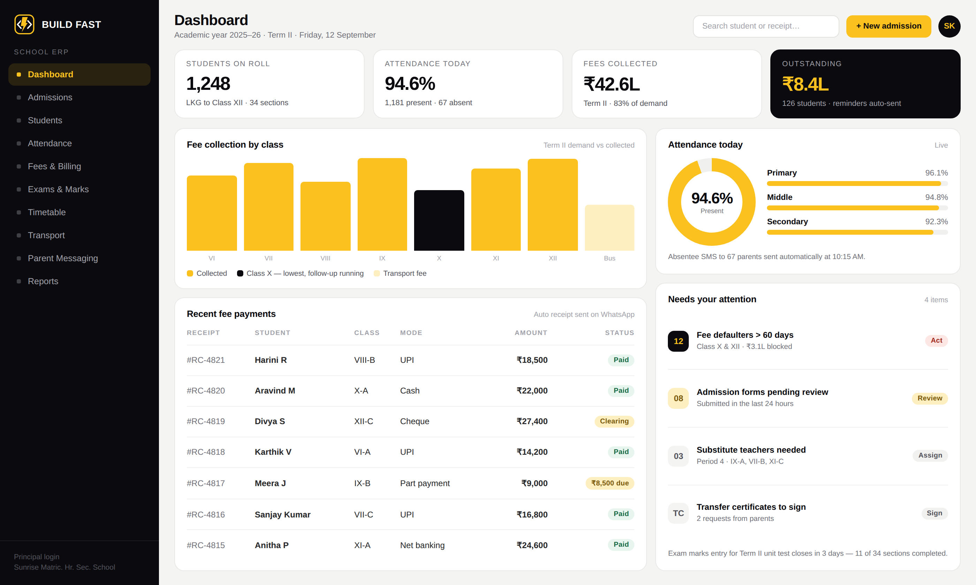
School ERP
For schools, matriculation & CBSE institutions and coaching centres.
Admission enquiries, applications and follow-up
Attendance by class, section and staff
Fee demand, collection and auto-reminders
Exams, mark entry, report cards and progress
Timetable, substitutions, transport and hostel
Parent portal with SMS and WhatsApp updates
WHAT CHANGES FOR THE OWNER
The principal opens one screen and sees roll strength, today's attendance, fees collected and who owes money — as of this minute, not last month.
School ERP — principal's dashboard
buildfastweb.in · hello@buildfastweb.in · +91 97895 02278
07
Notes:
Point at the outstanding card: ₹8.4L from 126 students, with reminders already sent automatically.

Slide 8
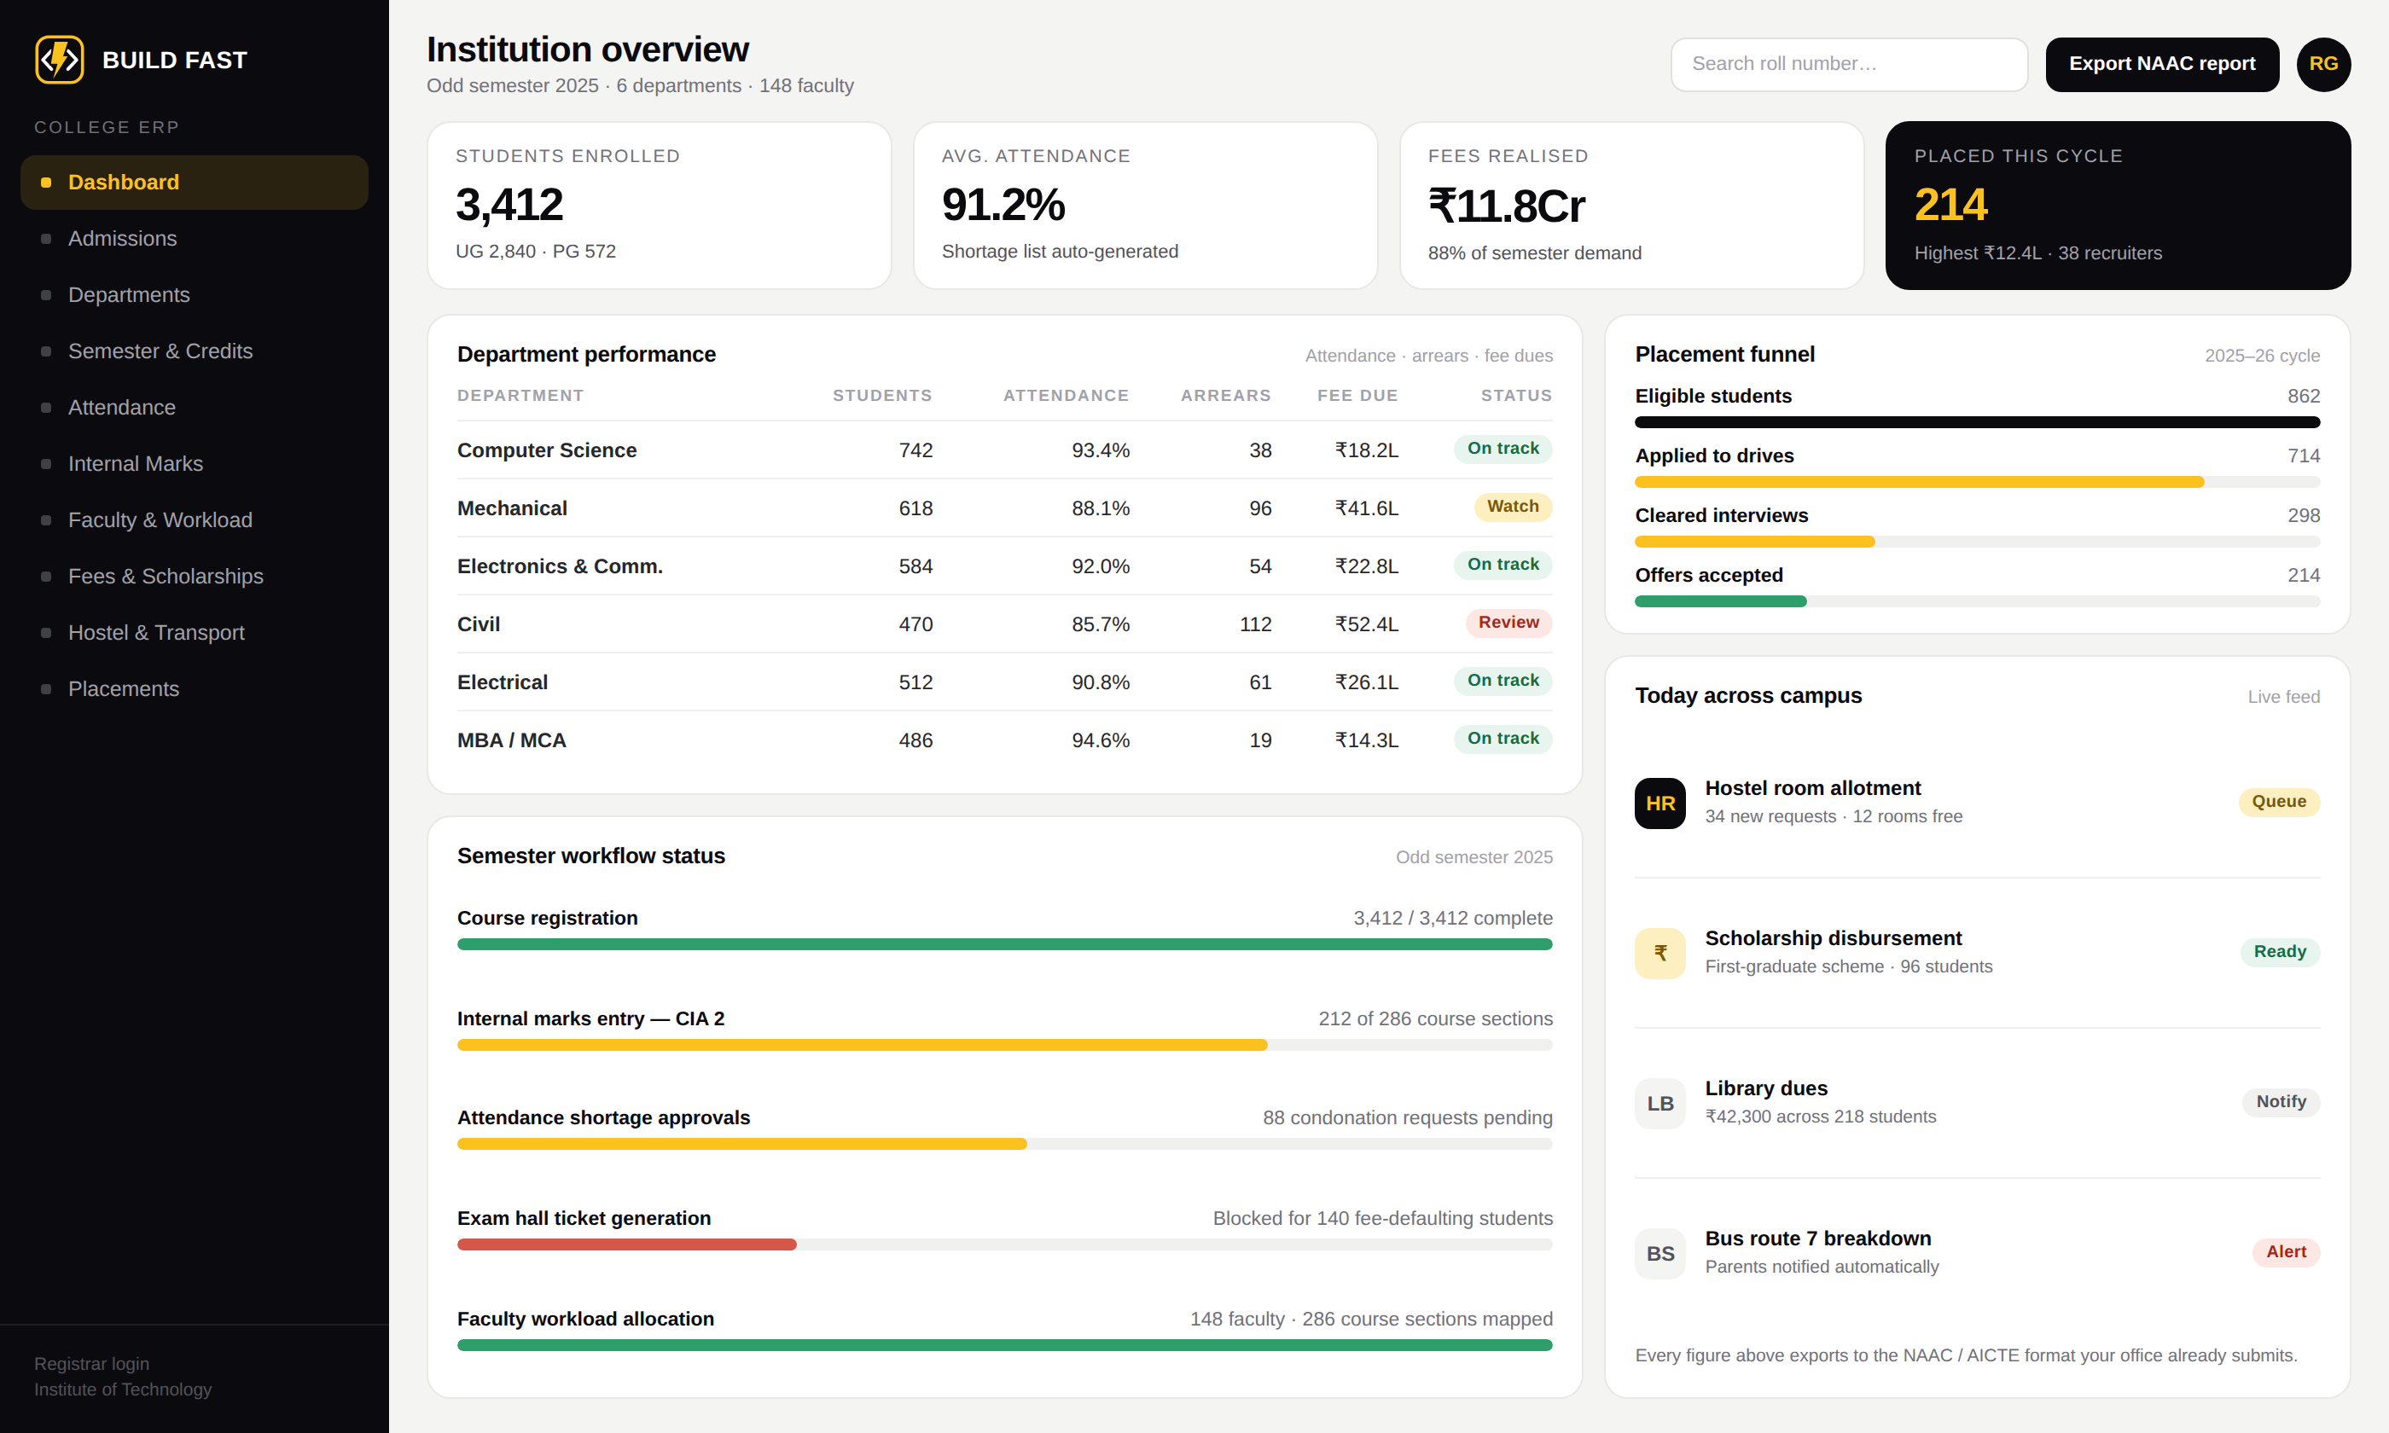
College ERP
For engineering, arts & science colleges and polytechnics.
Departments, programmes and semesters
Course registration and internal marks (CIA)
Attendance shortage, condonation and approvals
Fees, scholarships, hostel and transport
Faculty workload, timetable and substitutions
Placement drives, offers and NAAC reports
WHAT CHANGES FOR THE OWNER
Six departments, 3,400 students, and every report the office has to file — generated from the same data the staff enter once.
College ERP — registrar's overview
buildfastweb.in · hello@buildfastweb.in · +91 97895 02278
08

Slide 9
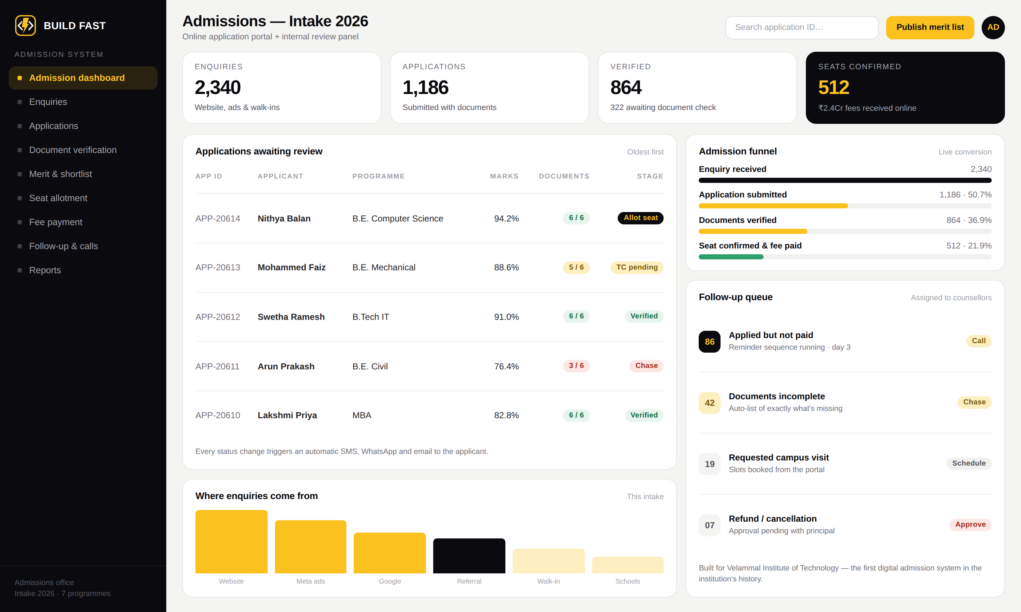
Admission system
A standalone portal when admissions are the bottleneck — with or without the full ERP.
Public application form with document upload
Application and admission fees paid online
Admin review panel — verify, shortlist, reject
Merit list, seat allotment and confirmation
Automatic SMS, WhatsApp and email updates
Follow-up queue for unpaid applications
WHAT CHANGES FOR THE OWNER
Built for Velammal Institute of Technology — the first digital admission system in the institution's history. Paper collection and manual tracking gone entirely.
Admission system — admissions office panel
buildfastweb.in · hello@buildfastweb.in · +91 97895 02278
09
Notes:
This is a real delivered project: admission.velammalitech.edu.in

Slide 10
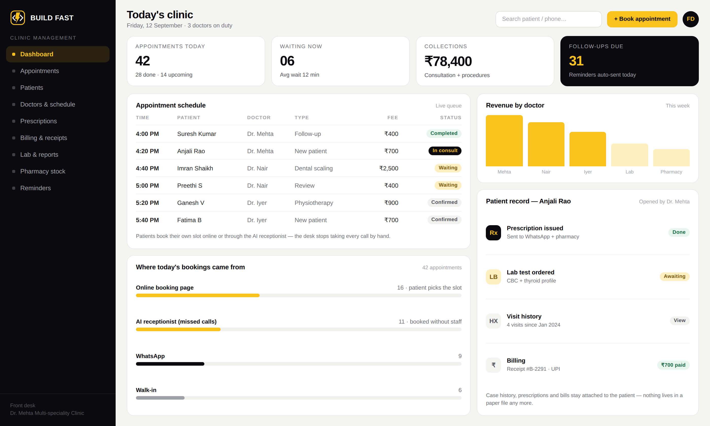
Clinic & hospital management
For clinics, dental and dermatology practices, diagnostic centres and multi-doctor setups.
Appointments, doctor schedules and live queue
Patient records, case history and prescriptions
Billing, receipts, packages and insurance
Lab tests, reports and pharmacy stock
Automatic visit and follow-up reminders
Online booking page + AI receptionist
WHAT CHANGES FOR THE OWNER
The front desk stops writing in a register, no-shows fall because reminders go out on their own, and any patient's history is one search away.
Clinic management — front desk view
buildfastweb.in · hello@buildfastweb.in · +91 97895 02278
10

Slide 11
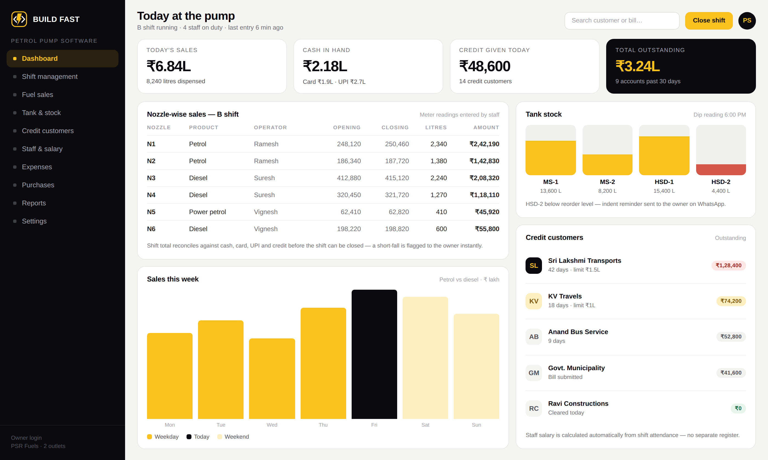
Petrol pump software
For fuel stations and bunk owners running one outlet or several.
Shift management with meter readings
Nozzle-wise fuel sales and cash reconciliation
Tank stock, dip readings and purchase indents
Credit customers, limits and outstanding ageing
Staff attendance with salary auto-calculated
Expenses, day book and monthly reports
WHAT CHANGES FOR THE OWNER
Live at PSR Petrol Pump. Shift tallies, staff salary and monthly reports that used to take a day of notebook work now take seconds.
Petrol pump software — owner's dashboard
buildfastweb.in · hello@buildfastweb.in · +91 97895 02278
11
Notes:
Real delivered project: psr.mypetrolpump.in — shifts, sales, staff, salary, expenses and reports.

Slide 12
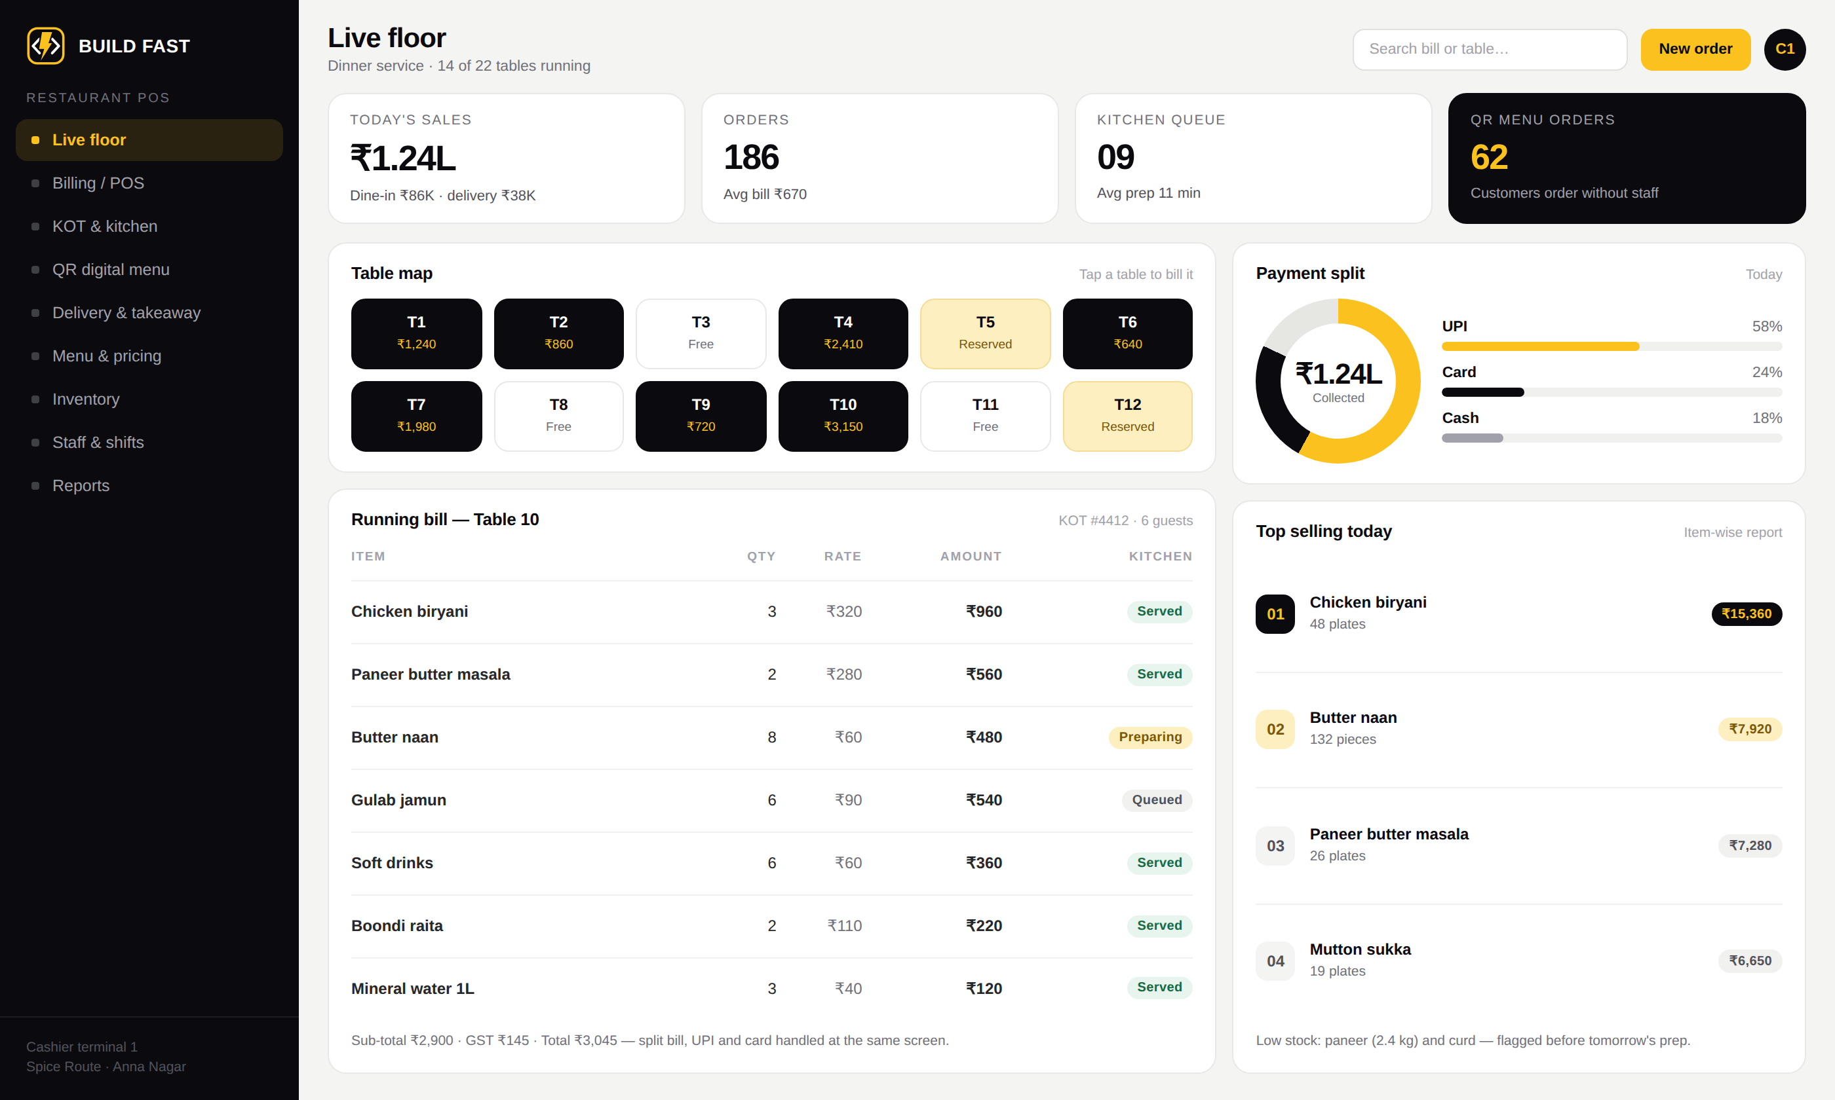
Restaurant POS & digital menu
For restaurants, cafés, bakeries and cloud kitchens.
Billing POS with KOT printing to the kitchen
QR digital menu — guests order from the table
Dine-in, takeaway and delivery in one screen
Table map, split bills, UPI, card and cash
Item-wise, hour-wise and staff-wise reports
Ingredient inventory with low-stock alerts
WHAT CHANGES FOR THE OWNER
Orders stop getting lost between the floor and the kitchen, tables turn faster, and the day's sales report is ready before you leave.
Restaurant POS — live floor
buildfastweb.in · hello@buildfastweb.in · +91 97895 02278
12

Slide 13
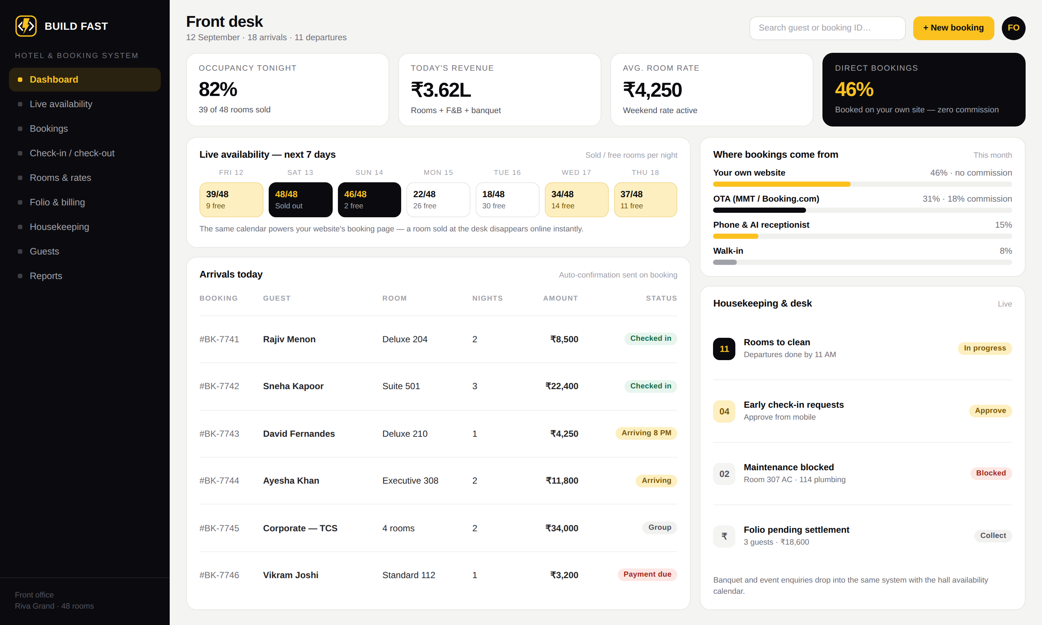
Hotel & room booking system
For hotels, resorts, service apartments and banquet halls.
Live room availability across every channel
Booking engine on your site, no commission
Check-in, check-out, folio and GST billing
Housekeeping status and maintenance blocks
Automatic confirmations and reminders
Banquet and event enquiries too
WHAT CHANGES FOR THE OWNER
A room sold at the desk disappears from your website instantly — double-booking stops being possible, and direct bookings cost you nothing in commission.
Hotel & booking system — front office
buildfastweb.in · hello@buildfastweb.in · +91 97895 02278
13

Slide 14
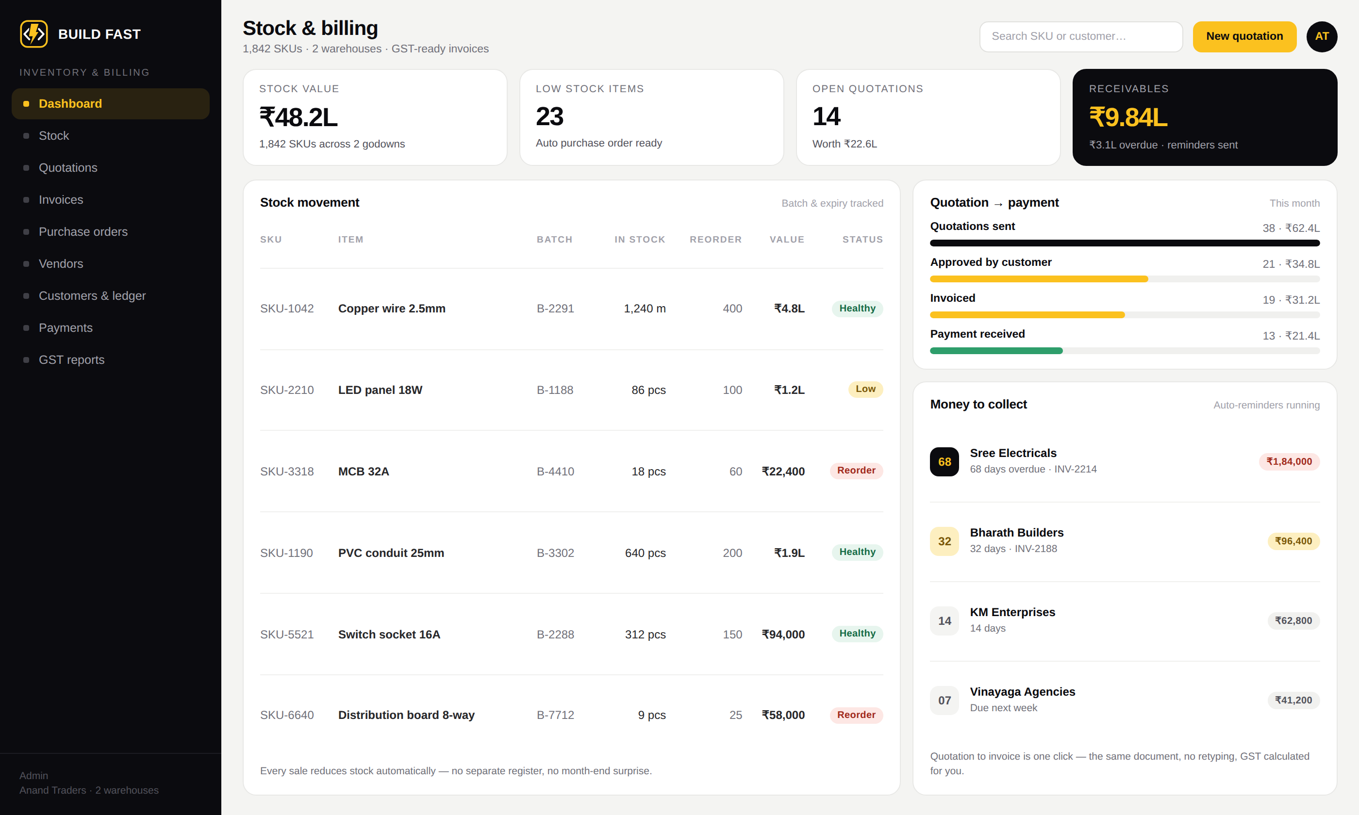
Inventory, quotation & billing
For traders, distributors, manufacturers and dealers.
Stock in and out with batch and expiry tracking
Quotation to invoice in one click, GST ready
Purchase orders and vendor ledger
Customer ledger, credit limits and receivables
Low-stock and payment-due alerts
Multiple warehouses and role-based access
WHAT CHANGES FOR THE OWNER
You always know what is in the godown, what is owed to you, and exactly who to chase today — without opening a single spreadsheet.
Inventory & billing — stock and receivables
buildfastweb.in · hello@buildfastweb.in · +91 97895 02278
14

Slide 15
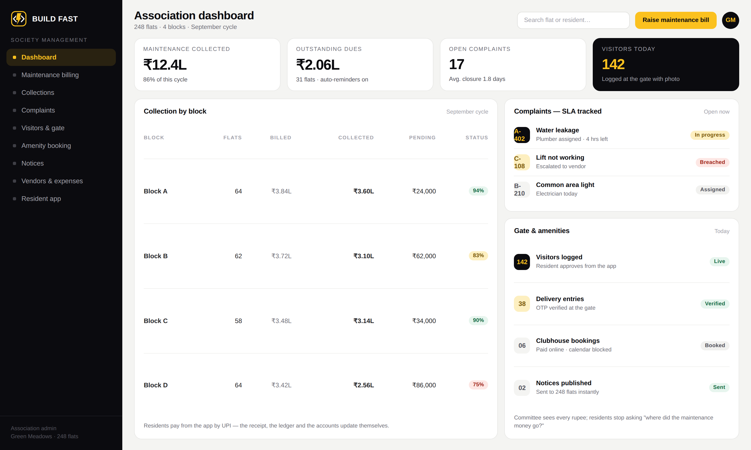
Apartment & society management
For apartments, gated communities, builders and associations.
Maintenance billing and online collection
Resident app — dues, receipts, notices
Visitor and delivery management at the gate
Complaint tracking with SLA and escalation
Amenity booking for clubhouse and halls
Vendor payments, expenses and audit trail
WHAT CHANGES FOR THE OWNER
The committee can show every rupee collected and spent at the next meeting, and residents stop asking where the maintenance money went.
Society management — association dashboard
buildfastweb.in · hello@buildfastweb.in · +91 97895 02278
15

Slide 16
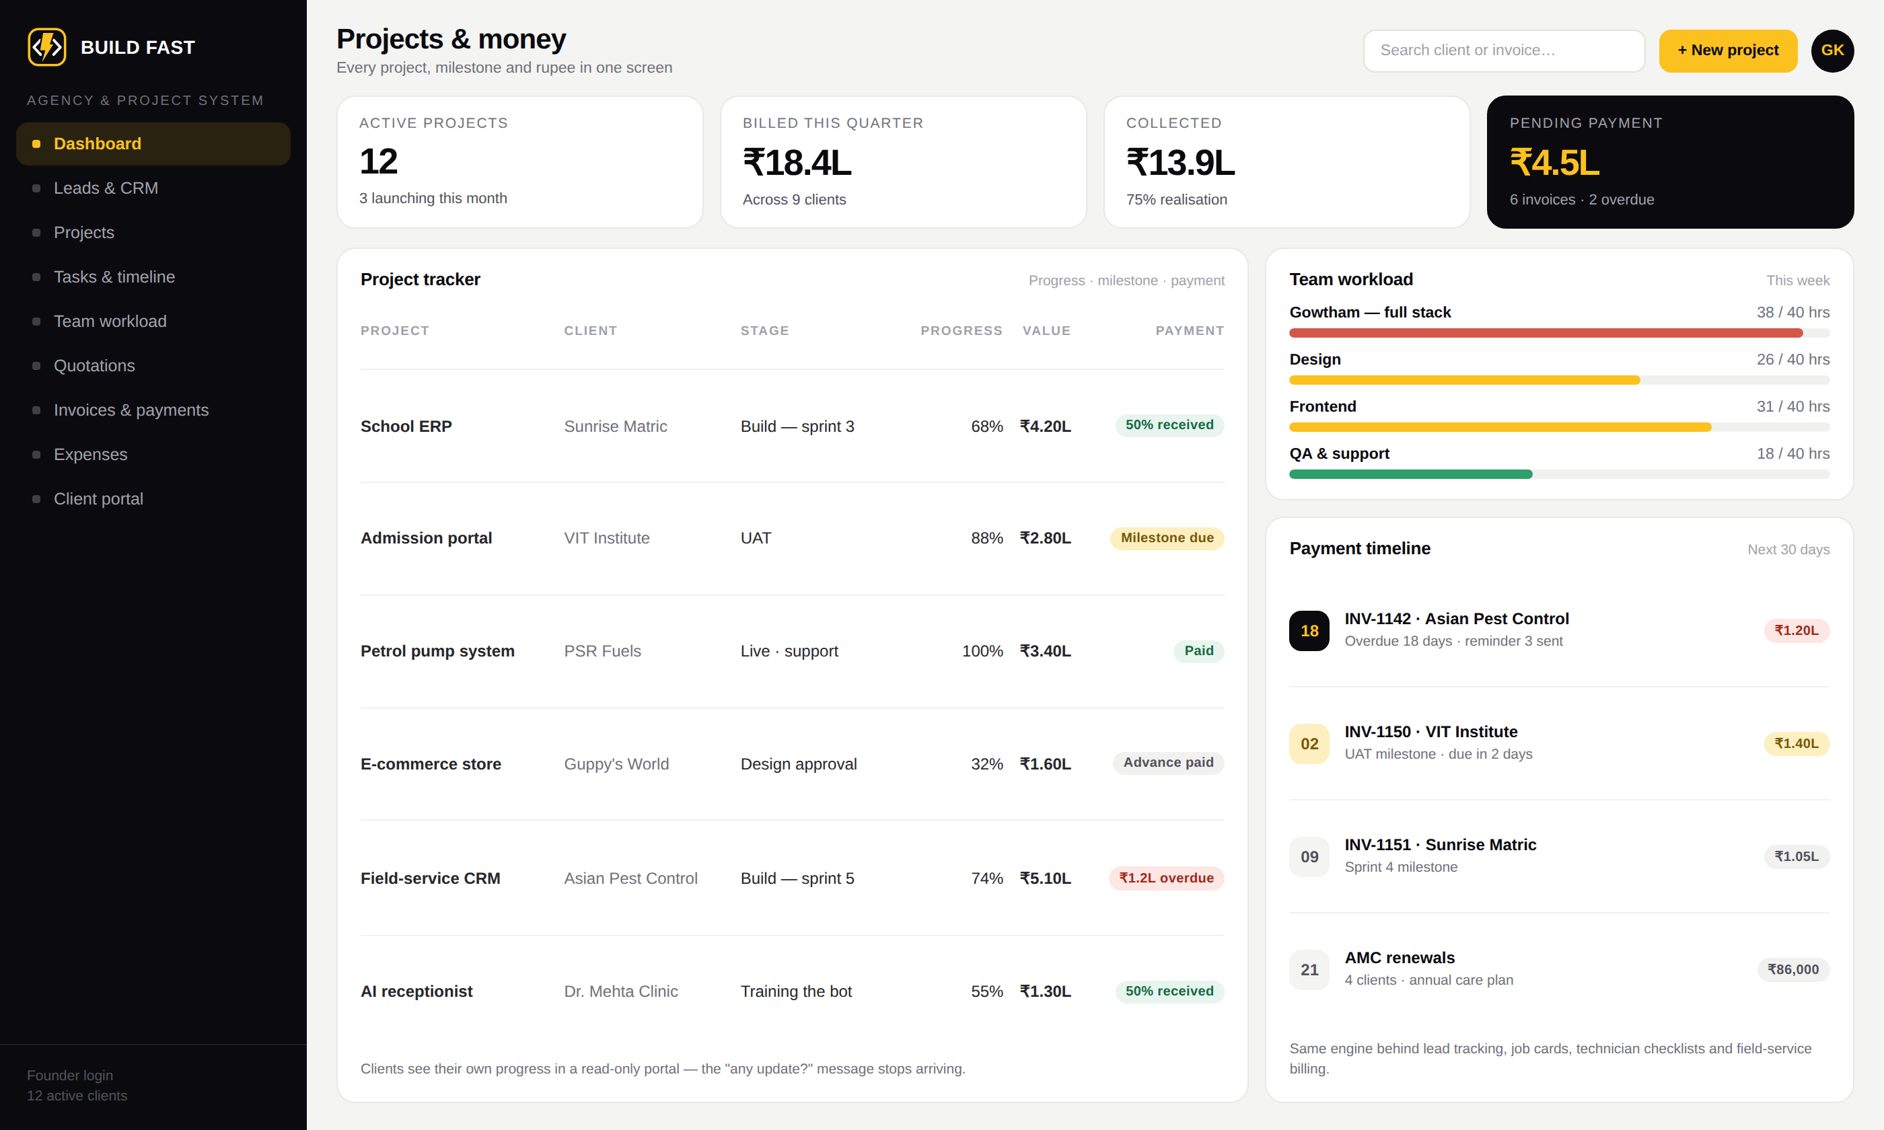
Agency, project & payment tracking
For agencies, contractors, service companies and field teams.
Lead and enquiry CRM with follow-up reminders
Projects, tasks, sprints and timelines
Team workload and time tracking
Quotations, milestone invoices and payments
Expenses and profitability per project
Client portal — progress without calls
WHAT CHANGES FOR THE OWNER
Every project's stage and every pending rupee on one screen. The same engine runs field-service jobs, technician checklists and service certificates.
Agency system — projects and payments
buildfastweb.in · hello@buildfastweb.in · +91 97895 02278
16
Notes:
Asian Pest Control runs this shape of system: customers, enquiries, quotations, work orders, invoices, payments, technician checklists and certificates.

Slide 17
02
Business & corporate websites
Landing pages built for ad traffic
E-commerce stores with payments
Websites that
bring the work in
Customer portals & web apps
Technical SEO & Core Web Vitals
A site is not a brochure. It is the first employee your customer meets — it should be fast, easy to find and always asking for the enquiry.
Google Business & local SEO
Meta and Google Ads campaigns
Analytics and lead attribution
buildfastweb.in · hello@buildfastweb.in · +91 97895 02278
17

Slide 18
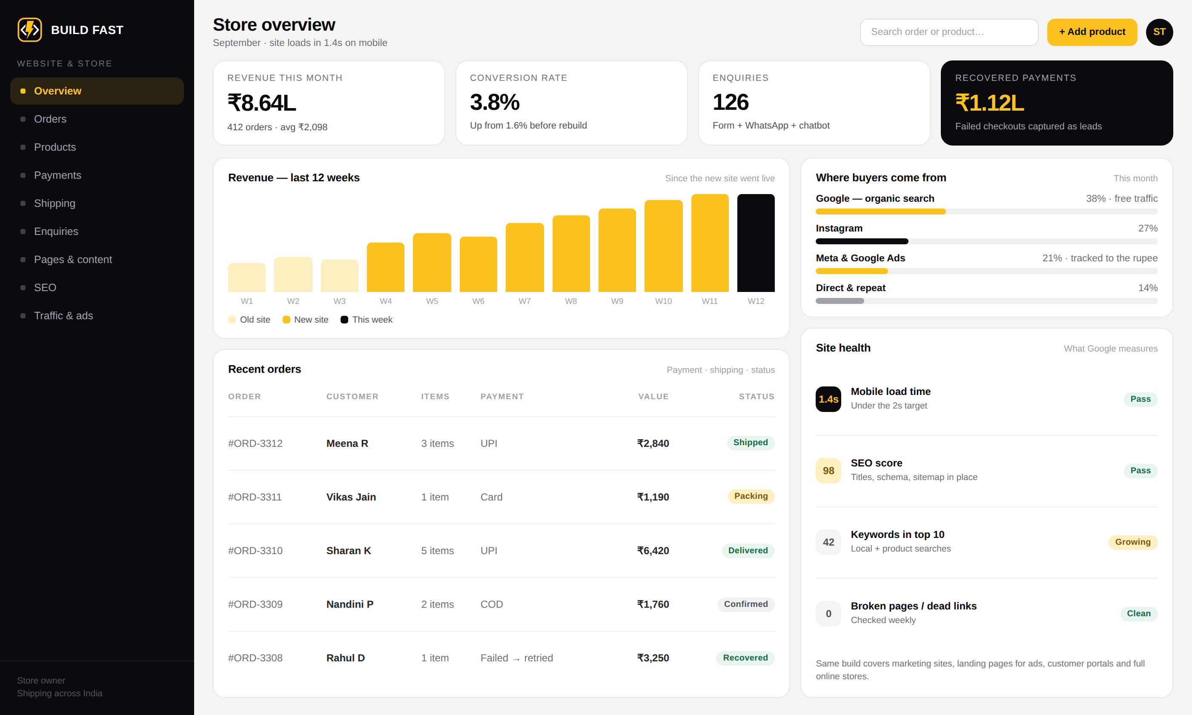
Website & e-commerce development
Built to load in under two seconds and to turn traffic into enquiries.
Business, corporate and service websites
Landing pages engineered for ad campaigns
E-commerce with payments and shipping
Customer portals and web applications
Technical SEO, schema and page speed
Enquiry forms, WhatsApp handoff, chatbot
WHAT CHANGES FOR THE OWNER
Failed payments get captured as leads instead of vanishing, and you can see which rupee of ad spend brought which enquiry.
Store & website admin — revenue, orders and traffic
buildfastweb.in · hello@buildfastweb.in · +91 97895 02278
18
Notes:
Guppy's World: 60K+ Instagram followers moved into a structured buying flow, with failed payments captured as leads.

Slide 19
03
AI receptionist on your phone line
Outbound AI calling campaigns
Website & WhatsApp chatbots
AI that answers,
books and follows up
Online booking with payment
Automatic payment reminders
The work that happens after hours, on Sundays, and while you are already on another call — handled without adding staff.
Follow-up sequences for cold leads
Daily owner report on WhatsApp
Workflow automation between tools
buildfastweb.in · hello@buildfastweb.in · +91 97895 02278
19

Slide 20
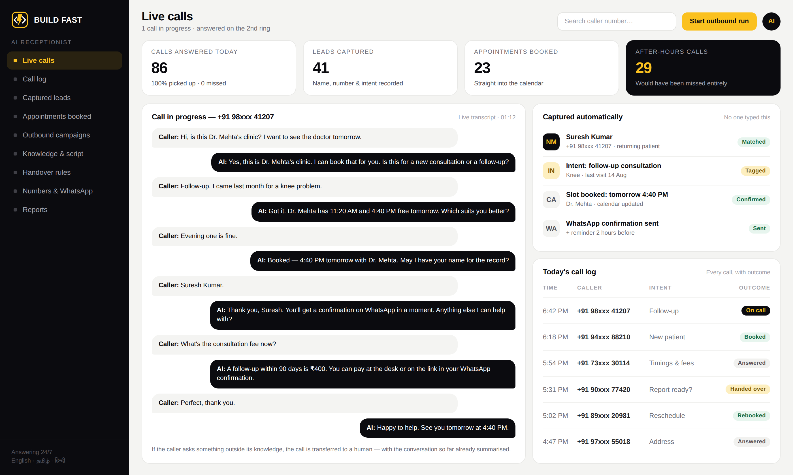
AI receptionist
It answers your phone the way a trained front-desk person would — every time, at any hour.
Answers every call — night, Sunday, festival day
Speaks English, Tamil and Hindi
Knows your services, timings and pricing
Captures the caller's name, number and intent
Books the slot straight into your calendar
Hands over to a human the moment it should
WHAT CHANGES FOR THE OWNER
29 of today's 86 calls came in after office hours. Every one was answered, and 23 appointments were booked without a single staff member picking up.
AI receptionist — live call and captured details
buildfastweb.in · hello@buildfastweb.in · +91 97895 02278
20

Slide 21
How the AI receptionist works
Six steps, all of them automatic. Nothing changes about the number your customers already call.
01
02
03
04
05
06
Call comes in
Answered in two rings
Understands the intent
Answers from your knowledge
Books or captures
You get the summary
Your existing number, or a new one. Missed and busy calls divert to the AI.
→
A natural voice, in the caller's language, with your business name.
→
Booking, price, timing, location, complaint or a returning customer.
→
Trained on your services, rates, timings and FAQs. It does not invent answers.
→
Writes the appointment into your calendar and records name, number and need.
→
WhatsApp message and CRM entry with the transcript, intent and next action.
BUILT IN
Human handover
Every call recorded
WhatsApp follow-through
Works with your CRM
Transfers to your staff with the conversation already summarised.
Recording and transcript stored against the caller's number.
Confirmation, location pin and reminder sent automatically.
Leads land in the system you already use — or the one I build.
Typical setup time: 1–3 weeks, including training it on your business and testing it on real calls.
buildfastweb.in · hello@buildfastweb.in · +91 97895 02278
21

Slide 22
Outbound AI calling
The same voice, working the other direction — calling your list instead of waiting for it to call you.
01
02
03
04
05
06
Load the list
AI calls each number
Asks your questions
Interested → booked
Not interested → tagged
Results in the dashboard
Fee dues, pending payments, old enquiries, no-shows or a fresh campaign list.
→
At the hours you choose, retrying the ones that do not pick up.
→
The qualifying script you approve — budget, timeline, interest, confirmation.
→
Books the appointment or transfers a warm caller to you straight away.
→
Marked with the reason so nobody wastes another call on them.
→
Answered, booked, callback, refused — with recordings against each number.
WHAT PEOPLE USE IT FOR
Fee & payment reminders
Admission follow-ups
Cold lead revival
Appointment confirmations
Schools, clinics and traders chasing dues without staff time.
Calling every enquiry from the ad campaign, the same day.
Six months of unworked enquiries called in a week.
Confirm, reschedule or cancel before the slot is wasted.
You approve the script and the calling window. Numbers that ask not to be called again are removed automatically.
buildfastweb.in · hello@buildfastweb.in · +91 97895 02278
22

Slide 23
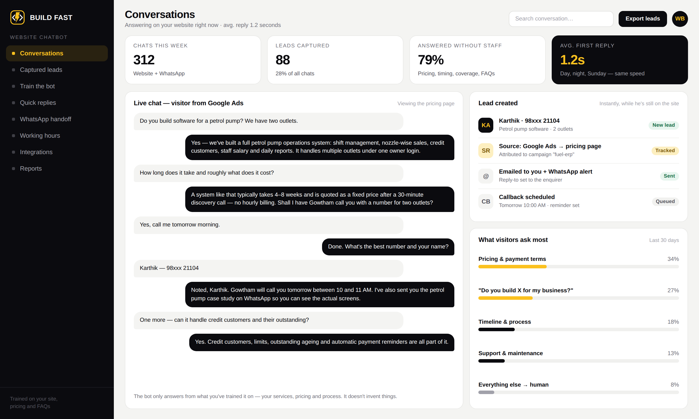
Website & WhatsApp chatbot
Trained on your business, answering while the visitor is still on the page.
Trained on your services, pricing and FAQs
Replies in about a second, day or night
Answers roughly 8 in 10 questions without you
Asks for the name and number naturally
Emails you the lead and pings your WhatsApp
Hands over to a human when it should
WHAT CHANGES FOR THE OWNER
A visitor who would have closed the tab at 11pm becomes a named lead with a phone number and a scheduled callback.
Chatbot console — live chat and the lead it captured
buildfastweb.in · hello@buildfastweb.in · +91 97895 02278
23

Slide 24
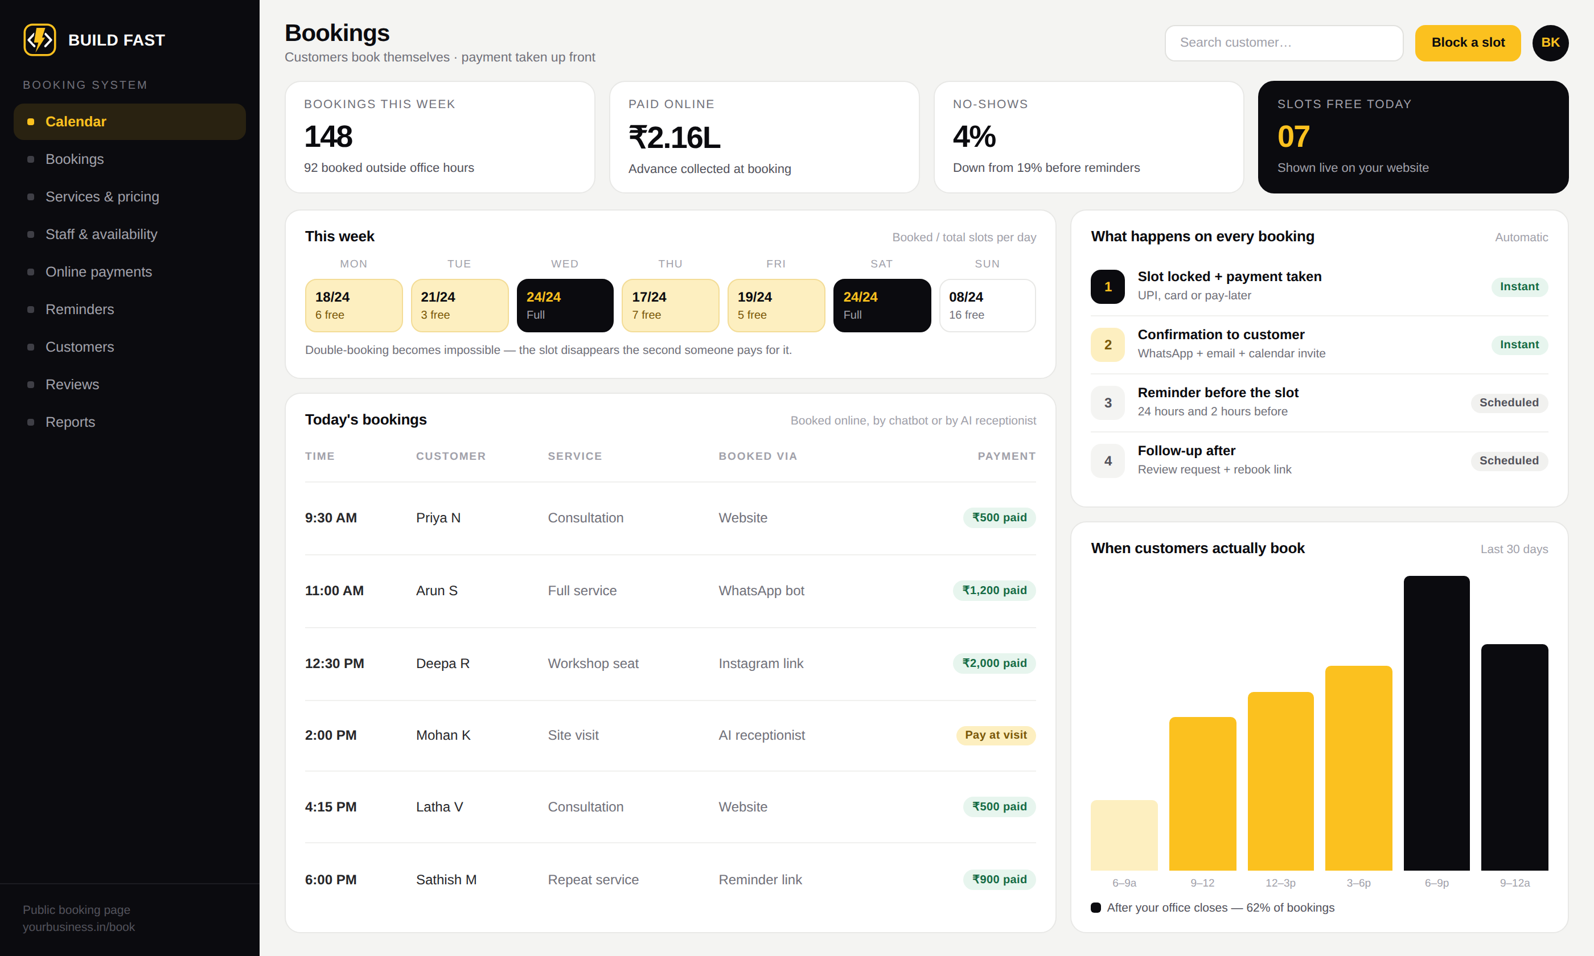
Online booking & appointments
Customers book and pay themselves — from the website, WhatsApp, Instagram or a phone call.
Live slot calendar on your own booking page
Advance or full payment collected at booking
Staff, service and duration-wise availability
Confirmation on WhatsApp, email and calendar
Reminders 24 hours and 2 hours before
Review request and rebooking link afterwards
WHAT CHANGES FOR THE OWNER
62% of bookings come in after the office closes, and no-shows drop from around 19% to 4% once reminders run on their own.
Booking system — calendar, payments and reminders
buildfastweb.in · hello@buildfastweb.in · +91 97895 02278
24

Slide 25
Automations that run without you
Small pieces of work that quietly cost you money when a human has to remember them.
Instant lead response
Payment & bill reminders
Follow-up sequences
Every enquiry from the site, ads or Instagram gets a reply within seconds — before your competitor answers.
Outstanding amounts chased on a schedule over WhatsApp, SMS and voice, with a payment link attached.
Cold enquiries worked for weeks — day 1, day 3, day 7 — instead of being forgotten after one call.
Daily owner report
Document automation
Tool-to-tool workflows
Sales, collections, attendance and pending items delivered to your WhatsApp every evening.
Invoices, receipts, service certificates and report cards generated and sent, not typed.
Your website, CRM, accounting, WhatsApp and Google Sheets kept in step without copy-paste.
Most automations are live within one to three weeks and run on top of whatever system you already use.
buildfastweb.in · hello@buildfastweb.in · +91 97895 02278
25

Slide 26
04
Tell me how the work flows today
I map the manual steps worth killing
You get a screen-by-screen blueprint
Your business is
not on the list?
And a fixed quote, before any code
Clickable design you approve first
Every system above is assembled from the same set of parts. That is why a new one takes weeks, not years — and why the price is fixed before we start.
Weekly builds you can watch
Data migrated, staff trained
Support you can reach on WhatsApp
buildfastweb.in · hello@buildfastweb.in · +91 97895 02278
26

Slide 27
The parts every custom system is built from
Pick the ones your business needs — clinic, gym, school, factory, transport, real estate, salon, workshop, anything.
Roles & logins
Live dashboard
Masters & records
Billing & payments
Inventory & assets
Owner, manager, staff and customer — each sees only what they should
The four or five numbers that tell you how today is going
Customers, students, patients, vehicles, properties, items
Quotations, invoices, receipts, GST, UPI and payment links
Stock, batches, expiry, serial numbers, service history
Scheduling
Field & job cards
Reports & exports
Notifications
Mobile app
Appointments, shifts, jobs, routes, rooms and slots
Work orders, checklists, photos and digital certificates
Daily, monthly, GST, statutory — in the format you already file
WhatsApp, SMS and email triggered by what happens in the system
Android and iOS for customers or field staff, one shared backend
Platform or SaaS product idea? The same parts, plus multi-tenant accounts, subscriptions and an admin console.
buildfastweb.in · hello@buildfastweb.in · +91 97895 02278
27

Slide 28
Mobile apps & interface design
Two things that decide whether your team actually uses what you paid for.
Mobile app development
UI/UX design
Android and iOS from one codebase — customer apps, staff and field apps with offline support, ordering, booking and delivery flows, push notifications, and Play Store / App Store publishing. One backend shared with your web dashboard.
Product and dashboard interfaces, clickable prototypes before a line of code is written, a brand kit of colours, type and components, and a handoff any future developer can read. Staff stop asking "where do I click?" on day two.
Design you approve first
Training that sticks
You click through the real flow on screen and change your mind while changes are still free — not after the build.
Your team is trained on a recorded call, with handover documents, so a new joiner next year is not stuck.
Typical timelines: UI/UX 1–3 weeks · mobile app 4–10 weeks · both quoted as a fixed price.
buildfastweb.in · hello@buildfastweb.in · +91 97895 02278
28

Slide 29
How we work together
Six steps from the first call to a system your staff are trained on. No hourly billing, no surprises halfway.
DAY 1
DAY 2–4
WEEK 1
Discovery call
Blueprint & fixed quote
Design you approve
30 minutes on how your business actually runs today — the registers, the WhatsApp groups, the Excel sheets.
A written scope, a screen-by-screen plan and a fixed price. No "that's extra" once we start.
Clickable screens before any code is written. You change your mind while changes are still free.
WEEK 2+
GO-LIVE
ONGOING
Build in weekly sprints
Launch & train the team
Support that answers
Every week a live link and a short video walkthrough. You watch it grow instead of waiting in the dark.
Existing data migrated, system live, staff trained on a call they can record. Handover documents included.
30 days of free post-launch support, then an optional care plan. You message a human on WhatsApp.
Typical build times: website 2–4 weeks · ERP or custom software 4–8 weeks · AI and automation 1–3 weeks.
buildfastweb.in · hello@buildfastweb.in · +91 97895 02278
29

Slide 30
Three of the systems in detail
Delivered projects — what was broken, what was built, what changed.
VELAMMAL INSTITUTE OF TECHNOLOGY
PSR PETROL PUMP
ASIAN PEST CONTROL
Online admission portal
Fuel station operations system
Field-service CRM + landing page
Every application was on paper, collected at the office and reviewed by hand — impossible to scale in peak season.
Shift records, fuel tallies, attendance, salary and expenses lived in notebooks and spreadsheets. No single place to see the day.
Jobs assigned over WhatsApp, paper service certificates, handwritten invoices, no way to track technicians or payments.
Public application portal with document upload and validation, plus an admin panel where the team reviews, filters and updates statuses. Works as a PWA on a phone.
Shift management, daily sales and expenses, customer records, staff management with salary calculated from shift data, system logs and a full reports module.
Lead-capture landing page plus a CRM covering customers, enquiries, quotations, work orders, invoices, payments, technician checklists, certificates and reporting.
First digital admission system in the institution's history
Shifts and fuel sales tracked in real time
Paper job tracking, billing and coordination replaced
Paper collection and manual tracking eliminated
Staff salary calculated automatically from attendance
Service certificates generated and stored digitally
Applications reviewed and updated in real time
Monthly reports in seconds instead of a day's work
Live dashboard for jobs, payments and staff
Also delivered: e-commerce stores with Razorpay payments, a workshop booking platform, and a rental marketplace serving customers in Russia.
buildfastweb.in · hello@buildfastweb.in · +91 97895 02278
30

Slide 31
What you get, and what it is built on
The same standards on a ₹40,000 website and a ₹5 lakh ERP.
INCLUDED IN EVERY PROJECT
BUILT WITH
Fixed price agreed before the build starts
Frontend
React · Next.js · Vite · Tailwind CSS
Clickable design approved before any code
Backend
Node.js · TypeScript · REST APIs
A live link and a video update every week
Database
PostgreSQL · MongoDB · Supabase
Your existing data migrated in, not retyped
Mobile
One codebase for Android and iOS
Staff trained on a call they can record
Hosting
AWS EC2 · Vercel · Nginx · daily backups
30 days free support, then an optional care plan
Payments
Razorpay · UPI · cards · payment links
Full source code and accounts in your name
Messaging
WhatsApp Business API · SMS · email
Handover documents any future developer can read
AI
Voice agents, chatbots and workflow automation
Hosting, domain and payment gateway accounts are created in your name — you are never locked to me.
buildfastweb.in · hello@buildfastweb.in · +91 97895 02278
31

Slide 32
BUILD FAST WEB
Tell me how your
business runs today.
Email
hello@buildfastweb.in
Phone & WhatsApp
+91 97895 02278
A 30-minute call is enough for me to tell you what can be built, how long it takes and what it costs — as a fixed number, in writing.
Website
buildfastweb.in
Gowtham · Founder, Build Fast Web · Tamil Nadu, India
buildfastweb.in · hello@buildfastweb.in · +91 97895 02278
32
Notes:
Close by asking which of the systems in the deck is closest to their business, and book the 30-minute discovery call before leaving the room.

