Slide 1
SECURE DATA HIDING IMAGES USING STEGANOGRAPHY
CAPSTONE PROJECT
Presented By:
Student Name : GOWTHAM C
College Name & Department : VELALAR COLLEGE OF ENGINEERING AND TECHNOLOGY, BTECH-INFORMATION TECHNOLOGY

Slide 2
OUTLINE
Problem Statement
Technology used
Wow factor
End users
Result
Conclusion
Git-hub Link
Future scope

Slide 3
PROBLEM STATEMENT
In the digital era, secure communication is crucial to prevent unauthorized access to sensitive information. Traditional encryption methods are detectable, making steganography a preferred approach for covert data transmission. This project focuses on hiding a secret message within an image without altering its visible appearance. The implementation involves embedding the message using pixel manipulation and retrieving it with a passcode. This ensures confidentiality and authentication, making it suitable for cybersecurity applications.

Slide 4
TECHNOLOGY USED
Python: Primary programming language.
OpenCV: For image processing and Pixel Manipulation.
Hashlib: For SHA-256 password hashing to enhance security.
Model Validation:
Extensive testing on various image formats and sizes.
Ensuring the hidden message remains undetectable and the image quality is preserved.
libraries

Slide 5
WOW FACTORS
1. Dual-Layer Security – Combines steganography + passcode protection for enhanced security, ensuring only authorized users can decrypt the message.
2. Invisible Data Embedding – The secret message is hidden within pixel values, making it undetectable to the human eye and standard analysis tools.
3. Lossless Data Encoding – Uses PNG format to prevent data loss, ensuring accurate decryption without distortion.
4. Lightweight & Efficient – No need for complex encryption algorithms; works with simple pixel manipulation for fast execution.
5. Cross-Format Testing – Validated on multiple image formats (PNG & JPG) to check message integrity and quality retention.
6. Secure & User-Friendly – Requires a correct passcode to decrypt, ensuring only authorized access to sensitive data.

Slide 6
END USERS
Cybersecurity Professionals – Can use it for secure communication and covert data transmission without detection.
Journalists & Whistleblowers – Helps in sending confidential information securely while avoiding surveillance.
Students & Researchers – Ideal for learning and experimenting with steganography techniques in cybersecurity.
Corporate & Government Agencies – Useful for data protection and secure information exchange without raising suspicion.
Developers & Ethical Hackers – Can integrate this technique into security applications or test vulnerabilities in digital communication..

Slide 7
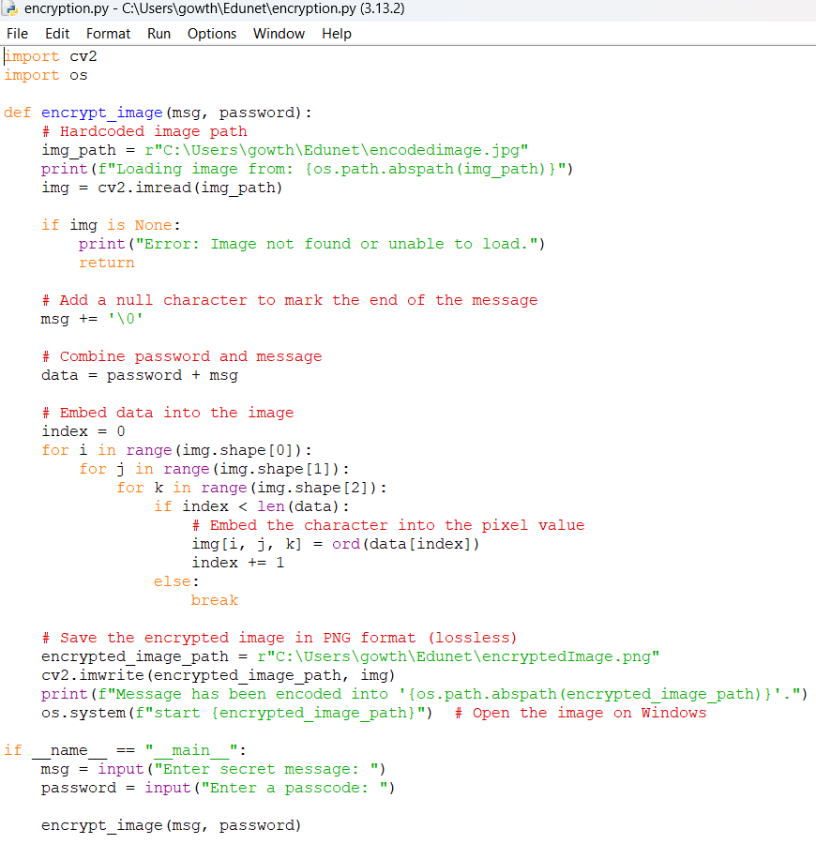

RESULTS
SOURCE CODE
ENCYPTED IMAGE

Slide 8

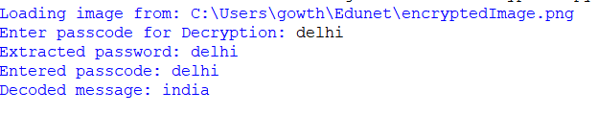
OUTPUT
Screenshots of the outcome (min 3)
Output of encryption.py
Output of decryption.py

Slide 9
CONCLUSION
This project successfully implements image steganography to hide sensitive information within an image while maintaining its visual integrity. By integrating pixel-based encoding and password protection, it ensures that only authorized users can retrieve the hidden message. The use of OpenCV for image processing and secure passcode verification enhances the security and reliability of the system.
Through testing on various image formats, the project demonstrates its effectiveness in secure communication, making it a practical solution for users who require covert data transmission. This approach provides a lightweight yet efficient method for protecting confidential information, contributing to advancements in cybersecurity and digital privacy.

Slide 10
GITHUB LINK
https://github.com/Gowtham5962/Edunet_Project.git

Slide 11
THANK YOU

