Slide 1

DEPARTMENT OF COMPUTER SCIENCE AND ENGINEERING VIGNAN’S LARA INSTITUTE OF TECHNOLOGY AND SCIENCE Project Review on SmartMaps: An AI-Powered Safe Route Navigation and Urban Insight System
Presented By Batch No:A17
D.Gowtham 23FE1A0542
G.S.V.Tejaswini 24FE5A0504
B.Abhiram 23FE1A0523
Under the Esteemed Guidance of
Ms. M. Aasha Priyadharshini
M.tech(Ph.D)
Associate professor
CSE Department
Department of Computer Science & Engineering 01

Slide 2
TITLE
Enering
SmartMaps: An AI-Powered Safe Route Navigation and Urban Insight System
Department of Computer Science & Engineering 02
Department of Computer Science & Engineering

Slide 3
CONTENTS
✔Title
✔Abstract
✔Problem Statement
✔Introduction
✔Literature Survey
✔Existing System
✔Proposed System
✔ System Architecture
✔ Proposed Methodology
✔ Technology Stack
✔Future Scope
✔Results
✔Conclusion
Department of Computer Science & Engineering 03

Slide 4
ABSTRACT
SmartMaps is an AI-assisted navigation and urban insight system developed to overcome the limitations of conventional navigation applications that primarily prioritize shortest distance or minimum travel time. The system generates multiple alternative routes and evaluates them using contextual factors such as road type, traffic congestion, road closures, time of travel, nearby active locations, street lighting, and air pollution. A bounded safety risk score from 1 to 6 is calculated for each route, where a lower score represents a safer route. The system also provides separate traffic-aware and low-pollution route selection and can combine these environmental factors when both options are enabled. The application uses a React-based interactive map frontend and a Flask backend integrated with external mapping, traffic, weather, air-quality, and location-data services. The resulting system provides users with a more informed and context-aware navigation experience.
Department of Computer Science & Engineering 04

Slide 5
PROBLEM STATEMENT
Current navigation systems mainly focus on finding the shortest or fastest route and may not adequately consider factors such as safety, pollution, road lighting, nearby public activity, traffic congestion, or road closures. Consequently, a route that is optimal in terms of distance may not always be the most suitable route for a user, particularly during late-night travel or in areas with poor lighting, heavy congestion, or higher pollution. SmartMaps addresses this problem by generating multiple routes and evaluating them using real-time and contextual information to recommend a safer, healthier, and more practical route.
Department of Computer Science & Engineering 05

Slide 6
INTRODUCTION
Navigation technology has become an essential part of everyday transportation, but conventional navigation generally emphasizes distance and travel time. SmartMaps introduces a broader approach in which route selection considers not only efficiency but also safety and environmental conditions.
The system allows users to enter a source and destination and select different travel modes such as car, bike, or walking. OpenRouteService generates alternative routes, after which the backend analyzes each route using road type, time of day, live traffic conditions, nearby points of interest, street lighting, and air-quality information. The resulting information is presented through an interactive map so that users can compare routes and make better travel decisions. The project implements separate strategies for safest, lowest-pollution, lowest-traffic, and combined environmental route selection.
Department of Computer Science & Engineering 06

Slide 7
LITERATURE SURVEY
S No. | Paper Title | Methodology | Drawbacks | Proposed Methodology to Overcome
1 | SafeTrack: Empowering Women's Security with GPS | Uses GPS-based location tracking and messaging to improve women's safety by allowing the user's location to be tracked and shared during emergency situations. | Focuses on emergency location tracking and messaging and does not provide comprehensive route selection. | overcomes this limitation by providing safety-aware route selection that considers multiple factors such as safety level, traffic, pollution, weather.
Department of Computer Science & Engineering 07

Slide 8
LITERATURE SURVEY
S No. | Paper Title | Methodology | Drawbacks | Proposed Methodology to Overcome
2 | SafeRoutes: Charting a Secure Path – Holistic Women's Safety | Uses GPS and mapping services along with machine-learning techniques such as K-Means clustering and Gaussian Mixture Models | Depends mainly on the availability of crime and public-safety data and focuses primarily on women's safety | Extends this approach by combining safety information with real-time traffic, pollution, weather, distance, and travel time to dynamically calculate route scores.
Department of Computer Science & Engineering 08

Slide 9
LITERATURE SURVEY
S No. | Paper Title | Methodology | Drawbacks | Proposed Methodology to Overcome
3 | AI-Driven Route Optimization for Sustainable Travel | The sustainable route optimization approach uses route optimization algorithms such as Dijkstra's algorithm and Genetic Algorithm. | Mainly concentrates on sustainable tourism and carbon- emission reduction and does not comprehensively consider personal safety | Overcomes these limitations by using a multi-criteria route optimization approach that combines safety, traffic, pollution, weather, distance, travel time.
Department of Computer Science & Engineering 09

Slide 10
EXISTING SYSTEM
Existing navigation systems mainly calculate routes based on distance, estimated travel time, and road-network information.
They are effective in finding shorter and faster routes.
They provide limited consideration of contextual safety conditions.
They generally do not consider whether a route passes through poorly lit or isolated areas.
They may not adequately account for traffic congestion and road closures.
Pollution levels and environmental conditions are often not included in route selection.
A route with shorter travel time may still have higher safety or environmental risks.
Traditional navigation systems do not provide a unified risk-based comparison of alternative routes.
Department of Computer Science & Engineering 10

Slide 11
ADVANTAGES OF EXISTING SYSTEM
1. Women’s Safety Analysis
The system analyzes factors such as crime rates, police presence, infrastructure, and socio-economic indicators to classify regions according to women’s safety. 2. Safe Route Recommendation The system uses Maps APIs and cab-service integration to recommend safer paths for users during travel. 3. Real-Time GPS Monitoring The system continuously monitors the vehicle’s GPS location and checks whether it remains within the predefined safe route or safety buffer. 4. Unsafe Area Alerts The system generates immediate alerts when a vehicle deviates from the recommended route and enters a potentially unsafe area.
Department of Computer Science & Engineering 11

Slide 12
ADVANTAGES OF EXISTING SYSTEM
5. Machine Learning-Based Safety Classification The system uses K-Means Clustering and Gaussian Mixture Models to classify regions into different safety clusters. 6. Safety Heatmap Generation The system generates safety heatmaps that provide a visual representation of different safety levels across regions. 7. Real-Time Rerouting The system can calculate a new safe route when a vehicle cannot return to the recommended path because of road conditions or unsafe-area deviations.
Department of Computer Science & Engineering 12

Slide 13
DISADVANTAGES OF EXISTING SYSTEM
1. Dependence on Data Quality The effectiveness of the safety model depends heavily on the volume, quality, and timeliness of the data collected from public and government sources. 2. Data Bias Crime and socio-economic datasets may contain biases because some communities may be underrepresented or have under-reported incidents. 3. Limited Representation of Vulnerable Groups The system may lack sufficient data about vulnerable populations, which can reduce the inclusiveness of its safety model. 4. Limited Environmental Factors The paper primarily focuses on safety-related parameters such as crime, police presence, infrastructure, demographics, and forest cover rather than combining safety with factors such as real-time pollution and weather conditions.
Department of Computer Science & Engineering 13

Slide 14
PROPOSED SYSTEM
Smart Navigation Features
Source and destination selection
Multiple route generation
Fastest route recommendation
Safest route recommendation
Alternative route comparison
Distance and estimated travel time
Safety & Risk Assessment
1–6 route risk scoring system
Road-type based safety evaluation
Time-of-day risk analysis
Traffic congestion risk assessment
Nearby active-place/crowd consideration
Lowest-risk route prioritization
Real-Time Conditions
Real-time traffic information
Traffic congestion and road-closure detection
Current weather information
Air quality and pollution information
Dynamic route evaluation based on current conditions
Interactive Map Features
Interactive map visualization using Leaflet
Route visualization on map
Multiple route display
Route-specific information
Nearby places and landmarks
Department of Computer Science & Engineering 14

Slide 15
PROPOSED SYSTEM
AI-Powered Route Recommendation
Multi-factor route evaluation
Intelligent safety-score calculation
Real-time data-based decision making
Route ranking based on risk score
Safest-route selection
Balanced consideration of safety and travel efficiency
Urban Insight Features
Nearby shops and cafés
Hospitals and healthcare locations
Police stations and safety-related locations
Active-place density information
Environmental condition awareness
Backend & API Integration
Python Flask backend
OpenRouteService integration for route generation
Weather API integration
Air-quality API integration
Unsplash API integration
Frontend–backend API communication
User Experience
Simple route search interface
Visual route comparison
Safety score display
Real-time travel information
Responsive and interactive interface
Department of Computer Science & Engineering 15

Slide 16
ADVANTAGES OF PROPOSED SYSTEM
1. Smart Online Pre-Ordering
Customers can browse the menu, customize dishes, and place orders before arriving at the restaurant, reducing waiting time.
2. Secure Digital Payments
Supports Razorpay and Cash at Table with secure payment verification, instant payment confirmation, and multiple payment options.
3. Real-Time Table Reservation
Customers can view available tables, reserve their preferred table, and select convenient dining time slots.
4. Automated Order & Kitchen Management
Orders are instantly sent to the kitchen dashboard, enabling faster preparation and efficient order tracking.
Department of Computer Science & Engineering 16

Slide 17
ADVANTAGES OF PROPOSED SYSTEM
5. Live Order Tracking & Notifications
Customers receive order confirmation, payment confirmation, and reservation emails with real-time order updates.
6. Inventory & Stock Management
Automatically updates food availability based on stock levels, preventing unavailable items from being ordered.
7. Enhanced Customer Experience
Offers personalized ordering, reduced waiting time, convenient reservations, and a smooth dining experience.
8. Admin Dashboard & Analytics
Administrators can manage menu items, reservations, orders, payments, and customer feedback from a centralized dashboard
Department of Computer Science & Engineering 17

Slide 18
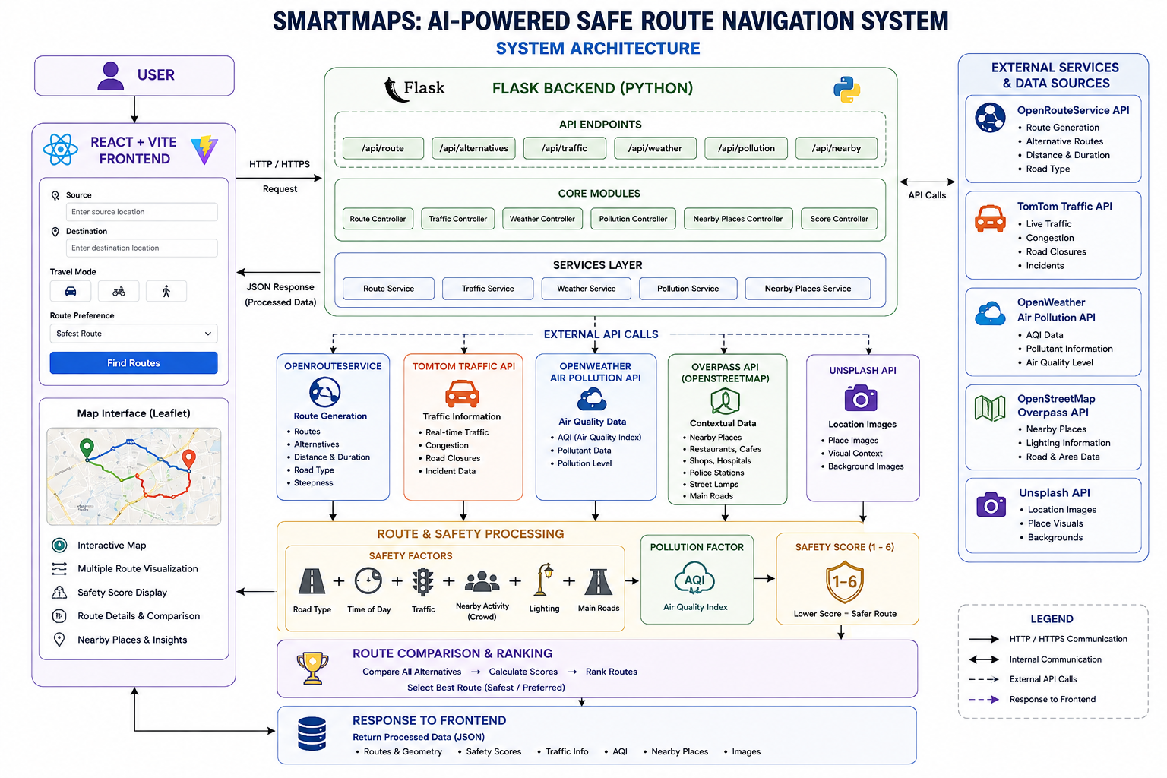
SYSTEM ARCHITECTURE
Department of Computer Science & Engineering 18

Slide 19
PROPOSED METHODOLOGY
Step 1: User Input & Route Generation
User enters the source, destination, and travel mode.
Flask backend sends the request to OpenRouteService.
Multiple alternative routes with road information are generated.
Step 2: Road & Time-Based Safety Analysis
Road types are analyzed to calculate the base risk score.
Late-night and low-light conditions add a time-based risk penalty.
The system considers road characteristics and travel conditions for each route.
Step 3: Activity & Lighting Analysis
Overpass API identifies nearby shops, cafés, hospitals, and police facilities.
Nearby active places provide a crowd/activity safety bonus.
Street lamps and lit/main-road coverage provide a lighting bonus.
Department of Computer Science & Engineering 19

Slide 20
PROPOSED METHODOLOGY
Step 4: Real-Time Traffic & Safety Score
Live traffic data is analyzed using current and free-flow speeds.
Congestion and road closures contribute to the traffic penalty.
All factors are combined into a 1–6 safety score, where lower is safer.
Step 5: Pollution-Aware Route Analysis
Route locations are sampled to obtain AQI data from OpenWeather.
Alternative routes are ranked based on their average pollution level.
The route with the lowest pollution can be selected for healthier travel.
Step 6: Route Ranking & Recommendation
Routes are ranked according to safety, traffic, and pollution preferences.
The safest route is selected using the lowest safety-risk score.
The final recommended route and its details are displayed on the interactive map.
Department of Computer Science & Engineering 20

Slide 21
TECHNOLOGY STACK
Frontend
Reat.js
Vite
JavaScript
Leaflet
Backend
Python
Flask
Python Requests
Database
MongoDB
PyMongo
APIs & External Services
OpenRouteService API – Route generation
TomTom Traffic API – Real-time traffic information
OpenWeather Air Pollution API – AQI and pollution data
OpenStreetMap Overpass API – Nearby places and lighting information
Unsplash API – Location-related images
Map & Route Processing
OpenStreetMap
Leaflet
Route Geometry / Polyline Processing
Safety & Pollution Scoring
Development & Version Control
Visual Studio Code
GitHub & Git
Department of Computer Science & Engineering 21

Slide 22
FUTURE SCOPE
Machine Learning-Based Safety Prediction:
Replace the current rule-based safety mechanism with a trained ML model using historical crime, traffic, infrastructure, lighting, and environmental data.
Unsafe-Zone Alerts & Automatic Rerouting: Notify users when they enter a potentially unsafe area and automatically generate a safer alternative route.
Emergency SOS & Accident Detection: Integrate an SOS feature and automatic accident detection to provide faster emergency assistance when required.
CCTV & Smart City Integration: Integrate CCTV and other smart-city infrastructure to provide additional real-time insights about roads and surrounding areas.
Public Transport & Cab Integration: Integrate public transportation and cab services to extend SmartMaps from route recommendation into complete journey safety monitoring.
Department of Computer Science & Engineering 22

Slide 23
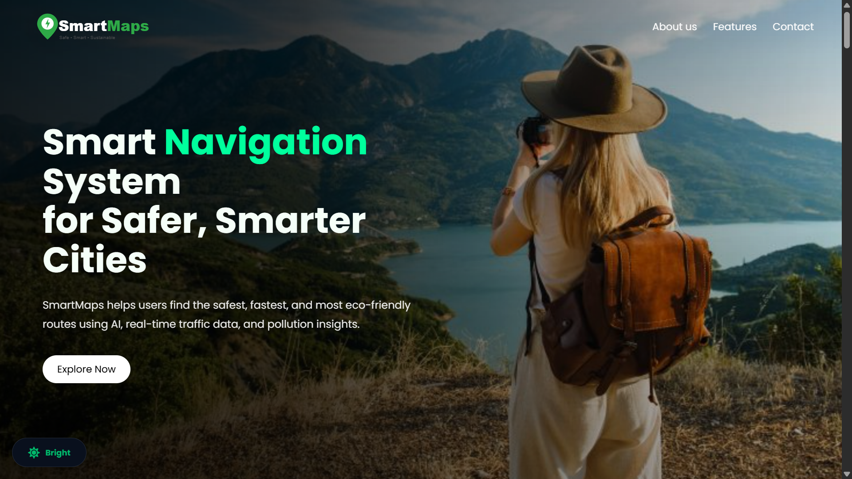
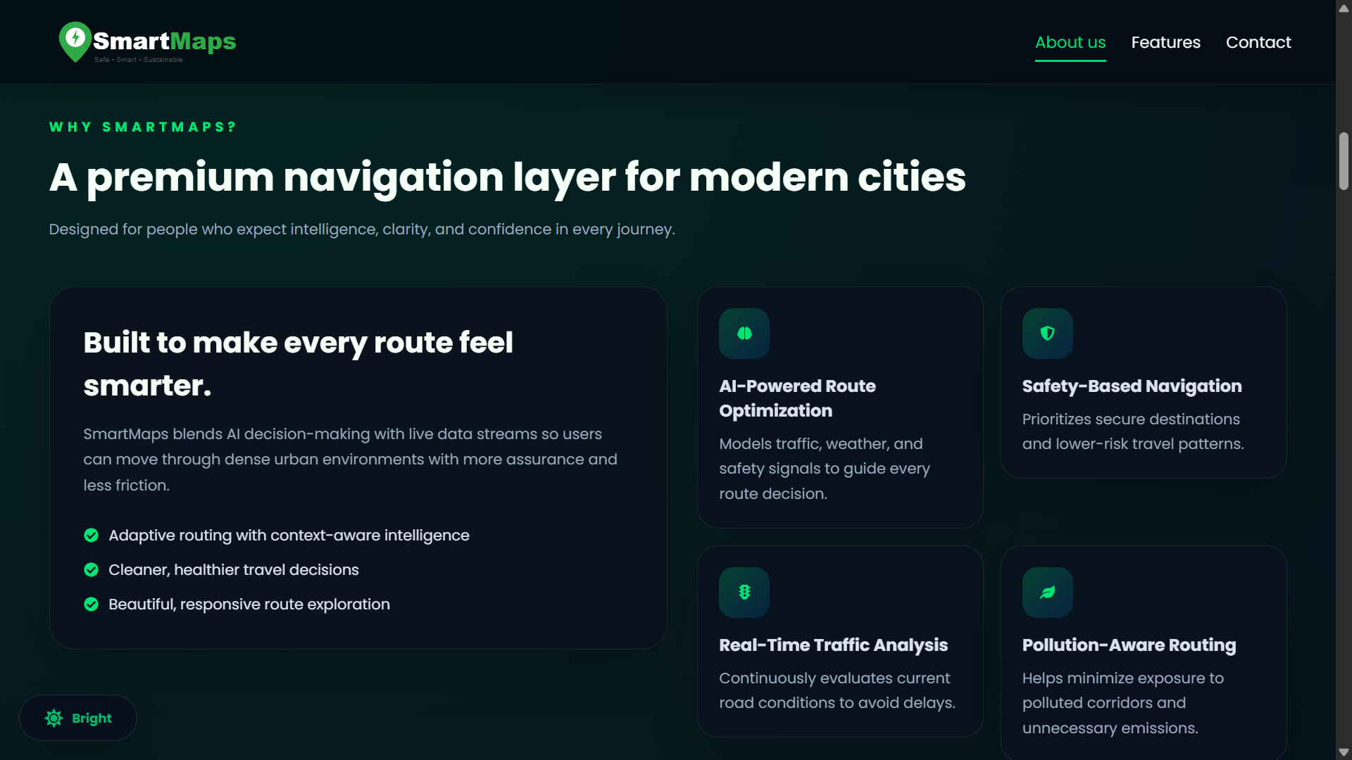
RESULTS
Department of Computer Science & Engineering 23

Slide 24


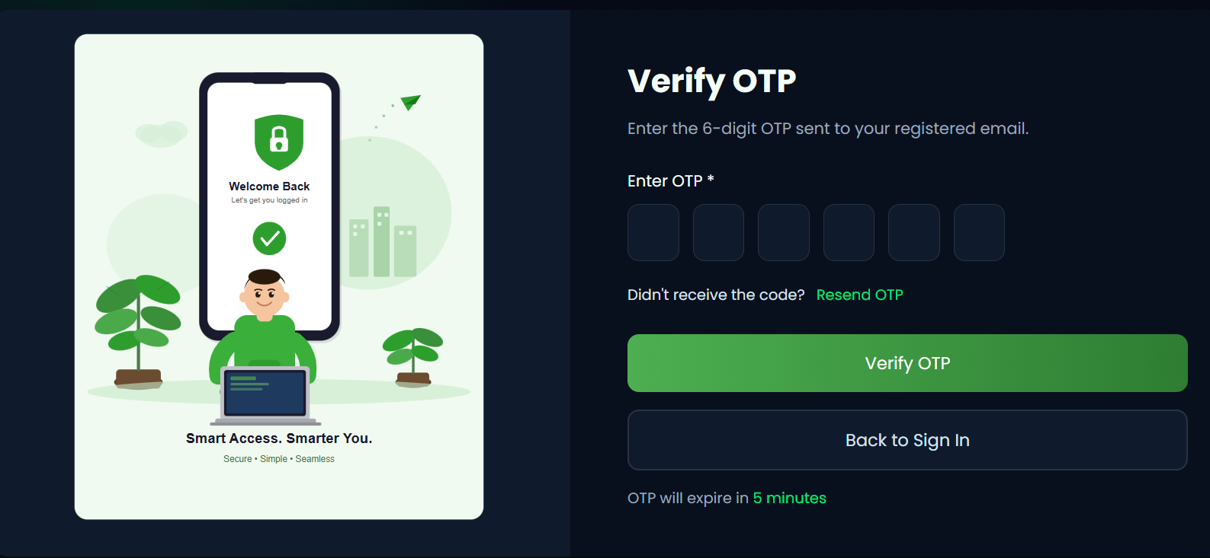
RESULTS
Department of Computer Science & Engineering 24

Slide 25
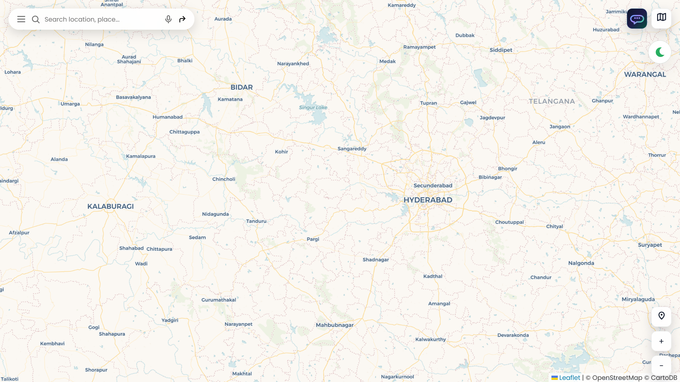
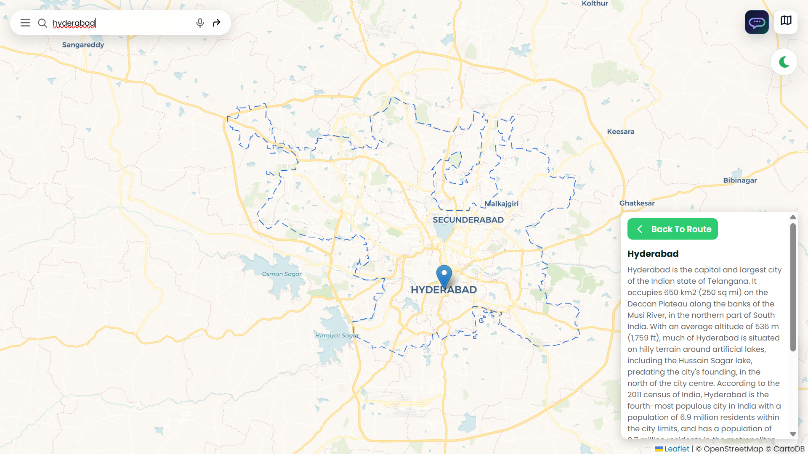
RESULTS
Department of Computer Science & Engineering 25

Slide 26
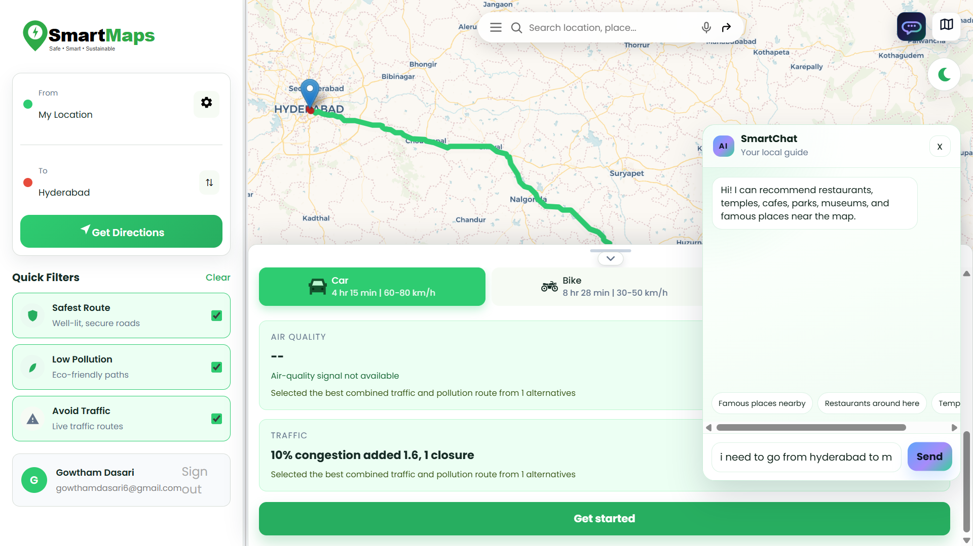
RESULTS
Department of Computer Science & Engineering 26

Slide 27
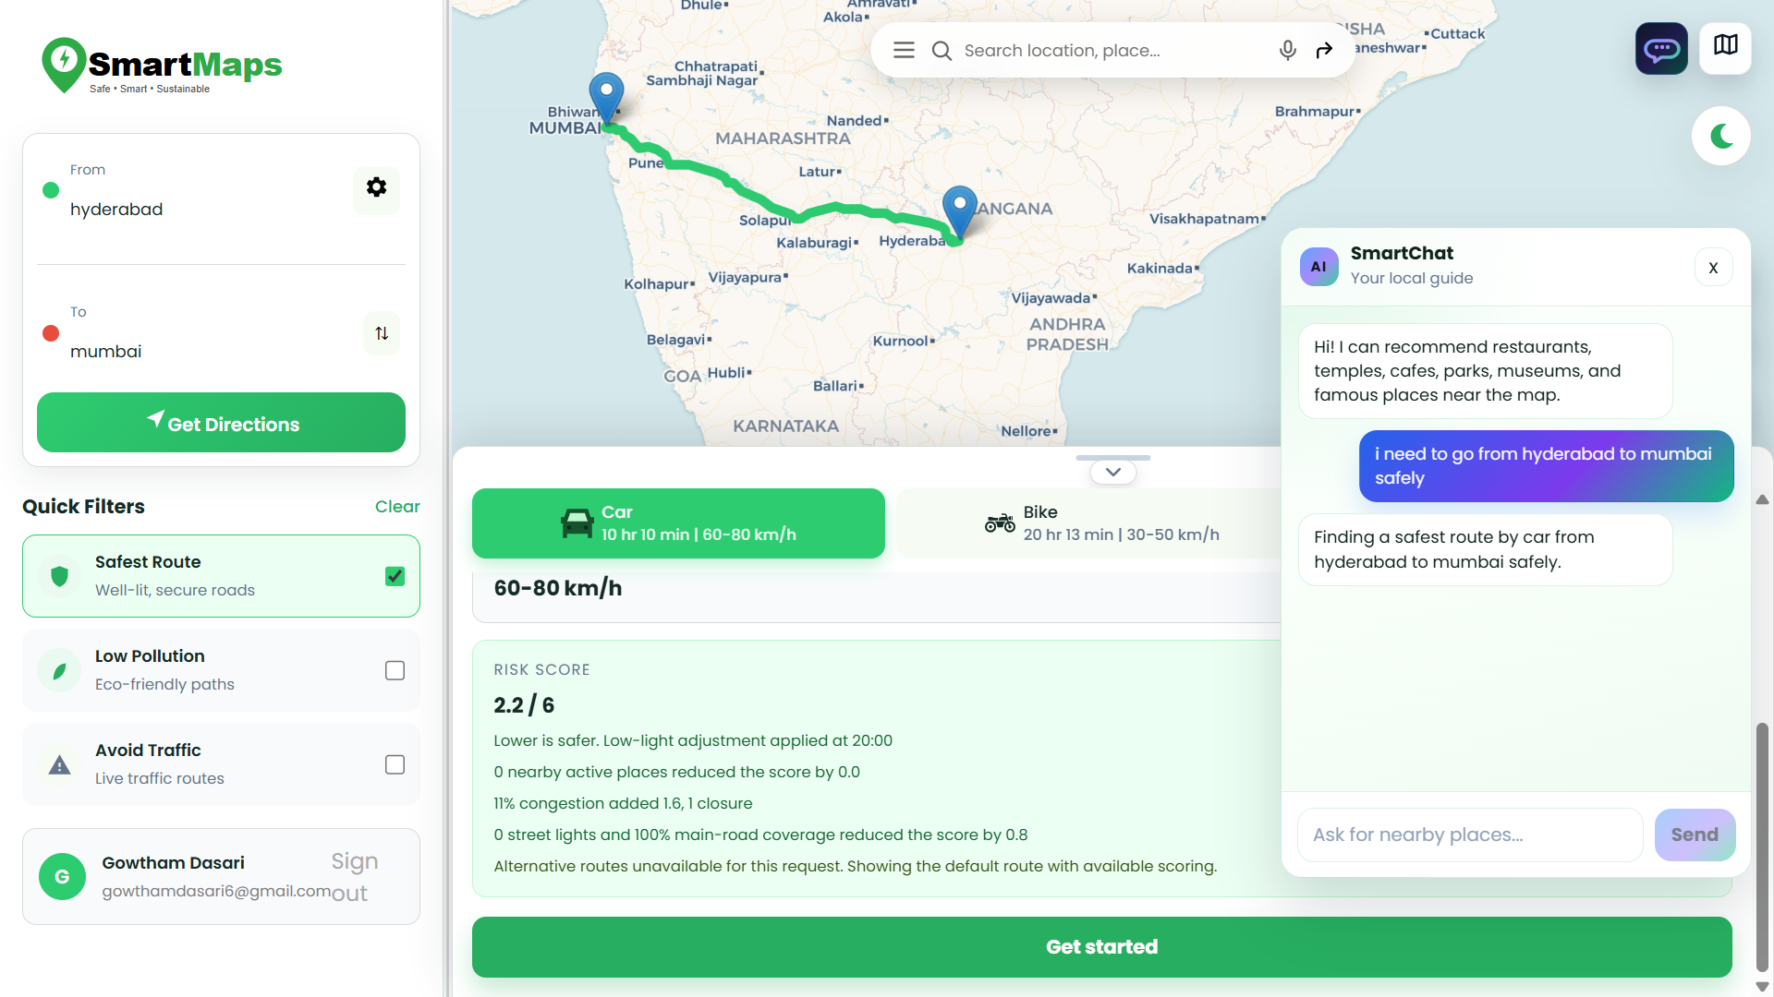
RESULTS
Department of Computer Science & Engineering 27

Slide 28
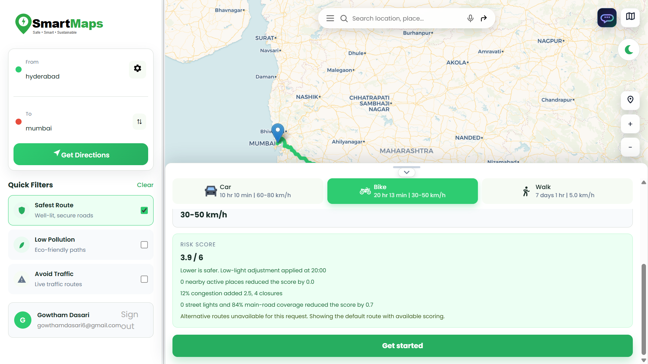
RESULTS
Department of Computer Science & Engineering 28

Slide 29
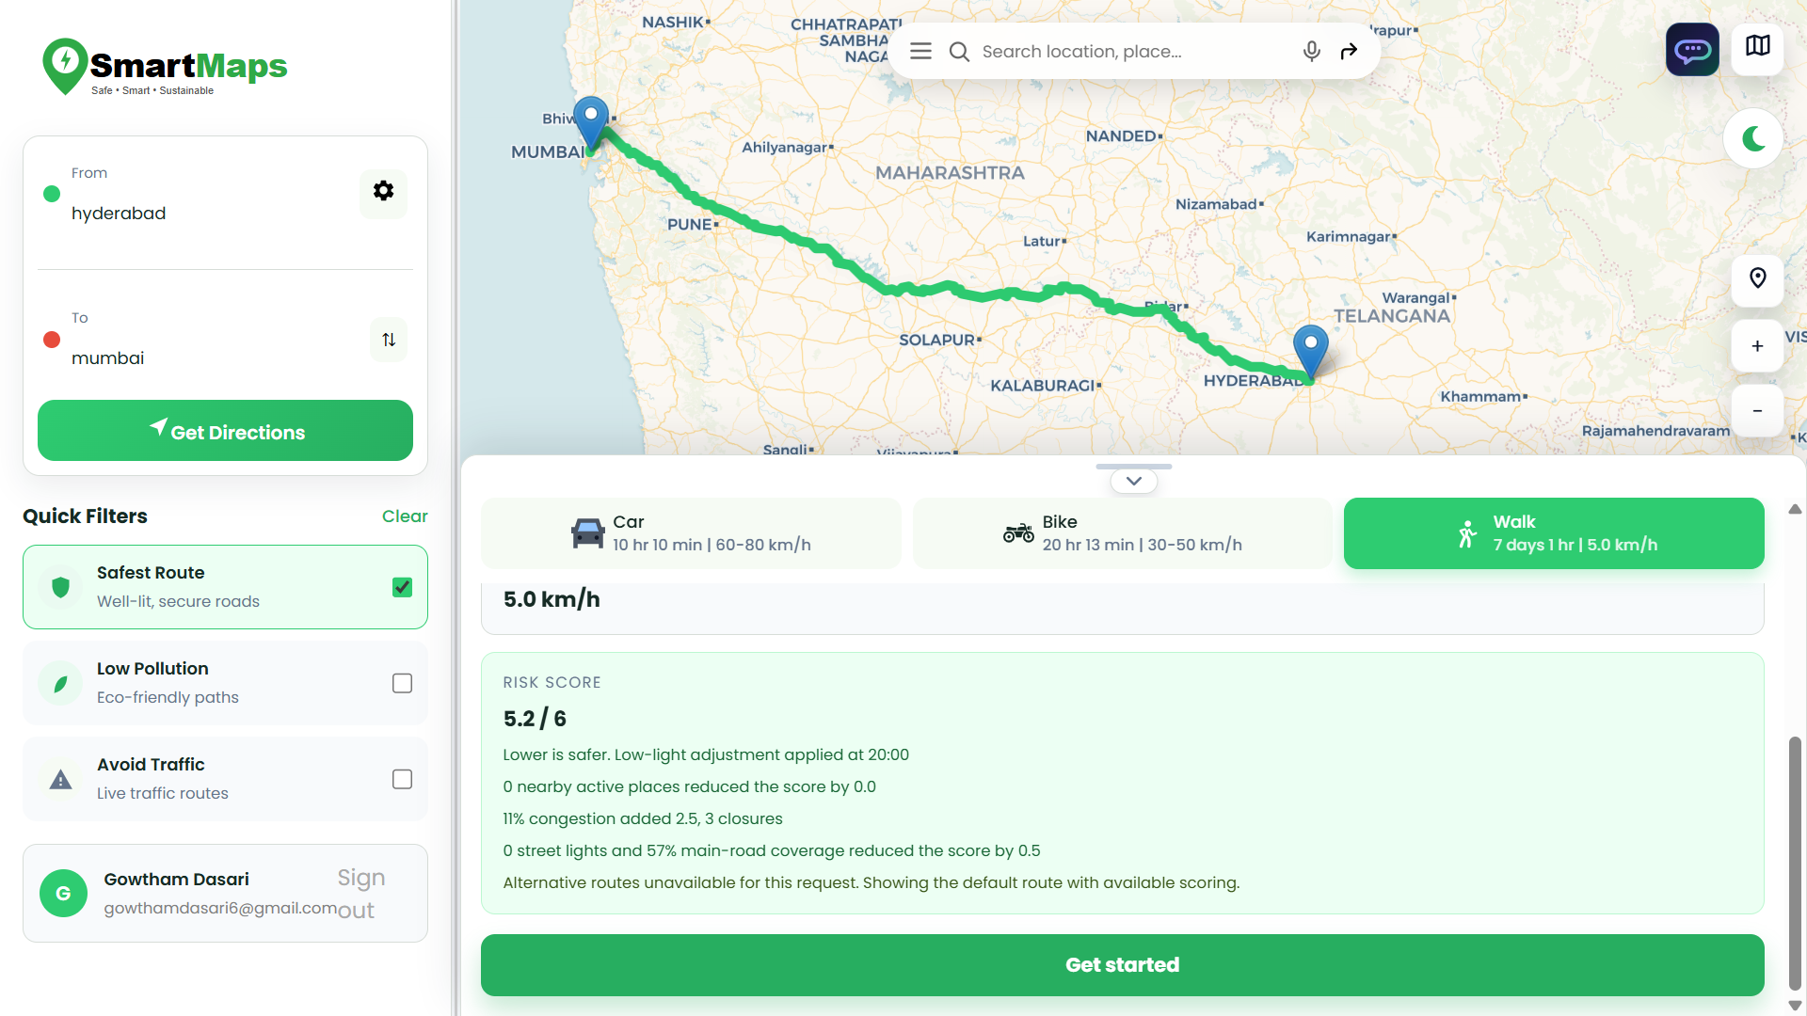
RESULTS
Department of Computer Science & Engineering 29

Slide 30
CONCLUSION
SmartMaps provides an intelligent approach to navigation by going beyond conventional distance- and time-based route planning. The system combines route information with real-time traffic, road closures, time of travel, nearby activity, lighting, and air-quality data. Its 1–6 safety risk scoring allows alternative routes to be evaluated and ranked based on their calculated risk. The system also supports traffic-aware and pollution-aware route selection, giving users greater flexibility in choosing suitable routes. By combining mapping services, real-time data, and intelligent decision-making, SmartMaps provides a foundation for safer and environmentally conscious navigation. In the future, machine learning, historical safety datasets, GPS monitoring, and emergency services can further enhance the system. This can transform SmartMaps into a comprehensive smart-city safety and navigation platform.
Department of Computer Science & Engineering 30

Slide 31
REFERENCES
1. SafeRoutes: Charting a Secure Path – A Holistic Approach to Women’s Safety Through Advanced Clustering and GPS Integration
IEEE Access (2024)
IEEE Xplore – SafeRoutes
2. SafeTrack: Empowering Women's Security with GPS Location Tracking and Messaging
2023 Second International Conference on Augmented Intelligence and Sustainable Systems (ICAISS)
SafeTrack – Research Paper
3. Recommendation of Sustainable Route Optimization for Travel and Tourism
HCI in Mobility, Transport, and Automotive Systems – MobiTAS 2023
Sustainable Route Optimization – Shibaura Institute of Technology
4. Integrated Women's Security System With Safe Route Navigation and Instant Law Enforcement Reporting
Quantum Networks and Their Applications in AI (2024)
Integrated Women's Security System – IGI Global
Department of Computer Science & Engineering 31

Slide 32
THANK YOU

