Slide 1
Problem Statement Solution Submission
Problem Statement Solution Submission
C program to create a list of software application details
BY,
R. GOWTHAM
DEPARTMENT OF ECE
ERODE SENGUNTHAR ENGINEERING COLLEGE

Slide 2
CONTENT
Problem statement
Software Used
Algorithm
Explanation
Sample input
Sample output

Slide 3
PROBLEM STATEMENT
Write a C program to create a list of software application details. The details of application include name, author, version, publishing year , price.
Perform the following with respect to the list of application created.
a) Display all the details of application by a given author.
b) Sort the details of application in the increasing order of price.
c) Display the details of applications published by a given publisher in a given year.
d) Sort the list of applications in the increasing order of two fields , author and publishing year of the books.

Slide 4
SOFTWARE USED
C Programming Language

Slide 5
ALGORITHM
STEP1 :Start
STEP2 :Initialize the structure with corresponding variables
STEP3 :Under the main function get the input variables to perform the regarding operation
STEP4 :Write the displaying statement for switch case
STEP5 :Under the case 1 the user input author name will be compared with the entered application
STEP6 :With the help of if condition the application will be displayed if it is present

Slide 6
STEP7 :Under case 2 the sorting process takes place to sort the cost of applications
STEP8 :In the case 3 the year will be get as user input and then the regarding application will be printed
STEP9 :The author name and year will be get us user input in the case 4 and the regarding application will be shown
STEP10 :publication year will be sorted with the given author name under the case 5
STEP11 :All the books will be displayed in case 6
STEP12 :Stop.

Slide 7
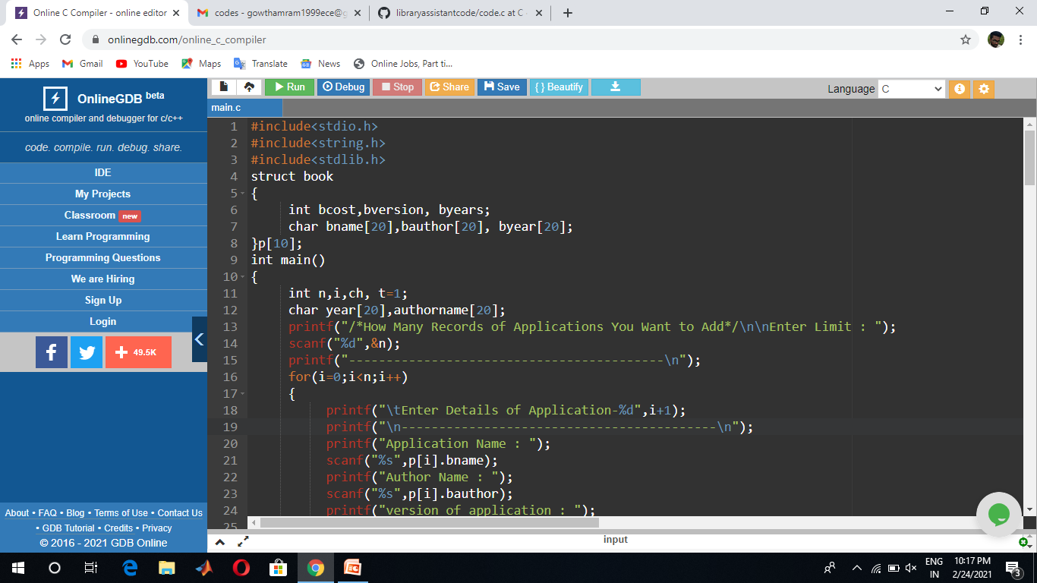
EXPLANATION
STRUCTURE
Here in this structure the needed Variables were declared

Slide 8
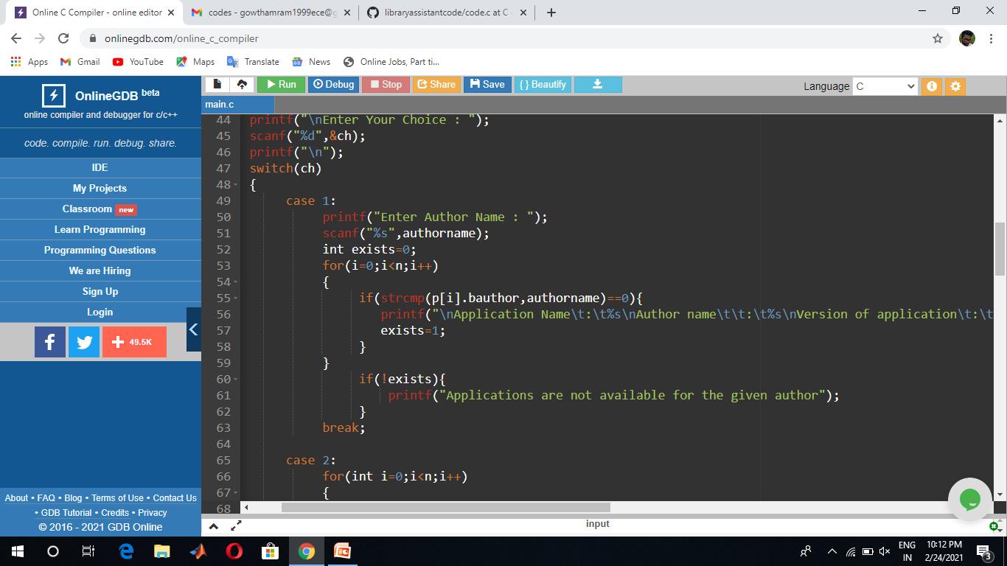
SWITCH CASE
Here in this case 1 applications will be displayed with the given author name

Slide 9
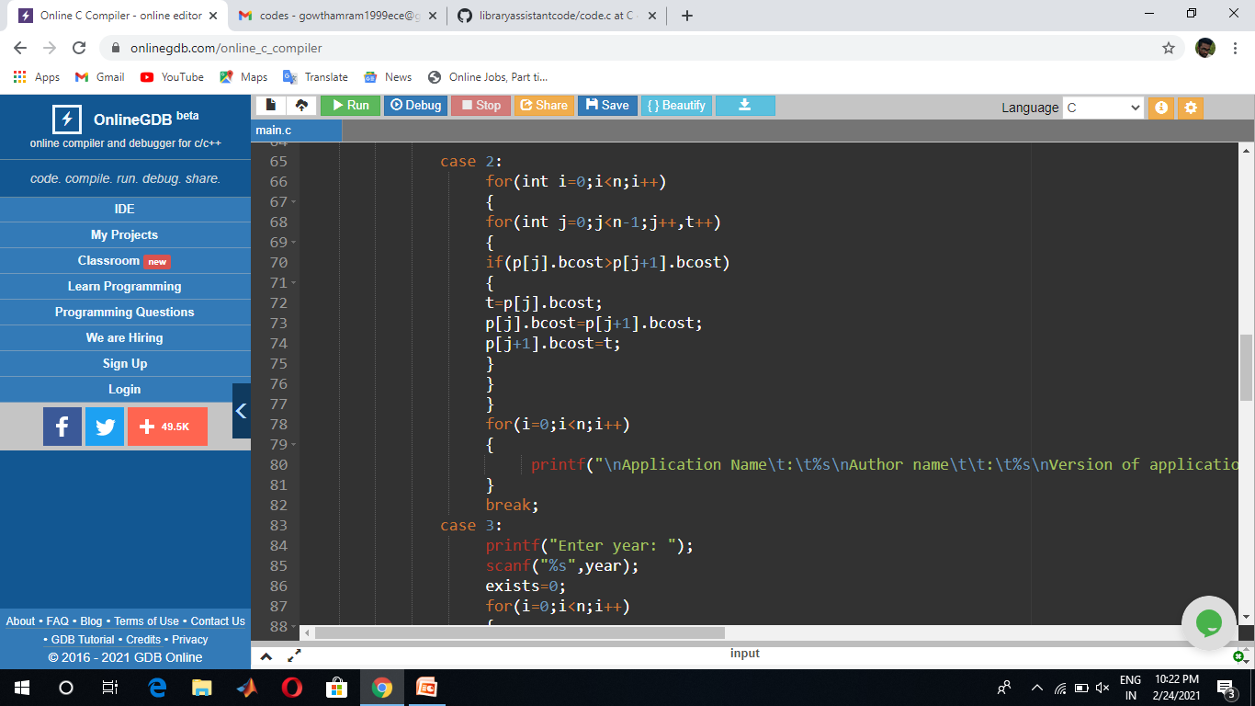
CASE-2
In this case 2 the cost price will be sorted and displayed

Slide 10
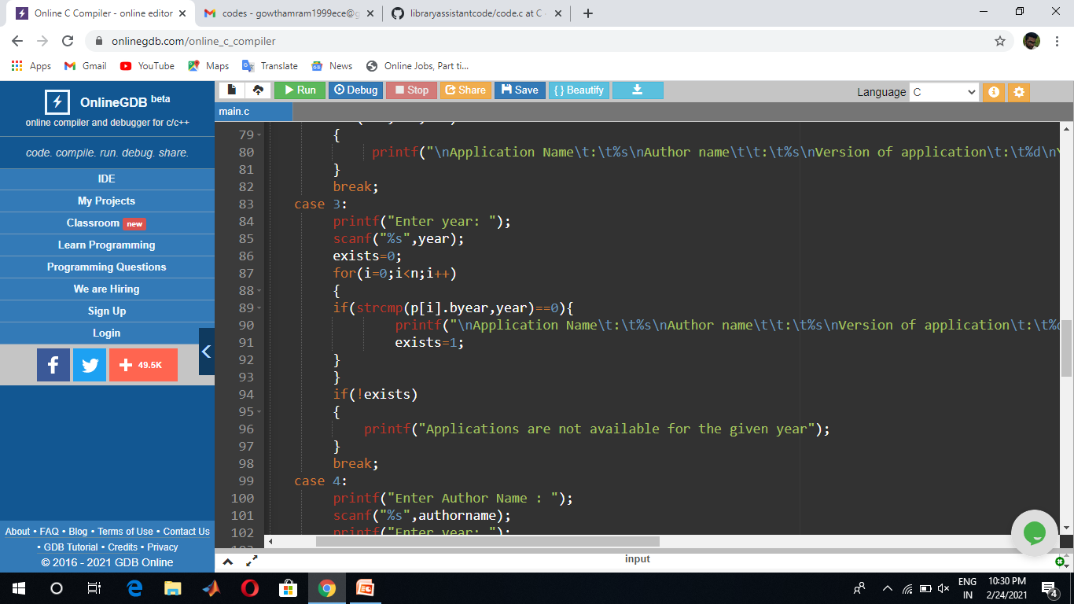
CASE 3
Under the Case 3 the year of the application will be get as user input and the regarding year book will be displayed

Slide 11
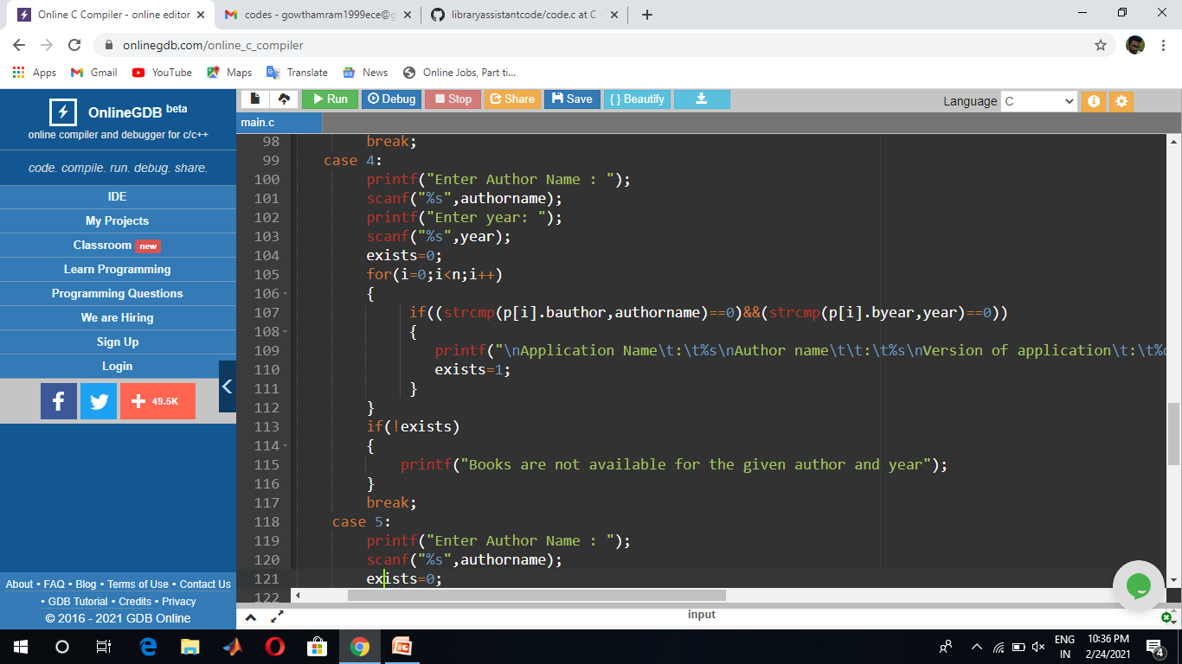
CASE 4
Here the author name and the year will be received as user input and then the available applications were displayed

Slide 12
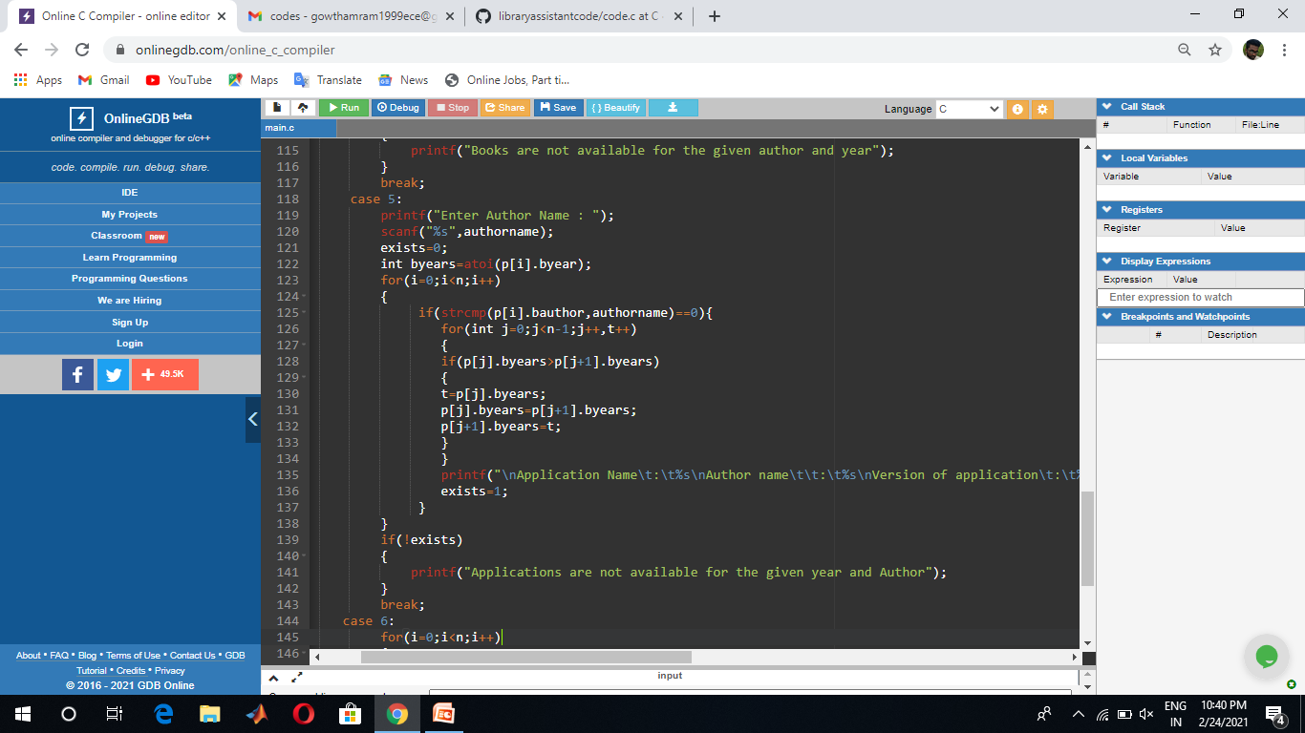
CASE 5
In this case 5 the author name will be received as a input and the year of the same author application will be sorted

Slide 13
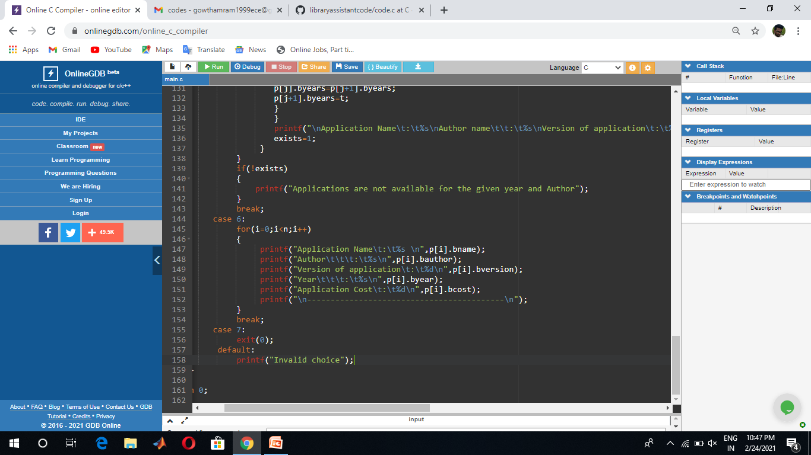
CASE 6
All of the available applications were printed here in this case 6

Slide 14
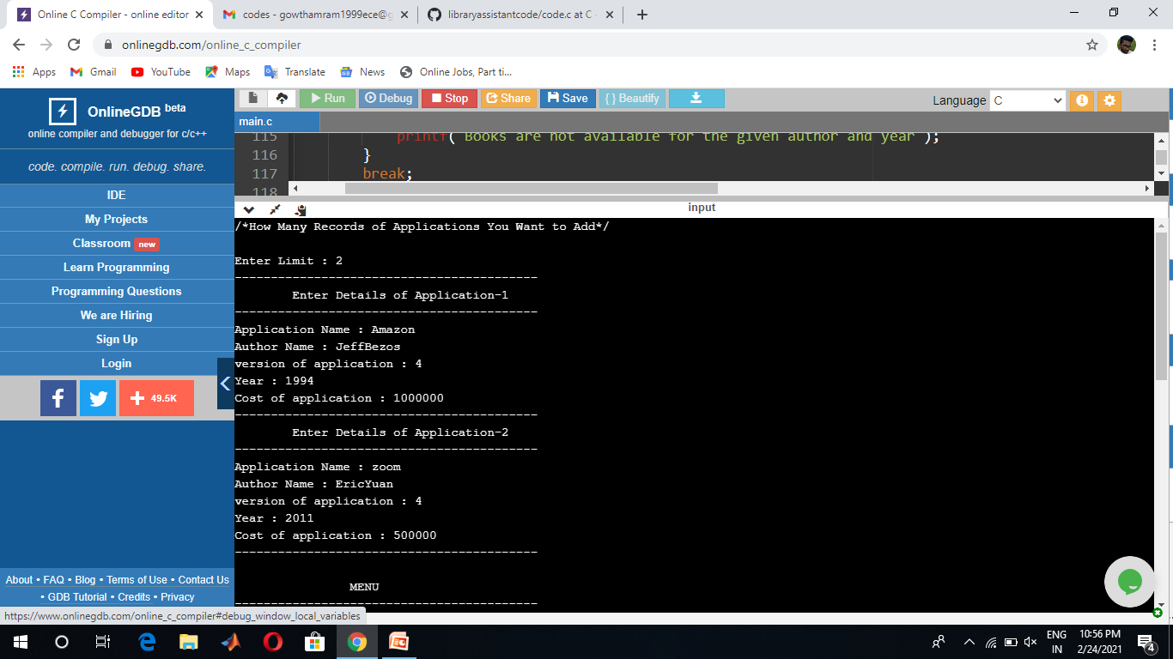
SAMPLE INPUT

Slide 15
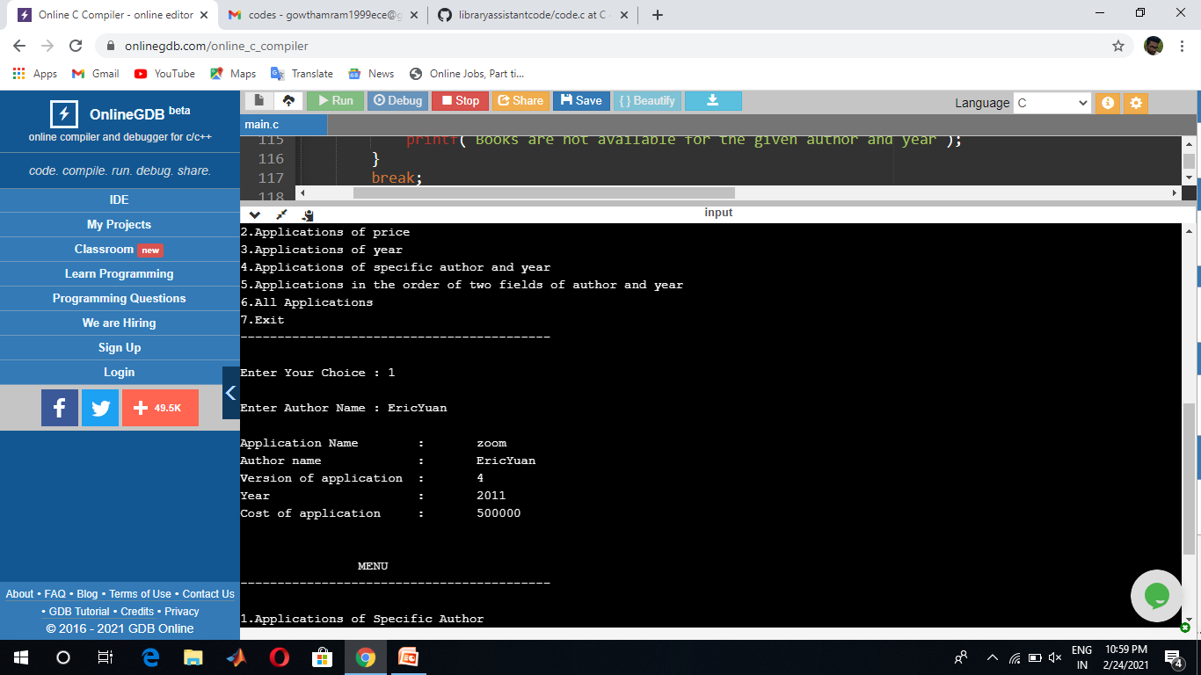
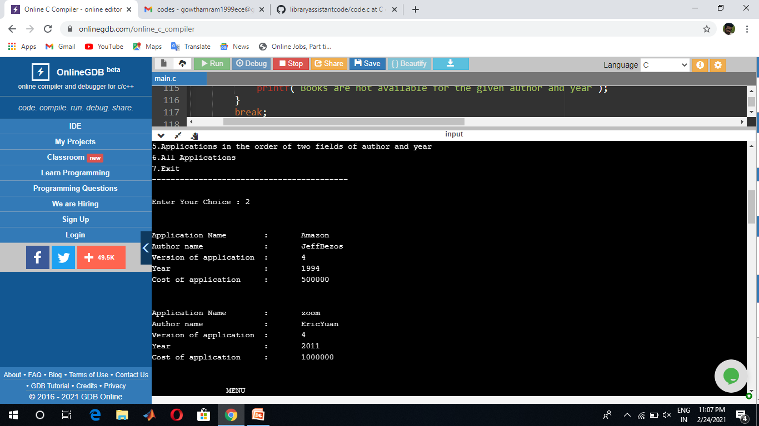
SAMPLE OUTPUT
CASE 1
CASE 2

Slide 16
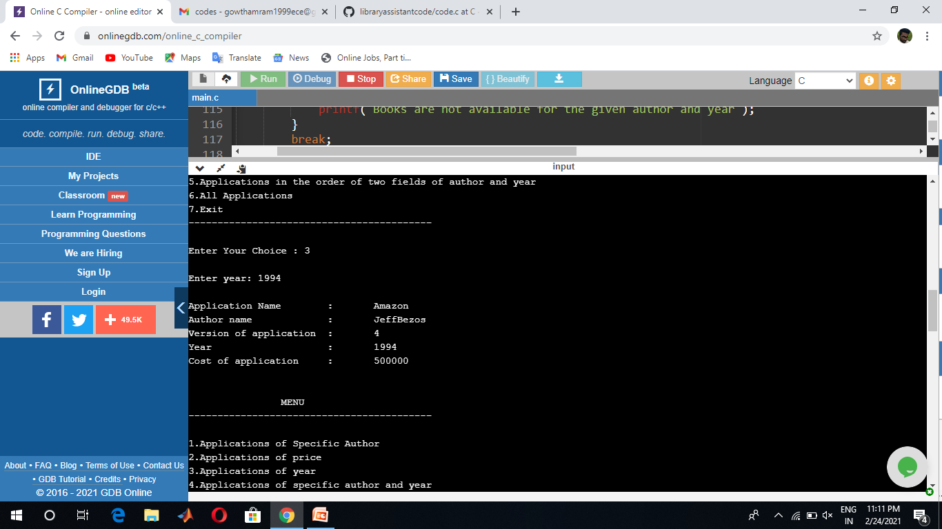

CASE 3
CASE 4

Slide 17
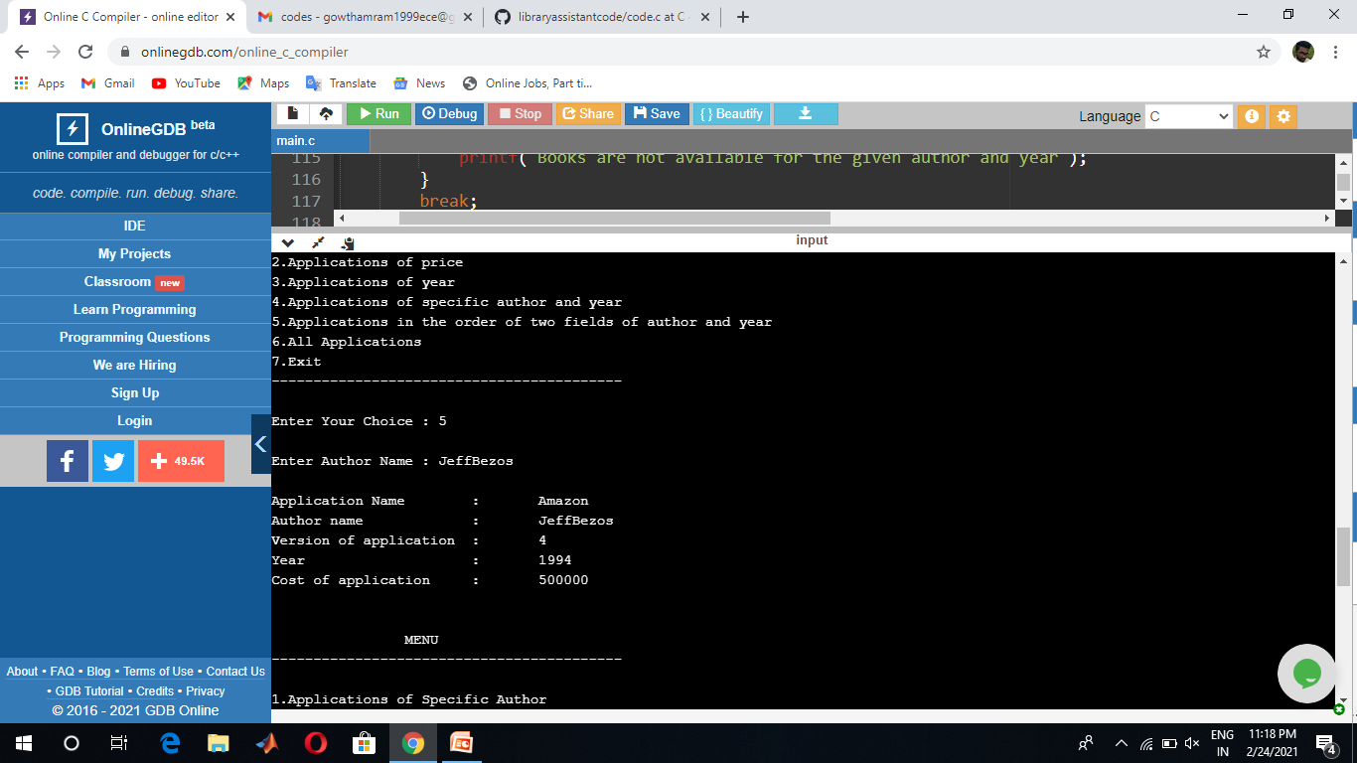

CASE 5
CASE 6

Slide 18
THANK YOU

