Slide 1






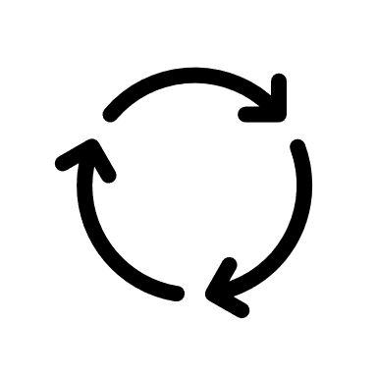






Data collection
Data Processing
Model Deployment
Data from MR . Rao’s system
Data Cleaning
Software
Model building
1). Feature Selection
Tableau
Process data
2). Train Model
Data analysis
3).Feature Engineering
4). Optimization
Web API
5). Testing
6). Evaluation
Data Visualization
Monitor
Retrain
Extraction of data
Get Response From MR . Rao

