Slide 1

Restaurant Database Management and Analysis
Authors:
Shraman Arya
Sai Gowtham Babu Amburi

Slide 2

Business Problem
Many restaurants are managing their business manually which involves taking orders from customers. This process can be an issue as there would be data redundancy and also there might be a chance of data loss.
The details of the employees working in that restaurant are supposed to be accounted properly.

Slide 3
Solution
This problem can be resolved by designing a relational database.
The relational database would help the restaurant to manage the restaurant more effectively and efficiently by computerizing meal ordering, billing and inventory control.
The employee details as well can be stored and accounted properly using the relational database.

Slide 4
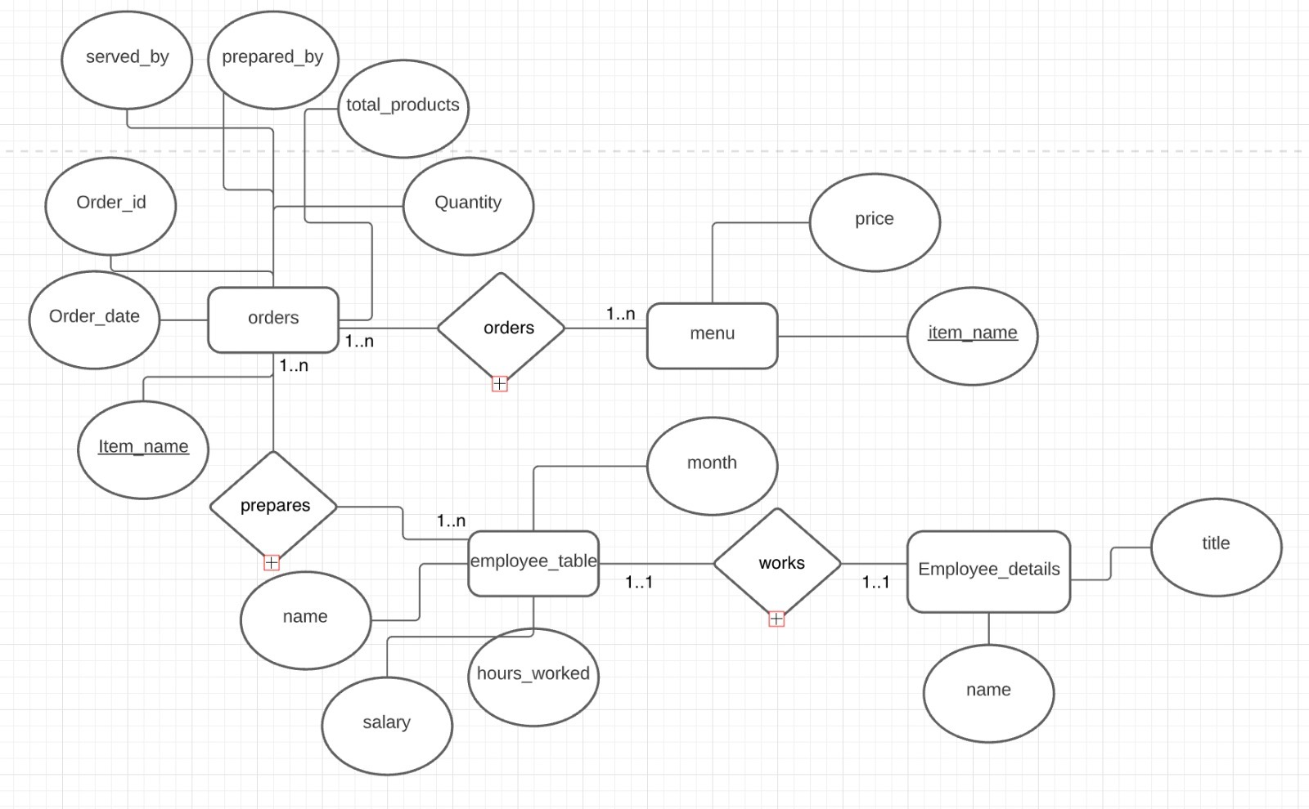
ER Model

Slide 5
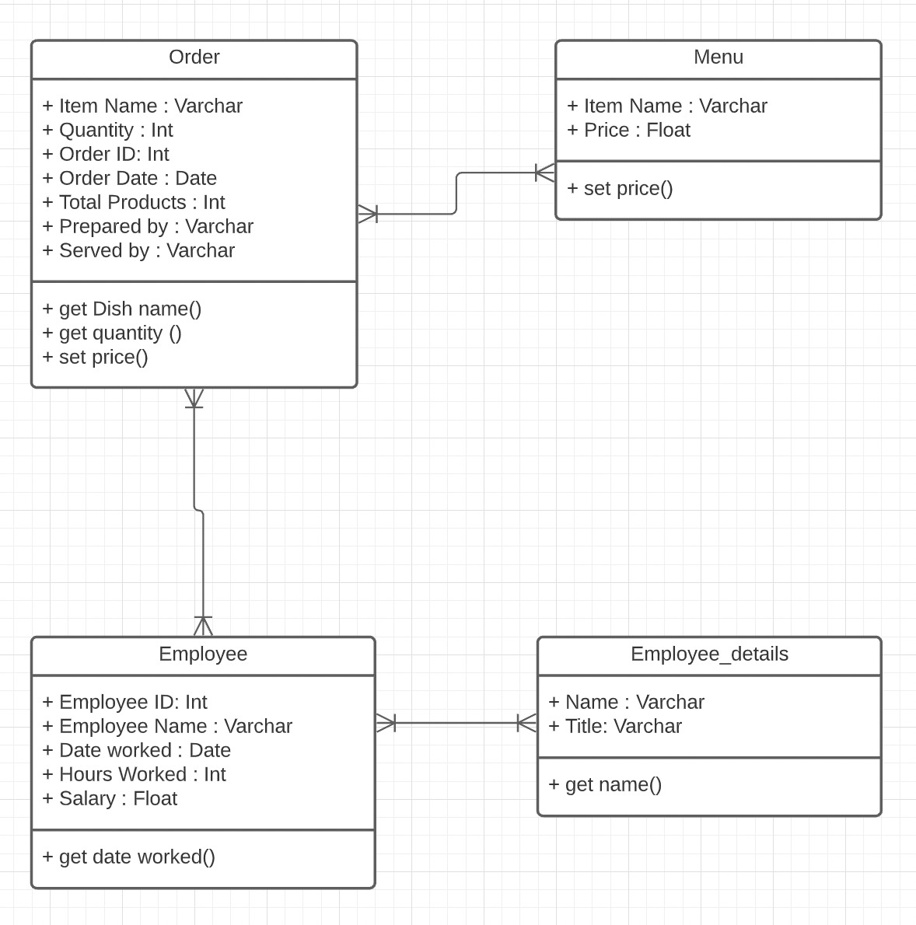
UML Diagram

Slide 6
Relational Model
Order (Order ID , Quantity, Dish Name, Total Products, Prepared by, Served by, Order Date)
Price (Price, Dish name)
Employee (Name, Date Worked, Hours Worked, Salary)
Employee_details (Name, title)

