Slide 1
EMPLYOYEE SALARY PREDICTION USING MACHINE LEARNING ALGORITHMS
CAPSTONE PROJECT
Presented By:
1. GOWTHAM GEDDADA-SAGI RAMA KRISHNAM RAJU ENGINEERING COLLEGE-AI&DS

Slide 2
OUTLINE
Problem Statement (Should not include solution)
System Development Approach (Technology Used)
Algorithm & Deployment (Step by Step Procedure)
Result
Conclusion
Future Scope(Optonal)
References

Slide 3
Problem Statement
Accurately predicting employee salaries is a complex challenge due to the interplay of various demographic, educational, and occupational factors.
Organizations currently lack a precise, data-driven method to predict individual employee salary ranges, leading to potential inconsistencies in compensation and challenges in budgeting for talent.
Existing methods may struggle to provide precise and fair estimates to predict salary for the future employees.
There is a need to quantify how various factors, such as education, experience, and role, influence salary outcomes to support fair compensation policies and socio-economic research.
Developing a reliable salary prediction model requires effectively addressing data quality challenges, such as handling missing values and inconsistent categorical entries, common in real-world employee datasets.

Slide 4
System Approach
System requirements
Operating system : Windows,MacOS,Linux
Memory : 8GB Ram
Processor : Intel i5 and equivalent
Python version : Python 3.8 or higher

Slide 5
System Approach
Library required to build the model
Pandas : For data manipulation and analysis
Numpy : For numerical operations
Sclearn : A machine learning library that provides encoders, various metrics, and different classification models
Matplotlib : For data visualisation
Joblib : used for serializing and deserializing python objects, essential for saving and loading the trained machine learning model

Slide 6
Algorithm & Deployment
Identifying and understanding the problem description
Load the data set for further exploration of the data
Now we go through data preprocessing and cleaning
Identify and address the missing data and replace them with distinct categories
Detect and manage the outliers in numerical features to prevent skewed performance
Remove features from the data set which causes redundancy
Transform all non-numerical categorical features into numerical representations using label encoder
Identify dependent and independent variable (target variable)

Slide 7
Algorithm and deployement
Split the data into training and testing sets
Train and evaluate the train dataset using different machine learning models and make predictions on the testing data
Assess model performance using accuracy score and other metrics by reports or by plotting the results
Select the best model by identifying the model with highest accuracy
Now make predictions on the testing data using the selected machine learning model and display
Finally merge the predicted data set with the default data set for better evaluation of actual income and predicted income

Slide 8
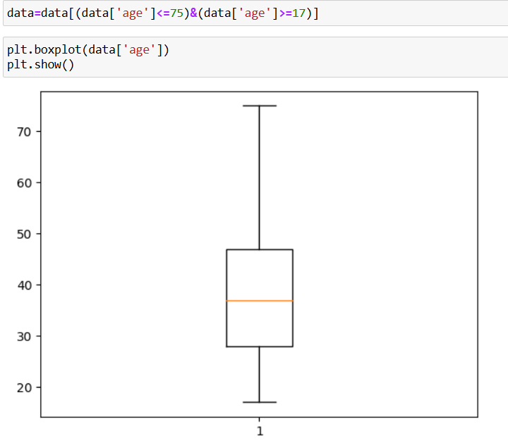
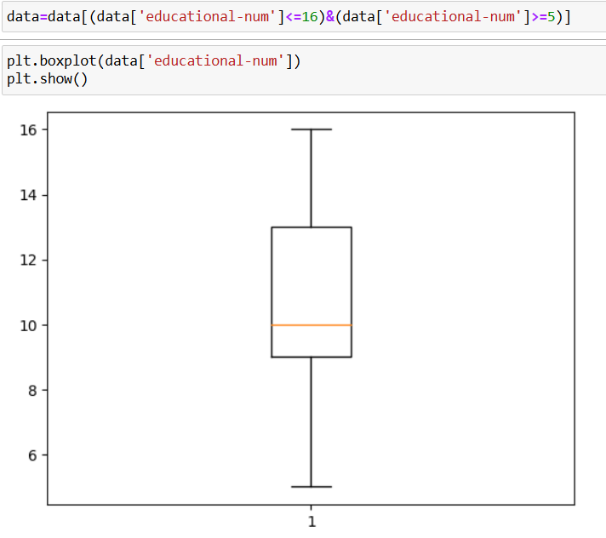
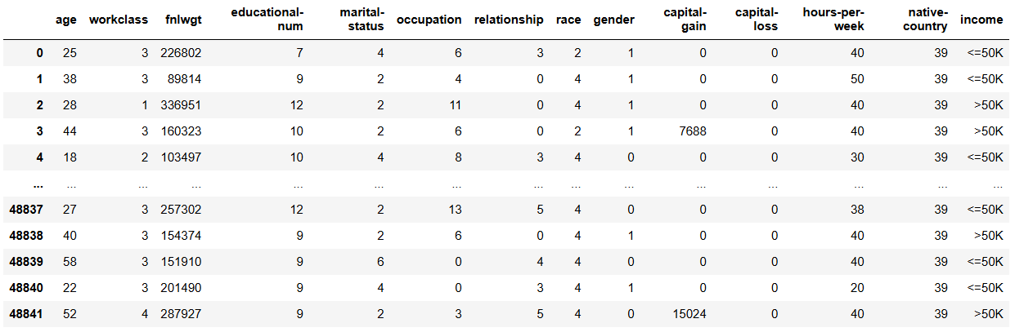
Result

Slide 9
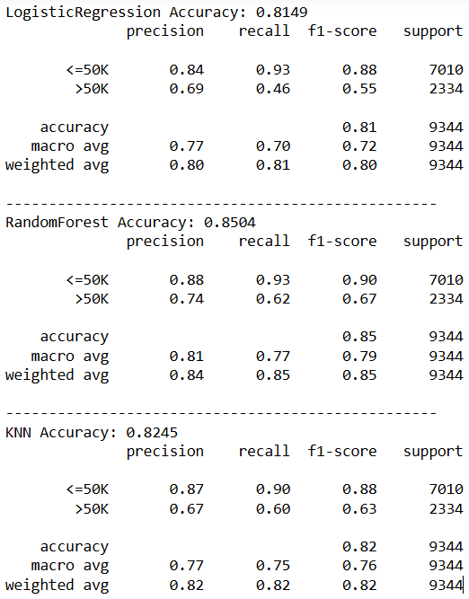
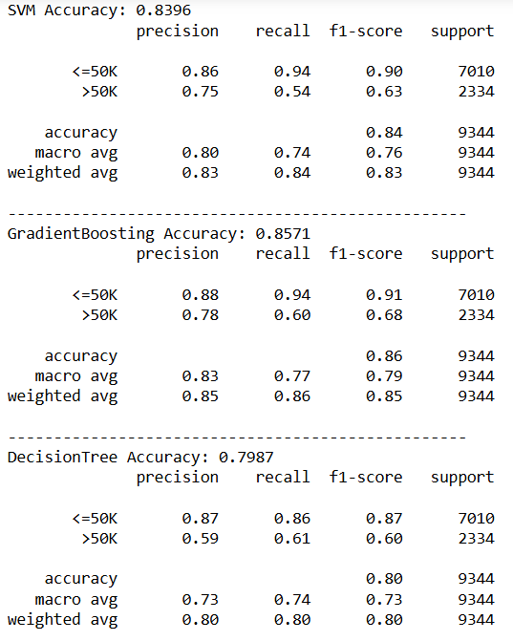

Slide 10
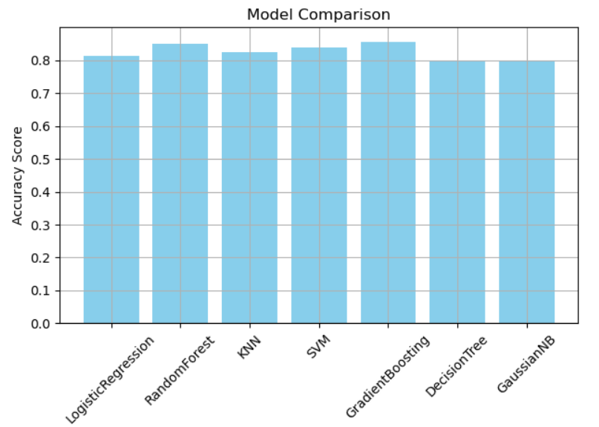
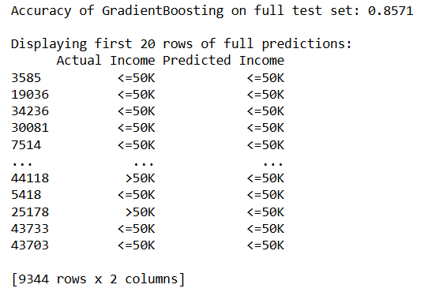

Slide 11
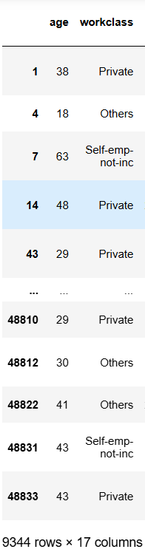
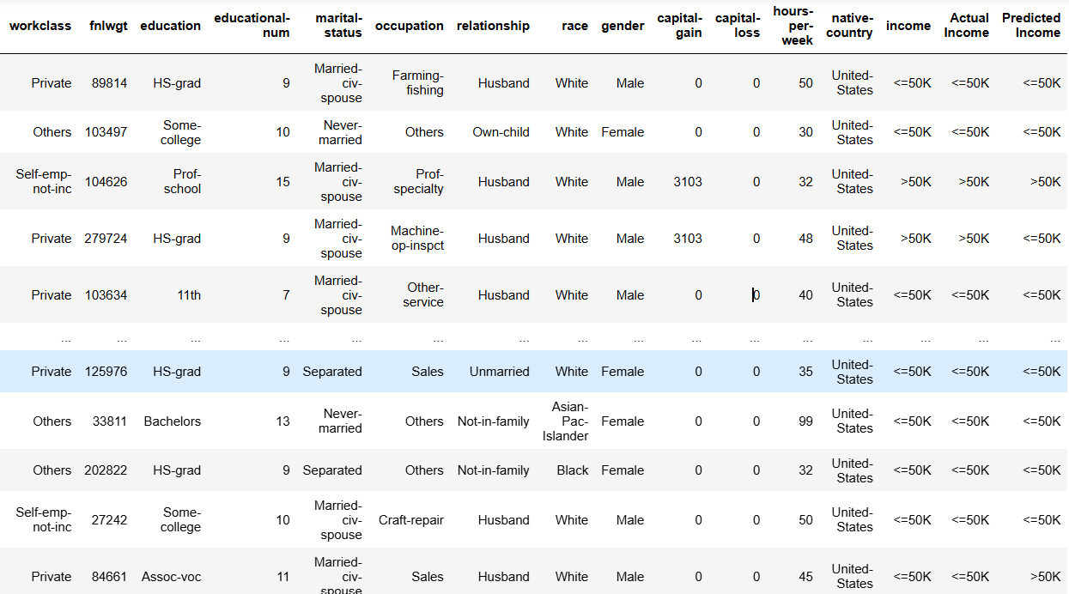

Slide 12
Git hub link
https://github.com/GowthamGeddada/Employee-Salary-Prediction.git

Slide 13
Conclusion
I successfully developed a machine learning model for employee salary prediction to classify individual income as either <=50k or >50k.
Through a rigorous process of data preprocessing, outlier treatment, and feature engineering, the raw dataset was transformed into a clean and suitable format for model training.
A comprehensive comparative analysis of different machine learning classification algorithms was performed, utilizing a robust pipeline that included feature scaling.
Gradient Boosting Classifier emerged as the best-performing model, achieving an accuracy of 0.8571 on the unseen test data.
The model is robust to variations in feature scales and that the preprocessing steps are consistently applied during both training and prediction.
By comparing multiple algorithms and using detailed classification reports, the solution provides a thorough understanding of model strengths and weaknesses, going beyond just overall accuracy.

Slide 14
.
Challenges
Ensuring all required Python libraries were correctly installed in the environment was a prerequisite to avoid ModuleNotFoundError
Consistently encoding numerous categorical features and the target variable to ensure they are converted into a numerical format
Managing outliers to reduce the skewed responses
Finding the model which is better than our best model

Slide 15
References
https://www.geeksforgeeks.org/machine-learning/
https://www.geeksforgeeks.org/ml-label-encoding-of-datasets-in-python/
https://scikit-learn.org/stable/
Géron, A. (2019). Hands-On Machine Learning with Scikit-Learn (2nd ed.). O’Reilly Media.
Employee Salaries Analysis and Prediction with Machine Learning
https://ieeexplore.ieee.org/document/9943146

Slide 16
THANK YOU

