Slide 1
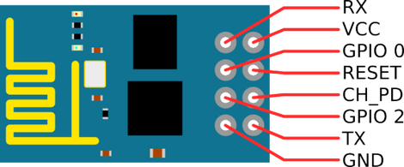
ESP8266 Pin Configuration

Slide 2
ESP8266 Pin Description
RESET: Erases the current software/code in the ESP8266 when connected to Ground
(Note: Never use this pin unless you know how to use)
GPIO 0: Enables programming mode when connected to Ground
(Note: Disconnect this pin after programming)
GPIO 2: Input or Output pin
RX: Connect to RX pin in Arduino Uno
TX: Connect to TX pin in Arduino Uno
CH EN: Chip Enable when connected to 3.3v
VCC: Connect to 3.3v
GND: Connect to Ground

Slide 3
ESP8266 Warnings !!!
Never mess with the ESP8266 RESET pin unless you know what your doing
Connect Arduino UNO board RESET pin to Ground
Connect GPIO-0 pin to Ground for programming the ESP8266
After uploading the code unplug the Arduino UNO board from PC and unplug the GPIO-0 pin from Ground
Use ESP8266 with 3.3 Volt Regulator
RESET pin of Arduino Uno must be connected to Ground

Slide 4
ESP8266 Package Links
http://arduino.esp8266.com/stable/package_esp8266com_index.json
https://dl.espressif.com/dl/package_esp32_index.json

