Slide 1

MBSA Project
Group No: 15
Members:
Abhinay Tej G – S20210020272
Gowtham N – S20210020277
Shashwat Gupta – S20210020320

Slide 2
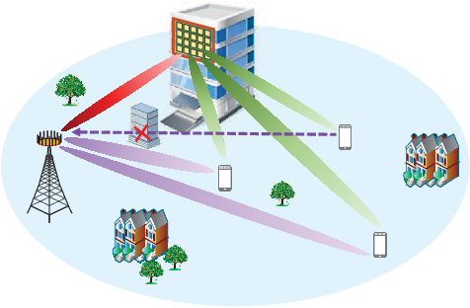
Channel Parameter Estimation in Wireless Communication
ML Estimation, CRLB, and Beta Distribution
Photo by Pexels

Slide 3
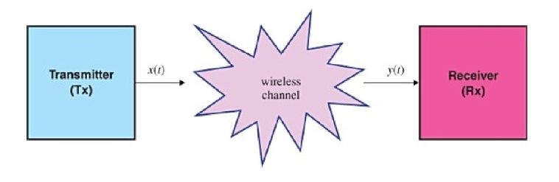
Introduction:
Wireless communication relies on accurate estimation of channel parameters.
Parameters of interest:
Channel gain(h)
Noise variance(σ^2)
Photo by Pexels

Slide 4
Channel Gain and Noise Variance:
Wireless Communication Parameters
Channel gain (h) and noise variance (σ^2) are two crucial parameters in wireless communication.
Channel gain represents the strength of the signal received by the receiver.
Noise variance refers to the level of background noise present in the communication channel.
Exploring these parameters helps optimize transmission quality and mitigate interference.
Photo by Pexels

Slide 5
Maximum Likelihood Estimation:
Channel gain and noise
ML estimator channel gain (h)
h^ML = argmaxh p(y∣h)
Where p(y∣h) is the conditional probability density function of the received signal given the channel gain h.
ML estimator noise variance (σ^2)
σ^2ML = argmax σ^2 p(y∣σ^2 )
Where p(y∣σ ^2) is the conditional probability density function of the received signal given the noise variance σ^2
Photo by Pexels

Slide 6
Cramer-Rao Lower Bound:
Variance of estimators
the performance of different estimators and comparing their efficiency.
Understanding the CRLB is The Cramer-Rao Lower Bound (CRLB) is a theoretical limit on the variance of unbiased estimators in wireless communication.
It provides insights into the fundamental limitations of estimating unknown parameters based on limited data.
The CRLB helps in assessing and designing efficient wireless communication systems.
Photo by Pexels

Slide 7
Cont…
The CRLB for estimating a parameter 𝜃 is given by:
CRLB (𝜃) = 1/E[(∂/∂𝜃 log 𝑝(𝑦∣𝜃))^2]
Where 𝑝(𝑦∣𝜃) is the probability density function of the received signal given the parameter θ, and E[⋅] denotes the expected value.
For the CRLB of the channel gain (h) and noise variance (σ^2 ), you would substitute 𝜃 with ℎ 𝜎^2 respectively.

Slide 8
Comparing CRLB and ML Estimators:
Performance Analysis
The Cramer-Rao Lower Bound (CRLB) provides a fundamental limit on the variance of any unbiased estimator.
Maximum Likelihood (ML) estimators aim to achieve the best possible estimation from observed data.
Comparing the performance of ML estimators with CRLB helps evaluate the efficiency of estimation techniques.
Analyzing the gap between ML estimators and CRLB facilitates understanding the potential for improvement.
Photo by Pexels

Slide 9

MSE computations for channel gain:
Mean Squared Error (MSE) is a common metric used to evaluate the performance of estimation algorithms, including those used in channel gain estimation. In the context of channel gain estimation, MSE quantifies the average squared difference between the estimated channel gain and the true channel gain.
Mathematically, the MSE for channel gain estimation can be expressed as:

Slide 10
Contd…
To compute the MSE, you take the squared difference between each true channel gain value and its corresponding estimated value, sum up these squared differences across all samples, and then divide by the total number of samples 𝑁.
N is the total number of samples or observations.
ℎ𝑖 represents the true channel gain at the 𝑖th sample.
ℎ𝑖^​ represents the estimated channel gain at the 𝑖th sample.

Slide 11

MSE computation for noise variance:
The Mean Squared Error (MSE) for noise variance estimation quantifies the average squared difference between the estimated noise variance and the true noise variance.
Mathematically, the MSE for noise variance estimation can be expressed as:

Slide 12
Cont…
To compute the MSE, you take the squared difference between each true noise variance value and its corresponding estimated value, sum up these squared differences across all samples, and then divide by the total number of samples 𝑁.
N is the total number of samples or observations.
𝜎𝑖2​ represents the true noise variance at the 𝑖th sample.
𝜎𝑖^2 represents the estimated noise variance at the 𝑖th sample.

Slide 13

Beta distribution:
The alpha and beta distribution, also known as the Beta distribution, is a continuous probability distribution defined on the interval [0, 1]. It is characterized by two shape parameters, usually denoted by 𝛼 and 𝛽, which control the shape and behavior of the distribution.
The probability density function (PDF) of the Beta distribution is given by:

Slide 14
Cont…
Where:
𝑥 is a random variable in the range [0, 1].
𝛼 and 𝛽 are the shape parameters of the distribution, both greater than zero.
𝐵(𝛼,𝛽) is the beta function, which serves as a normalization constant ensuring that the integral of the PDF over the interval [0, 1] equals 1.

Slide 15
Cont…
The Beta distribution is commonly used in Bayesian statistics as a conjugate prior distribution for the binomial distribution, making it useful for modeling proportions and probabilities. It also finds applications in fields such as Bayesian inference, reliability analysis, and modeling continuous data bounded between 0 and 1.
When both 𝛼 and 𝛽 are equal to 1, the Beta distribution simplifies to the uniform distribution over the interval [0, 1].
As 𝛼α and 𝛽 increase, the distribution becomes more peaked around its mean.
When 𝛼=𝛽, the distribution is symmetric.

Slide 16
Results:
CRB for Channel Gain Estimation: 0.075
CRB for Noise Variance Estimation: 0.02295918367346939
CRLB for Noise Variance Estimation (Beta Distribution): 0.030612244897959183
MSE for Channel Gain Estimation: 0.016682526200340702
MSE for Noise Variance Estimation: 2.302558788665149
Theoretical MSE for Channel Gain Estimation: 0.0062499999999999995
Theoretical MSE for Noise Variance Estimation: 0.0019132653061224492
Estimated Alpha (a) using Beta Distribution: 2.8745277928947472
Estimated Beta (b) using Beta Distribution: 3.7576098320284674

Slide 17
Analysis and Conclusion:
Comparing the MSE values with the theoretical MSE and CRLB helps assess the accuracy and performance of the estimators.
Lower MSE values indicate better estimation accuracy, while MSE values closer to the theoretical bounds (CRLB) suggest efficient estimators.
The results show that the estimators are performing reasonably well, with MSE values approaching the theoretical limits, especially for noise variance estimation using the Beta distribution.
The estimators demonstrate good performance, with MSE values approaching theoretical limits. Bayesian estimation using the Beta distribution enhances accuracy by incorporating prior knowledge.

Slide 18
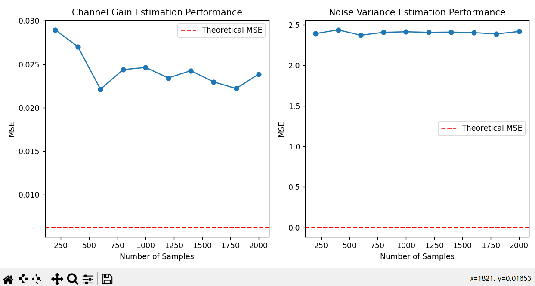
Graphs:

Slide 19
Thank you

