Slide 1

DEPARTMENT OF COMPUTER SCIENCE AND ENGINEERING
FACE MASK DETECTION
presented By:
1.Gowtham.R
2.Dhanush.N
3.Hubert Ryan.E
4.Mullai Balaji.V

Slide 2
CONTENTS
ABSTRACT
INTRODUCTION
1.PROBLEM STATEMENT
2.PROJECT OBJECTIVES
LITERATURE REVIEW
IMPLEMENTED SYSTEM
ALGORITHM USED
1.MACHINE LEARNING
2.COMPUTER VISION
3.DEEP LEARNING
SYSTEM DESIGN
1.Architecture of Proposed Face mask detection system.
RESULT
CONCLUSION
REFERENCES

Slide 3
FACE-MASK-DETECTION: FACE MASK DETECTION WEB APPLICATION BUILT WITH KERAS,TENSORFLOW,OPENCV. It can be used to detect face masks in real-time video. GOAL: The goal is to create a masks detection system, able to recognize face masks in real-time video, drawing bounding box around faces. In order to do so, I finetuned MobilenetV2 pretrained on Imagenet, in Conjuction with the OpenCV face detection algorithm: that allows me to turn a classifier model into an object detection system.

Slide 4
TECHNOLOGIES: - Keras/Tensorflow -OpenCV -Flash -MobilenetV2 USAGE: You have to install the required packages, you can do it: -via pip ‘’’ pip install -r requirements.txt’’’ Once you have installed all the required packages you can type in the command line from the root folder: python detect_mask_video.py to run the mask detector.

Slide 5
ABSTRACT:
Corona Virus (coronavirus) According to the World Health Organization, the COVID-19 pandemic is creating an international health crisis, and the most successful safety method is wearing a mask in public places.
The COVID-19 pandemic compelled governments all over the world to implement lockdowns in order to prevent virus transmission.
According to reports, wearing a face mask while at work significantly decreases the risk of transmission. A cost-effective and cost-effective method of using AI to create a safe environment in a manufacturing setting.
For mask detection, a hybrid model using techniques such as deep and classical machine learning is provided. A face mask detection dataset consists of images with and without masks. We're going to try to time period face detection from a live stream from our webcam using OpenCV. Using Python, OpenCV, Tensor Flow, and Keras, we will create a COVID-19 face mask detector with computer vision.
Our aim is to use computer vision and deep learning to determine whether or not the person in the image/video stream is wearing a mask.

Slide 6
INTRODUCTION:
Because of the global COVID-19 corona virus outbreak, the wearing of face masks in public is becoming more common.
The corona virus outbreak has resulted in unprecedented levels of international scientific collaboration. Machine learning and Deep Learning, which are assisted by artificial intelligence (AI), can aid in the battle against Covid-19 in a variety of ways.
We're going to implement a mask face recognition model that uses deep learning and computer vision. The proposed model could be used in conjunction with police work cameras to prevent COVID-19 transmission by detecting individuals who are not wearing face masks. The model was created using opencv, tensor flow, and keras, as well as deep learning, computer vision and traditional machine learning algorithms.

Slide 7
1.PROBLEM STATEMENT: The project's main point is that if we can use AI to find people wearing or not wearing masks in public places, we'll be able to increase our protection. If used correctly, the mask detector will almost certainly be used to help ensure our protection.

Slide 8
2.PROJECT OBJECTIVES:
The development of an AI solution to detect whether a character is wearing a face mask and grant them access could be extremely beneficial to society. In this project, a simple Face Mask detection machine is built using Convolutional Neural Networks, a Deep Learning method (CNN). This CNN Model is built with the TensorFlow system and the OpenCV library, which are both excellent used for real-time applications.

Slide 9
LITERATURE REVIEW:
Airports: While not goggles, the proposed System could be of great value to sight travellers at airports. The information of travellers may be recorded as videos in the system at the entrance. If a passenger is discovered without a face mask, an alarm is sounded, alerting the airfield authorities to take immediate action.
Hospitals: The proposed system could be combined with CCTV cameras, and the information could be used to see if any of their employees are wearing masks. If a doctor is discovered without a mask, they will be sent a note to put one on.
Offices: The proposed framework would aid in the maintenance of safety standards in order to prevent the spread of Covid-19 or any other airborne disease. If a worker is not wearing a mask, they will be reminded to do so.

Slide 10
IMPLEMENTED SYSTEM:
The proposed framework uses the OpenCV, Tensor flow, Keras, and PyTorch libraries to identify a person wearing a face mask in an image/video stream using computer vision and deep learning algorithms.

Slide 11
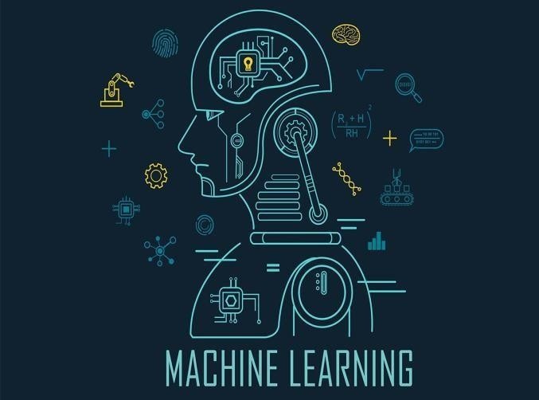
ALGORITHM USED:
MACHINE LEARNING:
1.Machine learning algorithms build a mathematical model based on sample data, known as training data, to make new predictions or make other decisions although they are not explicitly programmed to do so.
2.Depending on the essence of the "signal" and "feedback" available to the learning system, machine learning methods are historically divided into three different categories:
Supervised learning
Unsupervised learning
Reinforcement learning

Slide 12
Supervised learning: The computer is given examples of inputs and the need for required outputs, with the aim of learning a standard rule that maps inputs to outputs.
Unsupervised learning: The training algorithm isn't given a name, so it's left to figure out structure in an input on its own. Unattended learning may be a target in and of itself (finding hidden patterns in data) or a means to an end (finding hidden patterns in data) (feature learning).
Reinforcement learning: A computer programme interacts with a complex world in which it must achieve a specific objective (such as driving a car or playing a game against an opponent). As it navigates its problem space, it receives feedback in the form of rewards, which it attempts to optimise.

Slide 13
COMPUTER VISION:
Computer vision is a knowledge-based science area that deals with how machines can interpret visual images or videos at a high level.
Computer vision tasks include techniques for collecting, processing, analysing, and interpreting digital images, as well as the extraction of high-dimensional data from the real world in order to provide numerical or symbolic knowledge, such as in the form of decisions.

Slide 14
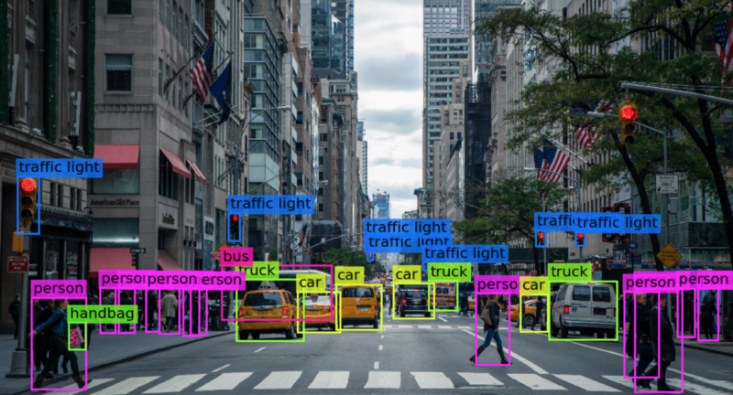
Computer vision is a field of artificial intelligence (AI) that enables computers and systems to derive meaningful information from digital images, videos and other visual inputs — and take actions or make recommendations based on that information.

Slide 15
DEEP LEARNING:
Deep learning is a subset of a Machine Learning algorithm that uses multiple layers of neural networks to perform in processing data and computations on a large amount of data. Deep learning algorithm works based on the function and working of the human brain.
The most popular deep learning algorithms are:
Convolutional Neural Network (CNN)
Recurrent Neural Networks (RNNs)
Long Short-Term Memory Networks (LSTMs)
Deep learning allows computational models made up of multiple process layers to discover information representations at multiple level of abstraction.

Slide 16
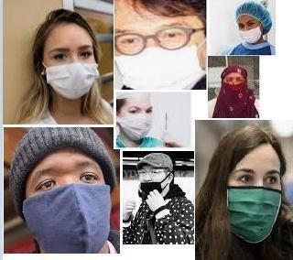
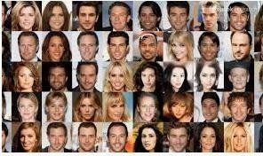
SYSTEM DESIGN:
This system aims at classifying whether a person is wearing a mask or not by taking input from
--Images
--Real time streaming Videos

Slide 17
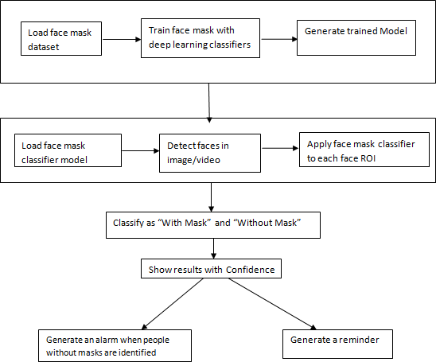
The model is coached in two phases to complete the classification of the photographs:
The face mask dataset is loaded into the device in phase one.
Different Supervised Learning classifiers are used to build a coaching model.
2nd Phase:
Open the mask classifier model and load it.
Scan the images/video stream for faces.
Use the classifier on each face ROI.
Confidently classify the images as ‘With Mask' or ‘Without Mask.'

Slide 18
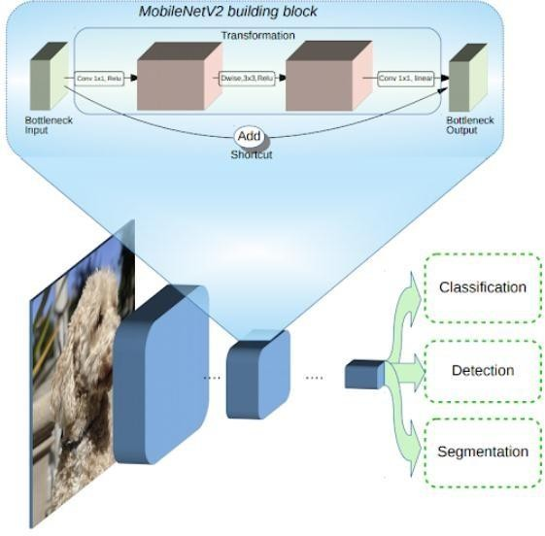
1.Architecture of Proposed Face mask detection system:

Slide 19

RESULT:

Slide 20
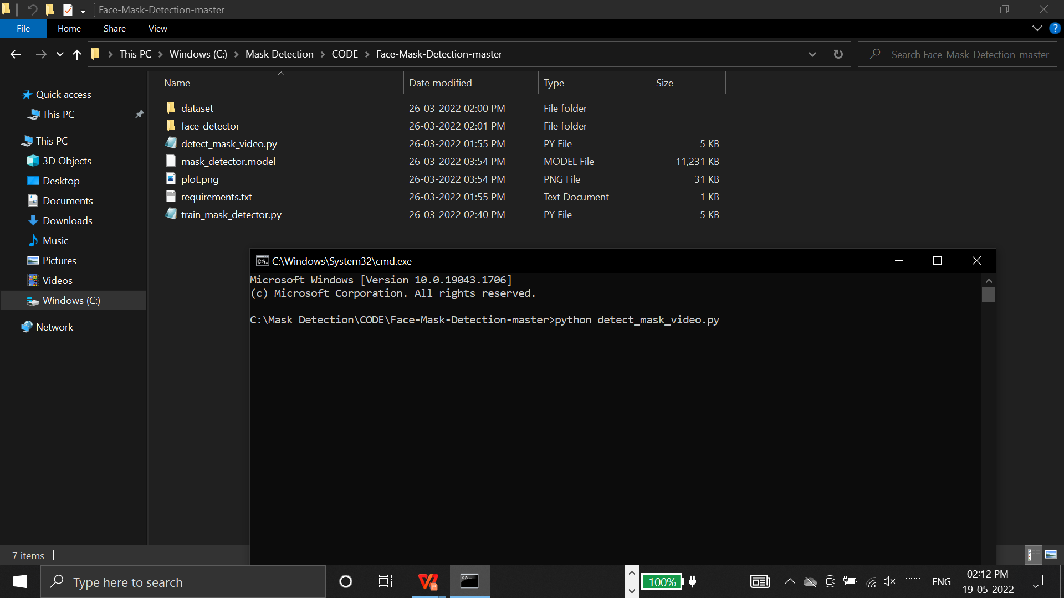
RUN COMMAND PYTHON DETECT_MASK_VIDEO.PY IN CMD PROMPT.

Slide 21
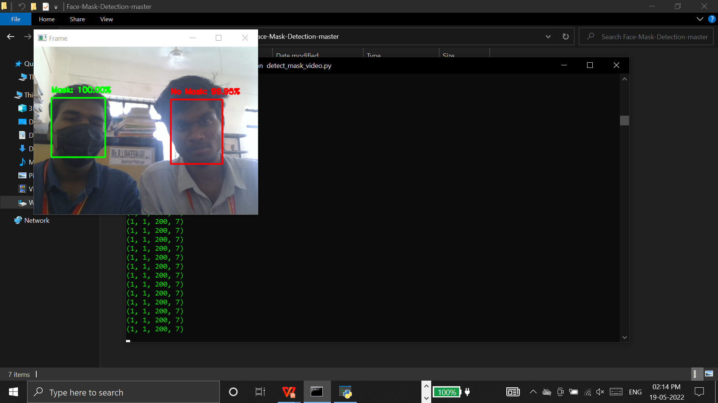
OUTPUT AS : WITH MASK AND WITHOUT MASK

Slide 22
REFERENCE :
[1] Bogdan Kwolek, W-Pola 2 “Face Detection Using
Convolutional Networks and Gabor Filters”. Rzeszao
University of Technology, Poland.
[2] N. Ozkaya, S. Sagiroglu “Intelligent face Mask
Prediction System”. 2008, IEEE International Joint
Conference on Neural Networks.
[3] Gayatri Deora, Ramakrishna Godhula and Dr. Vishwas
Udpikar “Study of Masked Face Detection Approach in
Video Analytics”. 2016, IEEE Conference on Advances
in Signal Processing.
[4] Naveen S, Shihana Fathima R, Dr. R.S Moni, 2016
International Conference on Communication Systems
and Networks.
[5] Wei Bu, Jiangjinn Xiao, Chuanhong Zhou, Minmin yang
and Chengbin “A Cascade Framework for Masked Face
Detection”. 2017, IEEE 8th International Conference
on CTS & RAM Ningbo

Slide 23
CONCLUSION :
The artificial intelligent (AI) and machine learning (ML) are developed various models for face mask detection. In this presentation,we have discussed about various methods are used for facial mask detection. As we know nowadays mask detection is a very challenging task.
The applications of Facial Mask Detection are used especially for the prevention of spreading Corona Virus, tracking & identifying criminals and anti-spoofing etc. By using a Deep Convolutional Neural Network Algorithm, we can easily detect the facial mask. But the facial mask detection and non-masked face detection accuracy provided high variations.

Slide 24
THANK YOU

