Slide 1

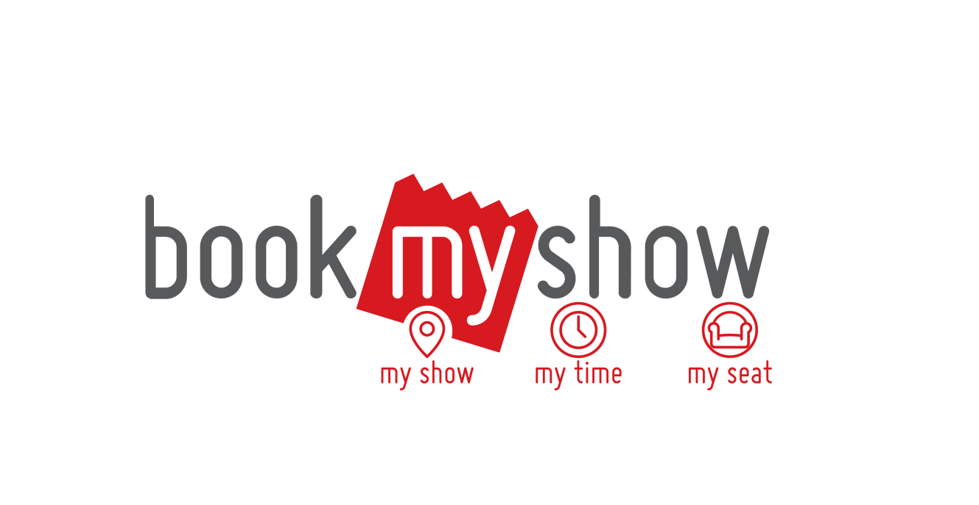
MOVIE TICKETING SYSTEM
Book My Show

Slide 2

Developed By: Rohan Chaudhary ( IIT2015073 ) Umang Narwal ( IIT2015070 ) Ashutosh Sharma ( LIT2015020 ) Rishabh Rai ( IIT2015047 ) Roshan Kumar ( IIT2015081 )

Slide 3
OVERVIEW
Book My Show is one of the most flexible and robust modern-day ticketing app built especially for movies in the recent times.
The project will allow an easy-to-use interface for the users to perform the checking, availability and booking of movie tickets, along with an interface for the administrative user to modify the existing data on the database.

Slide 4
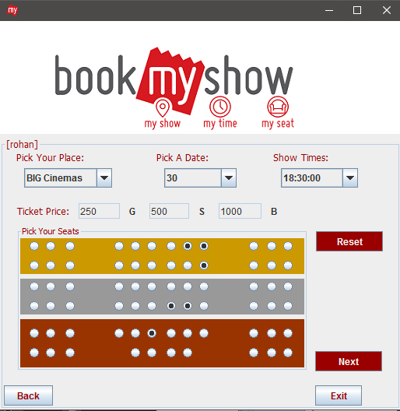

Introduction
This project helps the customer to view and book the movie tickets. The operational user interface also helps the ordinary users in managing their own information in a customized manner as per the included flexibilities.

Slide 5

Functional components of the project:
1. The operational or generic user interface (User/Client End):
allows the front-end customer to view movies (trailers), their timings and seat options, and henceforth book movie tickets, according to suitable time and date.
2. Administrative user interface ( Movie Details management):
allows the database administrator to add, modify or remove currently available movies list.

Slide 6

Modules:
Movies Details Module
User Registration Module
User Login Module
User Ticket-Booking Module
Administrative Page Module
After careful analysis the system has been identified to possess the following discrete modules:

Slide 7
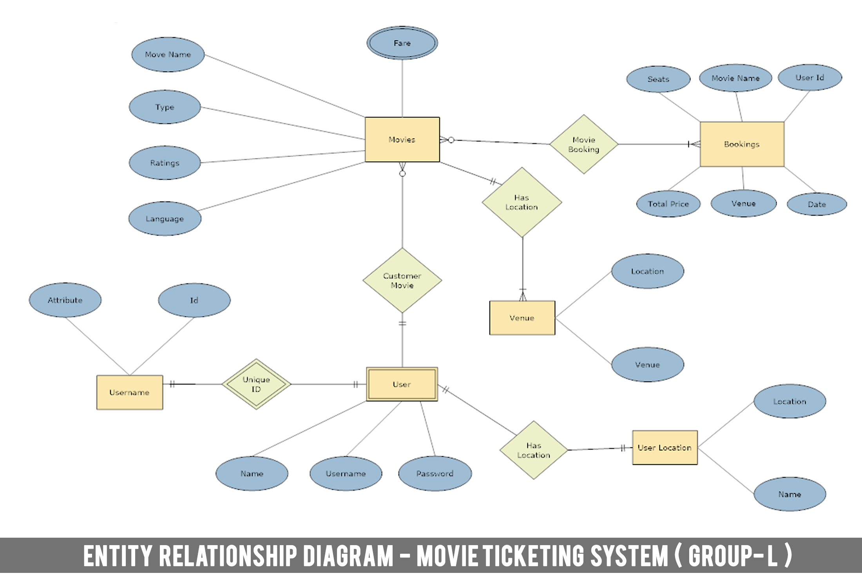
ER- DIAGRAM

Slide 8
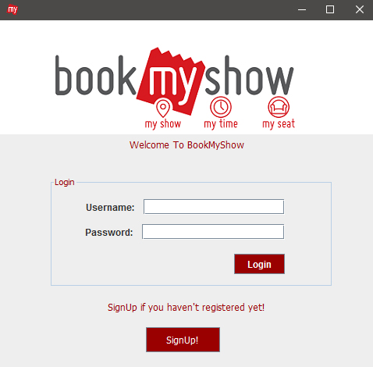
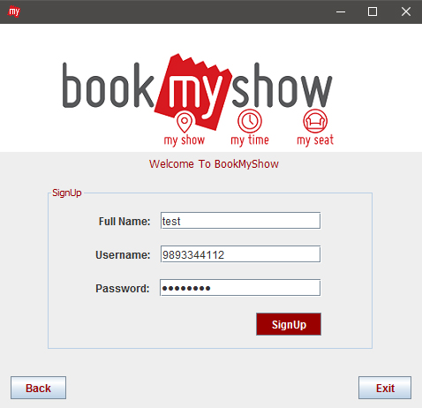
Client end interface :

Slide 9
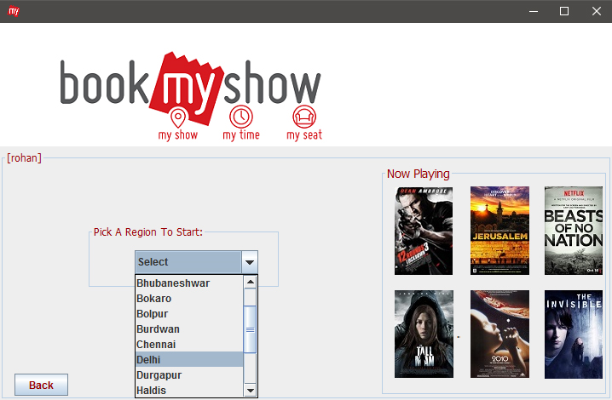
PROJECT SCREENS

Slide 10
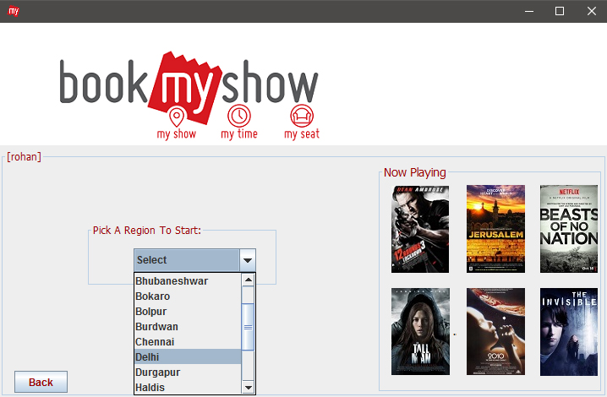
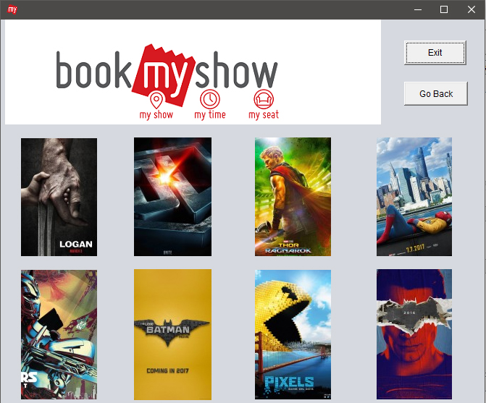
CLIENT END INTERFACE (CONTD.)

Slide 11
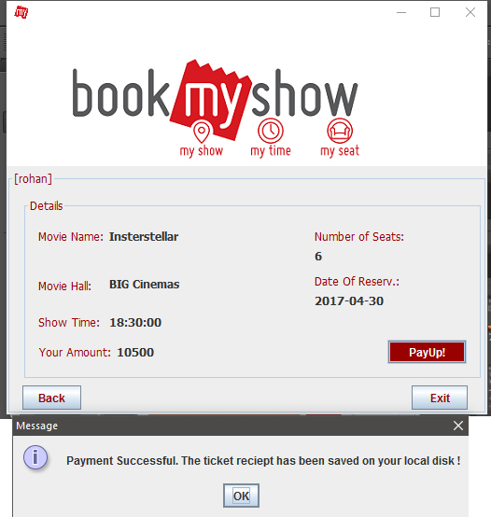
CLIENT END INTERFACE :

Slide 12
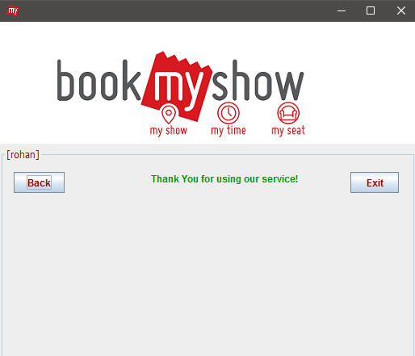
CLIENT END INTERACE :

Slide 13



Practical realization and applications
HOW ARE THE FEATURES ?
The project allows the front-end user to view the video trailers of the currently running movies. Besides, it also generates and allots a unique Booking ID to each booking submission from the user.
Added to that, it has a special utility which prints and saves the booking receipt on the customer’s computer once the payment has been done successfully.
IS IT RELIABLE ?
The back-end database ( MySQL ) used in the project deploys 2nd Normal Form of Normalization, wherein all non-key attributes are dependent on the key attribute and hence avoids data redundancies and anamolies.
WHO CAN USE IT ?
It can possibly be used by micro-sized ( town or district based ) companies providing movie booking services to their customers wherein the size of data set collected and generated is reasonably small for being handled by MySQL.

