Slide 1
Financial Analysis of Nifty Midcap Top 10 Stocks
A Comprehensive 3-Year Study

Slide 2
Agenda
1. Introduction
2. Asset Selection
3. Data Collection
4. Price Trends Analysis
5. Return Distributions
6. Correlation Analysis
7. Combined Index Construction
8. Portfolio Optimization
9. Efficient Frontier & Capital Market Line
10. Combined Index Performance
11. Conclusion

Slide 3
Introduction
Objective: Analyze the performance, risk, and correlations of the top 10 Nifty Midcap stocks over the past three years.
Scope: Data collection, statistical analysis, correlation study, portfolio optimization, and performance evaluation.

Slide 4
Asset Selection
Selected Stocks:
- ADANIPORTS
- BAJAJ-AUTO
- CIPLA
- EICHERMOT
- GAIL
- HCLTECH
- ICICIBANK
- INFY
- MARUTI
- SBIN
Rationale: Based on market capitalization, liquidity, and representation within the Nifty Midcap index.

Slide 5
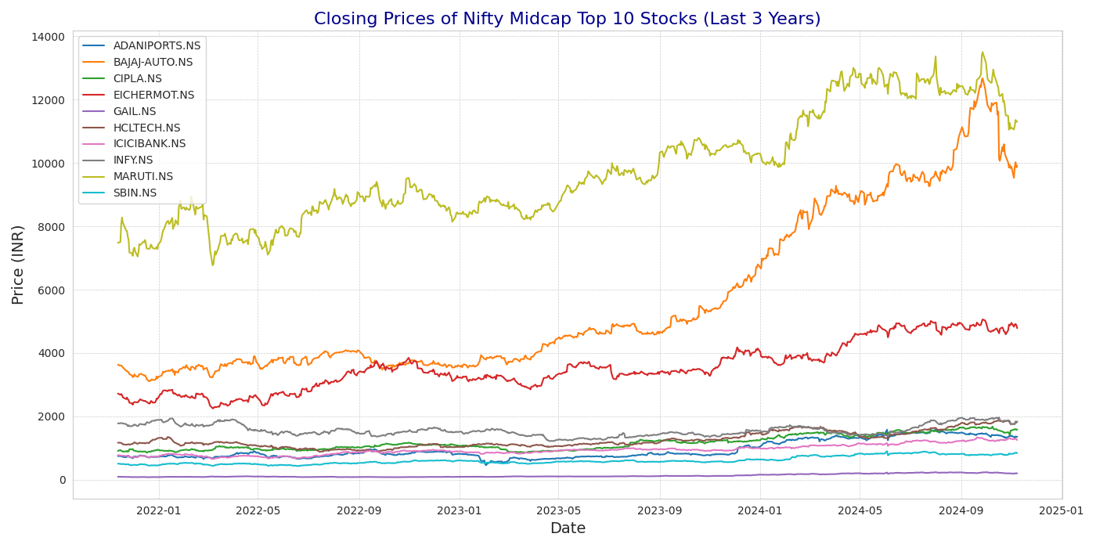
Price Trends Analysis

Slide 6
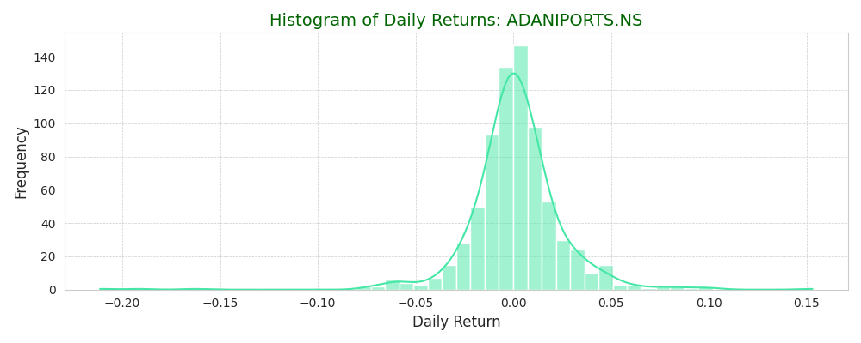
Histogram of Daily Returns: ADANIPORTS.NS

Slide 7
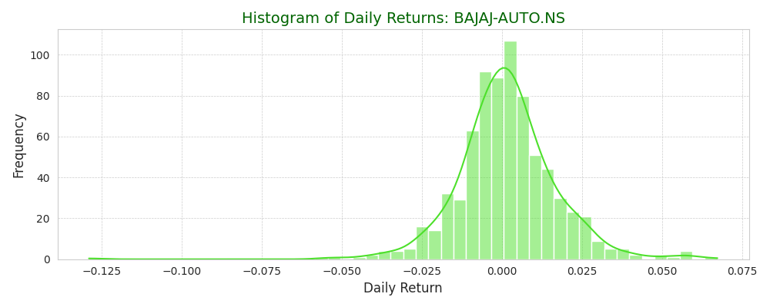
Histogram of Daily Returns: BAJAJ-AUTO.NS

Slide 8
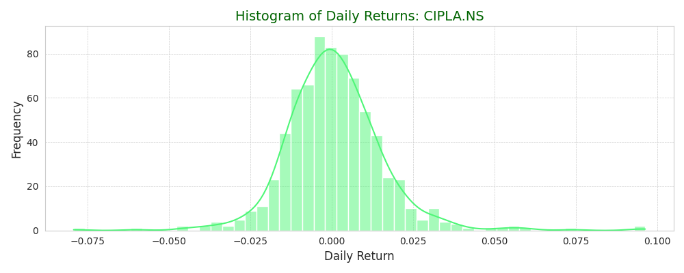
Histogram of Daily Returns: CIPLA.NS

Slide 9
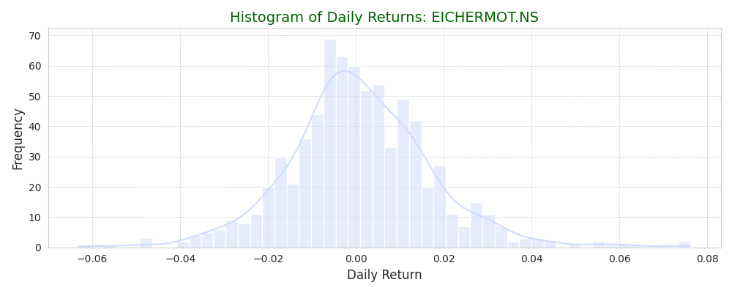
Histogram of Daily Returns: EICHERMOT.NS

Slide 10
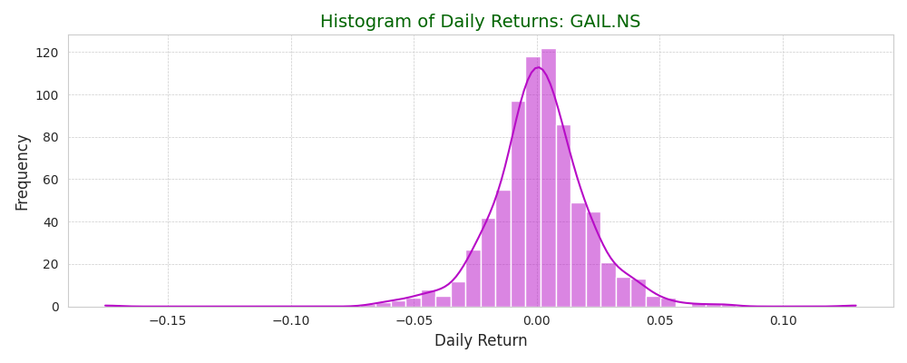
Histogram of Daily Returns: GAIL.NS

Slide 11
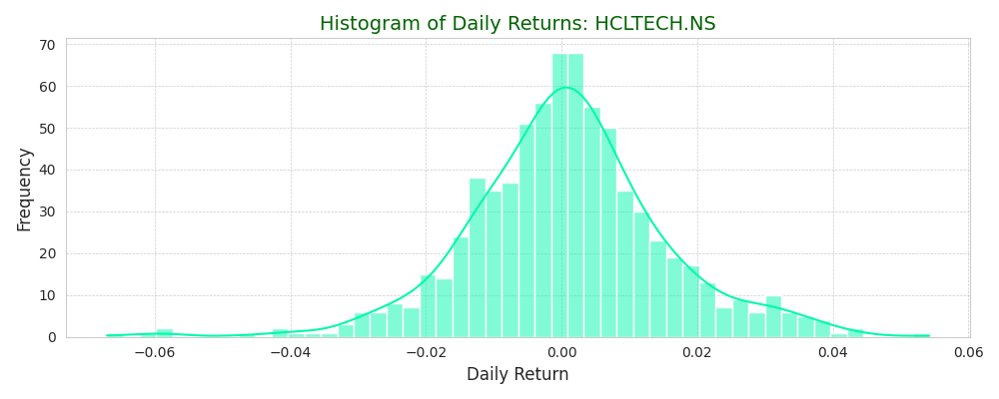
Histogram of Daily Returns: HCLTECH.NS

Slide 12
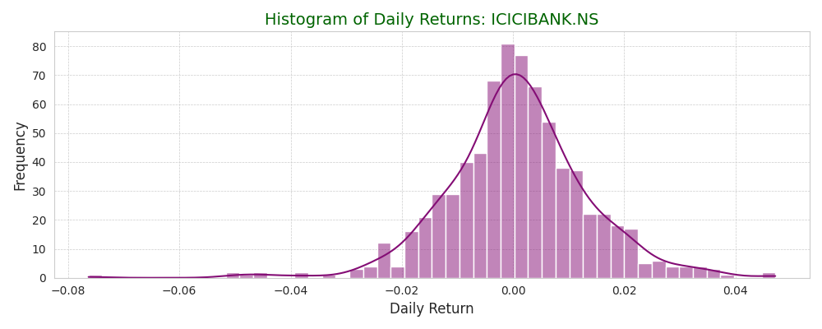
Histogram of Daily Returns: ICICIBANK.NS

Slide 13
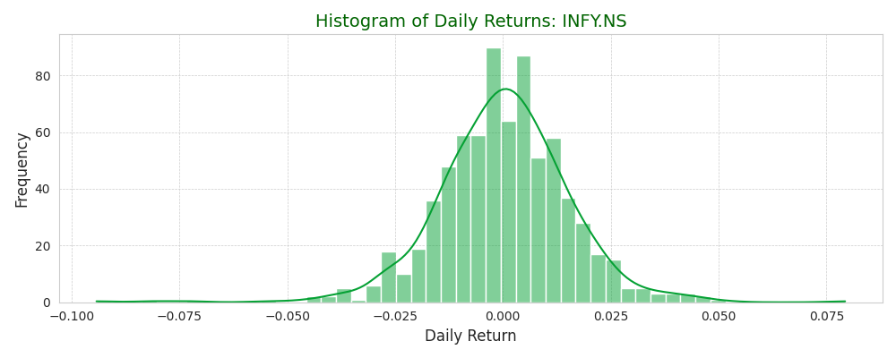
Histogram of Daily Returns: INFY.NS

Slide 14
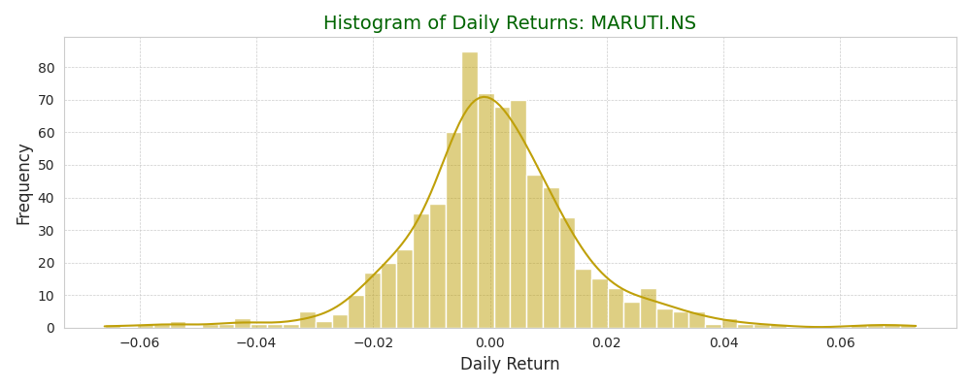
Histogram of Daily Returns: MARUTI.NS

Slide 15
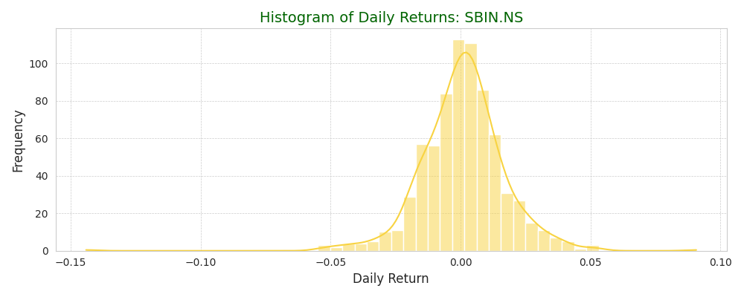
Histogram of Daily Returns: SBIN.NS

Slide 16
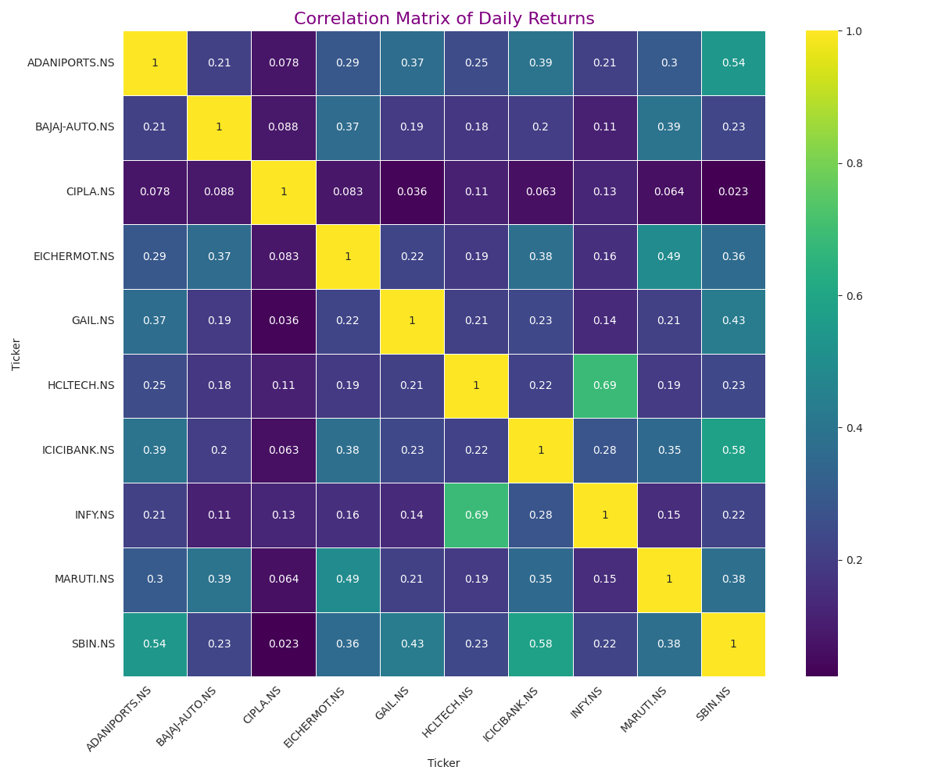
Correlation Matrix of Daily Returns

Slide 17
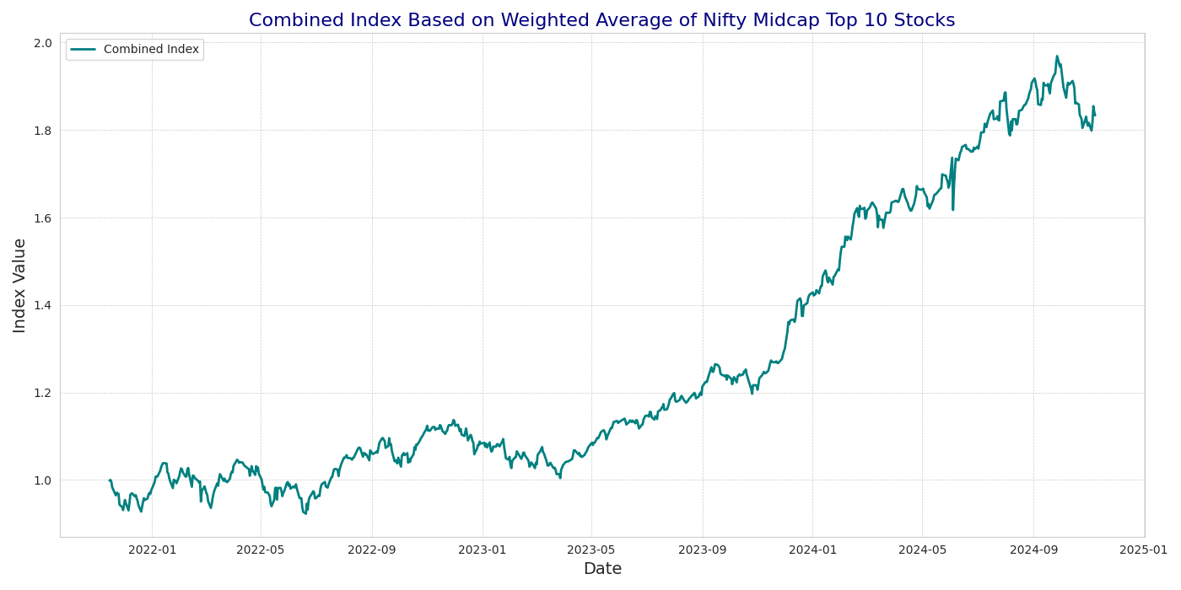
Combined Index Construction

Slide 18
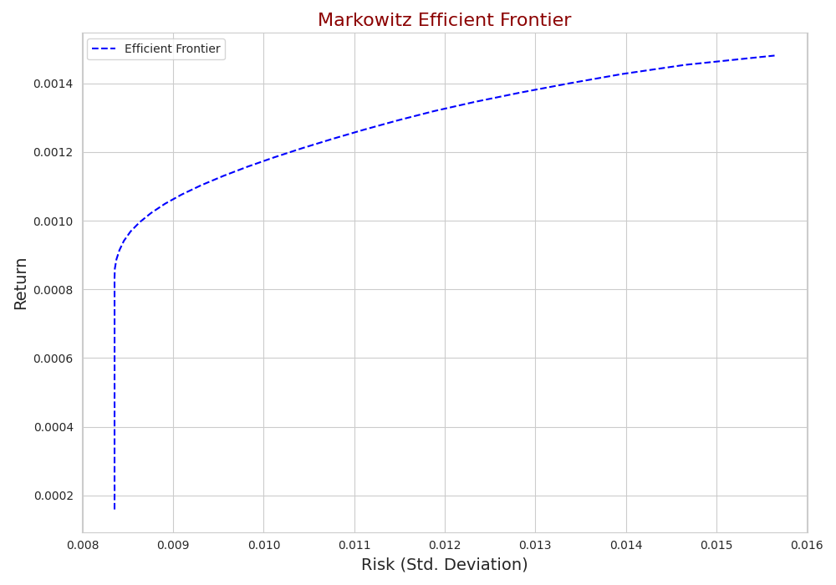
Markowitz Efficient Frontier

Slide 19
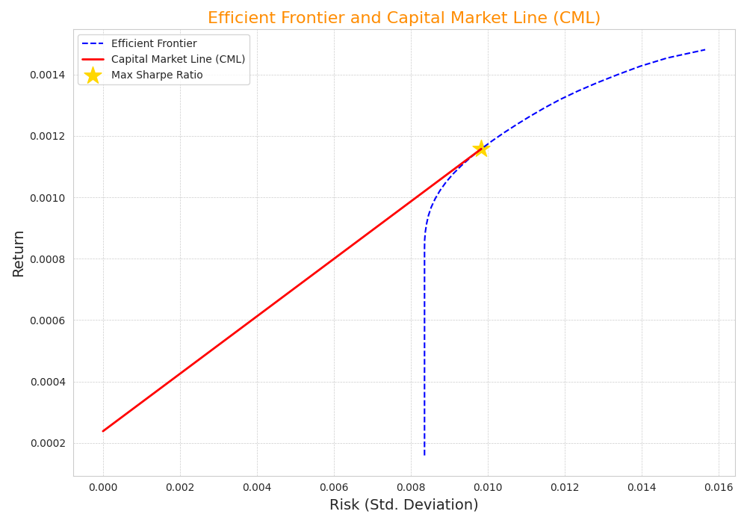
Efficient Frontier and Capital Market Line (CML)

Slide 20
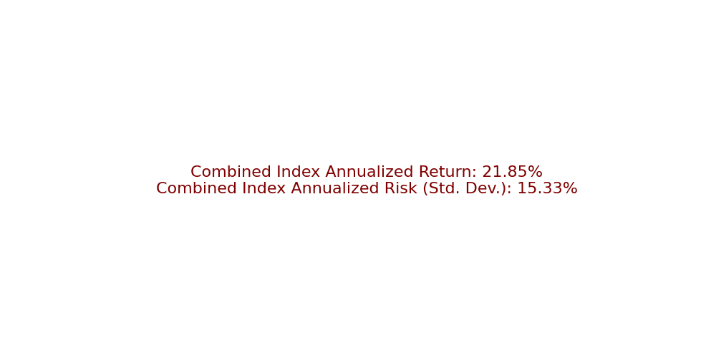
Combined Index Performance

Slide 21
Conclusion
Summary of Findings:
- Key performance drivers identified.
- Risk assessment completed.
- Diversification benefits observed.
Recommendations:
- Consider portfolio adjustments based on optimization results.
- Future analysis to incorporate more assets or different optimization techniques.

Slide 22
Questions & Answers
Thank you! Any questions?

