Slide 1
Predictive Analytics for Demand Forecasting: Leveraging Machine Learning Models in Small-Scale Industries And Shops

Slide 2
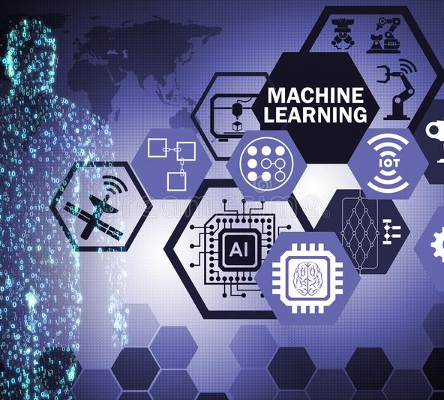
Introduction
Predictive Analytics uses smart Machine learning models to help small shops guess what customers might want to buy in the future. By looking at past sales and patterns, these models can guess what people will buy next. This helps shop owners make just the right amount of stuff, so they don't have too much left over or run out of things to sell. These special techniques make running a shop better and save money by making sure they have enough things to sell without wasting anything. It's like having a crystal ball to know what customers will want!

Slide 3
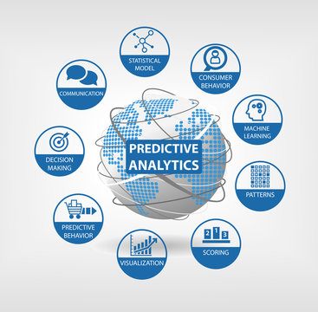
What is Predictive Analytics?
Predictive analytics is like using smart math to look at how things happened before and guess what might happen in the future. When it comes to guessing how much of something people will want to buy, like in small shops, we can use predictive analytics to guess how much we'll need to have in stock. It looks at things like when people usually buy more, if there are any special deals, and how other shops are pricing things. This helps the shop make sure they have enough stuff for customers without having too much left over. It's like a crystal ball that helps small shops plan better and make more money.

Slide 4
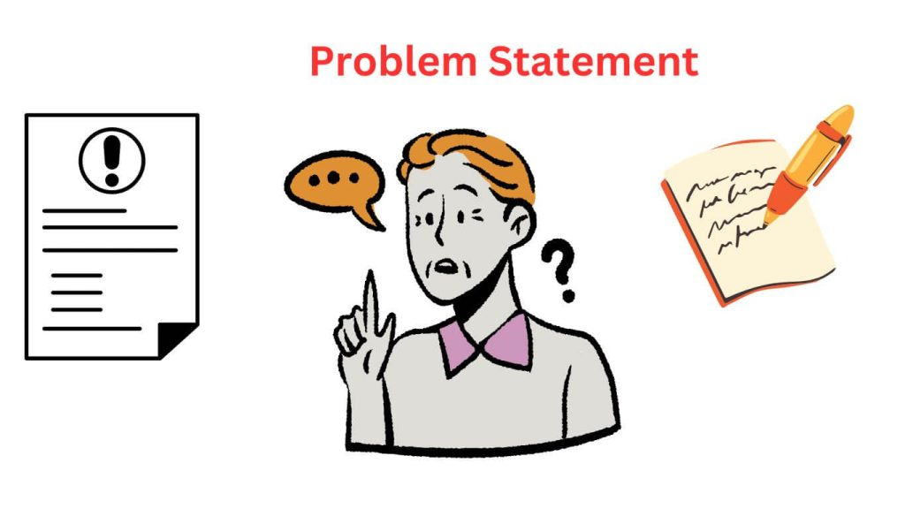
Problem Statement
Small-scale shops often struggle to predict how much of their products they will sell, leading to wasted inventory and lost revenue. The traditional methods they use for guessing future demand aren't very accurate. We want to find a better way for these small shops to know how much they'll sell by using computers and math. This will help them buy and stock the right amount of products, save money, and make more profit.

Slide 5
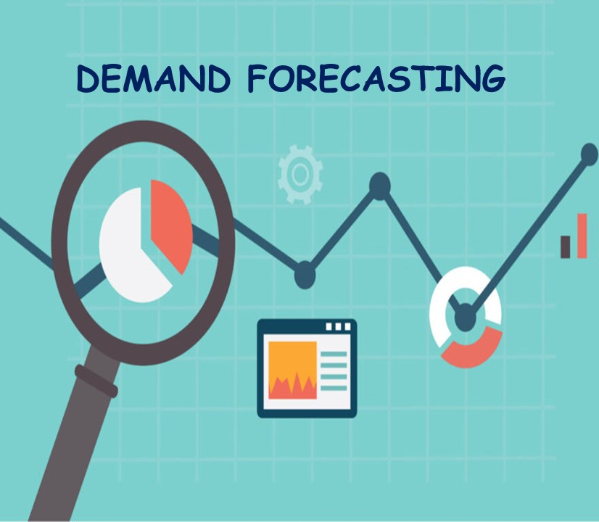
Traditional Demand Forecasting Methods
Traditional demand forecasting methods, such as time-series analysis and regression analysis, have limitations that can lead to inaccurate predictions. For example, time-series analysis assumes that past patterns will continue into the future, which may not always be the case. Regression analysis relies on a linear relationship between variables, which may not exist in real-world scenarios.
Furthermore, these methods do not take into account external factors that can impact demand, such as changes in consumer behavior or market trends. This can result in missed opportunities or excess inventory, leading to financial losses for businesses.

Slide 6
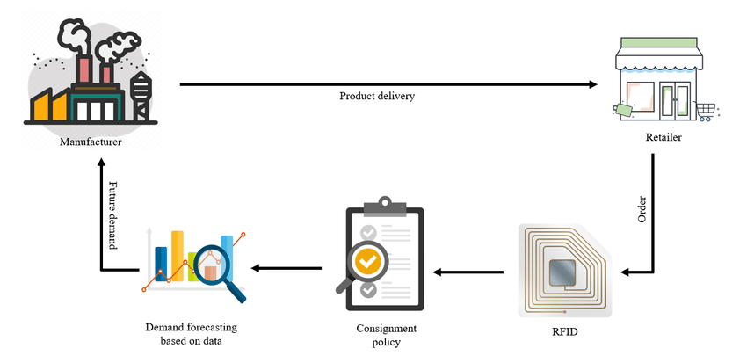
Machine Learning for Demand Forecasting
Machine learning is a powerful tool for demand forecasting that differs from traditional methods in several ways. Unlike time-series analysis or regression analysis, which rely on historical data and assumptions about future trends, machine learning algorithms can analyze large and complex datasets to identify patterns and make accurate predictions.
One advantage of machine learning is its ability to handle non-linear relationships between variables, such as the impact of weather on consumer behavior. Another advantage is its ability to adapt to changing conditions and learn from new data over time, improving forecast accuracy. For example, a retail company used machine learning to predict which products would sell out during a promotion, resulting in a 20% increase in sales and a reduction in inventory costs.

Slide 7
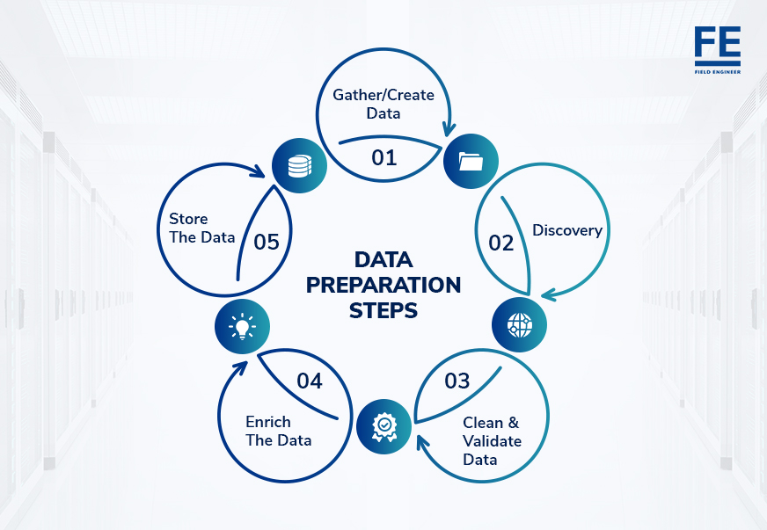
Data Preparation
Data is gathered by recording daily fruit usage in a spreadsheet. This involves tracking the quantities of different fruits like Apples, Bananas, Oranges, and Grapes used each day throughout the year. The data is collected manually or through automated systems that log fruit consumption. Each row in the spreadsheet represents a day, while columns represent different fruit types. The numbers in the cells depict the amount of each fruit utilized that day. This dataset offers a basis for predicting future demand patterns using machine learning algorithms

Slide 8
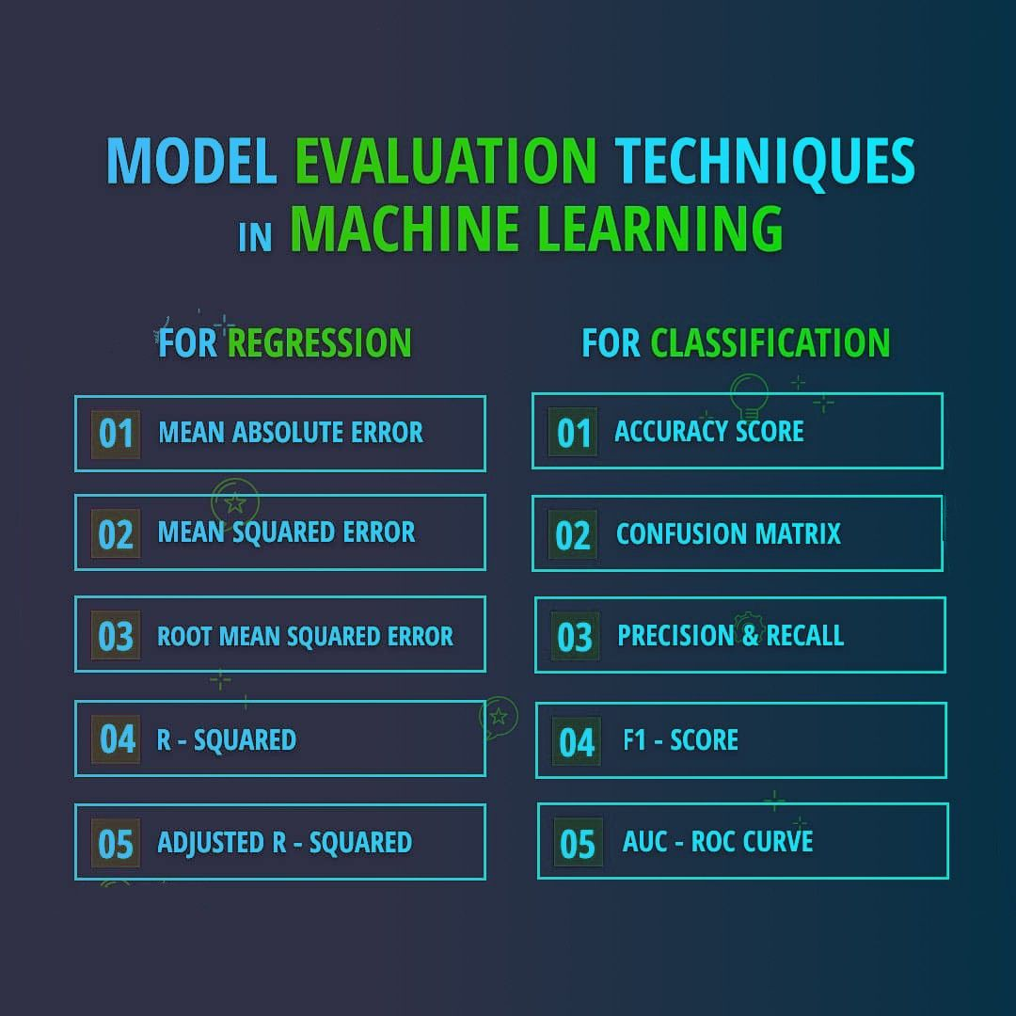
Model Training and Evaluation
Model training and evaluation involves my model to predict future outcomes based on past data. In our case, using the fruit usage dataset, the model learns how different fruits are used over time. It analyzes patterns like seasons and trends . After training, we give the model new data it hasn't seen before and see how well it predicts the fruit usage. We compare its predictions to the actual usage to measure its accuracy we check if the model predicts correctly. This helps us understand if the model is reliable and if we can trust its predictions for demand forecasting in my shop.

Slide 9
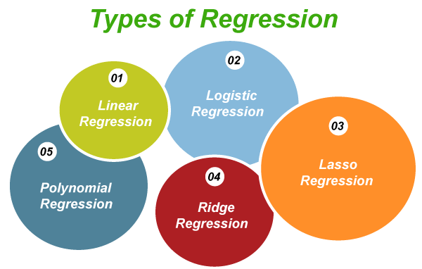
Machine Learning Models Used:
I used different types of machine learning techniques such as,
Linear Regression.
Polynomial Regression.
Stepwise Regression.
Decision Tree Regression.
Random Forest Regression.
Support Vector Regression.
Ridge Regression.
Lasso Regression

Slide 10
The Role of AI in Climatic Prediction for Demand Forecasting
“Changing temperature is changing demand”
To run the shop successfully,we need to know how much fruit to stock each day. But the weather greatly affects how much fruit people buy. AI, which is like a smart computer, helps us predict the weather and how it will impact fruit sales. This is super important because it helps us avoid having too much or too little fruit, reducing waste, and making more money. So, using AI to predict the weather and forecast demand is like having a smart assistant for your fruit shop, making sure you sell just the right amount of fruit to keep your business thriving.

Slide 11
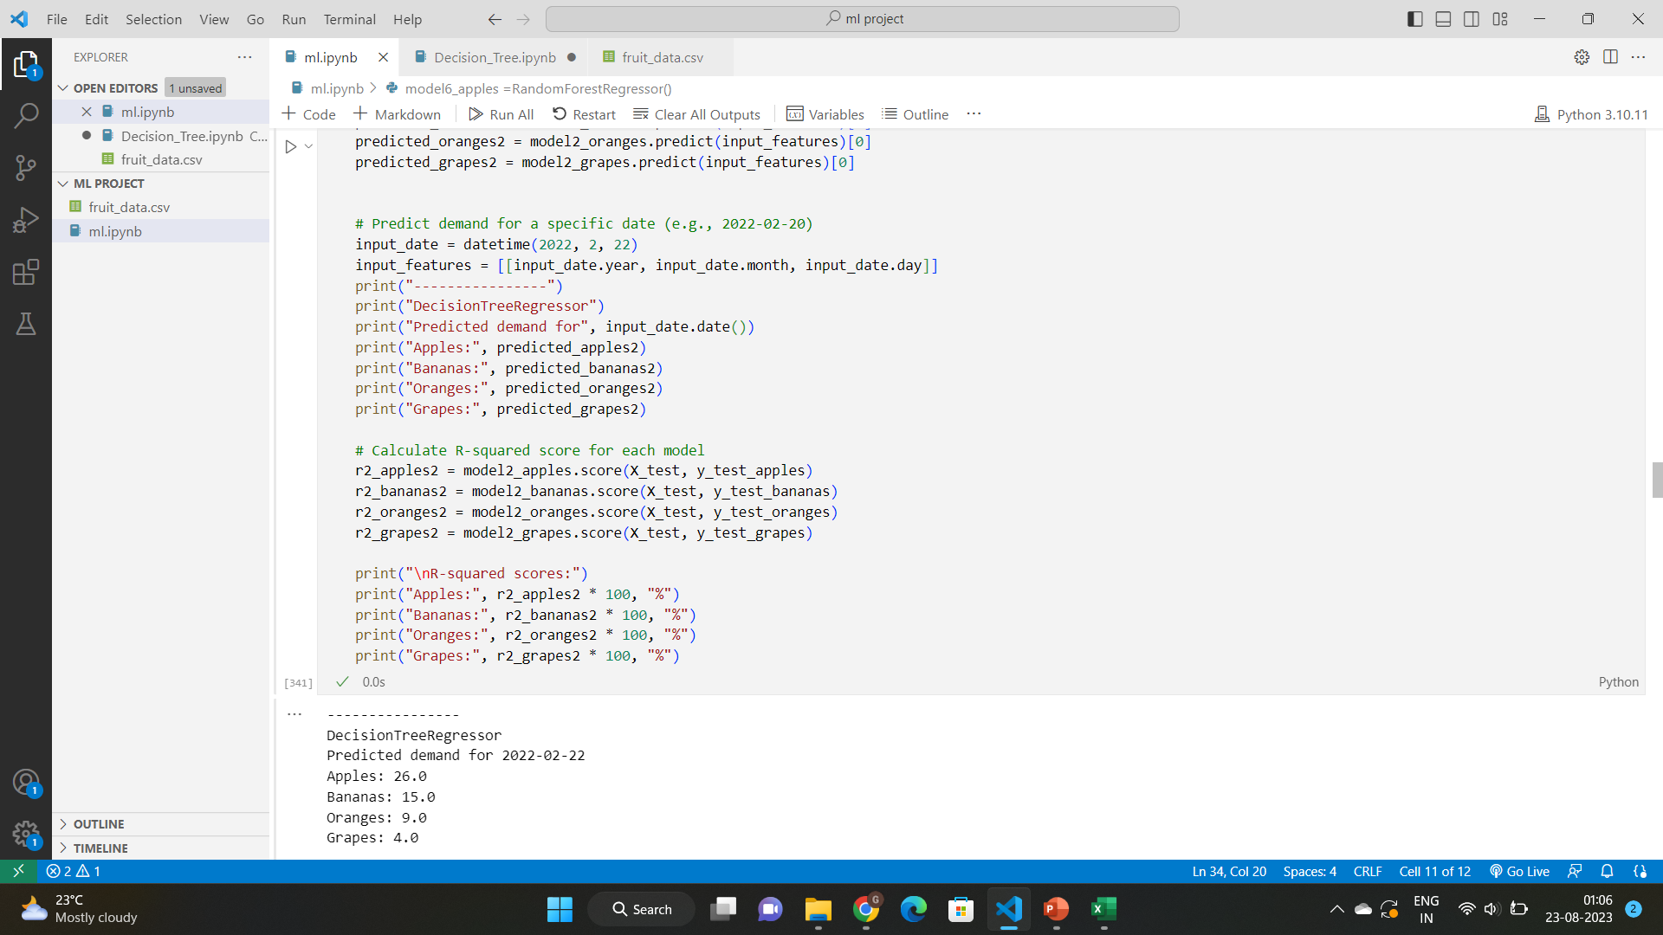
Result on Forecasting Using ML

Slide 12
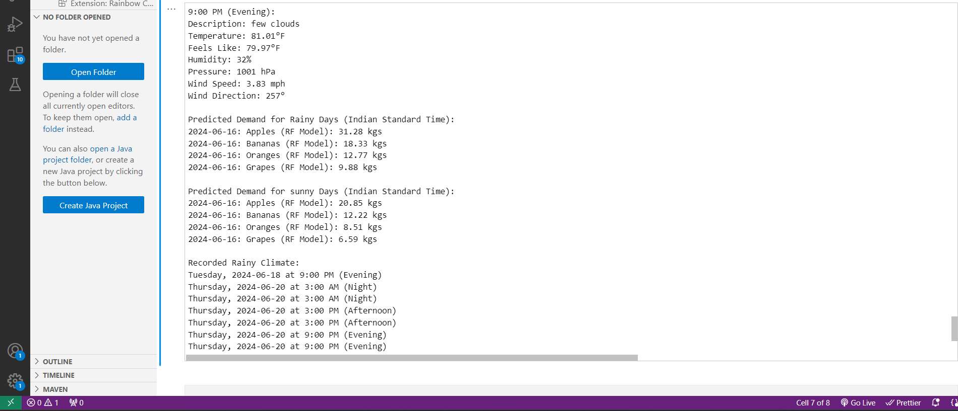
Model Evaluation Using ML and AI

Slide 13
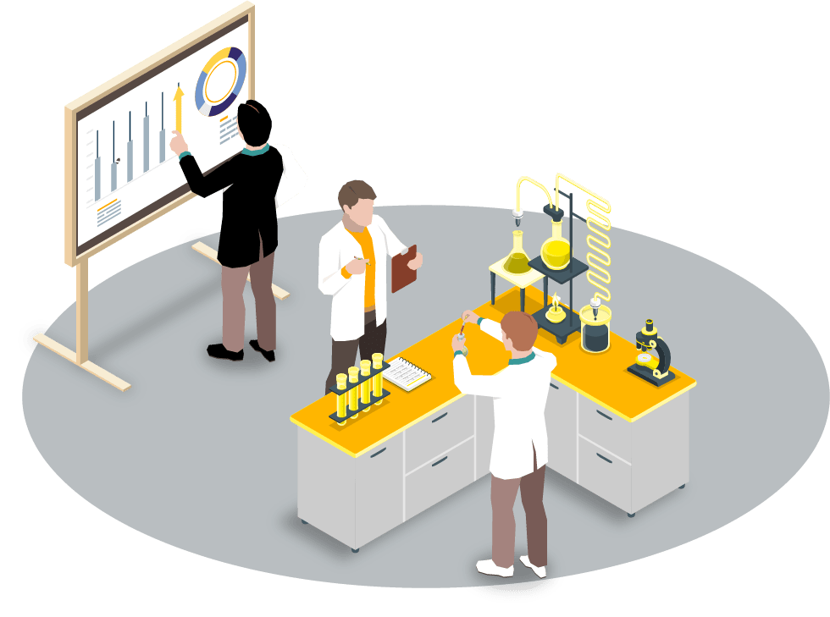
Why RandomForestRegression ?
RandomForestRegression are a preferred choice for our demand forecasting in small-scale shops due to their exceptional performance. After training various algorithms, the RandomForestRegression consistently emerged as the most effective one, displaying remarkable accuracy in predicting future demand patterns.Generally A RandomForestRegression is like a flowchart that helps you make decisions step by step.

Slide 14
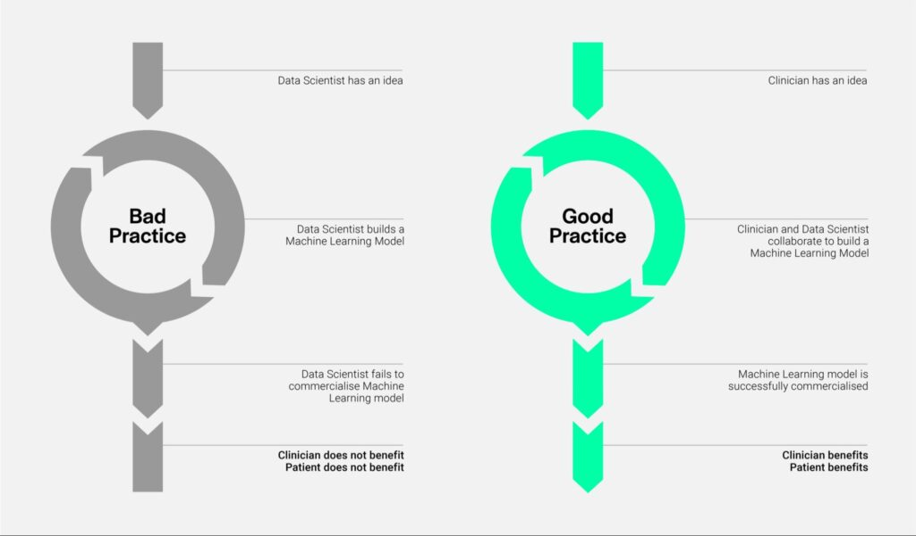
Promoting Demand Forecasting in a small-scale industries or shops:
"Use Data’s to Boost Sales: Predict Future Needs! Technology learns patterns for better inventory, lower expenses, and efficient resource use. Understand customers, prevent overstock or shortages. Decide smart, make customers happy, and earn more. Adjust to market changes, always have products. Follow numbers for smoother work. Beat competition with accurate predictions. Grow your business with smart insights. Shape tomorrow, starting now!"

Slide 15
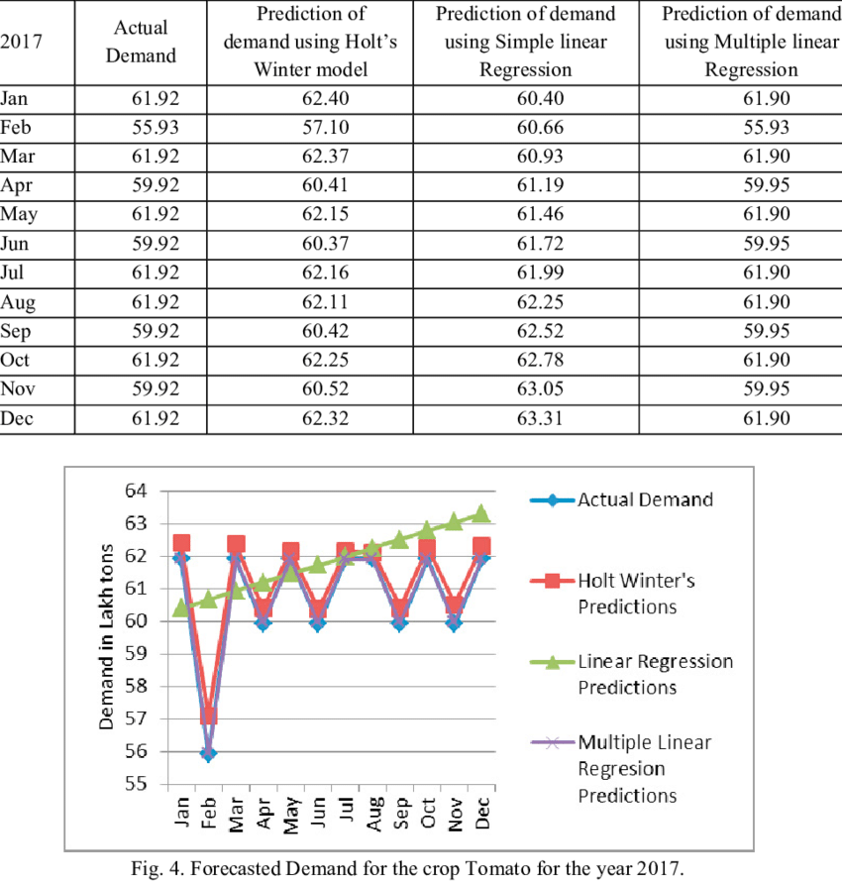
Conclusion
In conclusion, we have seen that predictive analytics using machine learning is a powerful tool for demand forecasting. By leveraging data and advanced algorithms, businesses can make more informed decisions, optimize inventory management, and improve profitability. Traditional methods have limitations that can be overcome with the use of machine learning.
We have discussed the importance of demand forecasting and how it impacts decision-making. We also explored the different types of machine learning models that can be used for demand forecasting, as well as the steps involved in data preparation, model training, and evaluation. Finally, we presented case studies of successful implementations and provided best practices for integrating machine learning into existing systems

Slide 16
Use "AI and ML: Supercharging Humans, Fueling Brilliance."

Slide 17


