Slide 1







SHOP FOR HOME G10

Slide 2

GROUP MEMBERS
CHENNAMSETTI PAVAN KUMAR
DASARI GANESH KUMAR REDDY
GOWTHAM SINGAMSETTI
RAHUL
SAI PAVITRO MISHRA
SALMA SHAIK
Notes:
Now, that you have narrowed your topic, you will want to organize your research in a structure that works. There are some common organizational patterns based on the kind of research you are doing.
Organizational Structures:
Cause and Effect- this kind of structure is great for explaining the causes and effects of a topic
Compare and Contrast- in this pattern you highlight the similarities and differences of the topic
Explain process- this structure is great for outlining a series of steps to follow;
Definition- if you want to make sure your audience understands what something is using illustrations, meanings, clarifying misconceptions, you may want to use this structure
Classification- a common organizational structure is grouping like topics or facts from the research together. For instance, in the internet safety about social media apps, you may organize the research where you look at each social media app one at a time

Slide 3

PROBLEM STATEMENT
SHOP FOR HOME is a popular store in the market for shopping the home decor stuff. Due to Covid 19 all the offline shopping stopped. So, the store wants to move to the online platforms and wants their own web application.
There are 2 users on the application: -
1. User
2. Admin

Slide 4
OBJECTIVES
To allow people to buy physical goods , digital products and make a purchase.
Through SHOP FOR HOME website , a business can process orders.
Find the best solution for their needs.

Slide 5

INTRODUCTION
Furniture items , cloths , home appliances etc ordering is a form
of electronic commerce which allows customers to directly buy
goods from a seller over the internet using web browser.
This SHOP FOR HOME is an application which is based on managing the home décor stuff and sell them online.
Customers can find a product based on type of categories by visiting the
website and searching among alternative products using search functionality.

Slide 6

This project SHOP FOR HOME has been developed in Angular , Java Spring Boot and MySql.
There are two categories of user available in this project.
First one is admin and second one is user . Admin can add the product items and can also manage the sales details.
In this project, customer can see the details of décor items in categories.
Only admin can edit or delete the details of décor items.
Notes:
When conducting research, it is easy to go to one source: Wikipedia. However, you need to include a variety of sources in your research. Consider the following sources:
Who can I interview to get more information on the topic?
Is the topic current and will it be relevant to my audience?
What articles, blogs, and magazines may have something related to my topic?
Is there a YouTube video on the topic? If so, what is it about?
What images can I find related to the topic?

Slide 7
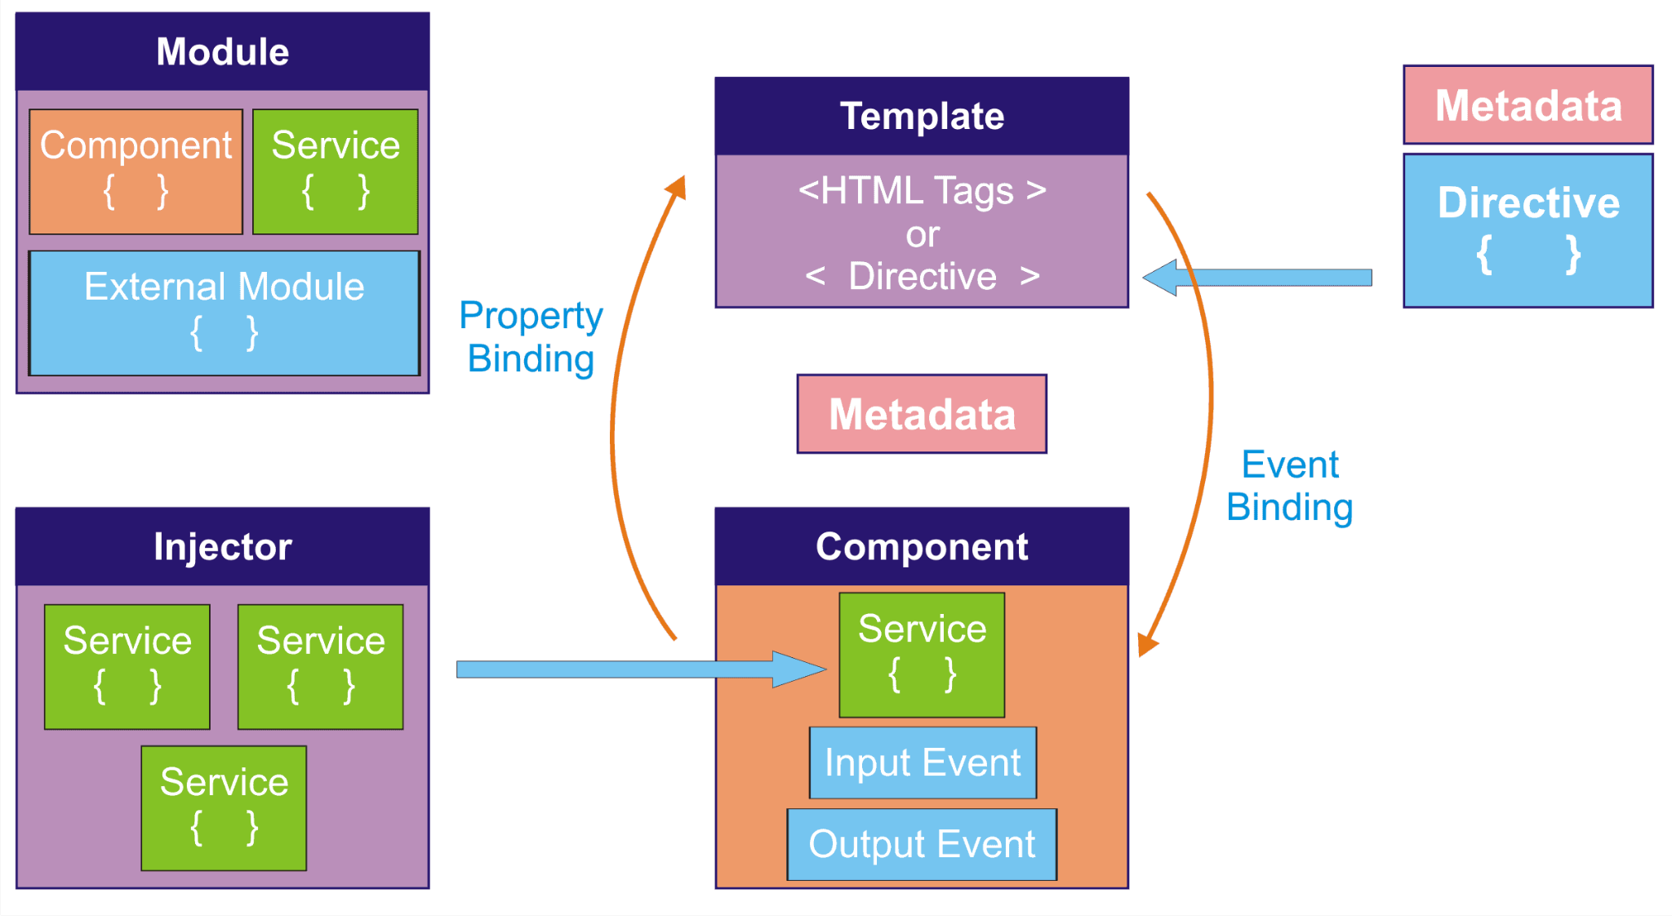
ANGULAR ARCHITECTURE

Slide 8
There are eight main blocks of angular:-
Module
Component
Metadata
Template
Data Binding
Service
Directive
Dependency
Injection
Notes:
After consulting a variety of sources, you will need to narrow your topic. For example, the topic of internet safety is huge, but you could narrow that topic to include internet safety in regards to social media apps that teenagers are using heavily. A topic like that is more specific and will be relevant to your peers. Some questions to think about to help you narrow your topic:
What topics of the research interest me the most?
What topics of the research will interest my audience the most?
What topics will the audience find more engaging? Shocking? Inspiring?

Slide 9
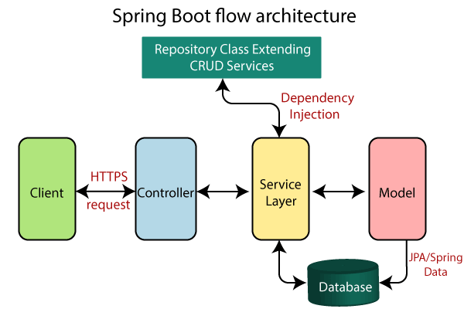
SPRING BOOT ARCHITECTURE

Slide 10
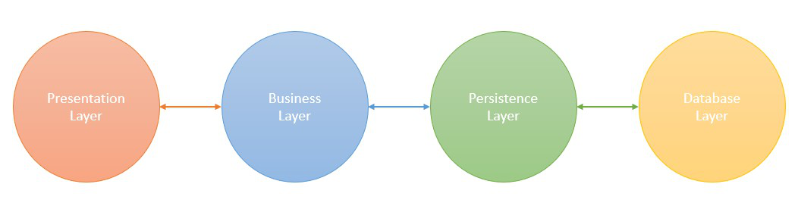
SPRING BOOT LAYER
Presentation layer : Authentication and Json Translation
Business Layer : Business Logic , Validation and Authorization.
Persistence Layer : Storage Logic
Database Layer : Actual Database

Slide 11

CONTROLLER
Responsible for processing incoming API requests.
Returning the view to be rendered as a response.
Annotations
- @Controller
- @ResponseBody
- @RestController
ENTITY
Classes represent entities
Mapped to database table
Annotations
- @Entity
- @Id
- @NotNull
Notes:
After consulting a variety of sources, you will need to narrow your topic. For example, the topic of internet safety is huge, but you could narrow that topic to include internet safety in regards to social media apps that teenagers are using heavily. A topic like that is more specific and will be relevant to your peers. Some questions to think about to help you narrow your topic:
What topics of the research interest me the most?
What topics of the research will interest my audience the most?
What topics will the audience find more engaging? Shocking? Inspiring?

Slide 12
REPOSITORY
Standard way of persisting java objects into relational database.
It is an Interface
Contains APIs for basic CRUD operations
Syntax
- JpaRepository<Classname,DataType>
SERVICE
Business Logic
Injected in Controller Class
Annotation
- @Service
Notes:
When conducting research, it is easy to go to one source: Wikipedia. However, you need to include a variety of sources in your research. Consider the following sources:
Who can I interview to get more information on the topic?
Is the topic current and will it be relevant to my audience?
What articles, blogs, and magazines may have something related to my topic?
Is there a YouTube video on the topic? If so, what is it about?
What images can I find related to the topic?

Slide 13
SECURITY
Provides J2EE application security services.
Helps to secure applications
User control access
Provides Authentication and Authorization
Key Terminologies
- Authentication
- Authorization
- Principal
- Granted Authority
- Role
Notes:
Now, that you have narrowed your topic, you will want to organize your research in a structure that works. There are some common organizational patterns based on the kind of research you are doing.
Organizational Structures:
Cause and Effect- this kind of structure is great for explaining the causes and effects of a topic
Compare and Contrast- in this pattern you highlight the similarities and differences of the topic
Explain process- this structure is great for outlining a series of steps to follow;
Definition- if you want to make sure your audience understands what something is using illustrations, meanings, clarifying misconceptions, you may want to use this structure
Classification- a common organizational structure is grouping like topics or facts from the research together. For instance, in the internet safety about social media apps, you may organize the research where you look at each social media app one at a time

Slide 14
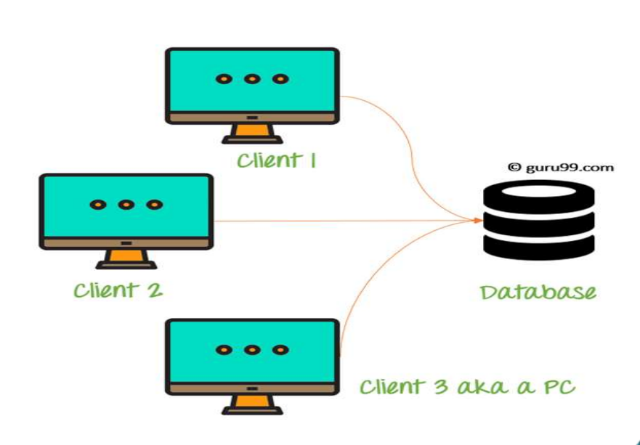
ENTITIES IN DATABASE
- cart
- discount
- order_main
- product_category
- product_in_order
- product_info
- users
- wishlist

Slide 15
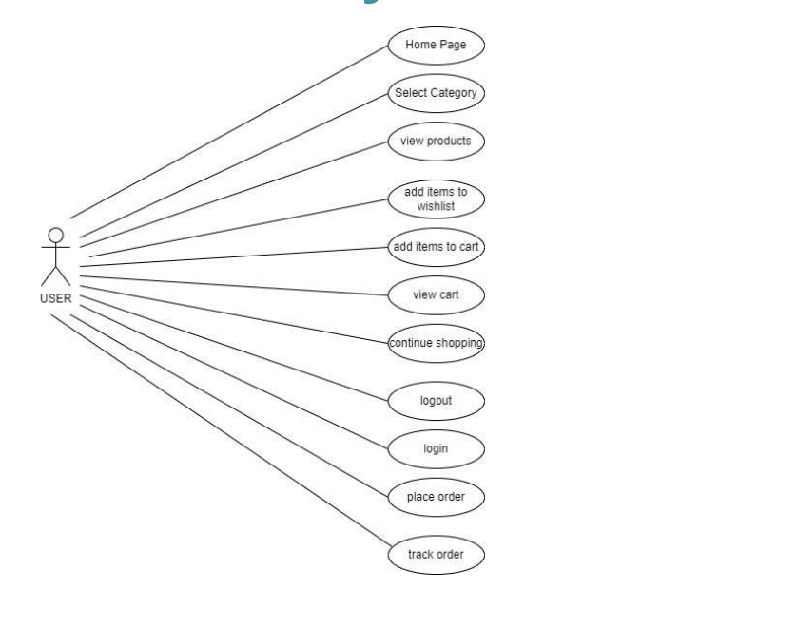
FUNCTIONALITY OF USER

Slide 16
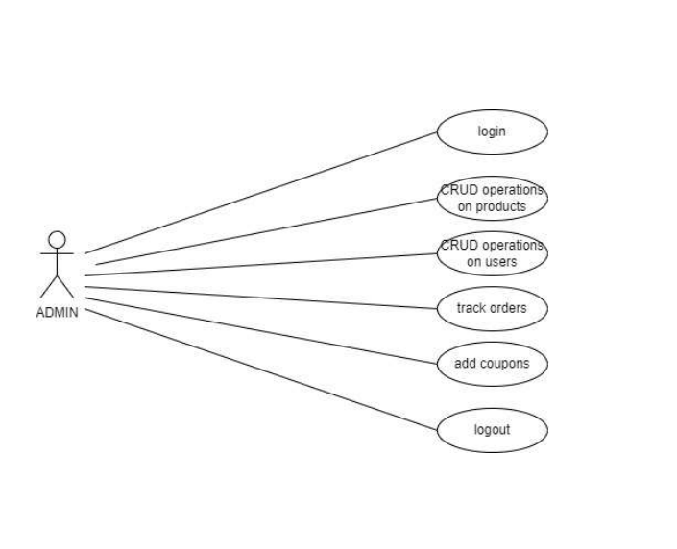
FUNCTIONALITY OF ADMIN

Slide 17
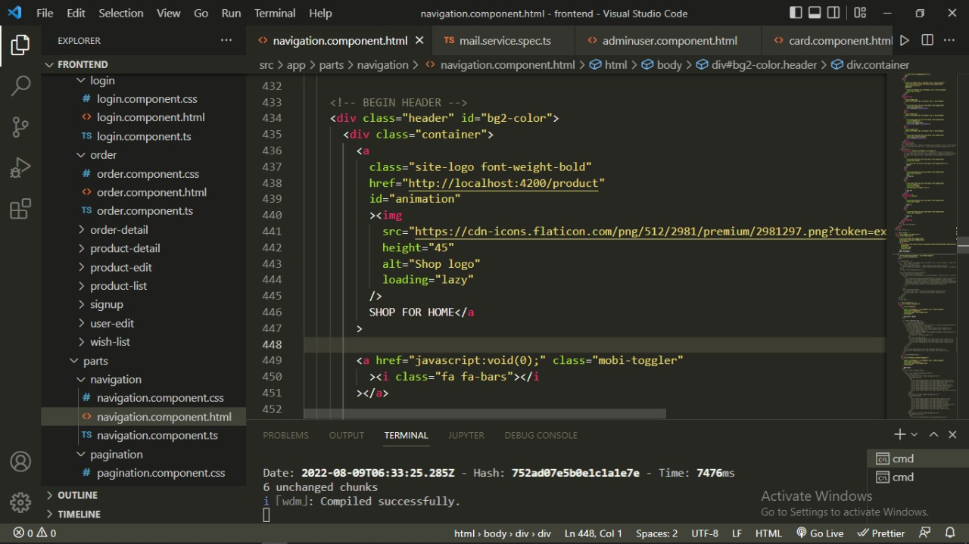
STRUCTURE OF FRONTEND

Slide 18
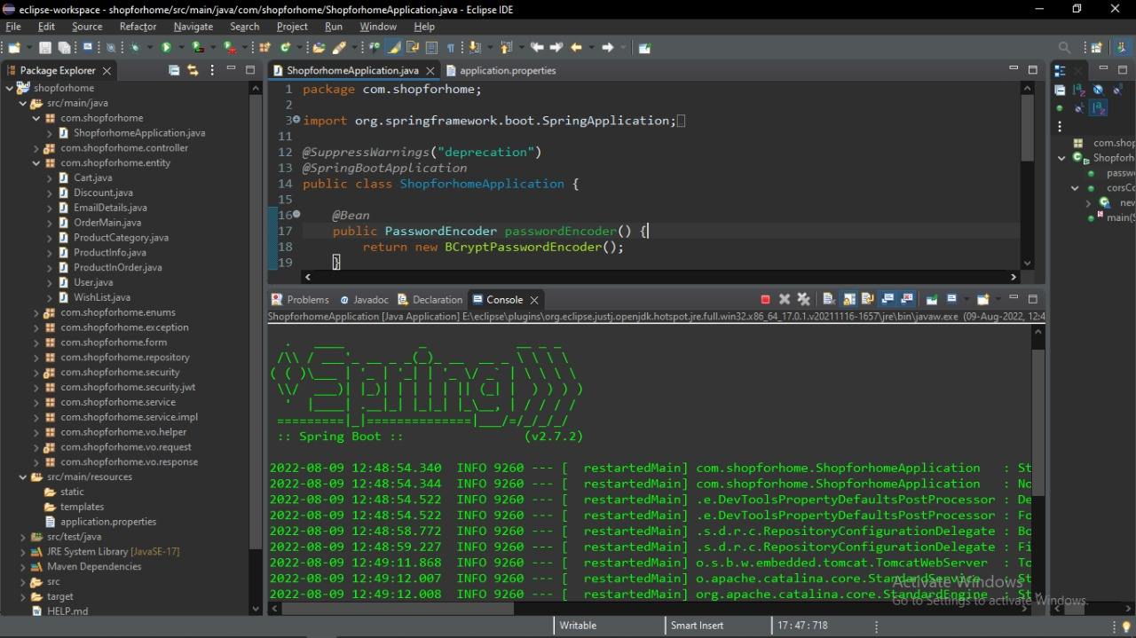
STRUCTURE OF BACKEND

Slide 19
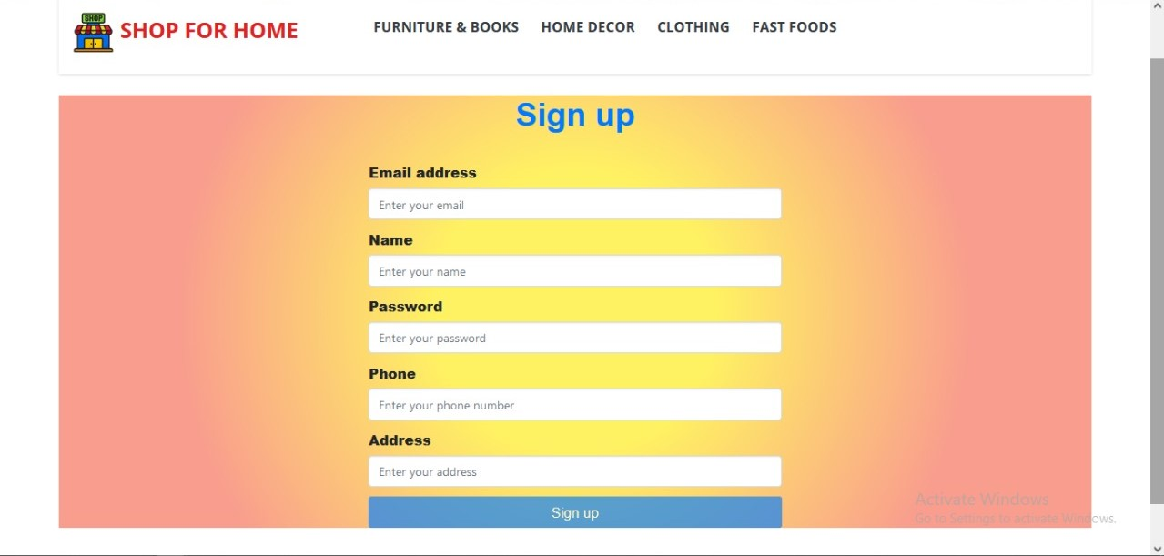
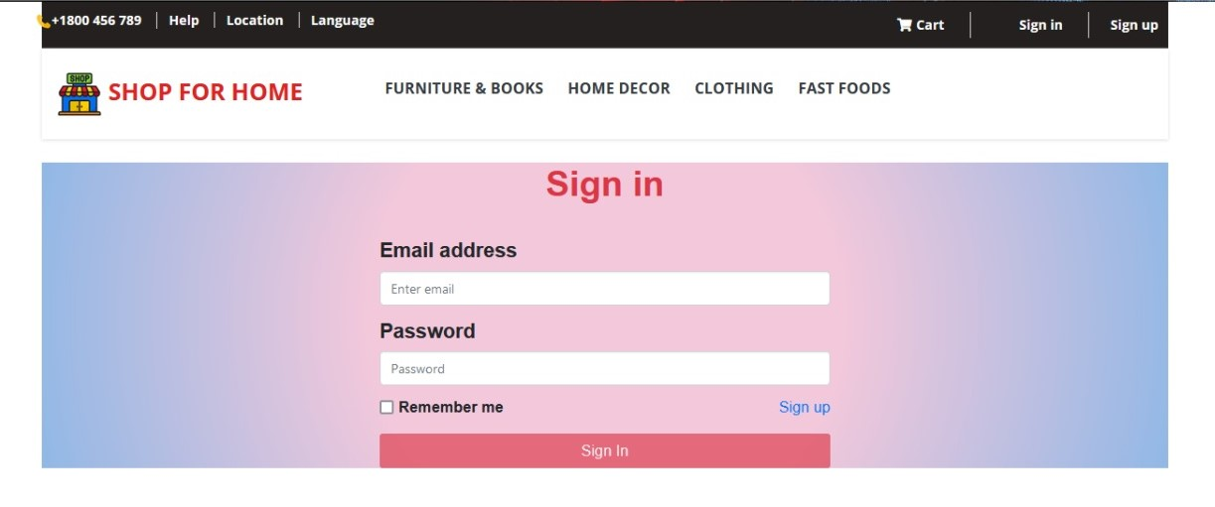
CUSTOMER REGISTRATION
CUSTOMER LOGIN

Slide 20
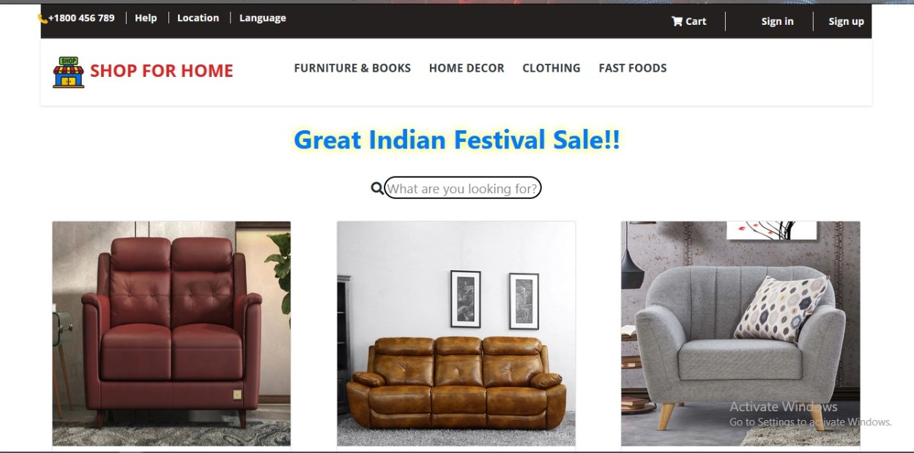
HOME PAGE

Slide 21
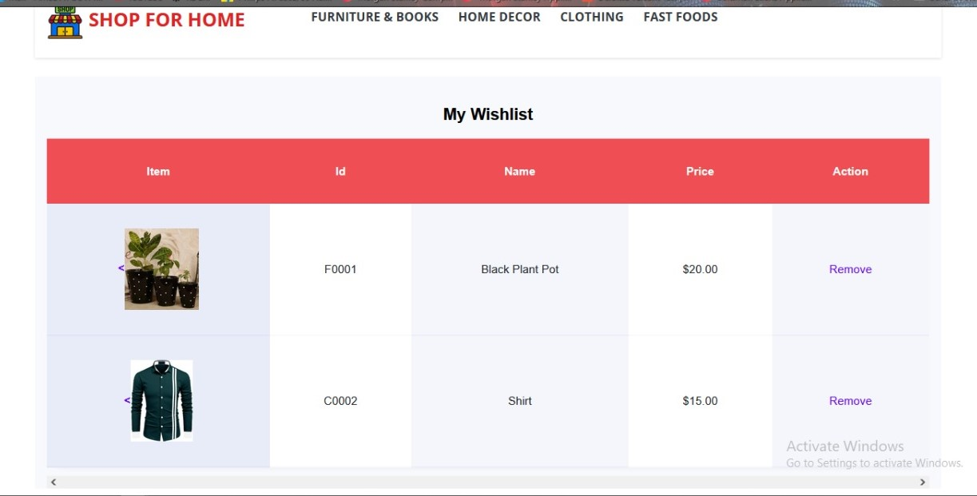
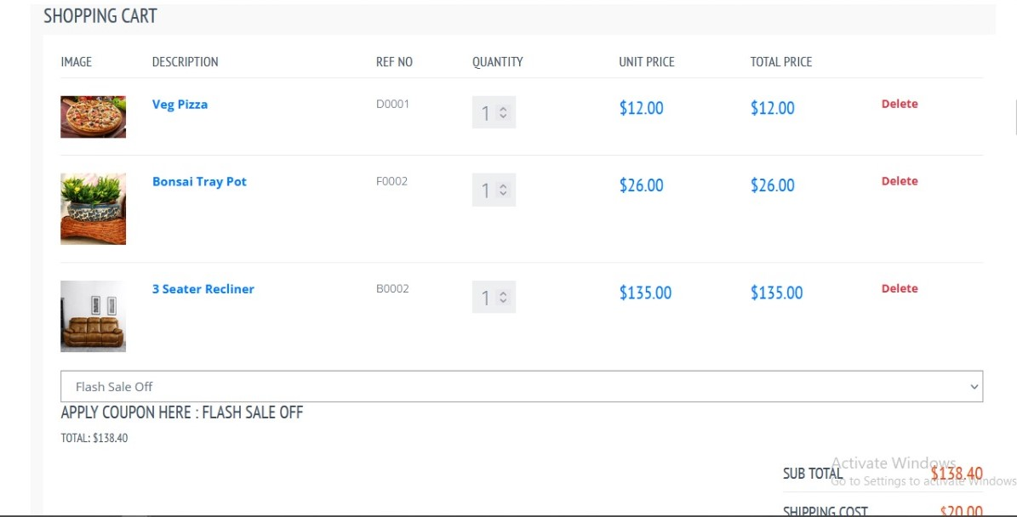
WISH LIST
CART

Slide 22
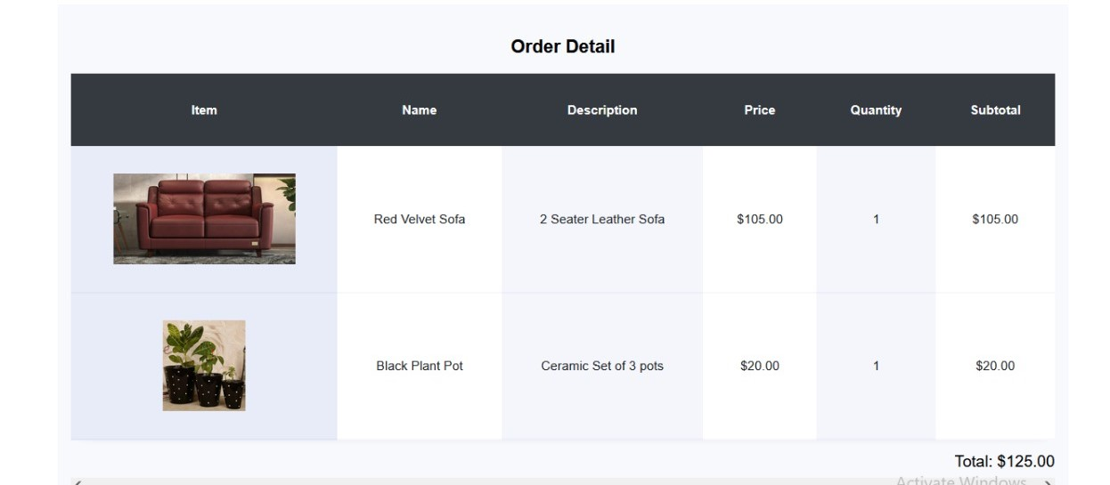
ORDER DETAILS

Slide 23


CONCLUSION
Thus, we developed a web application so that the store can extend their business on online platforms
This web application provides more convenience for both vendors and customers, so that customers don’t have to travel during these hard times and the business will continue to run.
Notes:
After you’ve done your research, it’s time to put your presentation together. The first step in the process is to introduce the topic. This is a great time to connect your topic to something that your audience can relate. In other words, why should they listen to all the information you will be sharing in your research presentation? What is in it for them? You may also want to include a graphic or image to grab their attention.
Feel free to duplicate this slide by right-clicking on this slide in the slides pane to the left and select Duplicate Slide.
The next step in your presentation is to state your claim or topic clearly. Your teacher may even call this your thesis. As you state your thesis, you may find that this layout is not the best layout for your claim or topic. You can change the layout by clicking the drop-down menu next to the Layout in the Slides menu section. You can choose Two Content, Comparison, or Picture with Caption. Note: A different layout might change the look of the icons on this page.
You will also want to state your facts. You have done the research now share some of the interesting facts with your audience. Facts do not have to be boring; you can communicate facts in a variety of ways by going to the Insert Tab. In the Insert tab you can:
Insert pictures from your computer or online.
Add a chart
Create some SmartArt
Insert a variety of icons to help your facts come to life. Note: You can change the color of the icons by selecting the icon and then click on the Format tab and then Graphics Fill. From there, you will choose a color from the list or choose More Fill Colors to give you more options.
Since this research presentation is a result of your hard work and searching, you want to make sure you support the claims or points in your presentation with facts from your research findings. Make sure you give the author proper credit for helping you share your ideas. If one of your sources has a video that is relevant to your topic, you can add the video as added support. Keep in mind the length of the video and the amount of time you have for your presentation. For a 5 minute speech, the video should be no longer than 30 seconds.
Questions to consider:
How will you state the author of the source?
Will you need to cite the source on the slide?
What are some ways you can engage your audience so they feel like they are a part of the presentation? Some ideas to consider is by taking a quick poll like: by a show of hands, how many of you think school uniforms are a way to cut down on bullying? Another suggestion is to have them hold up a certain number of fingers to see if they agree or disagree. Finally, you can share a story that the audience can relate to that makes them laugh.
After all the applause, your audience may have some questions. Be prepared to answer some of their questions by making a list of questions you think they might ask. You may also want to share the presentation with them by providing the link to your presentation, if they want more information.

Slide 24


