Slide 1
Advanced SQL – IMDB Dataset Analysis
Gowthaman.s
DADS-March-2025
20-05-2025

Slide 2
Introduction to Dataset
Dataset is a simplified version of IMDb containing:
• Movie details (title, year, duration, country, languages, production company)
• Genres, Ratings, Director Mapping
• Actor/Actress Role Mapping
• People info including name, birthdate, height, known movies
• Ratings: average, median, total votes

Slide 3
Project Objective
• Reinforce key SQL concepts: joins, aggregation, filtering, grouping
• Extract meaningful insights from a movie dataset
• Present findings clearly with SQL code, screenshots, and presentation

Slide 4
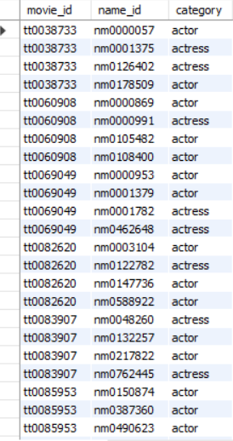
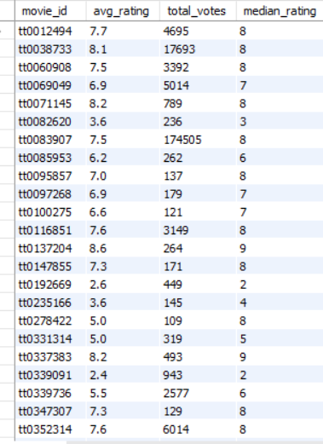
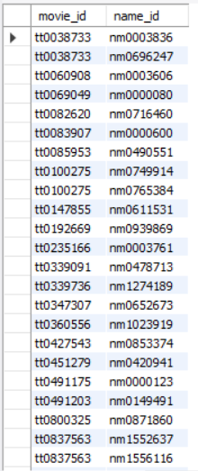
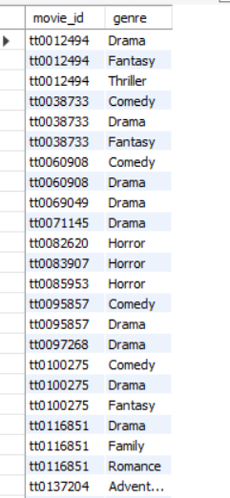
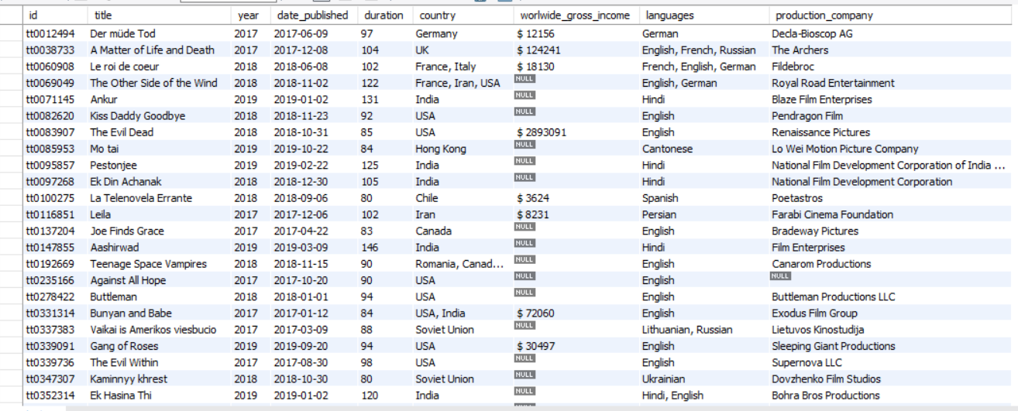
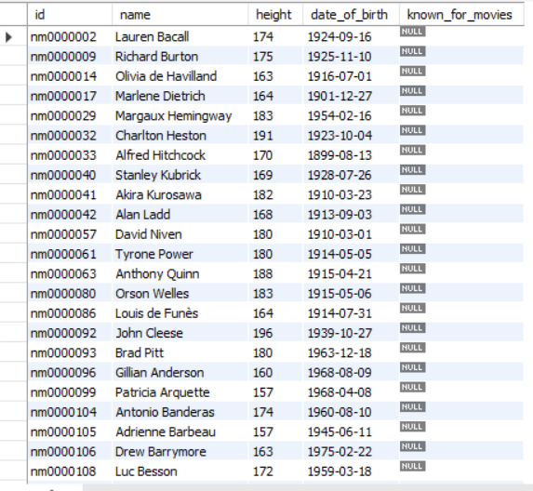
Role_Maping
Ratings
Director Mapping
Genre
Movie
Names

Slide 5
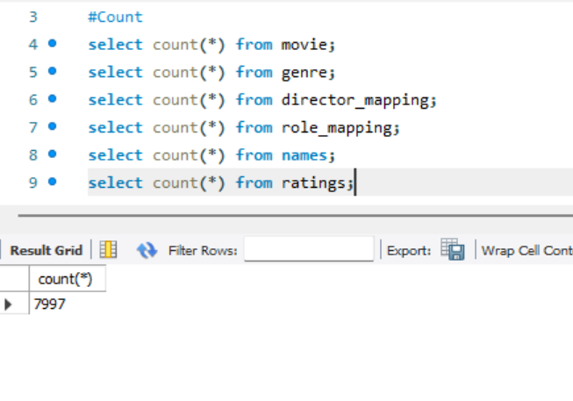
Count the total number of records in each table of the database.

Slide 6
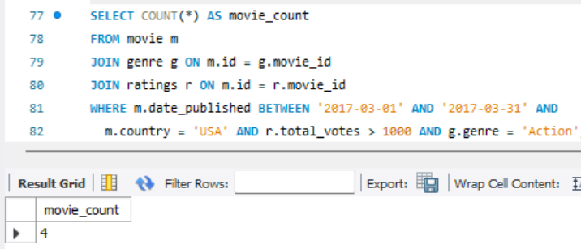
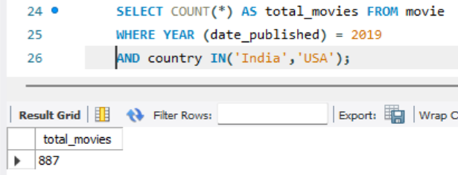
released in March 2017 in the USA within a specific genre, had more than 1,000 votes
How many movies were produced in either the USA or India in the year 2019

Slide 7
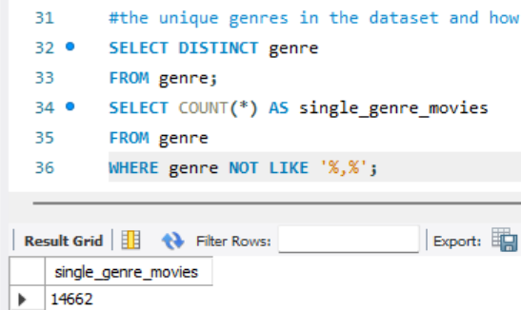
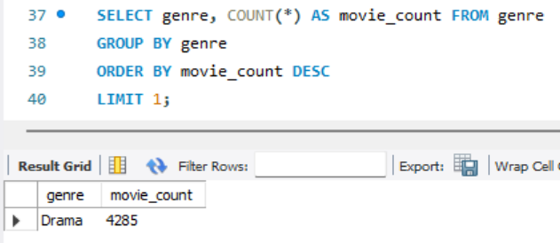
List the unique genres in the dataset, and count how many movies belong exclusively to one genre.
Which genre has the highest total number of movies produced

Slide 8
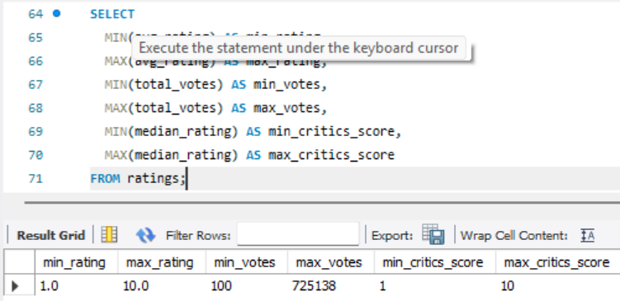
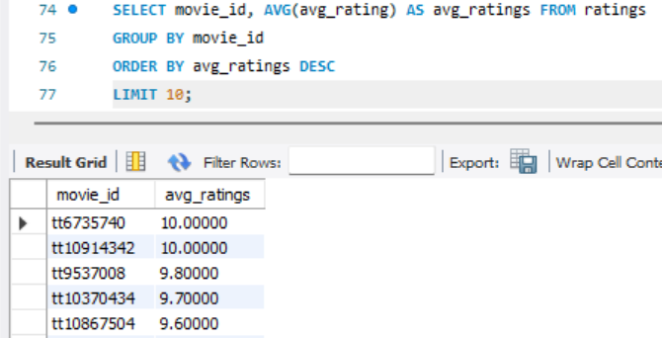
Find the minimum and maximum values for each column in the ratings table, excluding the movie_id column.
Which are the top 10 movies based on their average rating.

Slide 9
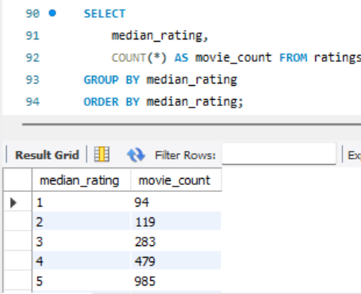
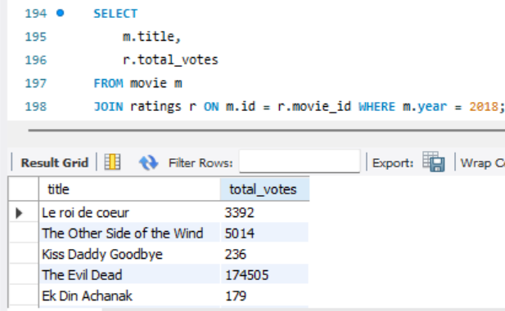
Summarize the ratings table by grouping movies based on their median ratings
Determine the total number of votes for each movie released in 2018

Slide 10
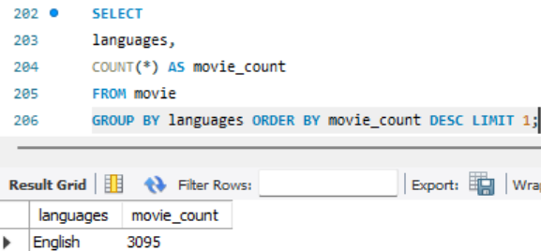
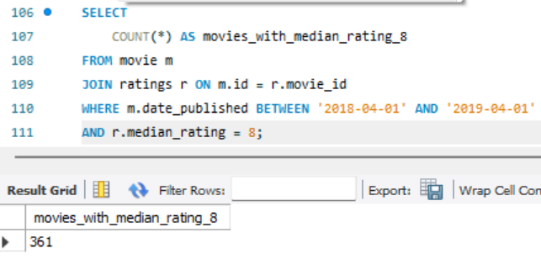
What is the most common language in which movies were produced
Of the movies released between April 1, 2018, and April 1, 2019, how many received a median rating of 8

Slide 11
Conclusion
Genre Popularity Drama, Comedy, and Action stood out as the most frequently featured genres, underscoring their lasting popularity with audiences.
Highly Rated Films A number of movies earned average ratings exceeding 8.5, demonstrating widespread praise from both critics and viewers.
Consistently Active Directors Multiple directors appeared repeatedly in the dataset, indicating a history of continuous creative work and industry acknowledgment.

Slide 12


Slide 13


Slide 14
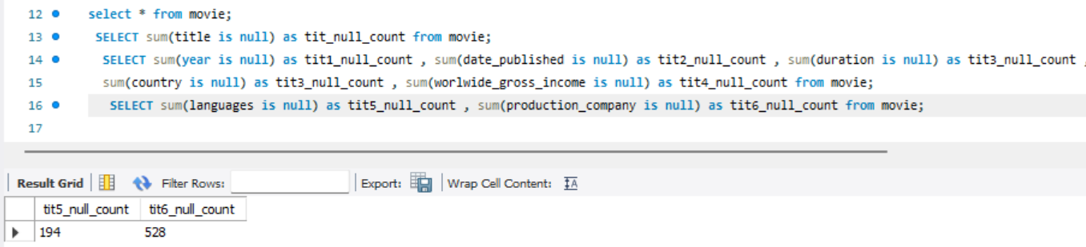
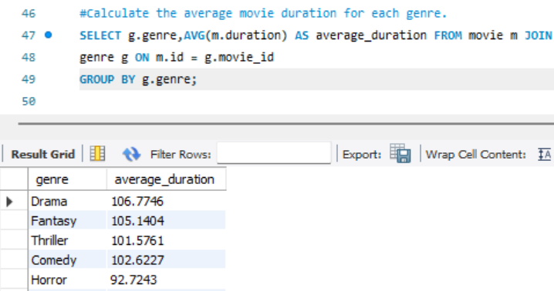
Identify which columns in the movie table contain null values
Calculate the average movie duration for each genre

Slide 15
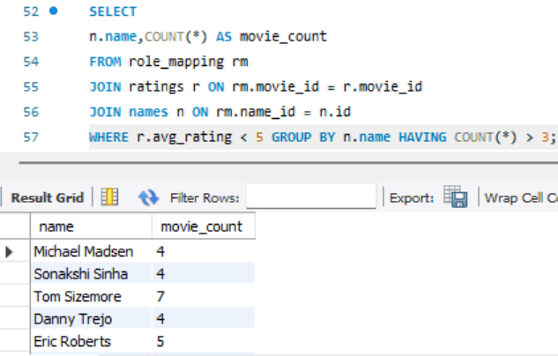
Identify actors or actresses who have appeared in more than three movies with an average rating below 5

Slide 16
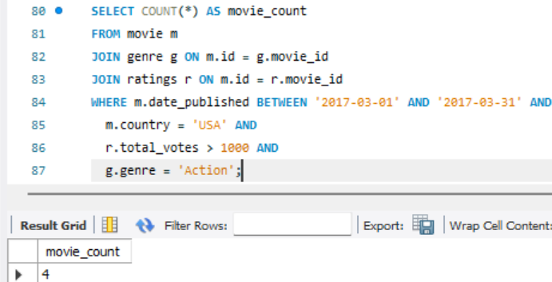
How many movies, released in March 2017 in the USA within a specific genre, had more than 1,000 votes

Slide 17
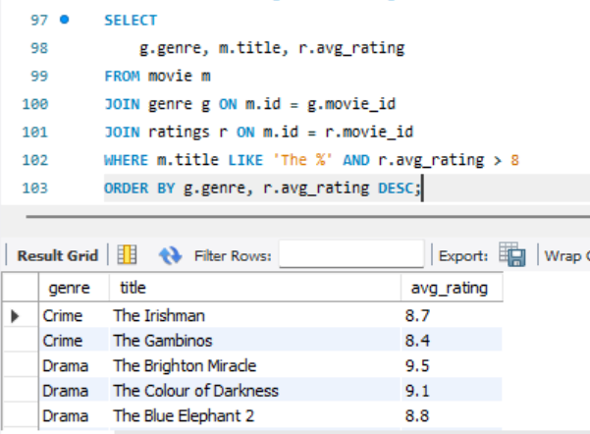
Find movies from each genre that begin with the word “The” and have an average rating greater than 8

Slide 18
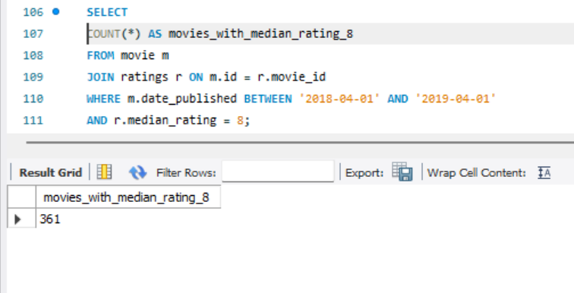
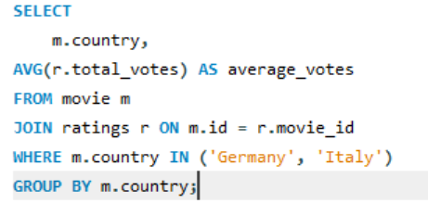
the movies released between April 1, 2018, and April 1, 2019, how many received a median rating of 8
Do German movies receive more votes on average than Italian movies

Slide 19
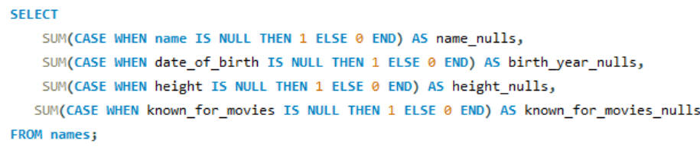
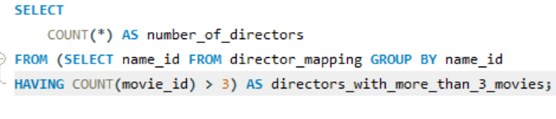
the columns in the names table that contain null values.
Which are the top three production companies based on the total number of votes their movies received?
How many directors have worked on more than three movies

Slide 20
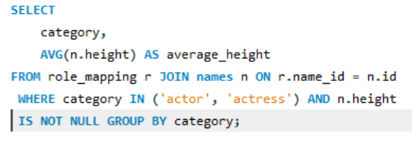
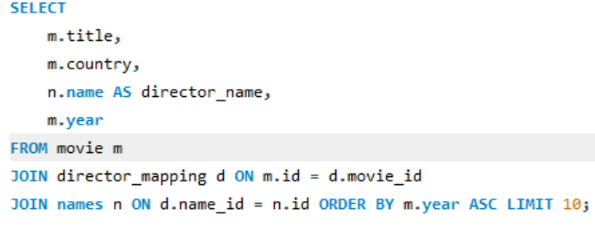
Calculate the average height of actors and actresses separately
List the 10 oldest movies in the dataset along with their title, country, and director

