Slide 1
Gowthaman.s March 2025 25/06/2025
Analysis of Career Trajectories: Salary & Experience Across Global Industries

Slide 2
Project Objective
Analyze salary patterns across industries and demographics.
Identify compensation trends based on gender, experience, and education.
Tools used: Excel, MySQL, Pivot Charts, Dashboarding.

Slide 3
Dataset Overview
Dataset includes attributes: Age, Industry, Job Title, Salary, Country, Gender, etc.
Source: Global salary survey.
Objective: Understand salary trends and job market dynamics.

Slide 4
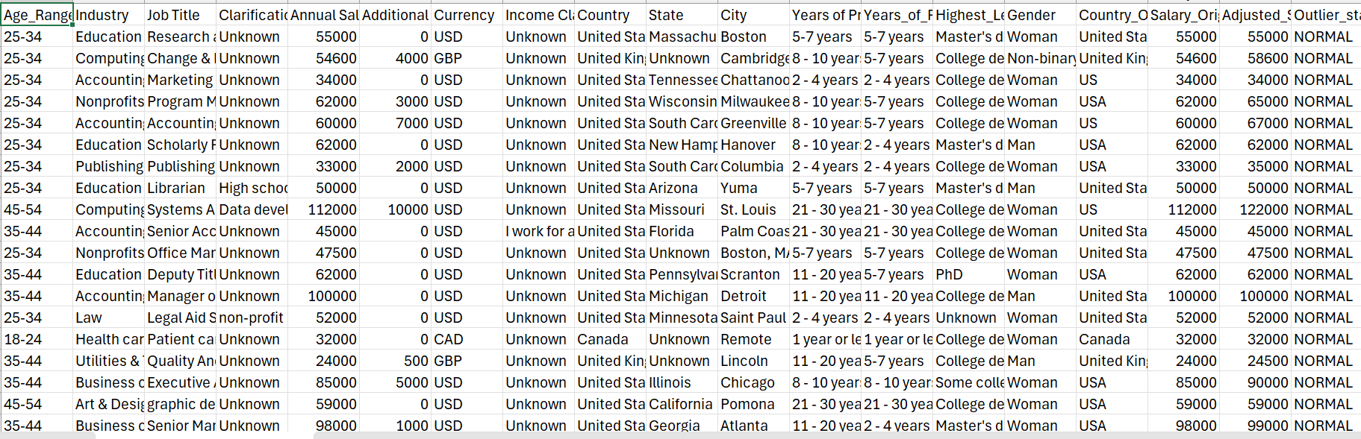
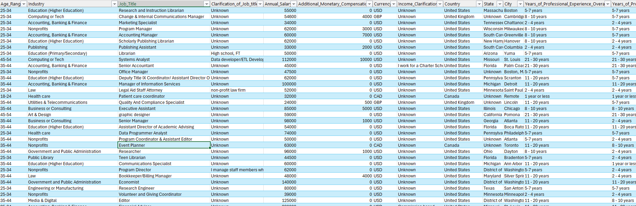
After
Data Cleaning Process
Handled missing values and standardized entries.
Cleaned job title inconsistencies and location formats.
Removed or adjusted outliers in salary fields.
Ensured correct data types across fields.
Before

Slide 5
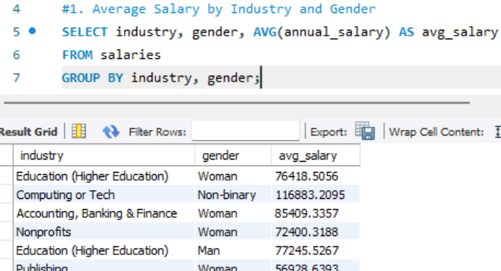
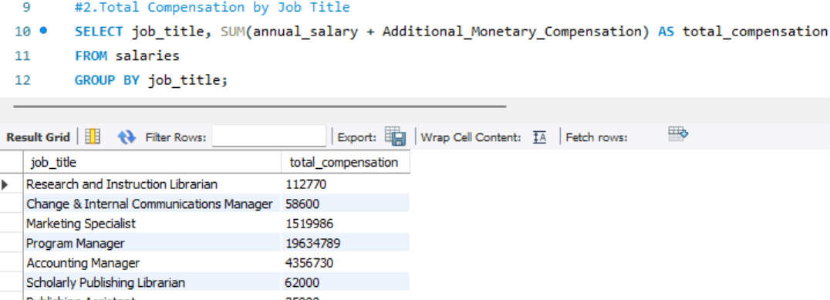
Key SQL Queries Executed
1. Average Salary by Industry and Gender
2.Total Compensation by Job Title

Slide 6
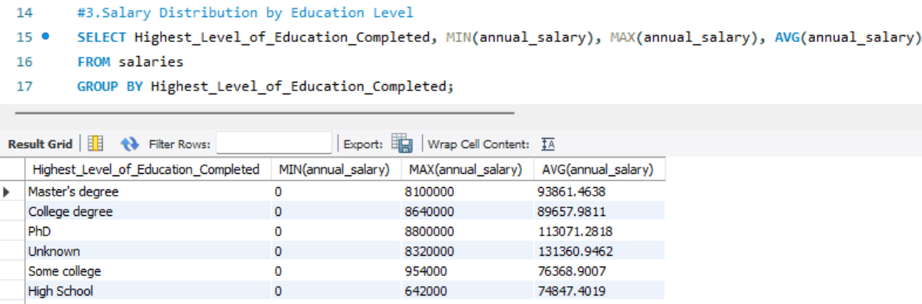
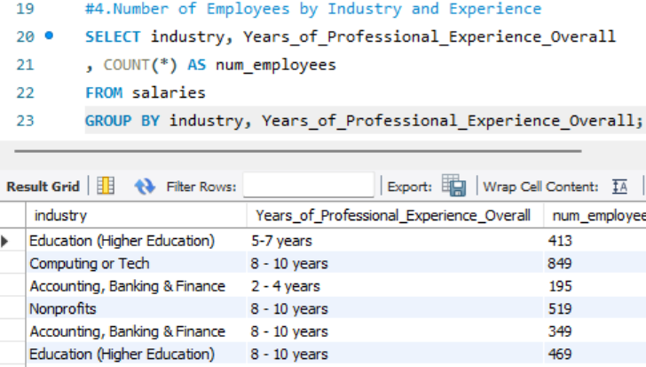
3.Salary Distribution by Education Level
4.Number of Employees by Industry and Experience

Slide 7
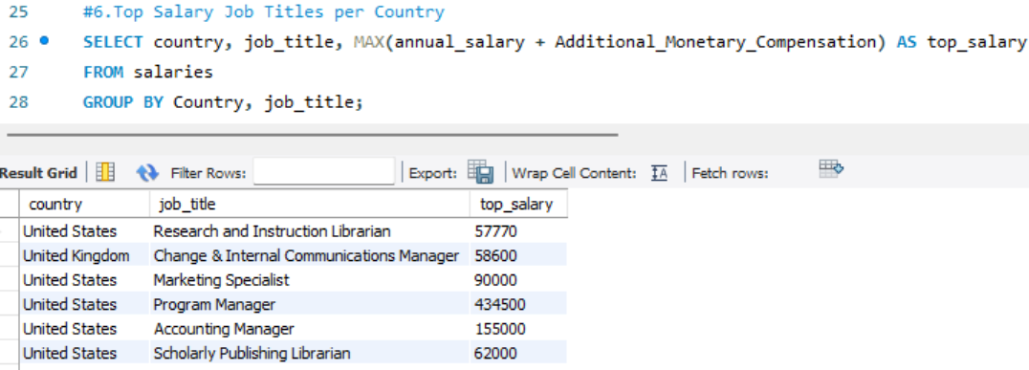
6.Top Salary Job Titles per Country

Slide 8
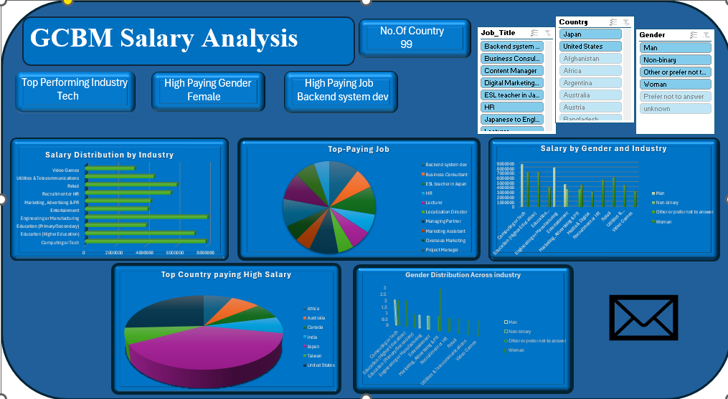
Dashboard Highlights

Slide 9
Insights and Findings
1.Top 5 Industries by Number of Entries:
Computing or Tech: 4,710
Higher Education: 2,466
Nonprofits: 2,419
Health Care: 1,899
Government & Public Administration: 1,893
2. Gender Distribution in the Dataset:
Women: 21,384 (76%)
Men: 5,502 (20%)
Non-binary: 747 (2.7%)
Other/Prefer not to answer: ~470 combined
3. Average Salary by Gender (Standardized to USD):
Other/Prefer not to answer: $1.95M
Men: $1.53M
Women: $1.07M
Non-binary: $818K
Unknown/Not disclosed: Much lower

Slide 10
Conclusion & Future Scope
Most Common Industry: Tech is the most popular field among respondents.
Gender Split: Most people in the data are women (about 76%).
Education Levels: Most people have a college or master’s degree.
Average Pay by Gender: Men tend to have higher average salaries than women and non-binary individuals.
Data Cleanliness: There are some unclear or duplicate entries, especially in gender and job titles.

